Slide 1
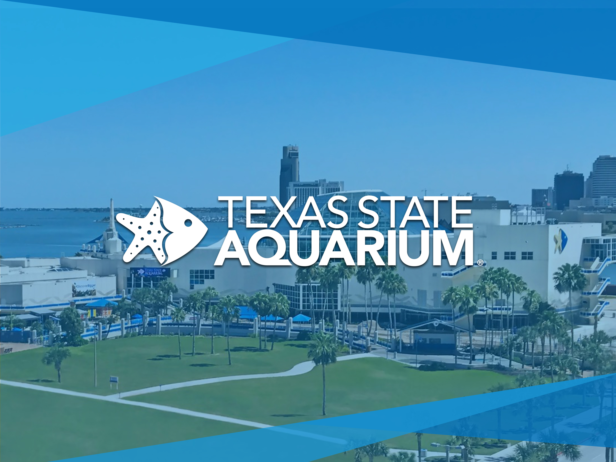

Slide 2
Rosanna Gossett
Guest Relations Manager

Slide 3
Mission
The mission of the Texas State Aquarium is to engage people with animals, inspire appreciation of our seas and support wildlife conservation.
Vision
To be a global leader in fostering support for the conservation of the Gulf of Mexico and Caribbean Sea.

Slide 4
Texas State Aquarium is a 501 © (3) not-for-profit association. The organization is accredited by The Association of Zoos and Aquarium (AZA).
The organization was envisioned in 1969 and through many years of fundraising efforts the opened the Gulf exhibit building on July 6, 1990. In May 2002 Dolphin Bay opened and in May 2017 Caribbean Sea opened. We do have a splash pad and a newly opened indoor children play area named Ocean Odyssey.
Guests receive an up- close look at dolphins, sea turtles, river otters, sand bar sharks and many species of birds and fishes that call the Gulf and Caribbean waters home.

Slide 5

Questions?

