Slide 1






Welcome to

Slide 2


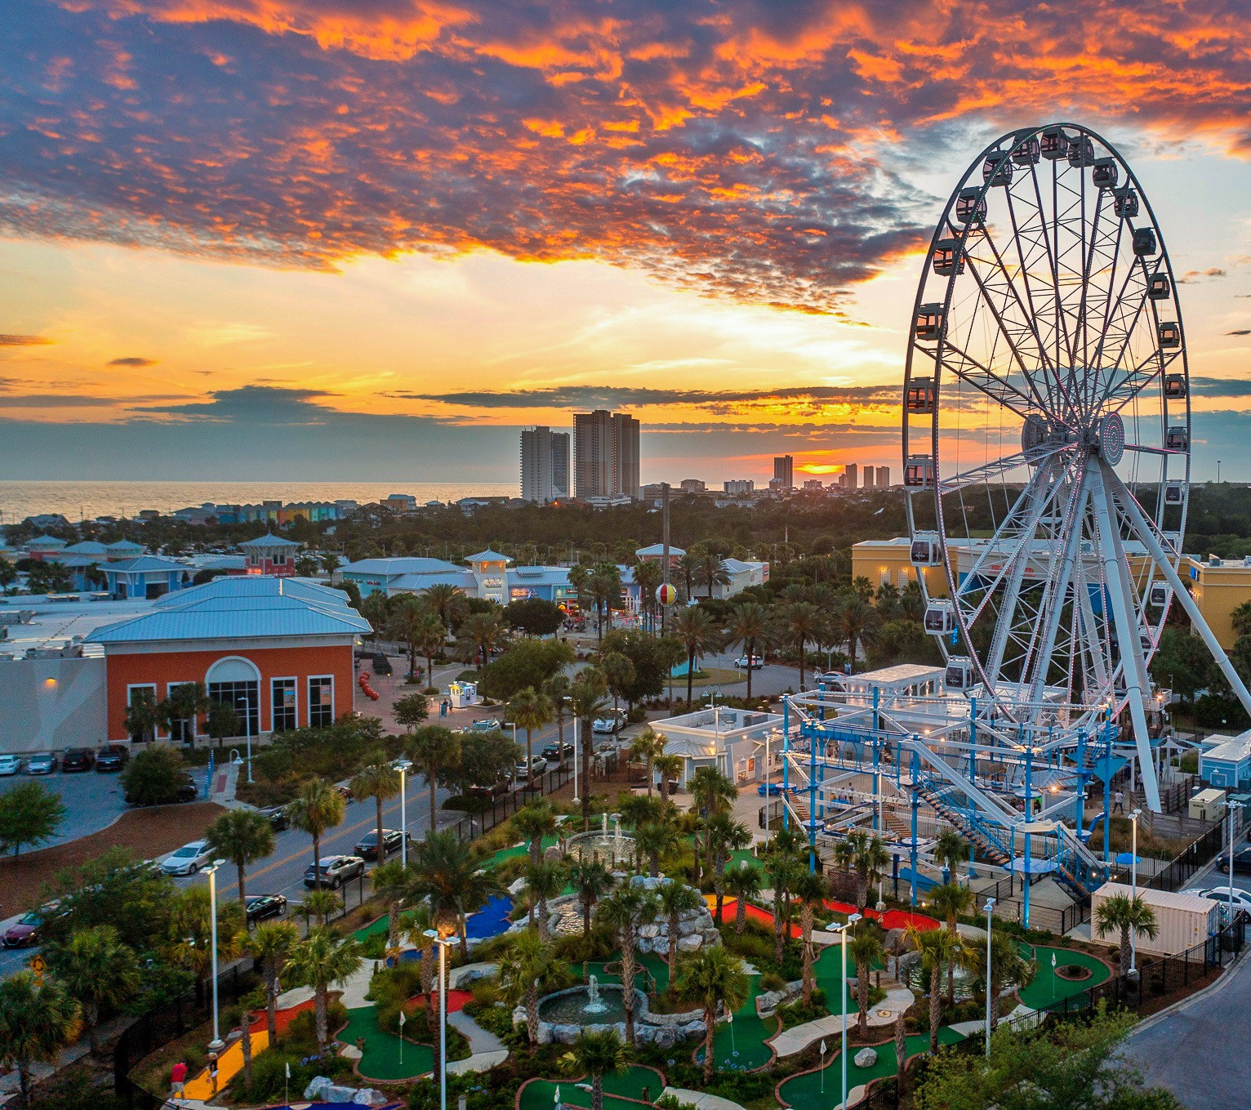




OVERVIEW OF THE BUSINESS
SkyWheel
Mini Golf
Ropes Course
Snack Shack

Slide 3
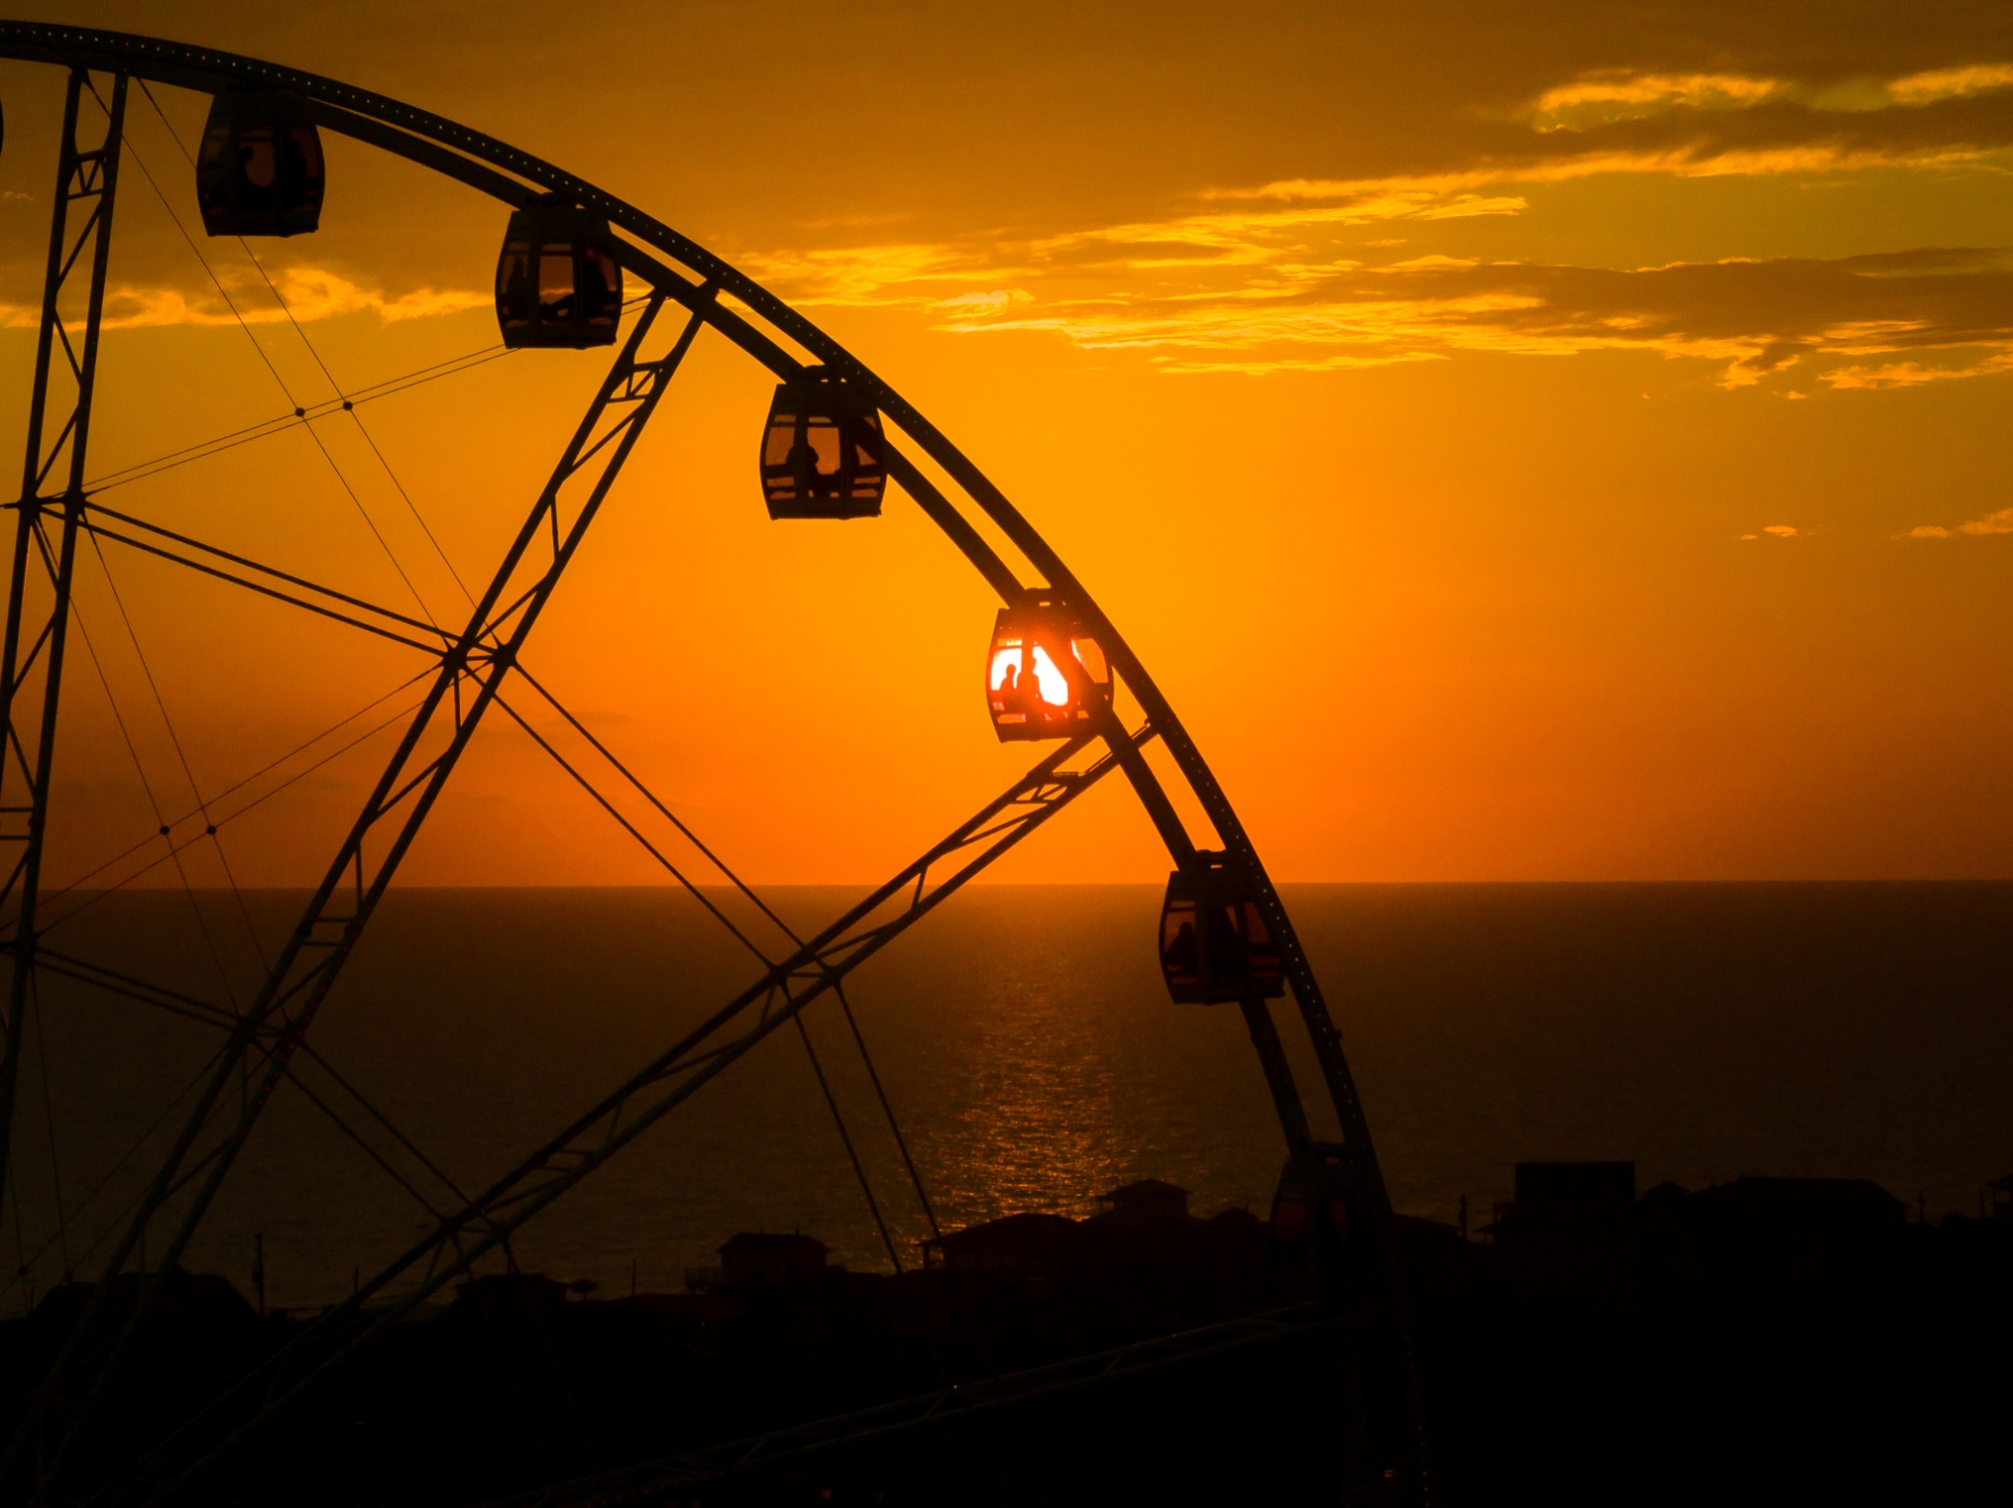
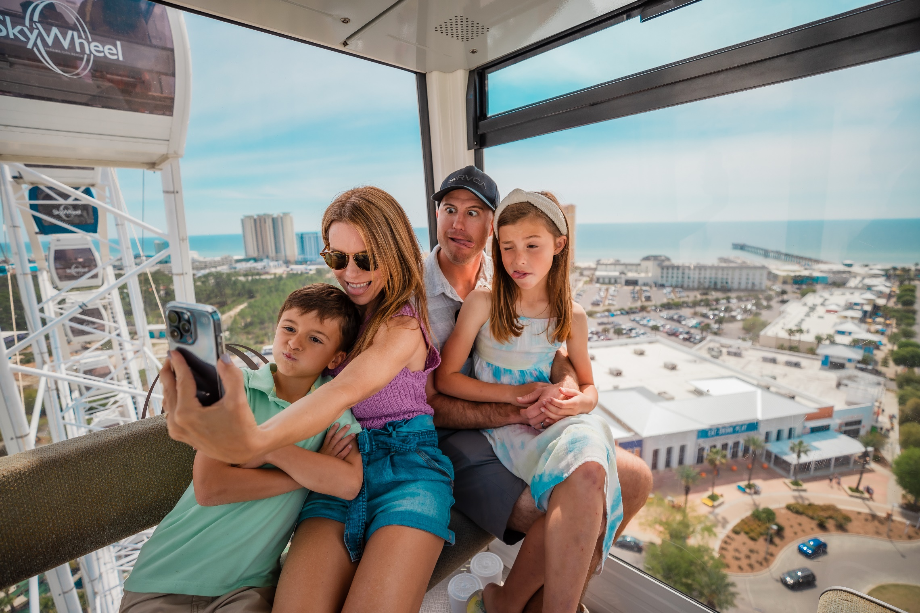
The skywheel experience
Best views over the Gulf
200-ft tall observation wheel
Climate-controlled
Open all year round
ADA accessible

Slide 4
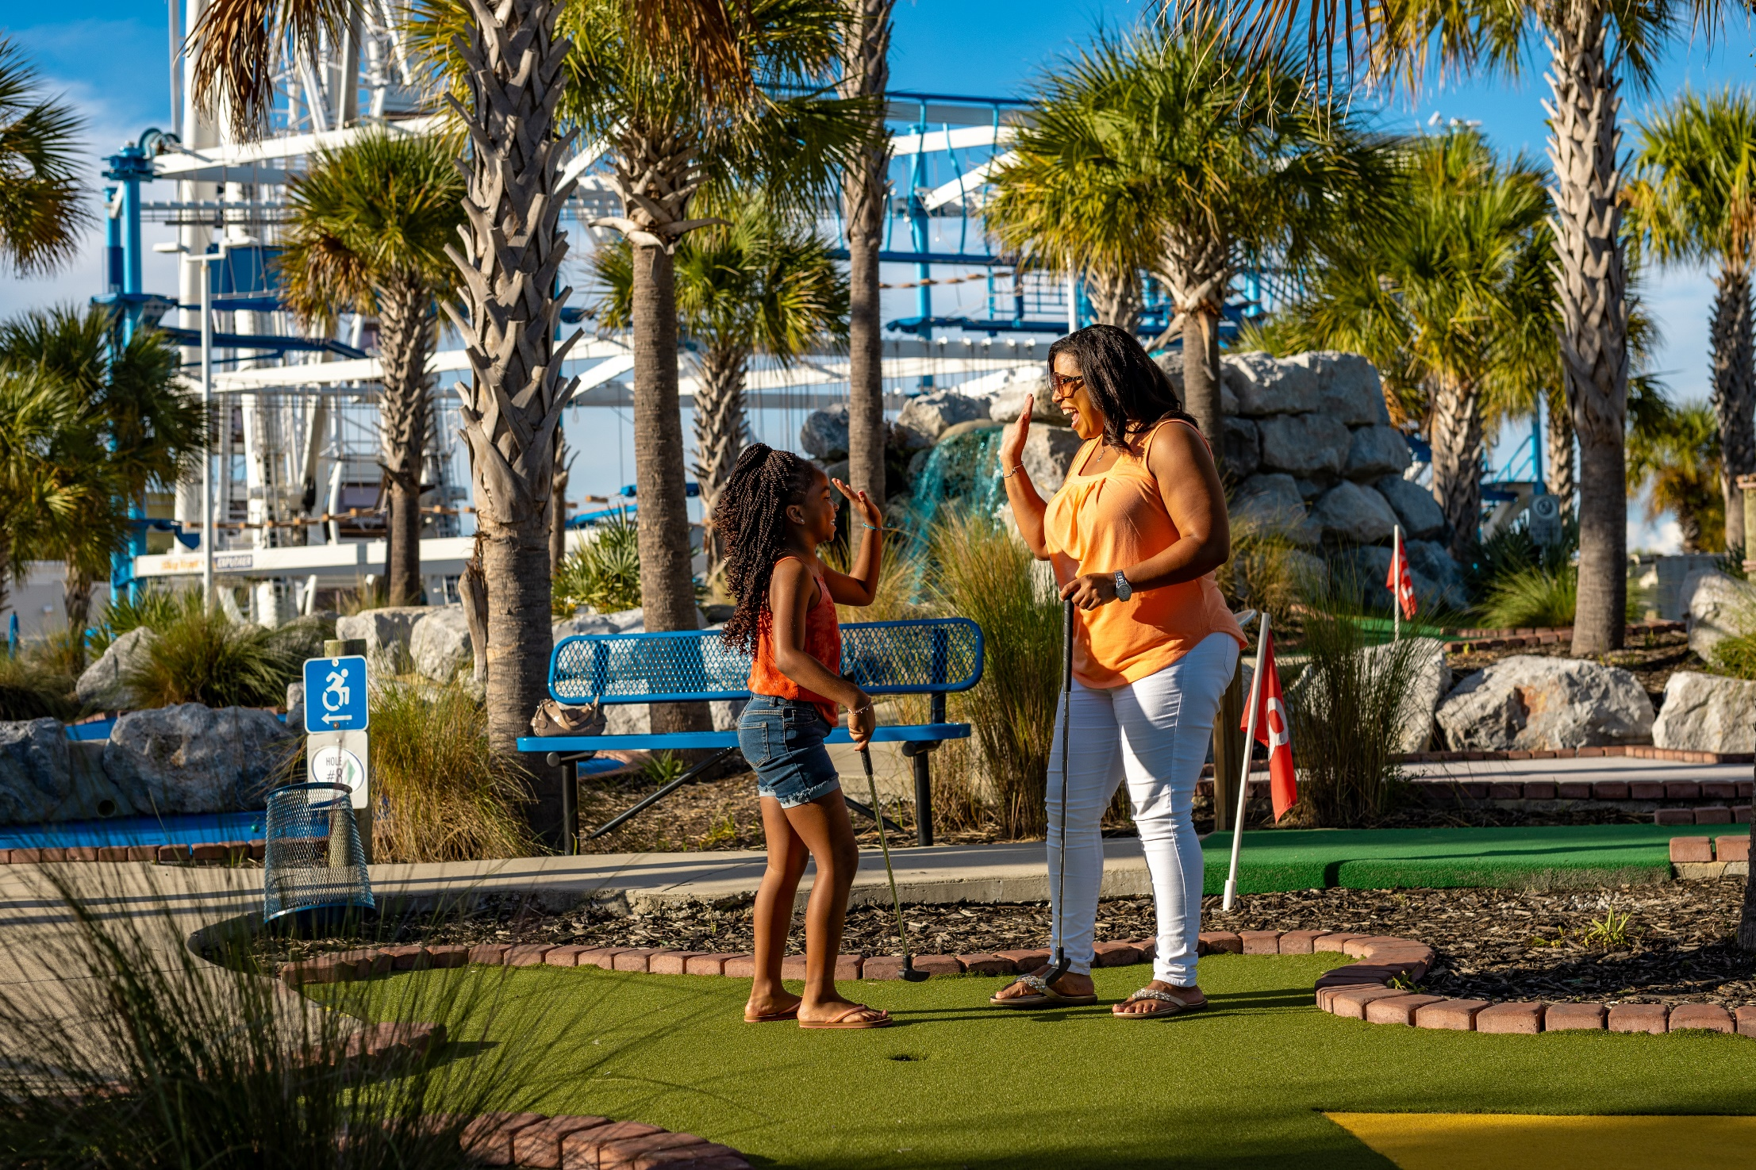
18-Hole Miniature golf
Best course on the “Golf” Coast!
Fun, challenging design
Suitable for all ages
Open all year round
ADA accessible

Slide 5
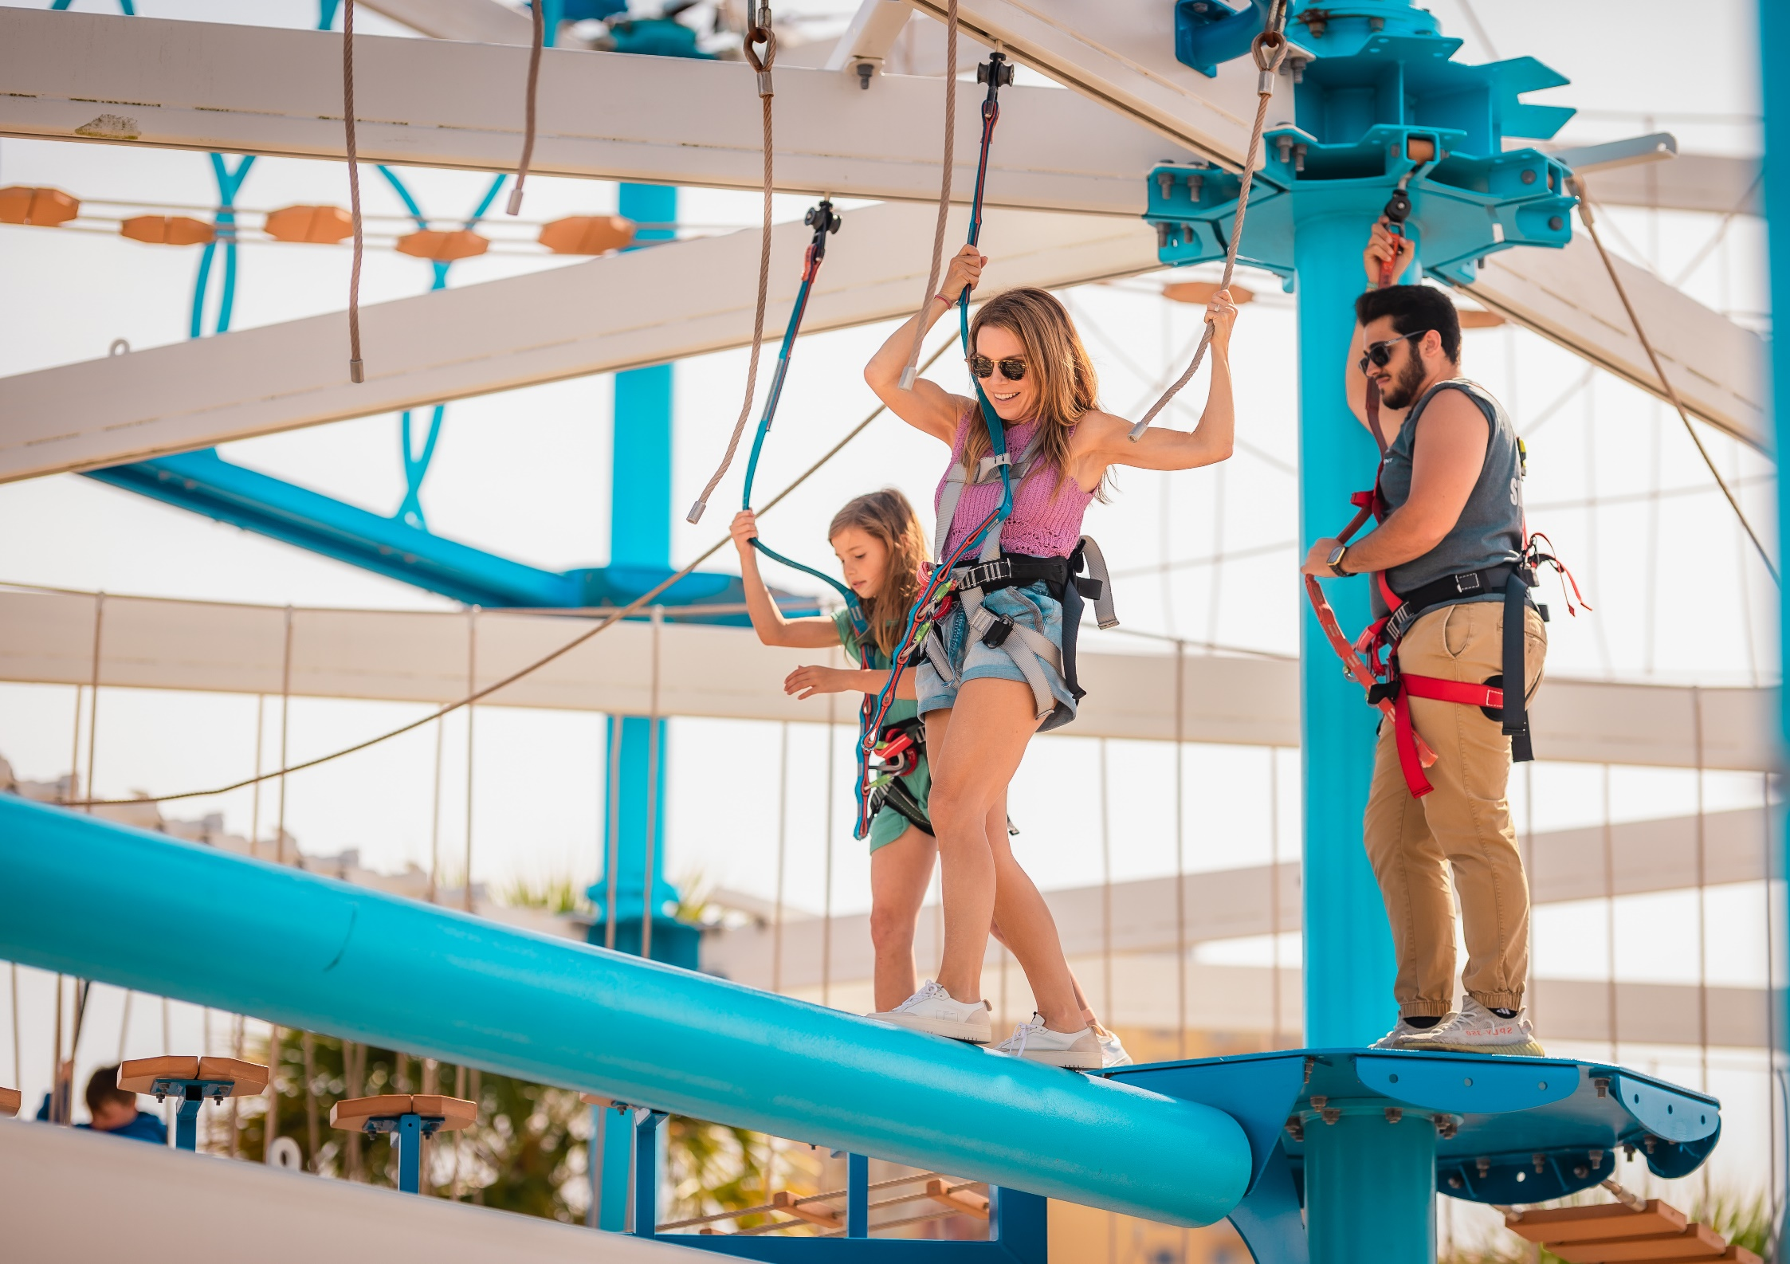
Skytrail ropes course
2-story tall aerial adventure
Engineered for safe FUN!
Over 20 different obstacles
SkyTykes for under 48”
Seasonal Attraction

Slide 6
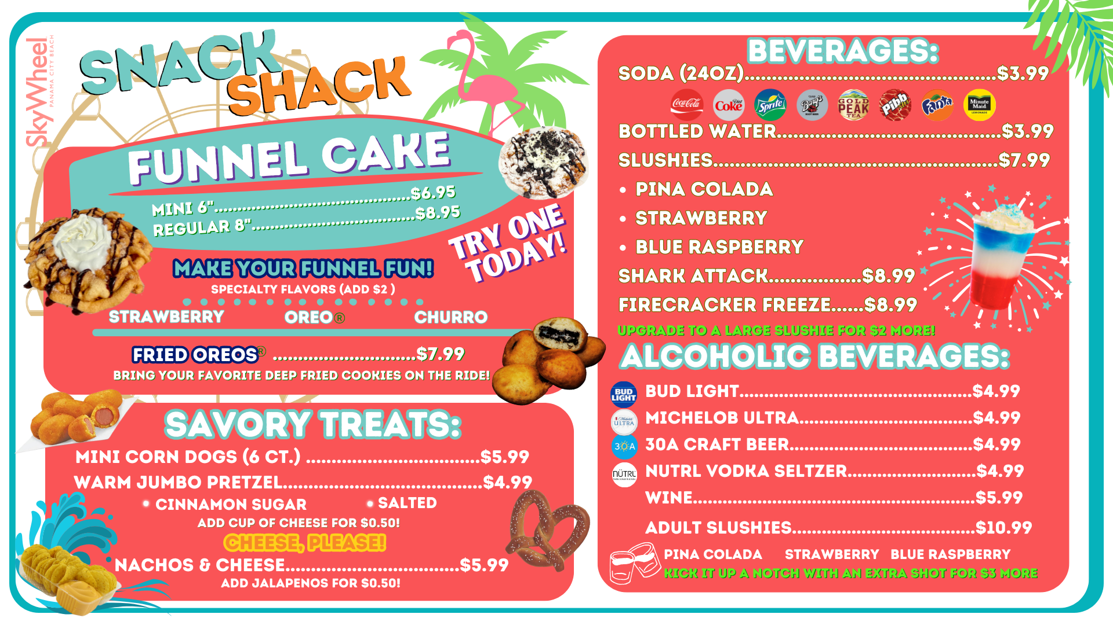
Skywheel snack shack

Slide 7
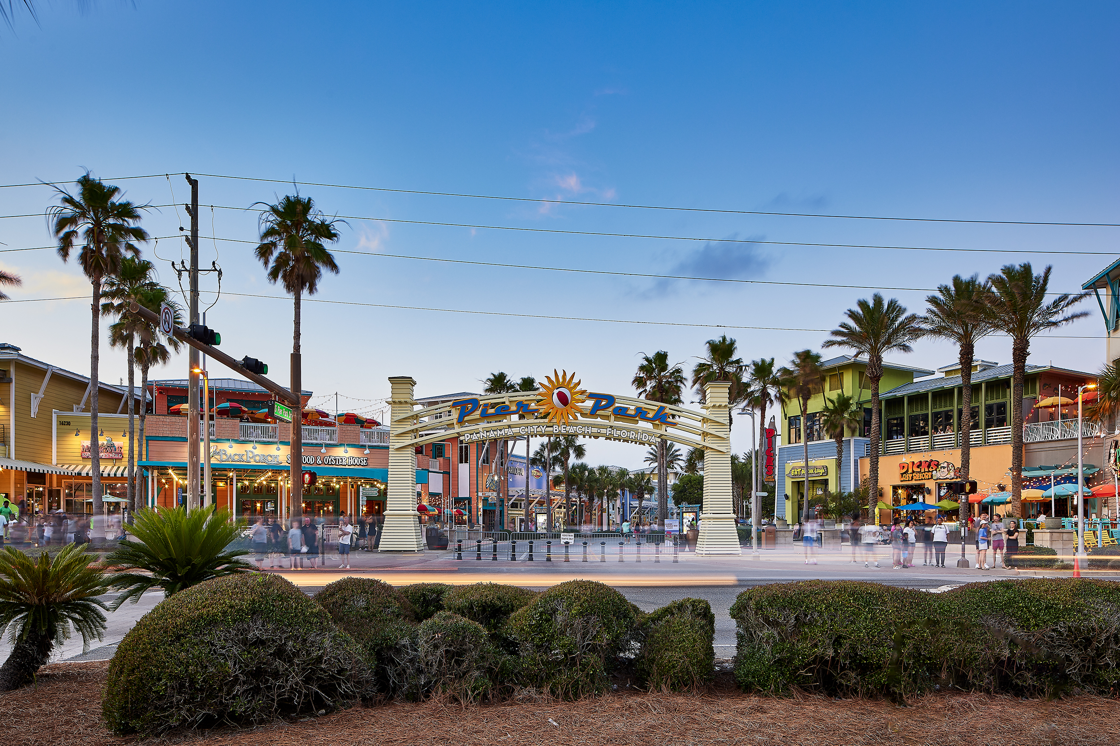
Location
  Ideally-located in the Emerald Coast’s premier shopping, dining and entertainment complex, Pier Park. The vibrant, coastal-themed center boasts more than 1 million square feet of open-air lifestyle shopping and features more than 120 stores.

Slide 8

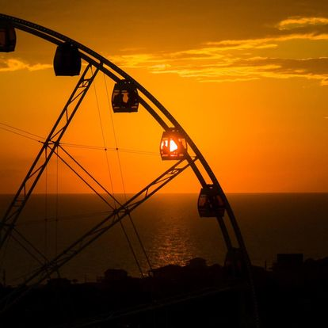



Contact info
15700 LC Hilton Jr. Drive, Panama City Beach, FL 32413
850.888.0020
www.SkyWheelPCB.com
CMaxwell@skywheel.com

Slide 9

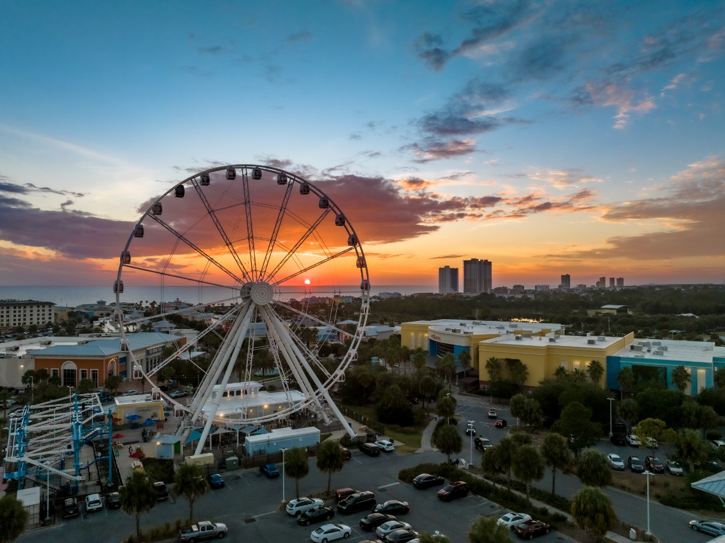
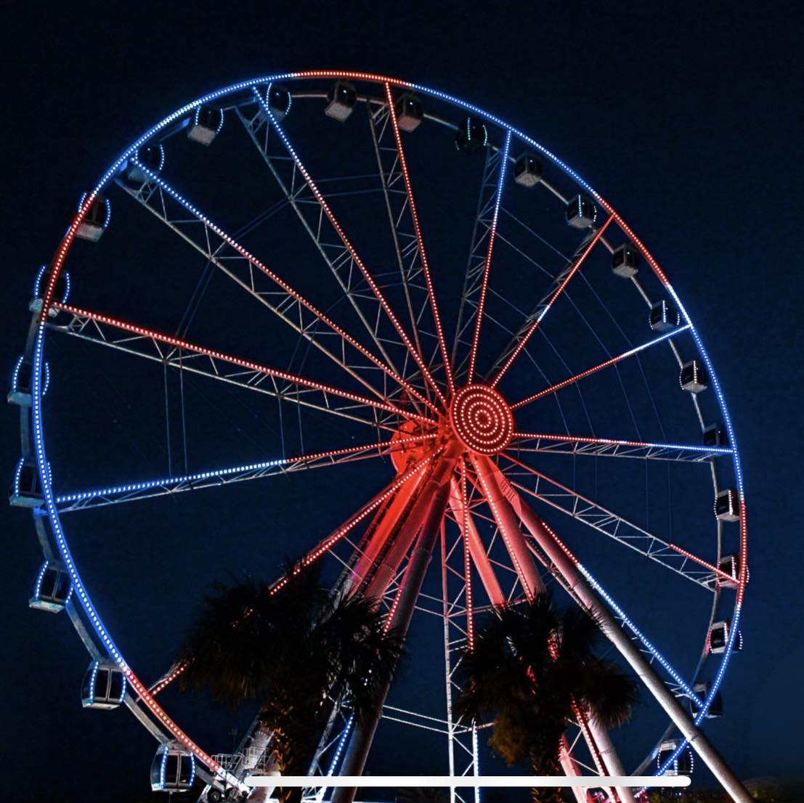



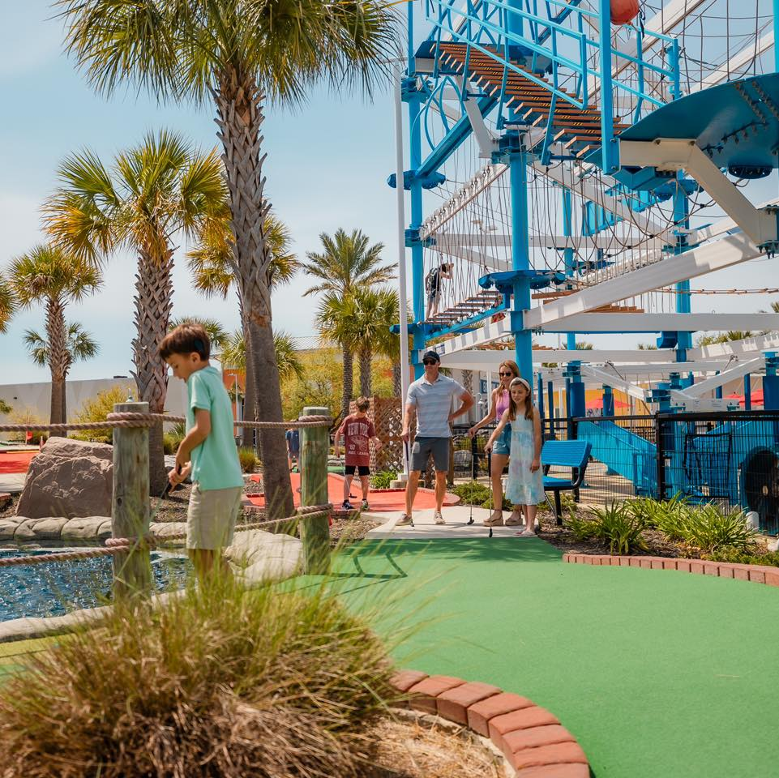

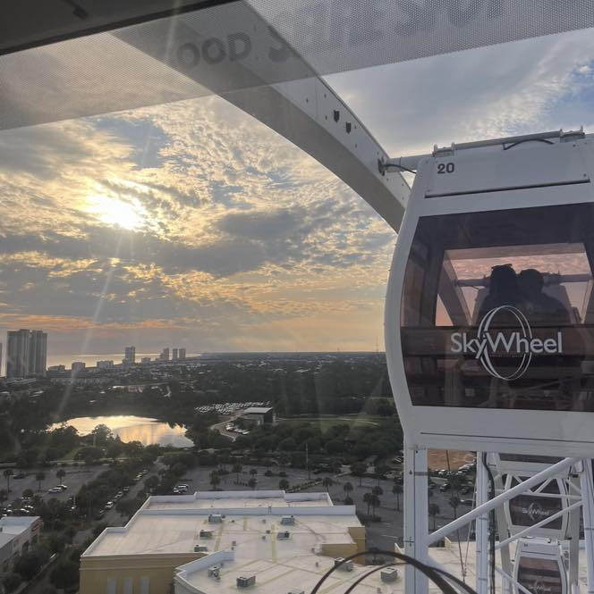

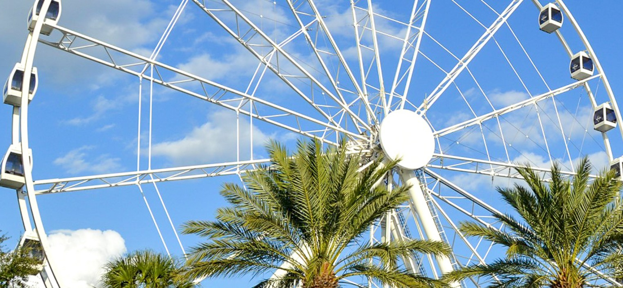
Questions?

