Slide 1
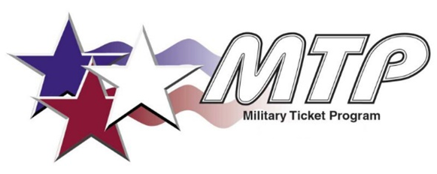

Military Ticket Program
FY26 thru March 2026
All Branches of Service:
Total Number of Tickets Sold 636,165 Total MTP Liability (Cost of tickets sold) $119,680,272.20
Total Savings to customers $93,125,553.02 Total MTP Commissions: $ 980,913.06
Total Est. Base Commission: $11,187,375.56
NAVY:
Total Number of Tickets Sold 303,918
Total Savings to Customers $41,274,850.25
Total MTP Commissions $ 457,269.63
Total Base Commissions $ 4,900,690.69
ARMY:
Total Number of Tickets Sold 179,446
Total Savings to Customers $31,526,794.64
Total MTP Commissions $ 303,243.45
Total Base Commissions $ 3,917,611.24
COAST GUARD:
Total Number of Tickets Sold 25,434
Total Savings to Customers $5,774,462,05
Total MTP Commissions $ 44,709.89
Total Base Commissions $ 602,654.38
USMC:
Total Number of Tickets Sold 100,370
Total Savings to Customers $12,536,058.79
Total MTP Commissions $ 144,179.36
Total Base Commissions $ 1,386,776.33
AIR FORCE:
Total Number of Tickets Sold 16,217
Total Savings to Customers $ 896,343.58
Total MTP Commissions $ 15,575.83
Total Base Commissions $ 166,702.52
DOD:
Total Number of Tickets Sold 10,780
Total Savings to Customers $ 1,117,043.71
Total MTP Commissions $ 15,575.83
Total Base Commissions $ 212,940.40

Slide 2
Top Selling Bases
FY26 thru Mar 26
Top 10 Selling Bases (All Services) Total Base Revenue Total Quantity Tickets Sold
(Retail)
1 Naval Base San Diego $ 8,154,084.37 63,936
2 MCCS Camp Pendleton $ 6,656,962.50 44,337
3 Shades of Green $ 6,787,643.25 31,691
4 Naval Ordnance Test Unit Cape Canaveral $ 6,173,337.50 29,500
5 MCCS Miramar $ 3,815,126.75 28,067
6 Naval Air Station Jacksonville $ 5,102,068.50 22,745
7 Naval Air Station North Island $ 2,738,332.29 20,897
8 Port Hueneme $ 2,547,193.96 18,031
9 Joint Base Pearl Harbor-Hickam $ 2,426,498.25 12,157
10 Fort Bliss $ 2,058,124.11 11,332
MTP serves a total of 198 bases & a total of 773 TMS users.
Navy Bases 58
Army Bases 49
Coast Guard Bases 54
Air Force Bases 20
Marines Bases 12
DOD Bases 5
Total Service Revenue Quantity of Ticket Sold
(Retail)
Navy $58,320,288.13 303,918
Army $45,546,429.47 179,446
Coast Guard $ 6,996,091.46 25,434
Air Force $ 2,050,590.29 16,217
Marine Corps $ 16,405,379.11 100,370
DOD $ 2,529,782.36 10,780

Slide 3
Top Selling Navy Bases
FY26 thru Mar 26
Top 20 Selling Navy Bases Total Base Retail Quantity of Tickets Sold
1 Naval Base San Diego $ 8,154,084.37 63,936
2 NOTU Cape Canaveral $ 6,173,337.50 29,500
3 Naval Air Station Jacksonville $ 5,102,068.50 22,745
4 Naval Station North Island $ 2,738,332.29 20,897
5 Naval Station Port Hueneme $ 2,547,193.96 18,031
6 Joint Base Pearl Harbor-Hickam $ 2,426,498.25 12,157
7 Naval Weapons Station Seal Beach $ 1,352,739.96 8,884
8 Naval Submarine Base Point Loma $ 987,109.54 7,993
9 Naval Station Mayport $ 1,644,873.00 7,864
10 Naval Air Station Lemoore $ 1,257,551.66 7,709
11 Naval Air Station Pensacola $ 1,837,645.75 6,831
12 Naval Station Norfolk $ 1,443,770.25 6,212
13 NAS Joint Reserve Base Fort Worth $ 1,635,404.75 6,115
14 Naval Submarine Base Kings Bay $ 1,431,384.25 5,917
15 Naval Air Station Oceana $ 1,185,512.25 5,167
16 Naval Air Station Patuxent River $ 909,851.75 4,153
17 Naval Submarine Base New London $ 1,371,586.00 3,945
18 Joint Expeditionary Base Little Creek $ 871,810.00 3,820
19 Naval Support Activity Bethesda $ 921,517.15 3,817
20 Naval Station Great Lakes $ 981,733.50 3,674

Slide 4
Top 20 Vendor Sales Volume
FY26 thru Mar 26
Top 20 Vendor List
*API Vendor
1 | Disneyland*
2 | DisneyWorld*
3 | Universal Orlando*
4 | Universal Hollywood*
5 | San Diego Zoo Global*
6 | Seaworld*
7 | Legoland CA*
8 | Medieval Times CA
9 | Kennedy*
10 | Legoland FL*
11 | Medieval Times FL
12 | USS Midway*
13 | GA Aquarium
14 | Old Town Trolley*
15 | Medieval Times MD
16 | Mammoth
17 | IKON Pass
18 | Dollywood
19 | National Aquarium*
20 | Gatorland

Slide 5

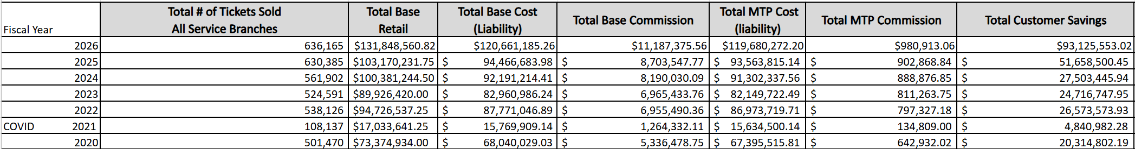
Annual Comparisons
March

Slide 6
New Vendors FY25
Tee Time Golf Pass – Nov 2025
Mountain of Entertainment – Apr 2026
How does MTP recruit new vendors?
MTP reaches out to popular attractions located near military installations
Participating ticket offices recommend attractions based on customer demand
Corporate agreements add new locations as their leadership approves.
MTP reaches out to vendors who are partners through our Galaxy API.

Slide 7
Questions

