Slide 1
Recreational Lodging
(RV Parks, Vacation Rentals, Campsites)
Joann Reyes, Program Manager
N922E
May 2026

Slide 2



Recreational Lodging N922E
Navy Getaway Recreational Lodging Inventory consists of
Vacation Rentals
RV Parks
Tent Camping
 | Vacation Rental Properties | RV Park Properties | Tent Camp Site Properties
Installations | 25 | 38 | 19
Sites | 29 | 41 | 24
Units | 1,172 | 2,532 | 367
Inventory by Region------→ | EUROPE | HAWAII | JAPAN | MID ATLANTIC | NAVAL DISTRICT WASHINGTON | NORTH WEST | SOUTH EAST | SOUTH WEST
RV SITES | 2 |  |  | 357 | 337 | 113 | 1,113 | 610
VACATION RENTALS | 31 | 77 | 31 | 167 | 83 | 123 | 391 | 269
CAMP SITES | 22 | 3 | 10 | 62 | 116 | 52 | 84 | 18
Notes:
Of the top 30 best places in the US, we have vacation rentals or RV spaces in
Hawaii: Kaui and Honolulu
Washington DC
San Diego
Key West
Washington State

Slide 3
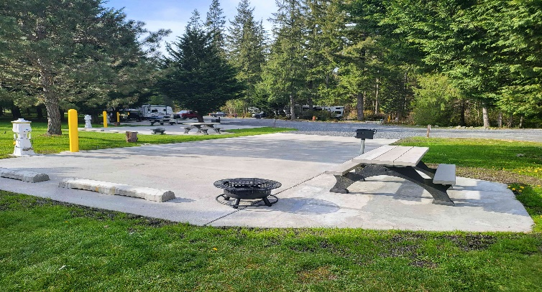
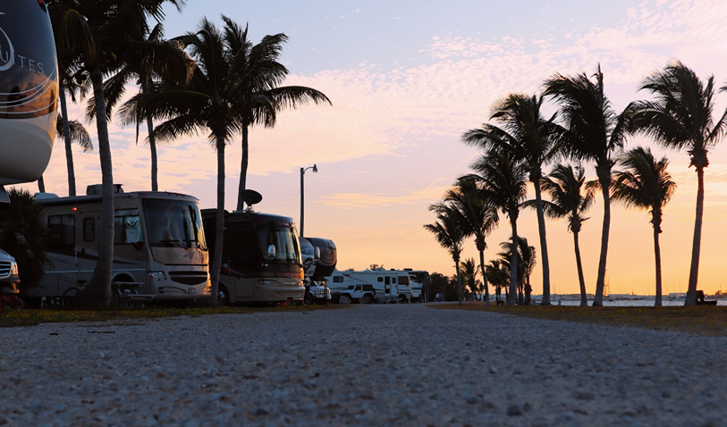
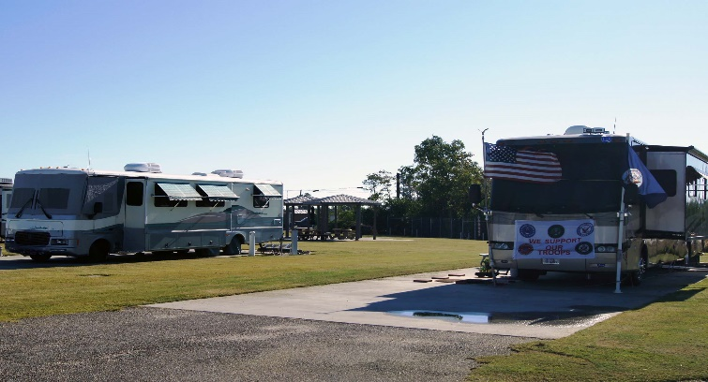
Recreational Lodging N922E
RV PARKS
SITE TYPES
Full hook up = Water, Sewer, Electric
Partial hook up = Water, Sewer, Electric (but not all three)
No hook up = No Water, Sewer or Electric
SITE STYLES
Back-in sites – range from 20 to 60 feet long !
Pull – through sites
MOST RV Parks also offer
Free Wi-Fi
Picnic tables and Bar-B-Que grills or fire pits
Bath Houses
Guest Laundry rooms (many are free)
Pet friendly
Navy MWR RV Parks now offer Long-Term stay options
(based on availability)
NEW – Leisure Travelers
  may book reservations up to 30-day stays
  extended stay requests may go up to 180-days, and then up to 365-days.
NEW – Active Duty & Geo-Bachelors on PCS Orders
  may book reservations up to length of their orders
  availability varies by RV Park

Slide 4
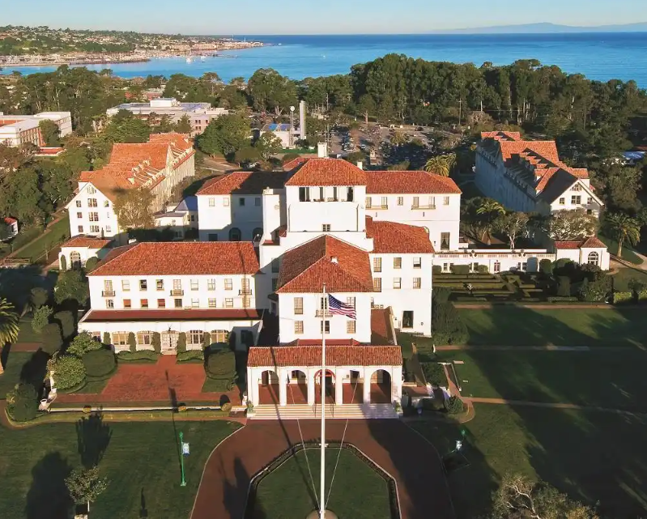
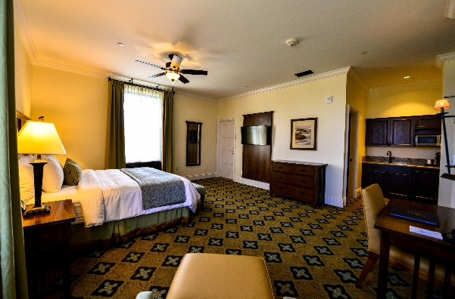
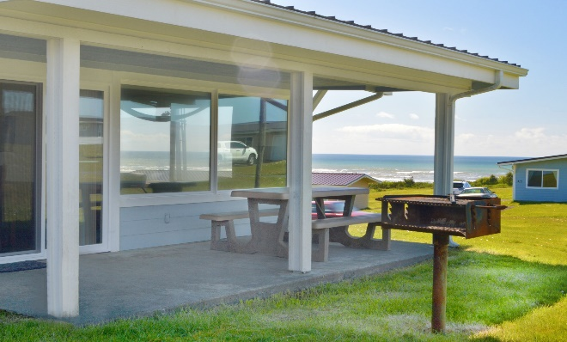
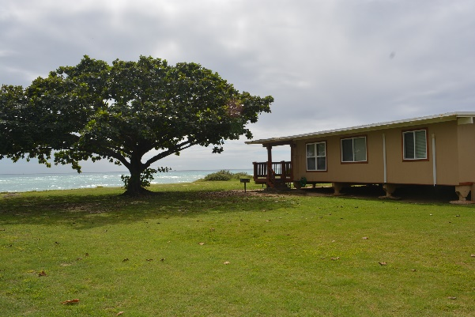
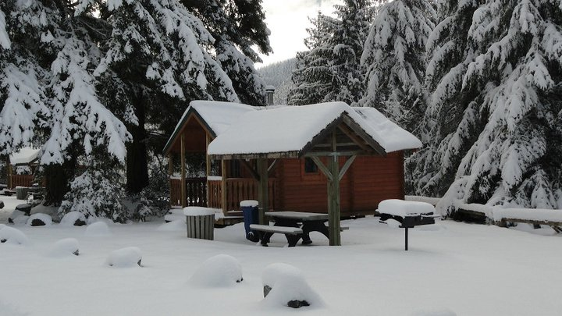
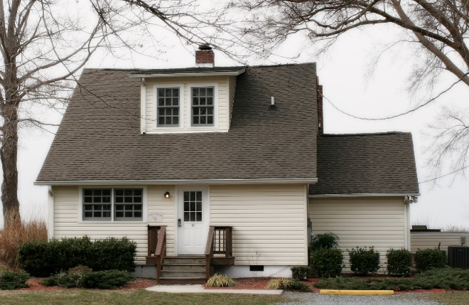
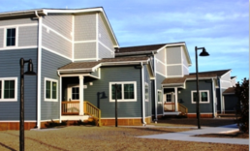
Recreational Lodging N922E
VACATION RENTALS
Styles
Cottages and Cabins
Houses, Townhouses, Mobile Homes
Hotel rooms
Log cabins
Tiny Homes
Yurts
Lodge and Bunkhouses
Sizes
From hotel rooms to 5-bedroom houses
Ideal for weddings, reunions, & groups

Slide 5
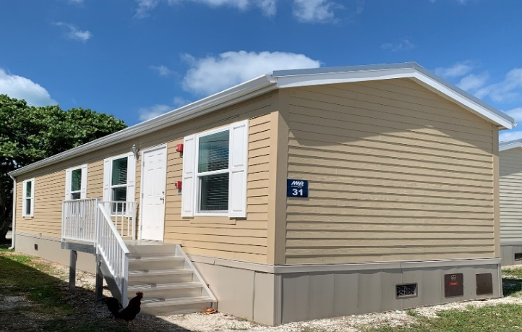
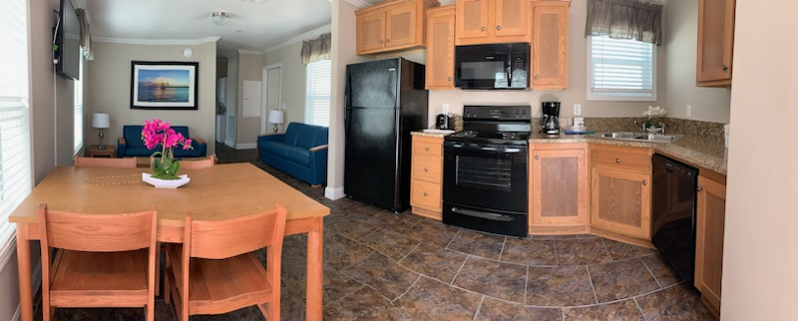
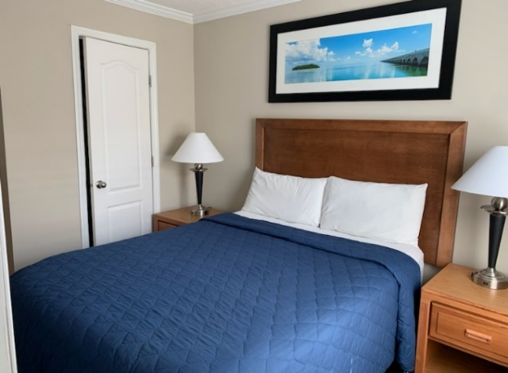
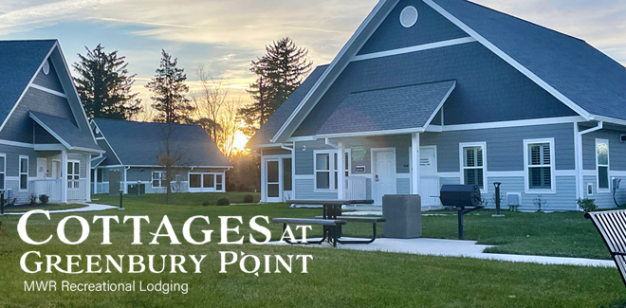
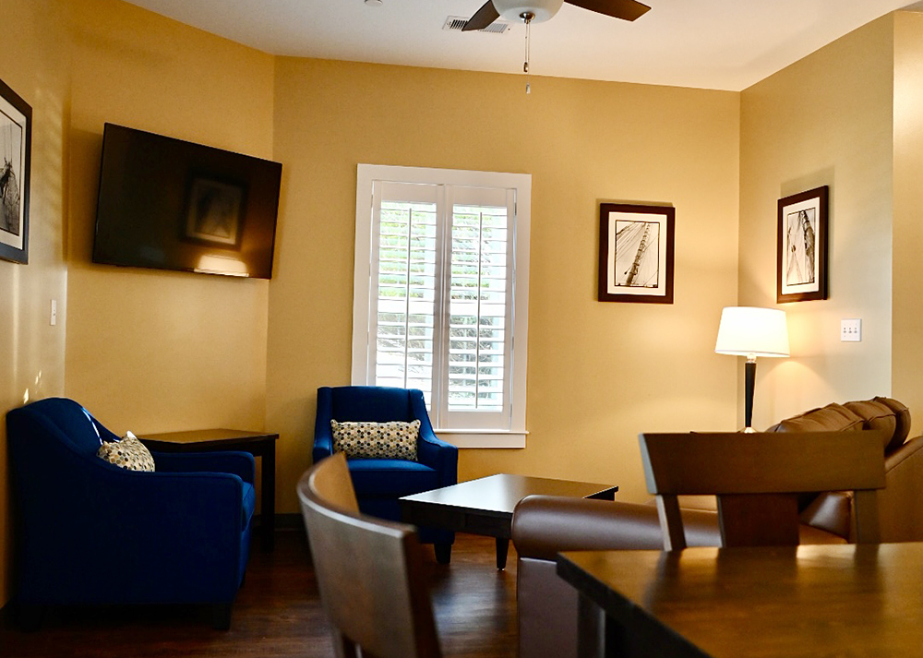
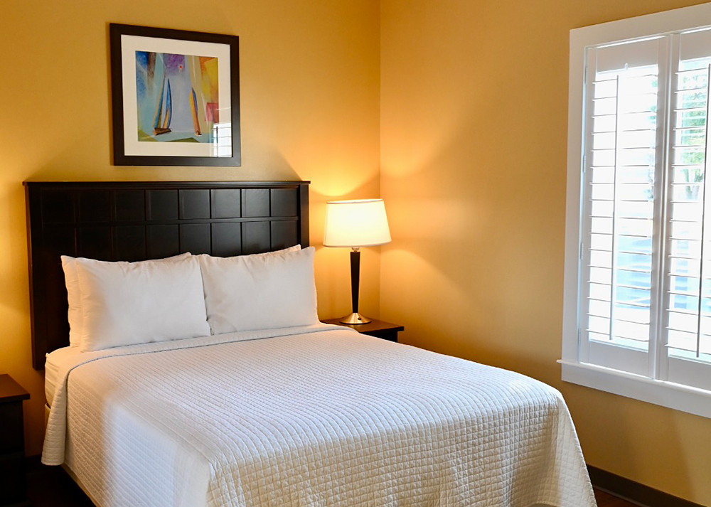
Recreational Lodging N922E
VACATION RENTALS
NEW - Key West, Florida – 2 bedroom Mobile Home Cottages
NEW - Annapolis, Maryland – 2 & 3 bedroom Cottages

Slide 6
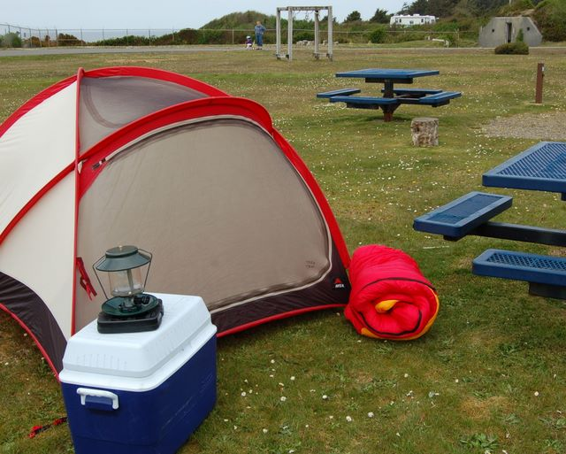
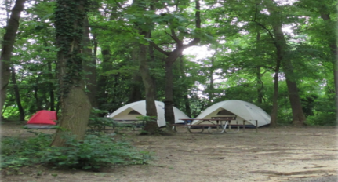
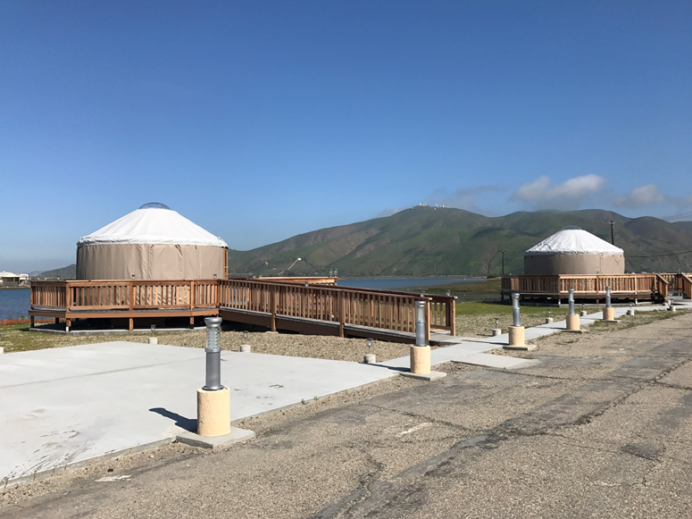
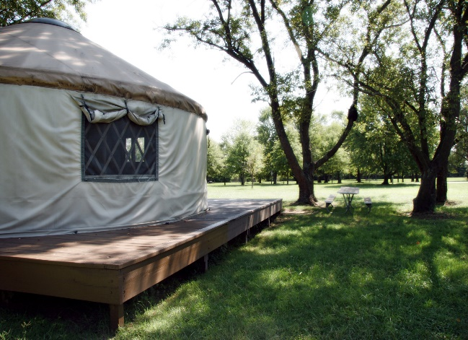
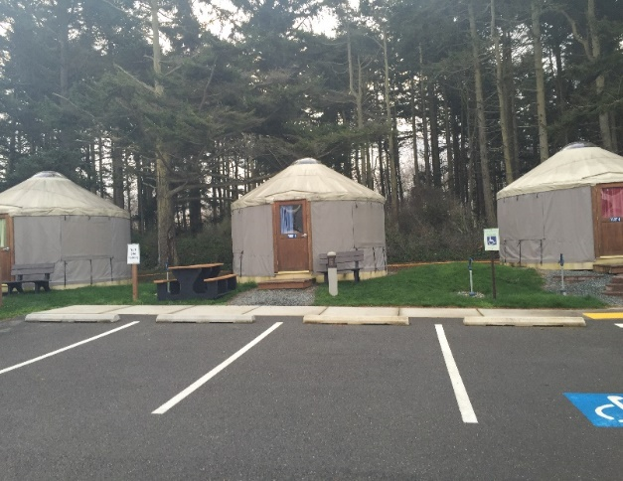
Recreational Lodging N922E
YURTS AND TENT CAMPING

Slide 7
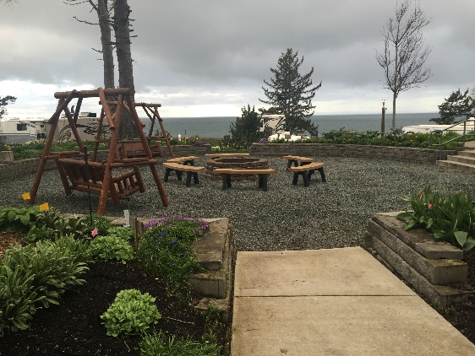
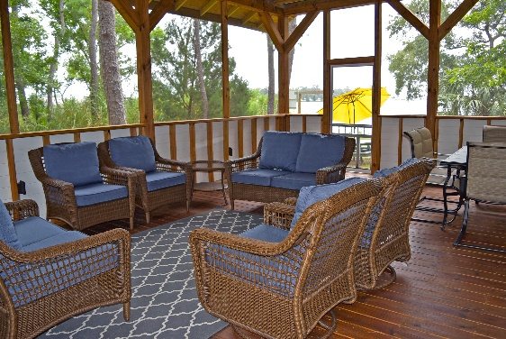
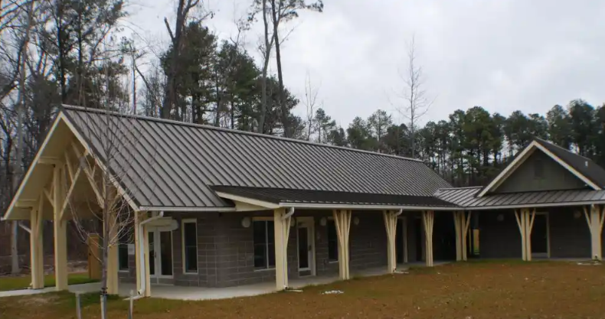
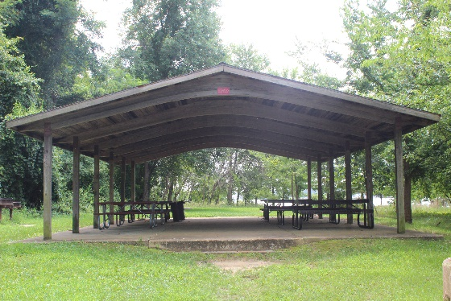
Recreational Lodging N922E
Some properties also offer:
Pet parks
Picnic Pavilions
Common area rooms

Slide 8

Recreational Lodging N922E
Reservations available 24/7 via DODLodging.net or 1-877-NAVY-BED
Select your site here
WIN –WIN opportunities
for GUESTS and MWR Programs

Slide 9
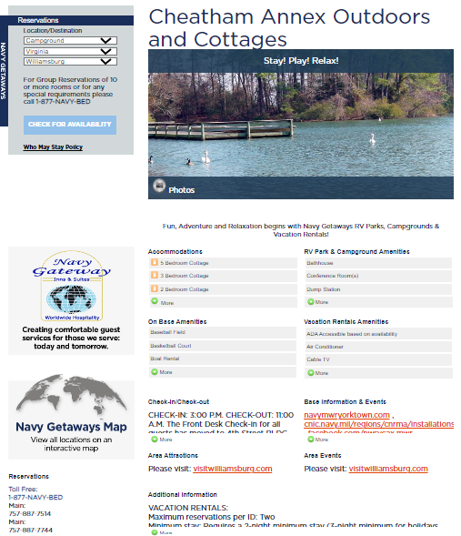
Recreational Lodging N922E
Some sites can do groups!
Multiple Site Photos
MAP of all sites

Slide 10
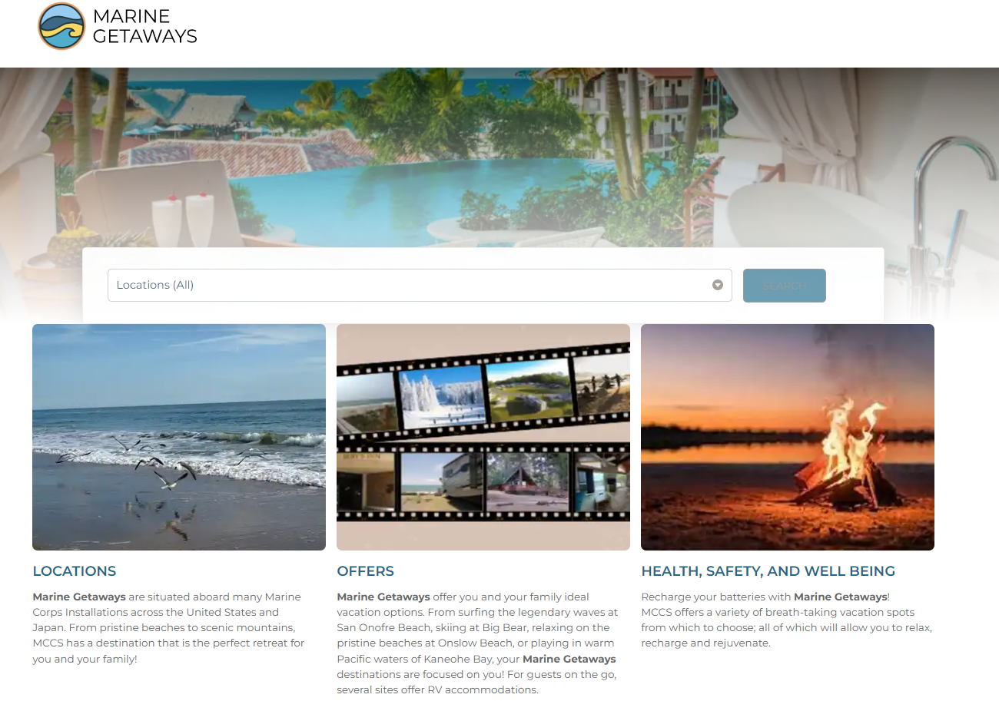
Recreational Lodging N922E
Also remember to sell:
Marine Getaways
www.marinegetaways.com
7 Locations across the United States and Japan

Slide 11

Recreational Lodging N922E
Also remember to sell:
AIR FORCE OUTDOOR RECREATION - https://afoutdoors.com/directory/
Locations across the United States, Europe, Korea, and Japan

Slide 12
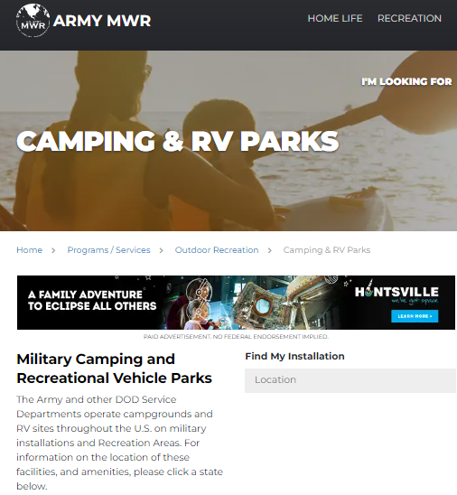
Recreational Lodging N922E
Also remember to sell:
ARMY CAMPING AND RV PARKS – across the United States
www.armymwr.com/programs-and-services/outdoor-recreation/camping-rv-parks

Slide 13
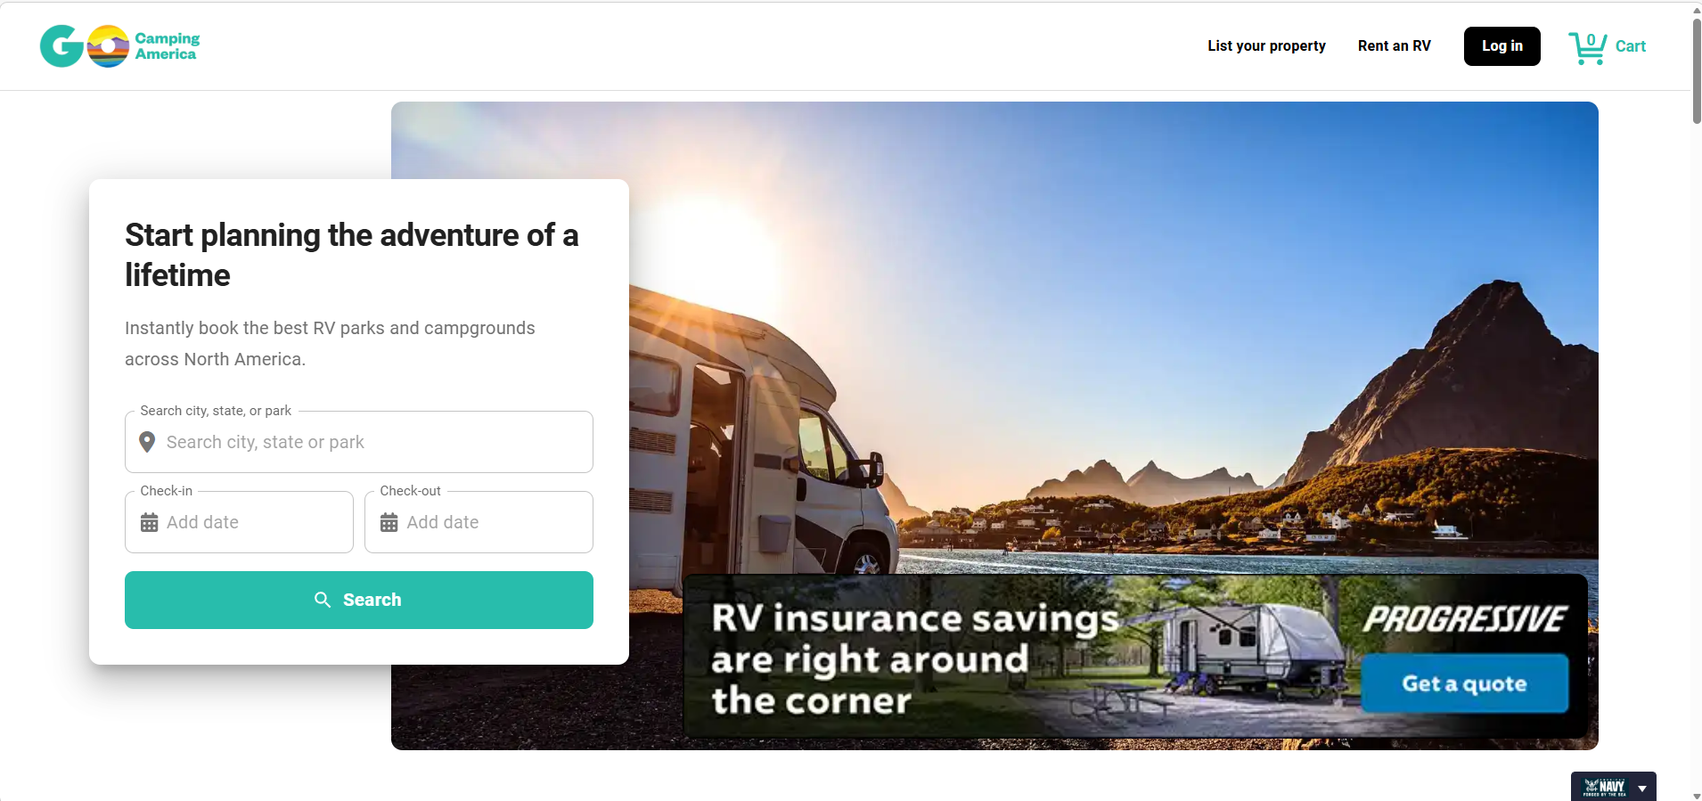
Program Exposure

