Slide 1

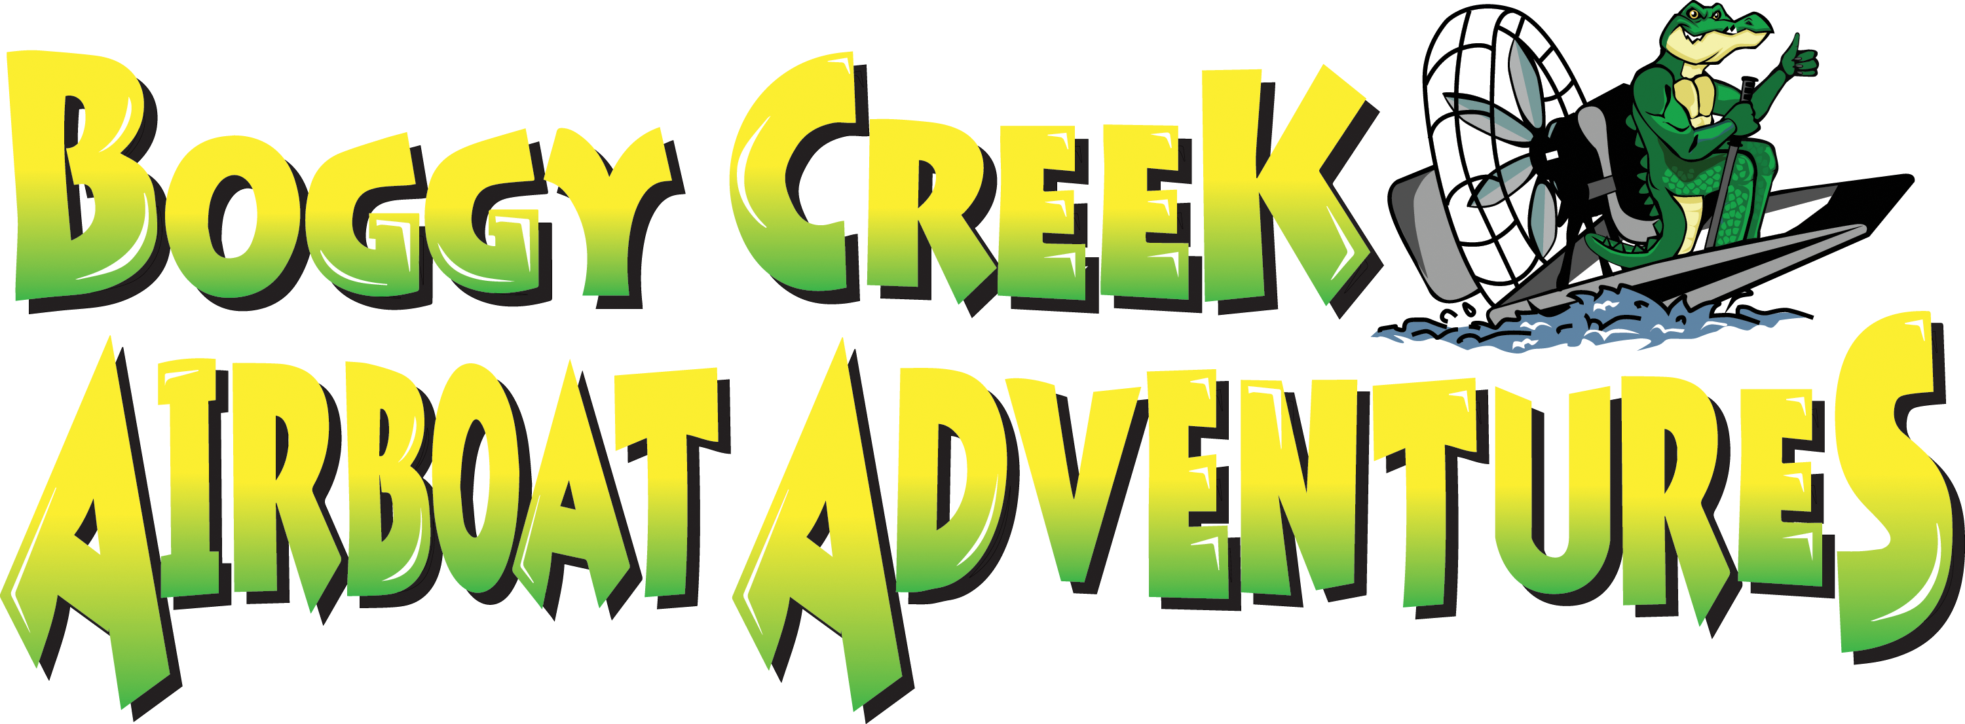
Escape to Nature!

Slide 2
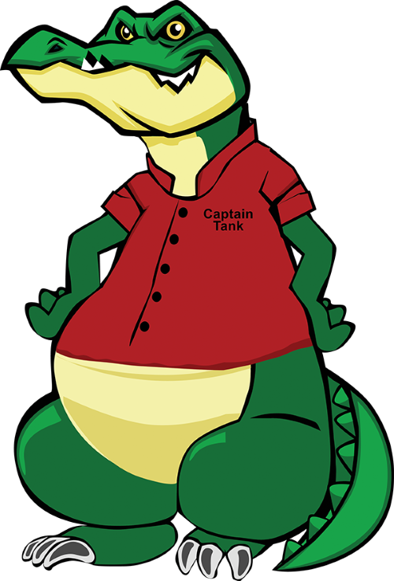

Welcome
Set in an enchanted 32-acre landscaped park
We invite you to experience our Natural attraction. You will see, hear and experience the real natural Florida
Experience an airboat ride at the speeds up to 45 mph with our Coast Guard certified captains
View our juvenile alligators for an up-close view Florida favorite reptile in our Gator Lagoon. Watch as they bask in the sun, or you can feed them
Walk through Lilys Butterfly Garden. Central Florida’s largest year-round Butterfly enclosure
Mine our slough and you can find semi-precious stones, crystals or even fossils
See our authentic Native American village and how they survived living inn the swamps of Florida
Purchase a delicious meal in our on-site BBQ restaurant

Slide 3
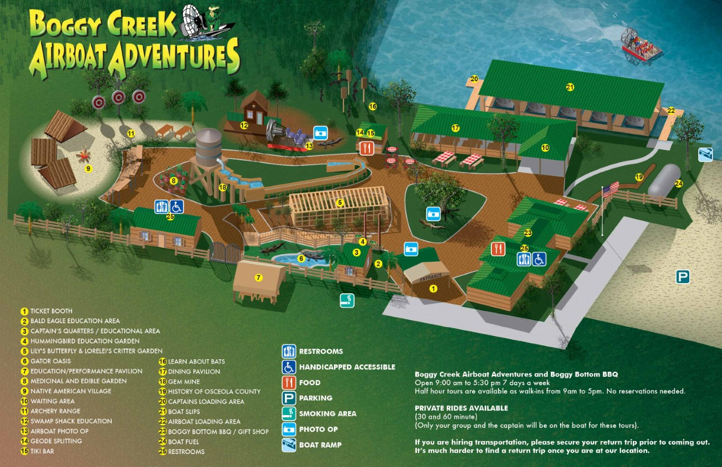

Slide 4
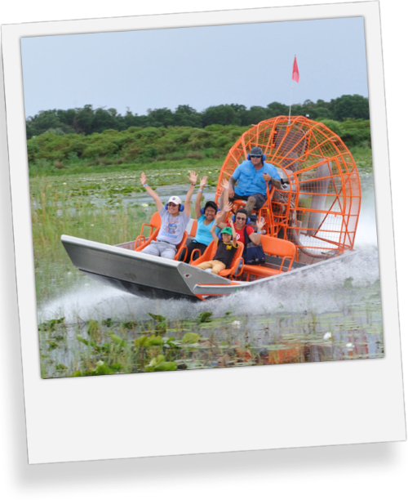
AIRBOATS
Get Ready to Spot Wildlife at Boggy Creek Airboat Adventures!
The Headwaters to the Florida Everglades is a wildlife haven, and now's the perfect time to get out and explore all it has to offer. From birds to alligators to otters, there's always something to see! Lake Tohopekaliga offers an abundance of wildlife that you won't see in theme parks!
Whether you're looking for a leisurely tour or an exciting adventure, our tours have something for you. Take your binoculars with you and look for birds soaring overhead, alligators gliding across the water, or spot the playful antics of otters and turtles.
We have experienced Master Captains who can show you the best spots for spotting wildlife. Learn about the history of the area while getting up close and personal with its inhabitants.

Slide 5
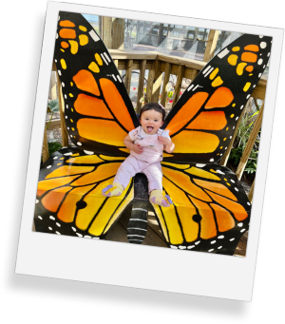
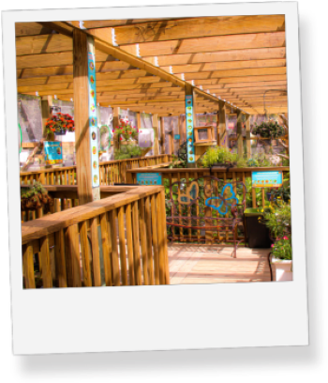
Lily’s Butterfly Garden
A screened plant-house where you can discover the natural beauty of Florida’s fluttering and colorful insects.
Sit within the serene enclosure surrounded by 17 different butterfly species while hearing the sounds of trickling water and birds. Observe the colors, sounds, and smells of the garden as butterflies pollinate and spread their wings.
Nectar that can be purchased for a small fee.
Observe the behaviors and habits of brightly colored Wood ducks, turtles, and Bob White quail within the garden.
You’ll be able to learn interesting facts about these beautiful creatures with our educational placards displayed throughout the enclosure.

Slide 6
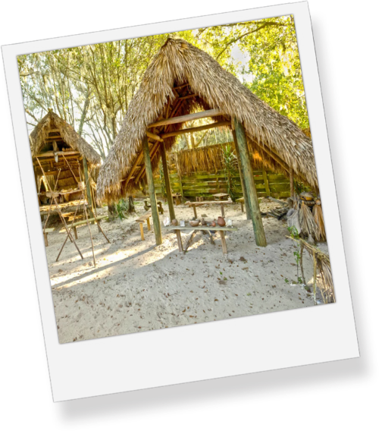
Native American Village
Step back in time and explore the ancient secrets of a Native American Village.
This outdoor museum provides visitors with a unique experience by portraying how Native Americans once lived on the swamp!
The village has been recreated with historic detail giving visitors an unparalleled opportunity to experience life as it once was. During your visit, you will have the chance to view their dwellings and artifacts that offer a glimpse into their past. Visitors have come away with a true appreciation for these communities that have accomplished so much throughout history.
So come join us on an unforgettable journey through time and space as we explore a unique piece of Native American culture.
For those interested in taking a deeper dive into learning about Native American history, we offer workshops on traditional skills like pottery-making, basket-weaving, language and dance. No matter what your interests may be, there is something here for everyone! Private workshops are an additional cost.

Slide 7
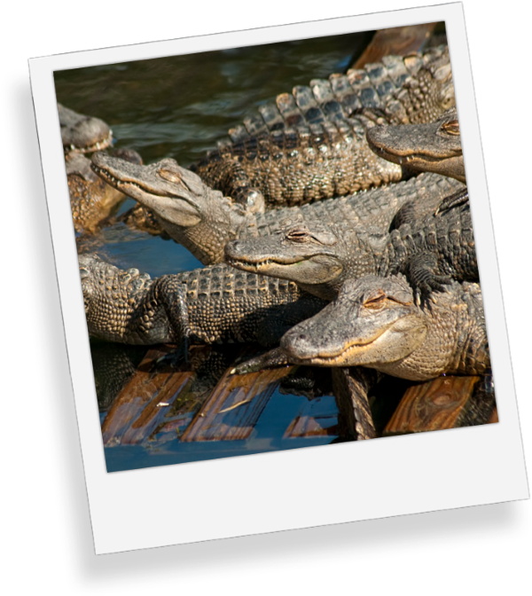
Gator Oasis
Welcome to the wonderful and surprisingly fascinating world of alligators!
There’s no better way to spend a day in nature than to visit our alligator oasis! These unique creatures have been around for millions of years, and they are certainly one of the oldest species on Earth. From their prehistoric-looking skin to their long, powerful jaws, these animals truly have some remarkable qualities that make them an exciting creature to learn about and observe!
These reptiles are so incredible, so dive into the exploratory journey and see our fascinating scaly friends right before your eyes!

Slide 8
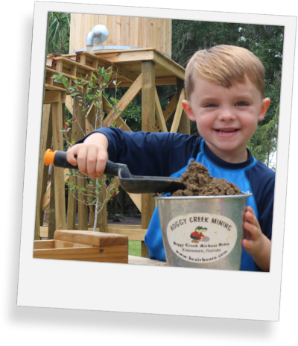
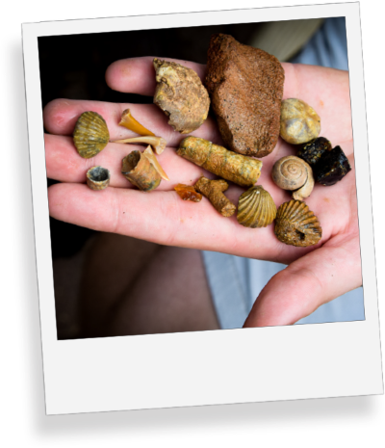
GO MINING!
Explore a world of color and shine digging for treasures in our 70 ft mine.
Uncover rare and beautiful gems or fossils and take home whatever you find! We provide all the essential tools and materials to start your gem mining adventure.
Get the whole family involved as you explore a new and exciting world finding and identifying rare gems and fossils. You never know what you might find. Our gem mining activity is fun for all ages!
Geode Splitting
This is our newest experience at the park
Everyone gets excited when they split open a geode to see what color crystals they find

Slide 9
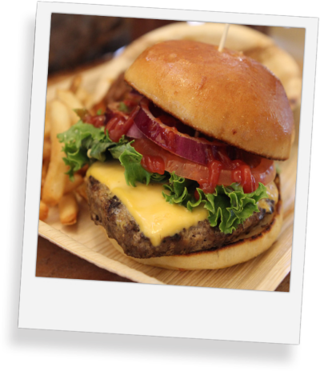

Boggy Bottom BBQ
Savor the Flavor of Our Delicious BBQ
Our outdoor restaurant is home to the best BBQ in town. Whether you're craving ribs, brisket, pulled pork, or just a good old cheeseburger, we have something for everyone. Our menu features a variety of dishes, from traditional favorites to our signature creations, you can even try our Gator Bites!
We also offer a wide selection of appetizers and sides, satisfy your cravings.
We provide more than just delicious BBQ – we create an atmosphere you won't forget. Our lakeside seating is the perfect way to relax and enjoy nature while eating with friends or family.

Slide 10
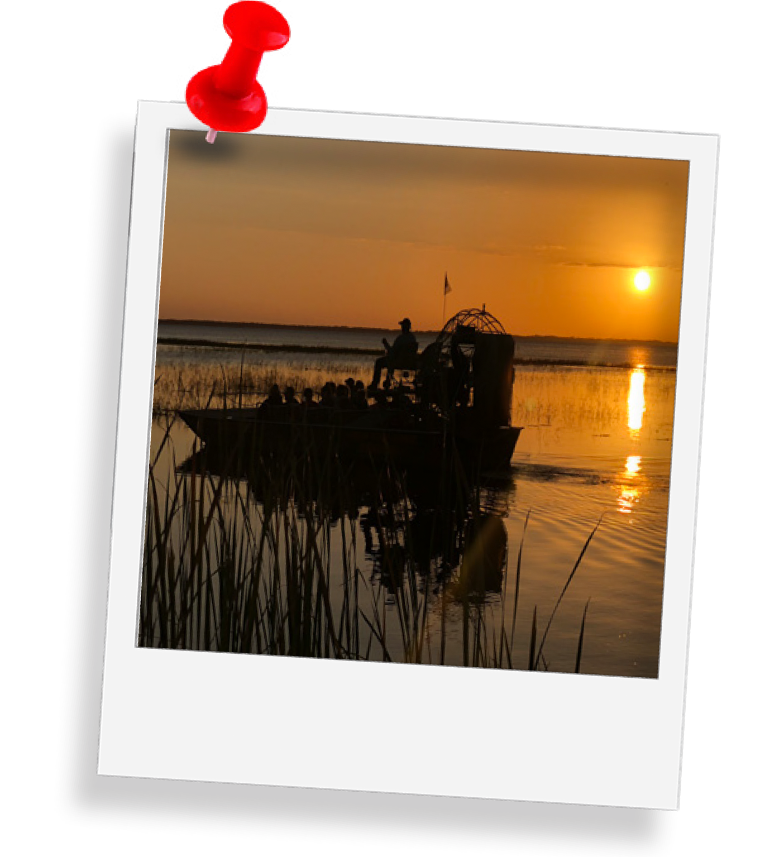
Thank You
Contact and Questions
Nick Romeo
Director of Sales and Events
Nick@BCAirboats.com
407-982-2237

