Slide 1

Military Ticket Program
23/24

Slide 2

Ikon Pass + Military Sales
Ikon Pass partners with the MRW and the Military Ticket Program to offer specially discounted rates on the Ikon Pass and Ikon Base Pass. These are season long ski passes for the 23/24 winter season that give you access to 50+ destinations worldwide.
MWR offers:
Ikon Pass = $737.25
Ikon Base Pass = $495.25
Notes:
Ikon Pass partners with the MRW and the Military Ticket Program to offer specially discounted rates on the Ikon Pass and Ikon Base Pass. These are season long ski passes for the 23/24 winter season that give you access to 50+ destinations worldwide.

Slide 3
Military Discount:
Who Qualifies?
Qualifications:
Adults (23 years or older)
Young Adults (13 to 22 years old)
Valid for active duty, retired (20+ years of service), reserve service members, and disabled veterans.
Must show valid military ID with name, branch of service, and current dates to qualify.
Spouses and dependents (26 years or younger) also qualify with proof of valid dependent military ID.
There is no military discount for child passes.
There is no discount for veterans or DOD employees.

Slide 4
Ikon Pass – What is Included
Unlimited (NO Blackouts) |  | 7 Days (NO Blackouts)
Big Bear | Snowshoe | Alta/Snowbird | Kitzbuhel | Sun Valley
Blue Mtn | Solitude | A Basin | Loon | Sugarloaf
Copper | Steamboat | Aspen | Lotte Arai | Sunday River
Eldora | Stratton | Big Sky | Mt Bachelor | Taos
June | Sugarbush | Boyne Highlands | Mt Buller | Thredbo
Mammoth | Tremblant | Boyne Mtn | NZ Ski | Valle Nevado
Palisades Tahoe | Winter Park | Brighton | Niseko | Windham
Snow Valley |  | Chamonix | Panorama | Zermatt
 |  | Crystal | Red Mtn | Alyeska - NEW
 |  | Cypress | Revelstoke
 |  | Deer Valley | Schweitzer
 |  | Dolomiti SuperSki | SkiBig3
 |  | Grandvalira | Snoqualmie
 |  | Jackson Hole | Snowbasin
 |  | Killington/Pico | Sun Peaks
Notes:
Ikon Pass has access to 56 destinations (CMH Heli Skiing counts as 1)
For marketing purposes, we use 50+ destinations
Unlimited Access = 15 destinations
Up to 7 Days Each = 40 destinations (Alta/Snowbird counts as 2 destinations)
***Presentation only, NZ Ski = Coronet Peak, The Remarkables, and Mt. Hutt. They count as 1 destination***
NO BLACKOUT DATES
Pass Benefits:
10 friends and family tickets @ 25% off the window rate (Not applicable to Zermatt, Kitzbuhel, Dolomiti, Lotte, Grandvalira, Chamonix)
F&B and Retail Discount - 15% at select destinations
First Tracks – one day per month at select destinations

Slide 5
Ikon Base Pass – What is Included
Unlimited (No Blackouts) | Unlimited w/ Blackouts | 5 Days w/ Blackouts |  | 5 Days NO Blackouts
Big Bear | June | Big Sky | Schweitzer | A Basin
Blue Mtn | Mammoth | Boyne Highlands | SkiBig3 | Chamonix
Copper | Palisades Tahoe | Boyne Mtn | Snoqualmie | Dolomiti SuperSki
Eldora | Solitude | Brighton | Snowbird (no Alta) | Grandvalira
Snow Valley | Stratton | Crystal | Steamboat | Kitzbuhel
Snowshoe | Sugarbush | Cypress | Sugarloaf | Lotte Arai
Tremblant |  | Killington/Pico | Sun Peaks | Mt Buller
Winter Park |  | Loon | Sunday River | NZ Ski
 |  | Mt Bachelor | Thredbo | Valle Nevado
 |  | Niseko | Windham | Zermatt
 |  | Panorama | Alyeska - NEW
 |  | Red Mtn
 |  | Revelstoke
Blackout Dates
Northern Hemisphere
12/26/2023 - 12/31/2023
1/13/2024 - 1/14/2024
2/17/2024 - 2/18/2024
Southern Hemisphere (Thredbo Only)
7/1/23 - 7/16/23
7/6/24 - 7/21/24
*NO ACCESS TO: Aspen Snowmass, Jackson Hole, Sun Valley, Deer Valley, Alta, Snowbasin, and Taos (NEW)
Notes:
Ikon Base Pass has access to 49 destinations (CMH Heli Skiing counts as 1)
Unlimited Access = 14 destinations (subject to blackout dates)
Up to 5 Days Each = 34 destinations (subject to blackout dates)
***Presentation only, NZ Ski = Coronet Peak, The Remarkables, and Mt. Hutt. They count as 1 destination***
NO ACCESS TO: Aspen Snowmass, Jackson Hole, Sun Valley, Deer Valley, Alta, Snowbasin, and Taos (NEW)
These are on the Ikon Base Plus Pass or Ikon Pass
Pass Benefits:
8 friends and family tickets @ 25% off the window rate (Not applicable to Zermatt, Kitzbuhel, Dolomiti, Lotte, Grandvalira, Chamonix). F&F Tickets are subject to blackout dates
F&B and Retail Discount - 10% at select destinations
First Tracks – one day per month at select destinations

Slide 6
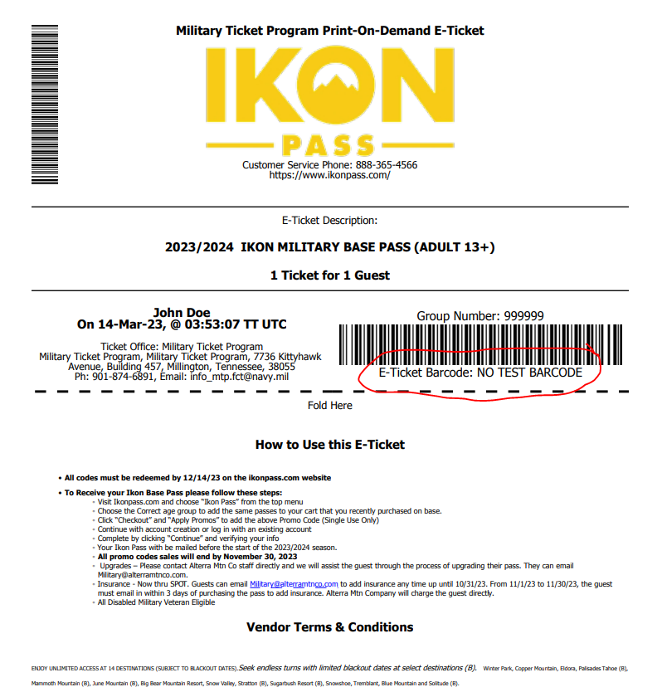
Purchasing
On-Base
Guest will buy their pass direct from your location.
In return, they will receive a E-Ticket pictured here.
The E-Ticket has a unique, single use promo code located under the barcode. It is a 12-character combo of letters and numbers.
The guest then takes that promo code and redeems it on IkonPass.com. The code will register the pass as $0 since it was pre-paid at the military installation.
The guest MUST redeem their promo code in order to activate their pass.

Slide 7
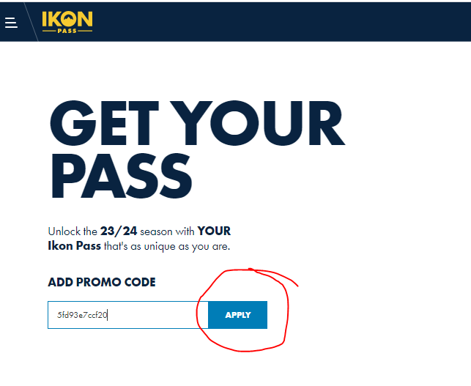
Activating the Pass
The E-Ticket has specific directions for the guest to follow. Recommended way to redeem is through:
https://account.ikonpass.com/promocode
Notes:
Recommended site is listed on the E-ticket voucher. This takes them to a page where they can enter their promo code directly and it will list the pass that promo code is for. Codes are specific to either the Ikon Pass or Ikon Base Pass. The guest can also go to IkonPass.com and select the pass type from the main list of options.

Slide 8
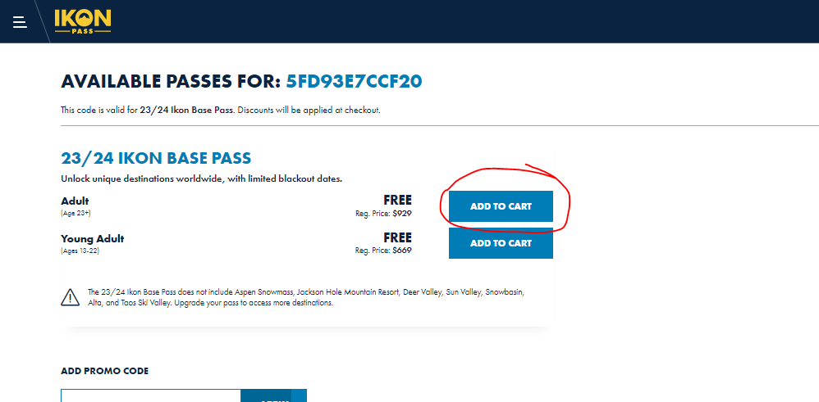
Notes:
This then takes them to the screen to select their age group (adult or young adult).

Slide 9
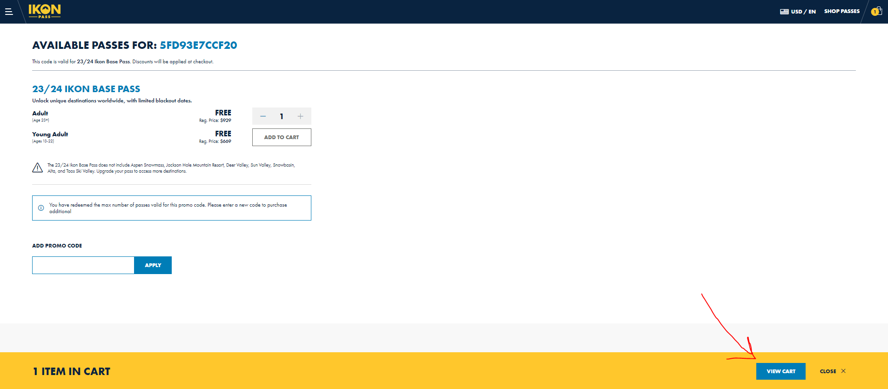
Notes:
One pass may be selected per promo code. After they click the pass for their age group, they can then click on VIEW CART to continue.

Slide 10
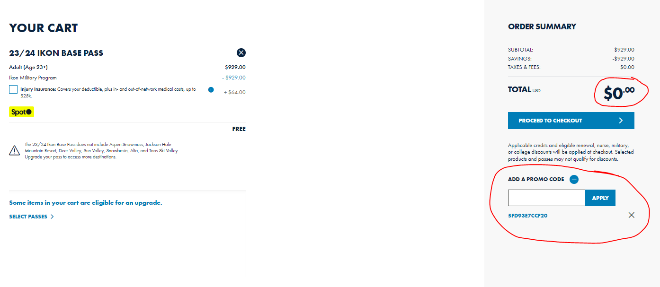
Notes:
The YOUR CART screen will show the pass selected, the promo code, and the price of the pass as $0 since they pre-paid on-base. They can then proceed to checkout to finish setting up their IkonPass.com account and activate their pass!

Slide 11
Spot Insurance
Direct service member to purchase Spot Insurance through Ikon Pass directly.
Best to email military@alterramtnco.com to purchase.
Pass Protection: protects the price of the pass should the unexpected happen
  Always 7% of the pass price – cannot be bought with a $0 promo code.
  Can be purchased at any time until Oct. 31st.
  Post Oct. 31st, it should be purchased the day of purchasing the pass.
Injury Insurance: helps pay for medical bills if the person gets injured while using their pass
  Can be purchased with a $0 promo code.
  Flat rate of $64 per Ikon Pass or Ikon Base Pass.
  Flat rate of $26 per Ikon Session 4-Day Pass ($6.50 per day).
  Can be purchased at any time.
Notes:
Insurance options allow guests to get reimbursed should the unexpected happen. All insurance claims are handled through a third party – SPOT.
Insurance will only be offered through IkonPass.com or by contacting our call center or military@alterramtnco.com.
Spot Insurance (getspot.com) – Pass Protection
Always 7% of the pass price
Can be purchased at any time up until Oct. 31st
Post Oct. 31st – it needs to be purchased the day they bought their pass. (can be tricky with the promo codes).
Spot Insurance (getspot.com) – Injury Insurance
Can be purchased with a $0 promo code
Flat rate of $64 per Ikon Pass or Ikon Base Pass
Flat rate of $26 per Ikon Session 4-Day Pass ($6.50 per day)
Can be purchased at any time

Slide 12
Adventure Assurance
ELECT TO DEFER BY DECEMBER 14, 2023
  Guest can defer their 23/24 at any time until 12/14/23.
  They must redeem the promo code on IkonPass.com and then click on the ELECT TO DEFER button in their account.
  They will receive a credit for what they paid in their IkonPass.com account in spring 2024.
  They can apply their credit to an Ikon Pass of their choice for the 24/25 season.
COVID CLOSURE CREDIT
  Guest can receive a credit should a destination close due to COVID.
  Timeframe: 12/16/2023 to 3/3/2024 (79 days)
  Partial Credit Criteria: 2 (or more) consecutive closure days at any single North American Ikon Pass resort.
Notes:
Adventure Assurance comes free with every 23/24 Ikon Pass. Designed to alleviate uncertainty while providing flexibility for Ikon Pass holders, Adventure Assurance gives pass holders credits in the case of COVID-related closures and the option to defer the purchase price of an unused pass by December 14, no questions asked.
https://www.ikonpass.com/en/adventure-assurance
DEFERRALS = 12/14/23
Yes – we can still process deferral credits for you from the 22/23 season (list on Deferral tab in Excel sheet)
NOTE – when the guest defers their pass, it will show $0. We go into their account and add the credit manually in the spring.
COVID CLOSURE CREDIT
NEW – simplified this year to cover all North American destinations (used to have 2 options)
No destinations closed last year (YAY!)
NOTE – Ikon Base Pass would not receive credit should a destination close that is not on this pass (example: Jackson Hole)

Slide 13
Spring Promo – Buy Now Ride Now
Spring Access
Big Bear | Immediately – Closed for the season
Snow Valley | Immediately – Closed for the season
Stratton | Immediately – Closed for the season
Sugarbush | Immediately – Closed for the season
Snowshoe | Immediately – Closed for the season
Blue Mountain | Immediately – Closed for the season
Tremblant | 4/3/2023 – Closed for the season
Solitude | 4/3/2023 – Open until May 21st, 2023
Deer Valley | 4/10/2023 – Closed for the season
Mammoth | 4/10/2023 – Open through the end of July
June | 4/10/2023 – Closed for the season
Palisades Tahoe | 4/10/2023 – Open through July 4th, 2023
Steamboat | 4/10/2023 – Closed for the season
Winter Park | 4/10/2023 – Mary Jane side open until TBD
Notes:
Spring access for NEW pass holders – buy in the spring and start skiing in the spring at select destinations.
Pass holder must:
Redeem their promo code.
Add a photo to their IkonPass.com account for their pass.
Check in at ticket office with photo ID and have Ikon Pass or Ikon Base Pass printed on site.
NOTE:
Destinations will NOT print passes ahead of time (example, Mammoth will not print a spring pass on 4/8).
These passes are for spring use only, they will receive a new card in the mail during the fall for the official 23/24 season.
Use of the pass for spring skiing disqualifies them from having the ability to defer the pass.

Slide 14
Misc. Notes
All physical passes will be printed and mailed to the guest starting in the fall – they must redeem their code, have a valid mailing address and photo for their pass in their IkonPass.com account.
November 30th, 2023 is the LAST day for the Military Ticket Program sales.
Any guest need assistance or have questions, please refer them to military@alterramtnco.com
Participating locations are listed on our website here: www.ikonpass.com/military
If you would like your location to be listed on the website, please email us at military@alterramtnco.com.

Slide 15

Thank You!

