Slide 1
MTP Ticket Portal Sellers Guide Training

Slide 2
Training Objective
This training can be used in conjunction with the Ticket Portal Sellers Guide. This training is geared to ticket new employees on how to access and generate MTP Ticket Management System (TMS) E-tickets.
How to get access to TMS Ticket Portal
User Login, set –up and account information
TMS Dashboard & Support and Documentation
Ticket Options and Selling a Ticket
  Selling tickets with required information
Use Advanced Filters
Reviewing Sales
Cancelling Tickets
  Cancellation Requests

Slide 3
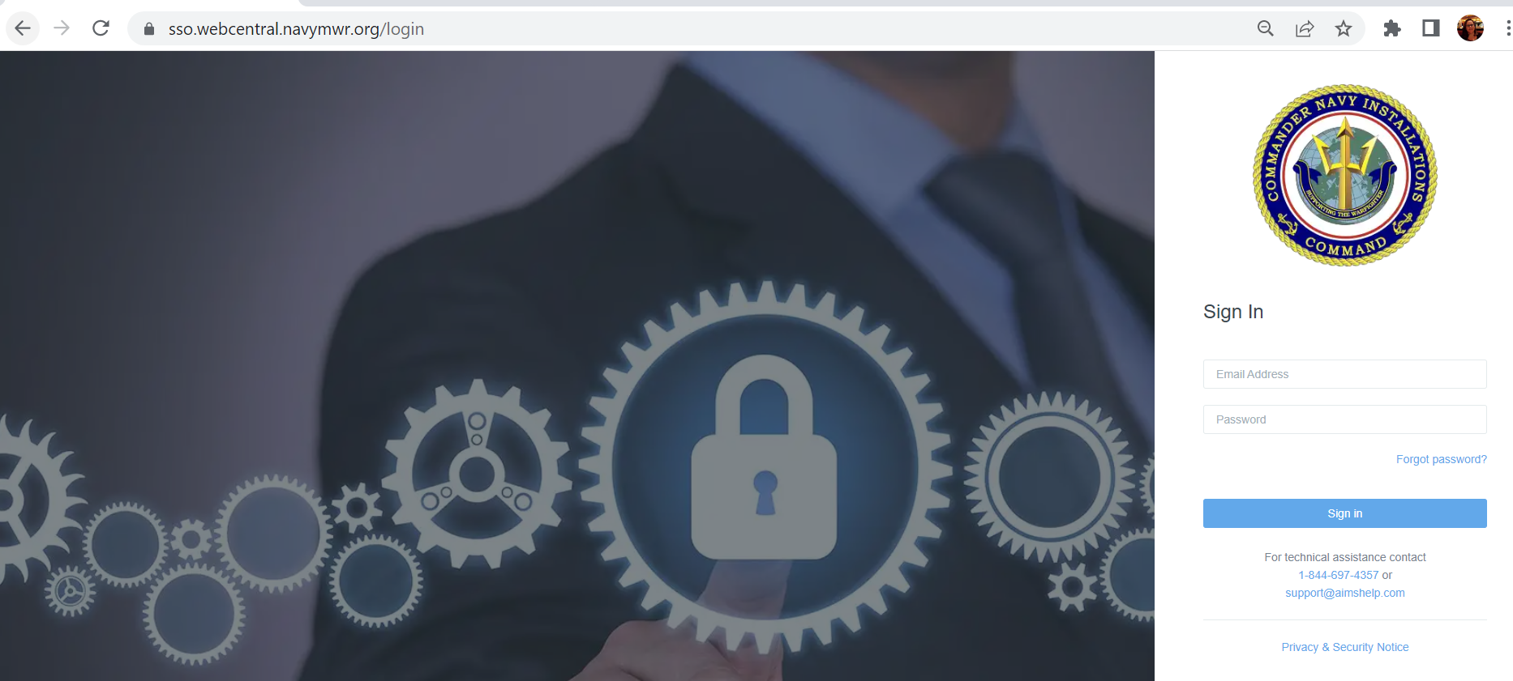
TMS Access for Ticket Sellers
Installation Ticket Managers are responsible for adding new users to Navy Single Sign On (Navy SSO) which is where the TMS application is accessed.
  https://sso.webcentral.navymwr.org/

Slide 4
TMS Access for Ticket Sellers
The monthly MTP managers training covers how to add new users to TMS. As does the TMS Back Office Managers Guide
Managers need to send an Updated Address Update form to MTP and then create the new sellers accounts.
  Cannot stress how important it is to make sure that the address form is completed in full and kept up to date with our offices. It is the only way MTP could assist a user with access in the event that the manager is out of office and user needs special support or access to any additional MTP applications- if MTP does not have an up to date form to validate the user is authorized for your location we are not allowed to assist.

Slide 5
How to Login
When a manager sets up the SSO account users will receive an email from “Navy Single Sign On” with a link to login and complete the account activation process.
  Each user must have their own account
  Each user account will have its own unique email, which is also their user name.
When user locates their initial account email. There will be a link in the email. User will access the link to activate their account.
  They will input their user name: their email
  Input a temporary password found in the email
  Then will be prompted to set up a password & pip

Slide 6
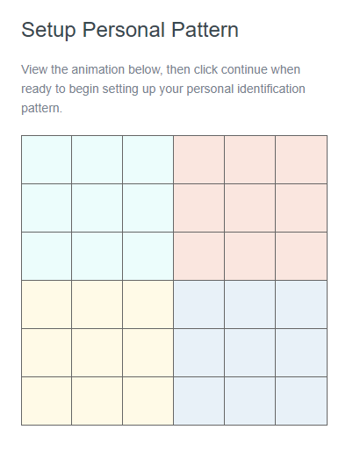
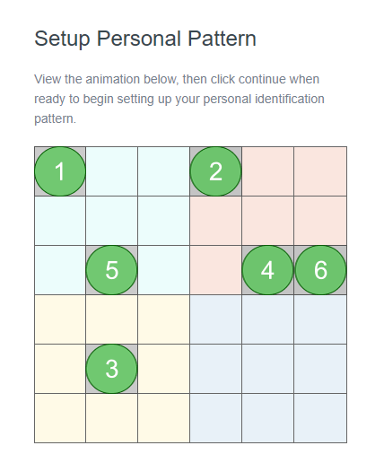
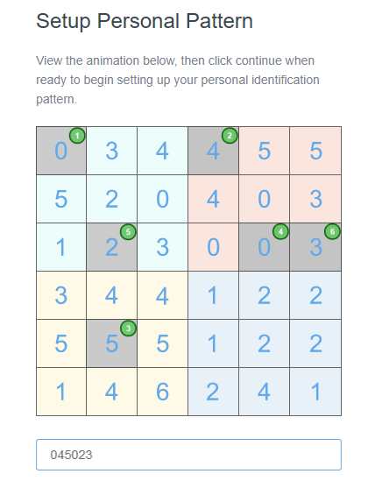
Set –up Pip

Slide 7
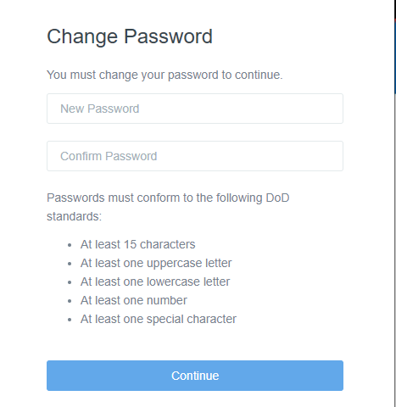
Set up Password
Make sure to follow the DOD password Standards.
  Users will be prompted to change their password every 60 days.
  Accounts for users who do not login at least once every 30 days will be automatically locked
  After 90 days of inactivity user TMS access will be removed.
    Manager will have to add a users access back

Slide 8
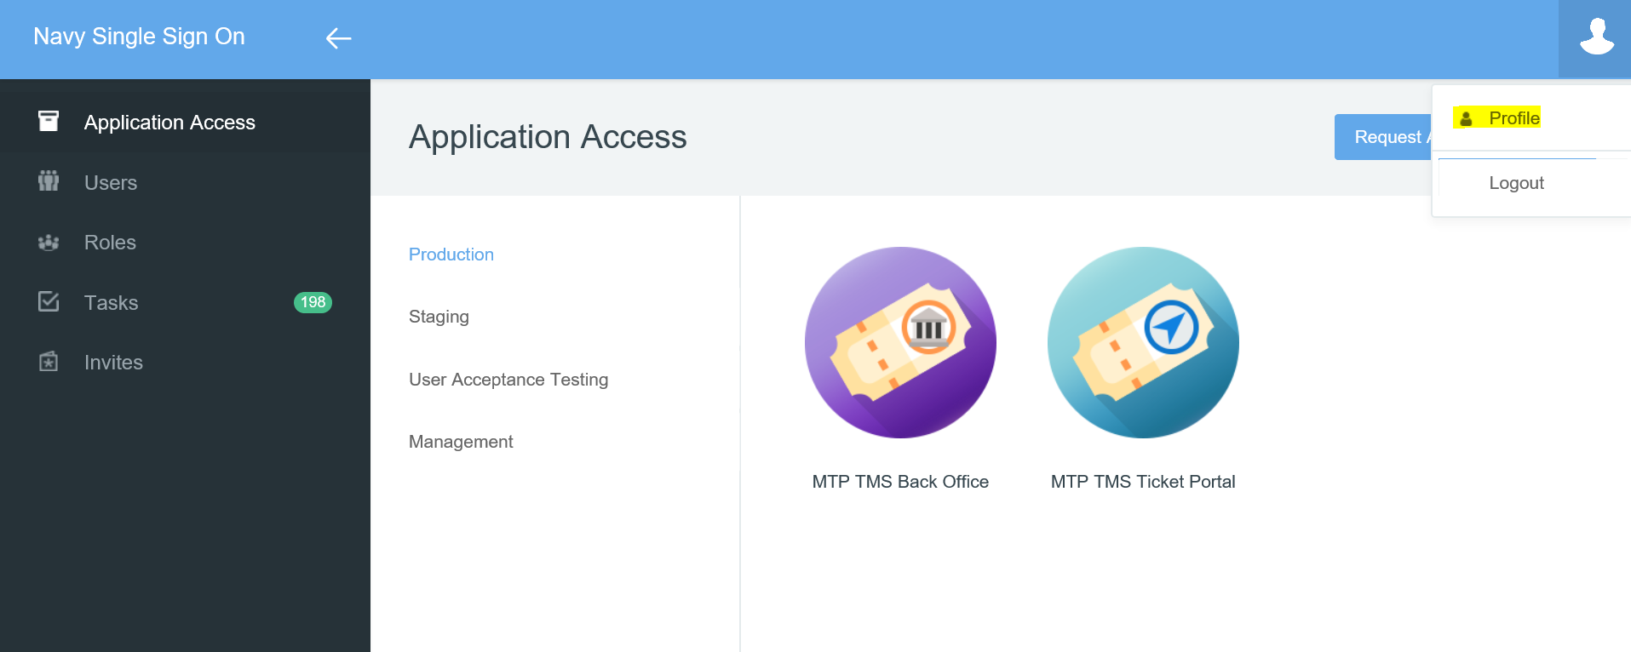
Navy Single Sign On – application portal

Slide 9
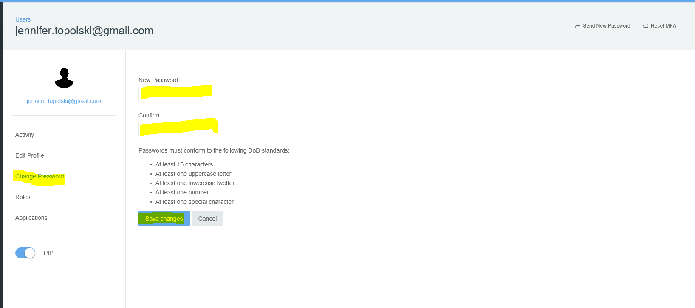
Select profile icon to change password

Slide 10
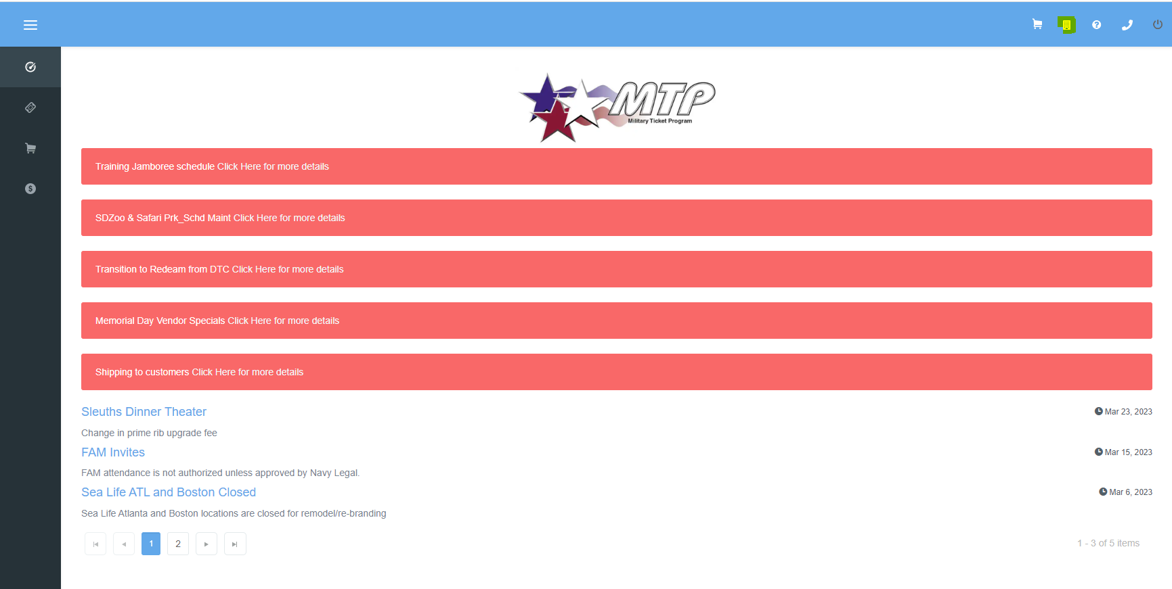
Navigating TMS Dashboard & Support

