Slide 1


Military Ticket Program (MTP)
Ticket Management System (TMS)
Ecommerce Project Brief
Kate Cutshall
Comm Rec Program Analyst
CNIC HQ
5 May 2026

Slide 2
AGENDA
TMS Current vs TMS Future
Ticket Office Process
Ecommerce Website Process
Accounting Changes
Project Status/Implementation
Questions
Notes:
There is a lot of information shared on each of these slides with the intention being that we can disseminate this slide deck to anyone who wasn’t able to join us this morning. I will touch on the key points of each slide and do my best not to read the slides word for word.

Slide 3
TMS Current vs TMS Future
Current
Future
Back Office/Agent Portal through SSO URL
Travel Office is the merchant of record.
Travel office uploads ticket information to RecTrac.
Complete Order in TMS and process sale in RecTrac/POS system.
End of Month:
  MTP Invoices Travel Office for MTP Cost of tickets sold.
  MTP pays vendors for tickets sold.
Back Office/Agent Portal through Okta Portal
MTP is the merchant of record.
Complete Order and process payment in the Agent Portal
Online Sales Option for Patron
Travel Office earns commissions from online sales
End of Month:
  MTP Accounting pays Travel Office commission for tickets sold in office/online.
  MTP pays vendors for tickets sold.
MTP Help Desk
Notes:
Change in Platform
Merchant of Record
RecTrac and Sales in the Agent Portal
Online commissions
End of Month Process
Introducing a MTP Help Desk

Slide 4
Travel Office Process
New Platform for Back Office and Agent Portal
  Applications are optimized but remain similar
  MTP will coordinate with CNIC IT for a massive migration to new platform
Check-Out
  Agent IDs will accompany each transaction for commission assignments
  Order Review Form
  Payment Process
    Payments will now process through the Agent Portal.
    Patrons will not receive confirmation of ticket purchase until payment has been processed.
Cancellation
  Process remains similar to today.
  Assisting with Online Order cancellations:
    Submit a cancellation request on the patron's behalf
    Provide contact for the MTP Help Desk
Refunds:
  Current APIs cannot process Modifications/Upgrades to tickets
    If changes are needed: Cancel the entire order and refund the customer.
  Cancellation Fee
    Cancellation of tickets may result in a cancellation fee determined by the cost of the ticket.
Notes:
New Platform: No new tech is needed
Order Review Form:
A large percentage of cancellation for tickets is due to human error, whether the patron provided the wrong information or the ticket agent misspelled a name/email.
In effort to cut down on cancellations due to human error we are introducing the Order Review Form to the check out process.

Slide 5
Ecommerce Website Process
New Branding and URL
  www.mwrtickets.com
  MTP maintained website that will be integrated into our ticket inventory
  Strong competition against our competitors GovX and VetTix
Authentication Process:
  Using the same process of AFT, patron's authentication will determine their access level to specific tickets
    Example: DoD Civilian will be able to see the Disney Military Salute Tickets but not able to add them to the cart
Commission Assignment:
  Moving Away from UICs
  Patron Store Affiliation
    After authentication patrons will be asked to affiliate to their local ticket office. Their choice will tie that transaction to the store for commission assignment.
Online Cart to Agent Sales:
  Agents will have the capability to help finalize a patron's online purchase by retrieving a cart code and completing the sale.
  Agents will receive In Office level commission rate for that sale.
MTP Help Desk:
  Help Desk Phone number to assist agents as well as online patrons with all questions and transactions.
  Offices can provide this phone number to patrons for direct contact with MTP for cancellations or refunds.

Slide 6
Accounting Changes
Current
Future
Travel Office is the merchant of record.
  Assumes Credit Card Processing Fees
  FY 25 Fees est. - $7M
Travel office uploads ticket information to RecTrac.
  EOD Process
Complete Order in TMS and process sale in RecTrac/POS system.
MTP Commissions:
  Agent Sales: 2%
End of Month:
  MTP Invoices Travel Office for MTP Cost of tickets sold.
  MTP pays vendors for tickets sold.
MTP is the merchant of record.
  MTP assuming all credit card processing fees.
Complete order and payment in the Agent Portal
Program Budget Change
RecTrac remains for Local Ticket Sales
Travel Office earns commissions from In Office Sales and Online Sales
MTP Commissions:
  Agent Sales: 2.5%
  Online Sales: 8%
End of Month:
  MTP Accounting pays Travel Office commission for tickets sold in office/online.
  MTP pays vendors for tickets sold.
Notes:
Commission Example:
Ticket Retail $100
Ticket Cost $90
MTP Commission: 2.5% = $2.50
Base Commission = $7.50
Online Commission Example:
Ticket Retail: $100
Ticket Cost: $90
MTP Comm: 8% = $8.00
Base Comm = $2.00

Slide 7
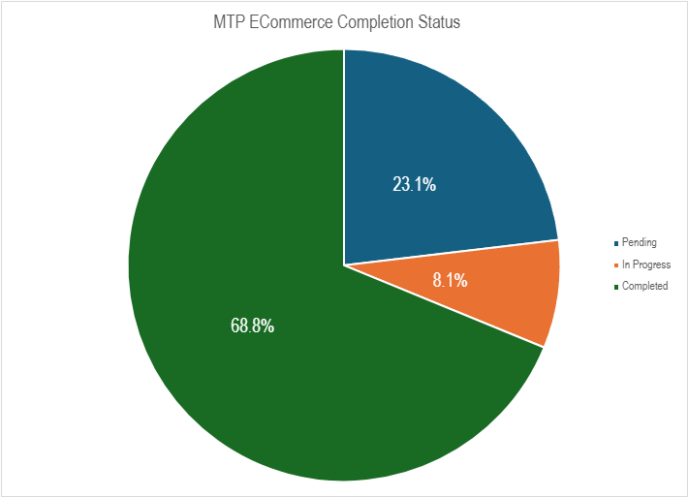
Project Status
Projected Agent Portal Go Live: End of Summer FY26
  MTP hosted trainings prior to go live
Projected Website Go Live: Beginning of FY27
Notes:
The current implementation plan is to stand up the Agent Portal and Back Office functions of the new TMS without the addition of a functioning website. The MTP Help Desk and the MTP HQ team will be there to help troubleshoot any issues that arise with the new portals.

Slide 8
Recap
Projected Agent Portal Go Live: End of Summer FY26
Project Website Go Live: Beginning of FY27
Competition against GovX and VetTix
Familiar Back Office and Agent Portal Applications
MTP Merchant of Record
  Changes budgeting process for Ticket Offices
  Credit Processing Fees will fall to MTP
  MTP will pay Ticket Offices instead of invoicing Ticket Offices for payment
All sales performed in Agent Portal
  No more RecTrac Uploads
  No more Ticket emails to patron prior to payment

Slide 9
Questions

