Slide 1

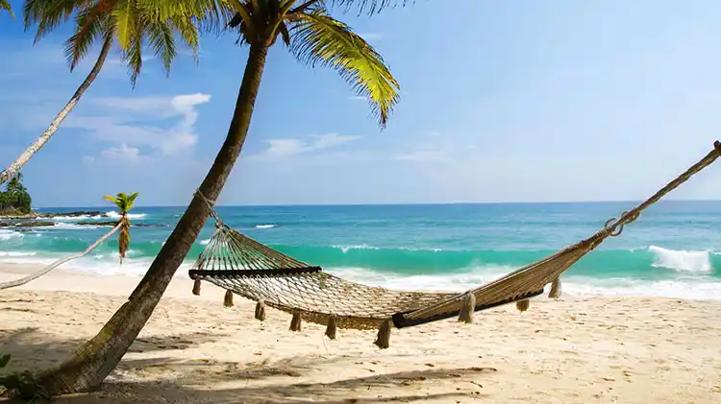
ALL THINGS TICKETS & TRAVEL

Slide 2



Slide 3
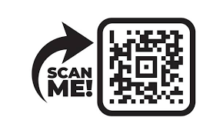




BEST PRACTICES WE HEARD YOU WERE DOING!!
QR Codes linking back to website where most up to date pricing is listed
Ticket Tuesdays Social Media Posts - highlight a different vendor or AFT each week
Promote products and services on various Social Media platforms
In-doc, Newcomers and Student Briefs prior to Holiday Leave (November - December) to let them know about services
Partner with other MWR programs that offer trips and tours (CYP, BOSS/Liberty, Community Recreation, Recreational Lodging, Fleet Rec, etc.)
Cross Promotion - Fliers at the Visitors Center and other MWR locations
Cross Train other MWR locations to sell tickets when Ticket Offices are closed to maximize sales opportunities
Send out quarterly newsletters to all former clients
Mini travel fairs – highlight a specific geographic location and their attractions
Joint travel fairs with local bases:
  Work with marketing to get commercial sponsorship for give aways
  Work with vendors to get informational items and possibly be in attendance
Customer Comment Cards: Monthly drawing just for commenting (work with marketing to get prizing)
Post ticket changes for all agents to see in a timely manner
Offer resale merchandise as a way to generate additional revenue
Teach agents how to upsale by getting to know the customer and what their interests may be.
Make sure agents know how to use TMS to its full advantage.

Slide 4
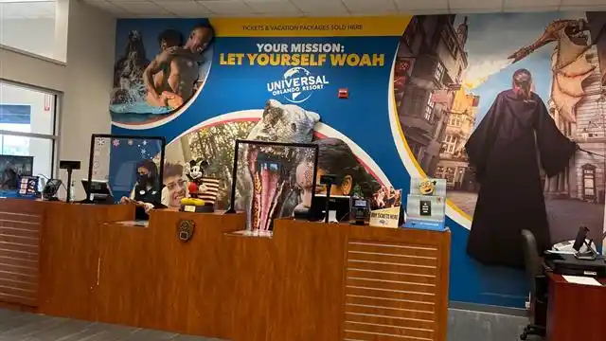
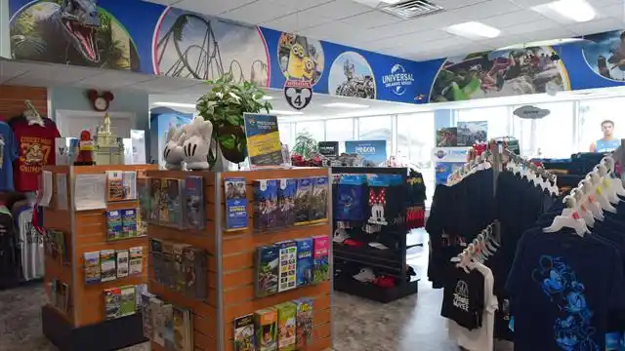
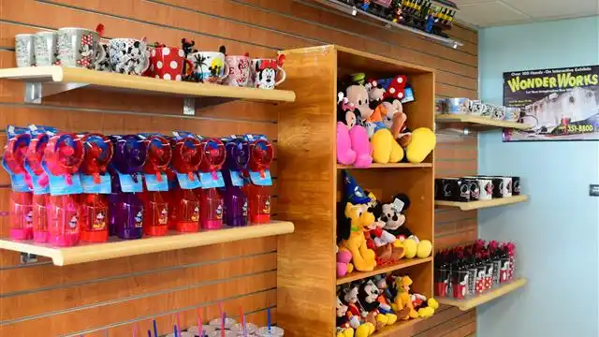
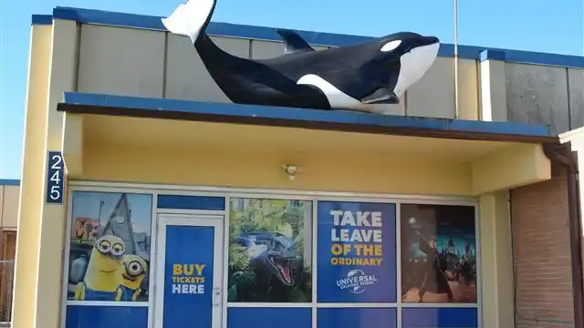
BEST PRACTICES WE HEARD YOU WERE DOING contd.
Vendor promotional material in the office
Make your office pop and stand out
Make sure customers know how to find you
Make sure your space is inviting, clean, organized and well lit
Make sure literature is up to date and fresh

Slide 5
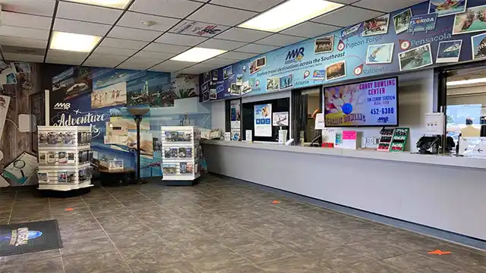
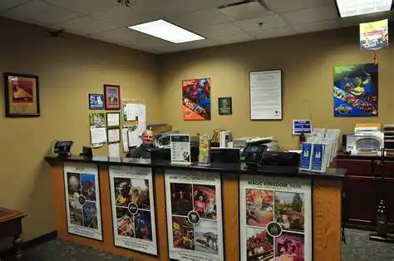
Organized and inviting storefronts with up-to date information to get your customers excited!

Slide 6


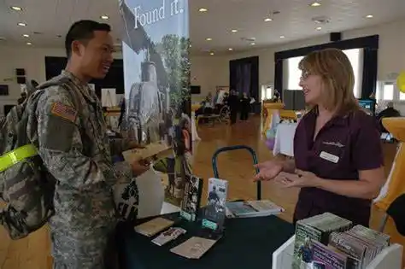
Travel Fairs
MTP will collect Travel Fair Dates and share with top vendors
Coordinate your travel fair with multiple bases so vendors can maximize reach
Use marketing to produce fliers and brochures and get commercial sponsorship to get prizes for giveaways
Coordinate with vendors to get up to date promotional materials
PLAN AHEAD 6-12 months!!
Vendors budget that far in advance
Custom calling cards and brochures
INDOC and Newcomer Fairs

Slide 7
Tips, Tricks and FAQs:
(Based on feedback from the survey)
How do we get training for Managers and staff who may have been here awhile?
  Monthly MTP Round Tables with a different vendor each month
  Monthly New Managers Training can be attended as a refresher for Managers and Ticket Administrators
  Job Aids and training guides are available in TMS Support and Documentation
Where can I find the parameters of a ticket in TMS (e.g. eligibility, dates, etc.)?
  The Description tab will outline the parameters for each ticket
  This information is provided just as given by the vendor
Where can I find marketing materials for vendors?
  TMS Support and Documentation Link hosts a spreadsheet with Marketing POCs for all MTP Vendors that provide marketing materials.
  Digital and printable marketing materials provided by the vendor may also be found at this link.
  MTP will also email all marketing assets to the Managers as they are received.
How do I get my local attraction to be part of MTP?
  Reach out to the vendor and get a good POC and refer them to MTP.
  If you are already selling the product, provide your sales information.
  MTP will reach out to the vendor to establish a relationship and determine viability.
  We understand the desire to offer a variety of attractions and want to provide as many local vendors as possible. However, please note that not all attractions will fit the needs of the program (e.g. discounts, technology, ratings, sales volume, etc.). In this case, MTP will refer the vendor back to the base as a local contract.

Slide 8
Tips, Tricks and FAQs contd.:
(Based on feedback from the survey)
Why did some of my favorite attractions drop off (e.g. waterparks)?
  After COVID several vendors stopped offering third party discounts and are offering direct discounts only.
  MTP is considered a third party.
  We are working with these vendors to try and bring them back on board now that there has been some time since reopening.
  If you have a specific vendor in mind or have guests requesting, please let us know.
  Several vendors consolidated attractions into one contract. Check the MTP Ticket Detail Report located in the TMS Back Office, Reports section, to see if your favorite attraction is listed! The most recent consolidation is Six Flags.
  MTP will notify Ticket Offices of changes such as these thru the weekly upcoming product change emails and ticket announcements.

