Slide 1

AmericanForcesTravel.com
Updates
Marketing Efforts
Commissions Performance
Future Product Enhancements
Summary of Resources

Slide 2
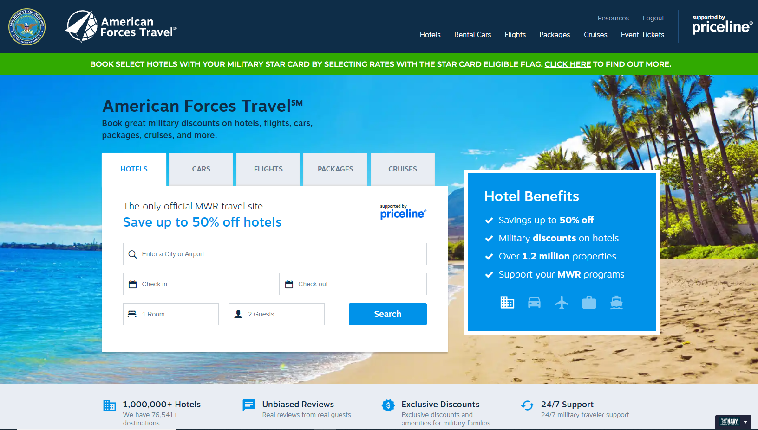
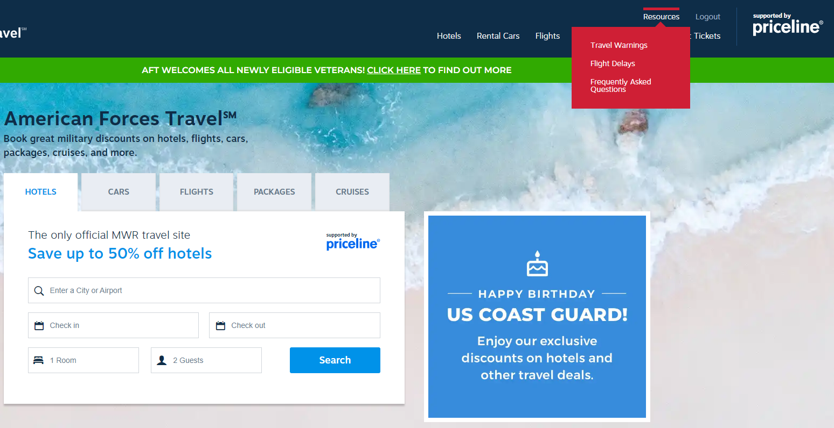
AmericanForcesTravel.com (AFT)
New FAQ Location
Notes:
AmericanForcesTravel.com is the ONLY true e-commerce joint travel service offered by all of the services. The goal is to promote this DoD MWR leisure travel website to our customers, especially those not near an installation, to ensure every eligible patron knows about this benefit.
New FAQ location for better User Experience
Reminder that AFT is a resource for the estimated 99% of each service population that was deemed as unreachable in brick and mortar travel facilities

Slide 3
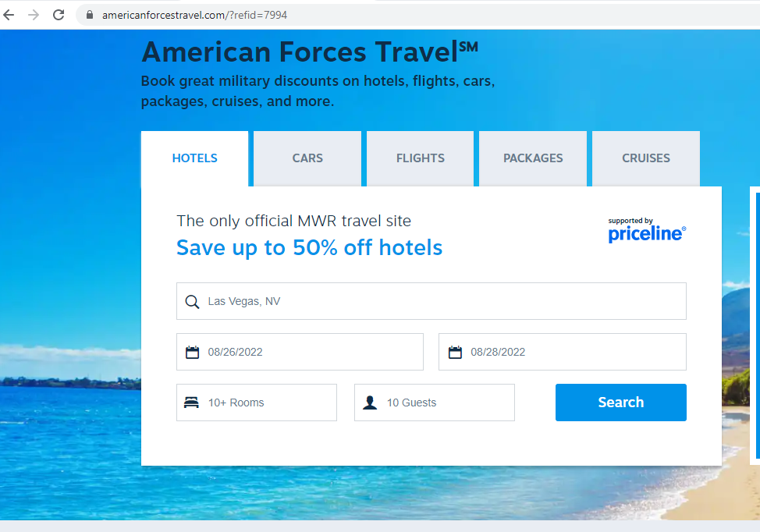
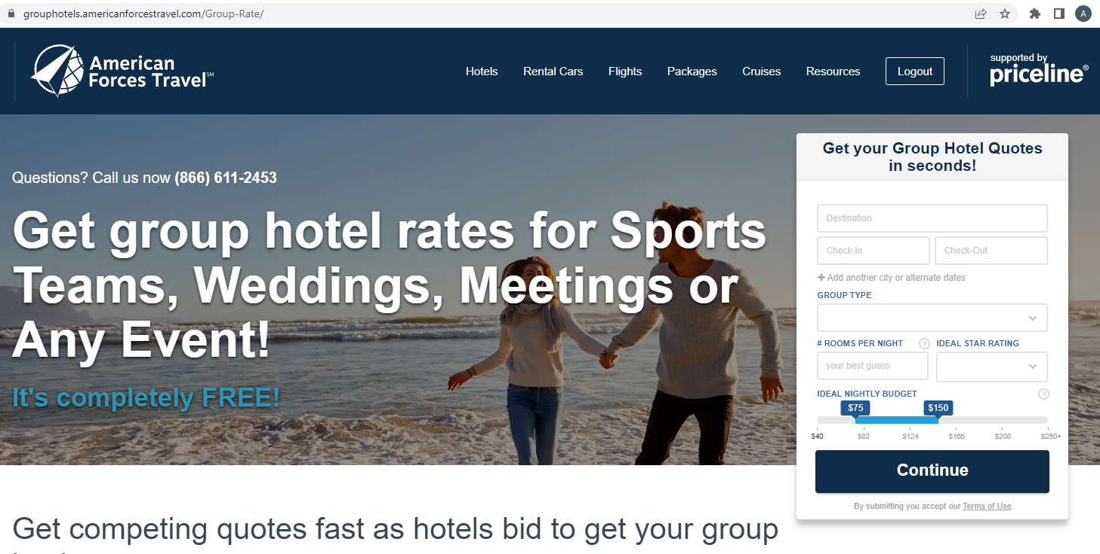
Product Enhancements - Hotel Planner – Added June 2022
Individuals can now select 10+ Rooms for their hotel reservation
This selection will take them to a third party Priceline booking site run by Hotel Planner
Customers can input search details to find a larger amount of rooms to accommodate large groups for reunions, events, etc.

Slide 4
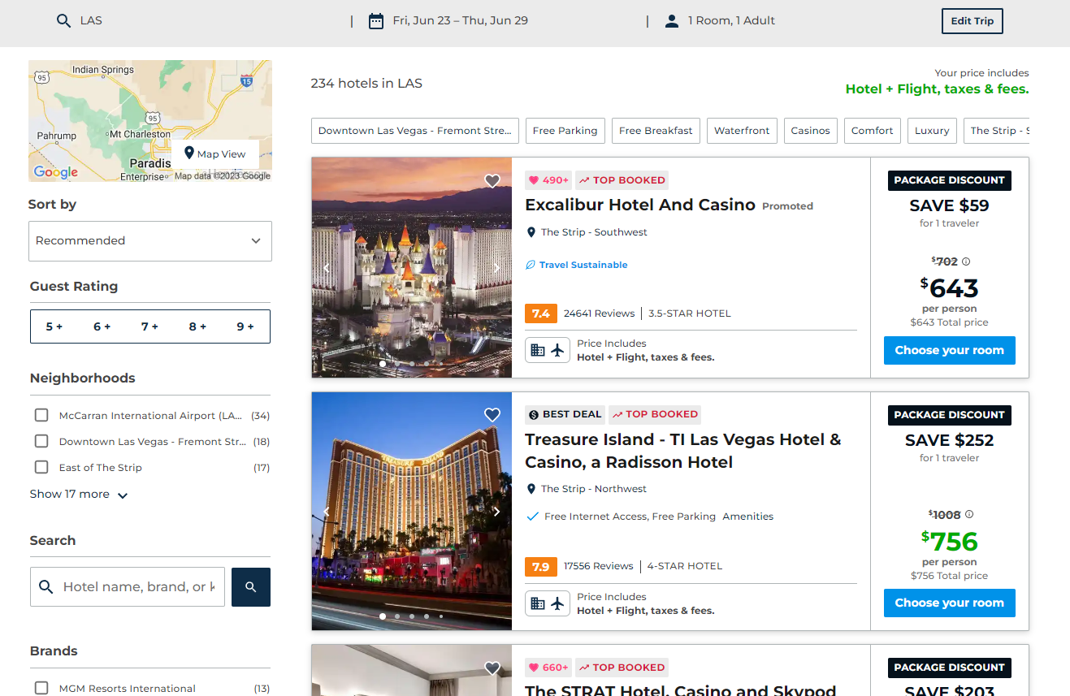
Vacation Packages Listings Migration
Migration completed February 2023
Involved taking Hotels and Packages to one listing page for streamlining backend upkeep and better user experience
New features include:
  New Map View (full page)
  Numerous Quick Filters
  Updated Hotel Card and Favorites Icon
  Neighborhood Filter and Guest Rating
  Selected Sort Options
Notes:
- Reminder: Vacation Packages white label is only available via the direct AFT URL. VP white label is not available on agent URL.

Slide 5

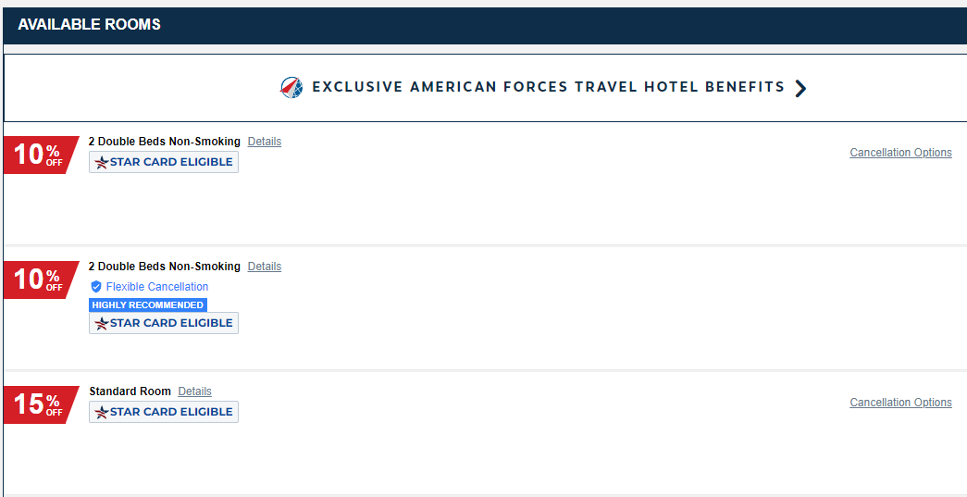
Military STAR Card on Select Hotels
Payment Option for Select Hotels ONLY where Priceline Partner Solutions is the merchant of record.
Digital Marketing available on https://www.navymwr.org/resources/marketing/aft/aftmc/aftmc-militarystarcard
Hotels migrating to Priceline.com white label platform this year
Access to more inventory and quicker updates from Priceline team
Notes:
Military STAR Card called out on almost all marketing campaigns
Customer can locate the STAR card eligible rates by selecting their hotel of choice from their search and browsing the rates for that property.
85-90% of Hotel inventory on AFT is STAR card eligible.
Hoping to have more products eligible for STAR card payment in the next 12-24 months

Slide 6
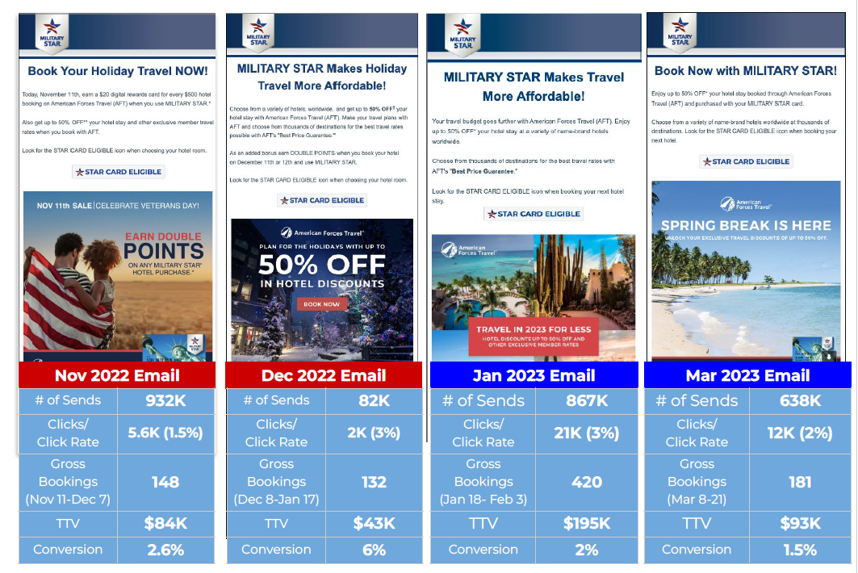

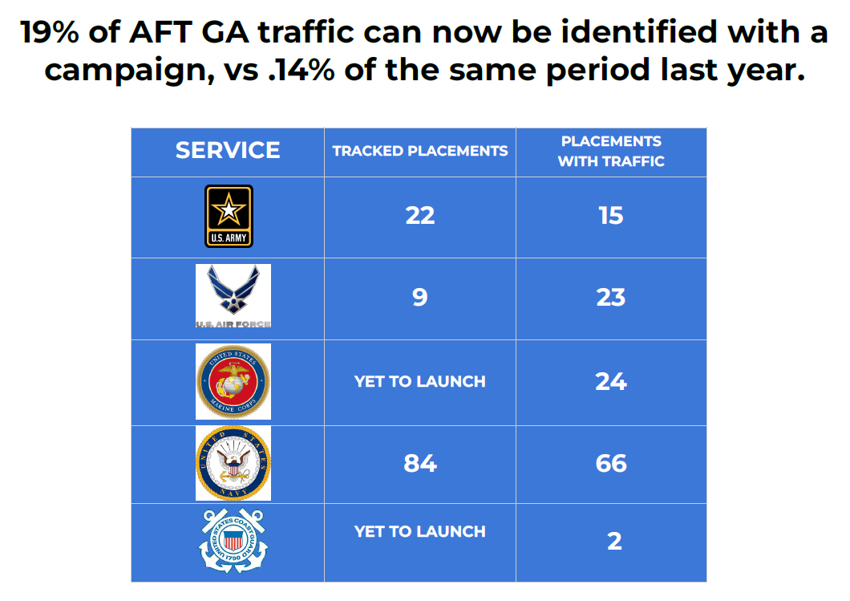
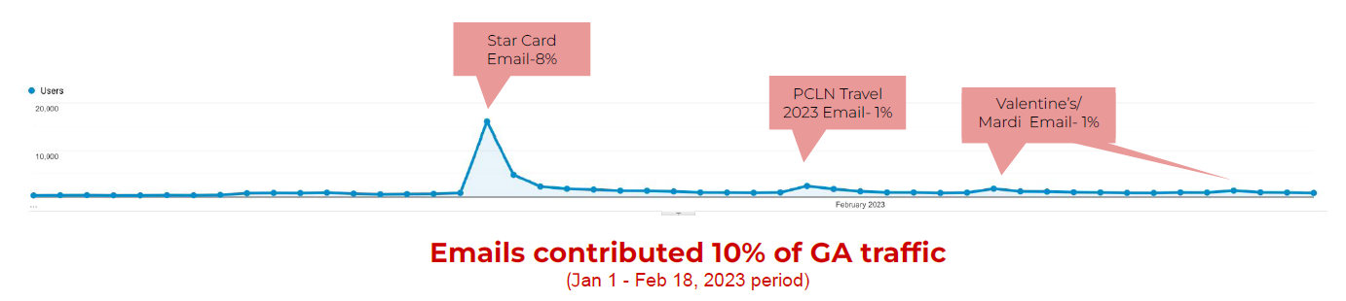
Marketing Efforts
Military STAR Card
and PCLN Emails
Successful conversion rates
Spikes in Authentications and Bookings
Tracking via Google Analytics to measure data more efficiently to drive marketing decisions
Notes:
December, we sent to a smaller subset of users (those who made a recent purchase) and conversion went up to 6%

Slide 7
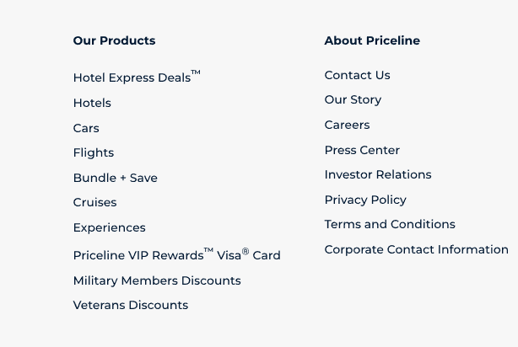
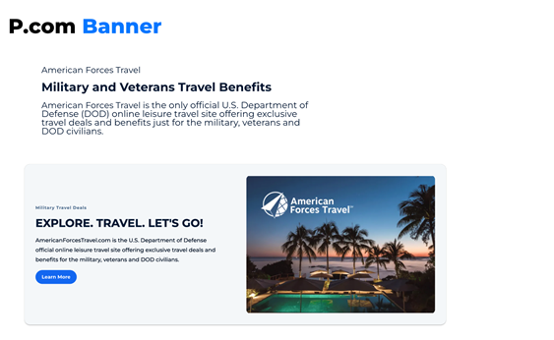
Marketing Efforts
Industry Standard Conversion = 2.3%
Placement | Traffic | Sales | TTV | Conversion
Footer- Veterans | 1390 | 48 | $21.6K | 3.5%
Footer- Military | 1330 | 43 | $19K | 3.2%
Priceline.com Banner Placements
Priceline.com Footer

Slide 8
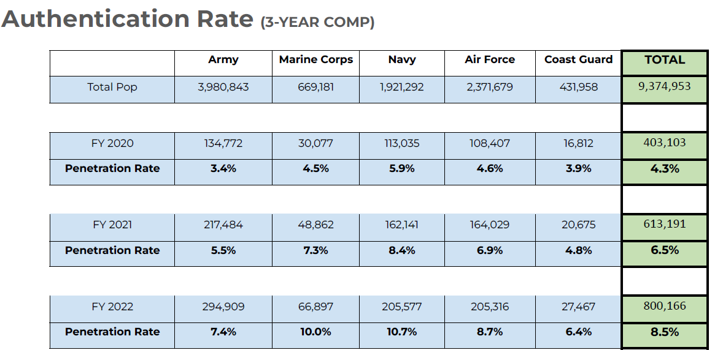
Marketing Efforts Service Results
- Tracking Veterans separately so we can learn how to target such a vast population more effectively
Veterans are not included in this comparison graph or total population
All services have penetrated about 1% of total veteran population for their service
Notes:
Authentication steady increase year over year
Tracking Veterans separately so we can learn how to target such a vast population more effectively - Veterans are not included in this comparison graph or total population

Slide 9
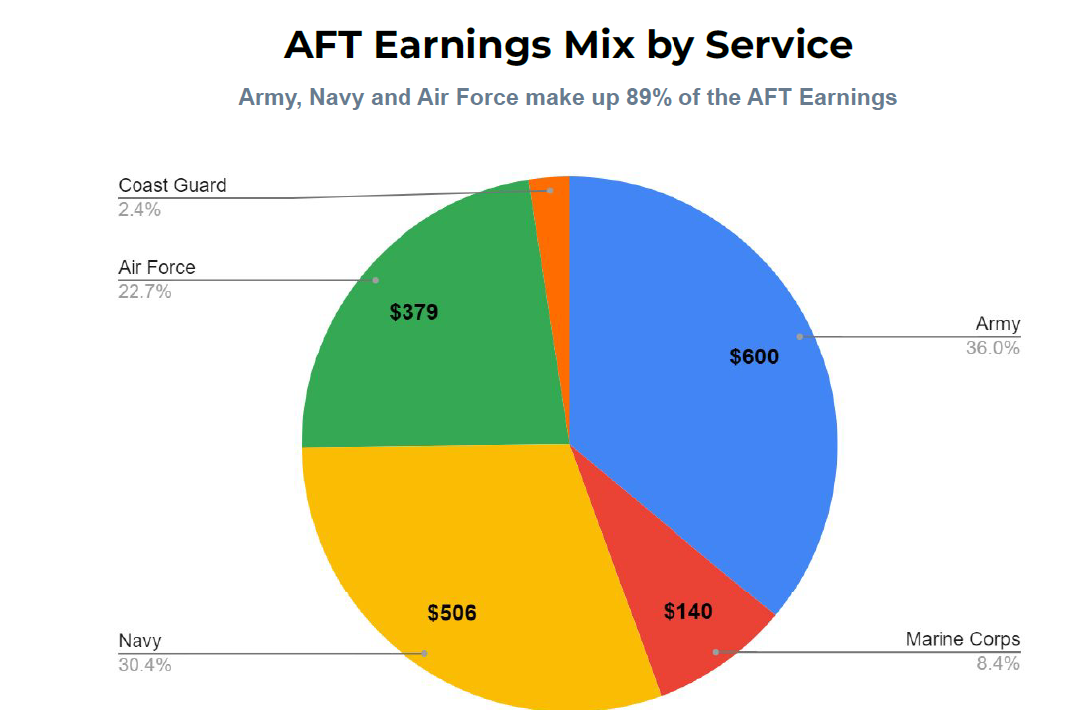
Commissions YTD Comparison
- Commissions Paid to Services YTD (October 22 – March 23) = $1,015, 253
- Commissions Paid to Services YTD (October 21 – March 22) = $796,885
Increase of $218K
- Earnings mix is on trend for
population size by service
- Commissions and authentications
tracked closely with marketing efforts
FY22

Slide 10
Future Product Enhancements
Summer FY23 – Hotels migrating to Priceline.com white label platform
  This is will open up a larger inventory base with member exclusive rates for hotels
  Current MILITARY STAR Card payment capability will migrate over as well
  Military STAR Card expansion
  Q2-Q3 of FY24 – Hoping to have Military STAR Card as a payment option on Flights and Rental Cars
  Profile Feature
  Delivery date TBD – feature would allow customers to save information for repeat bookings and travel itinerary history for reference

Slide 11
Resource Summary
Marketing Resources:
AFT Marketing Calendar Link: https://www.canva.com/design/DAFSVbQUxwo/BhRIltQ6CzWW44_QaS-7CA/view?utm_content=DAFSVbQUxwo&utm_campaign=designshare&utm_medium=link&utm_source=publishsharelink
Agent Training Resources:
- AFT Overview Course – Updated 2023
- Agent ID Training
Marketing Team Points of Contact:
- Navy: Megan Trexler – megan.e.trexler.naf@us.navy.mil
- Army: Pierre Laxa – pierre.i.laxa.naf@army.mil
- Marine Corps: Katelyn Philippsen – Katelyn.Philippsen@usmc-mccs.org
- Air Force: Richard Cooper – richard.cooper.12@us.af.mil
- Marine Corps: Michael Criswell - Michael.Criswell@uscgmwr.org
Operations Board Points of Contact:
- Navy: Brooke Haley - brooke.m.haley.naf@us.navy.mil
- Army: Patrice Johnson-Winters - patrice.johnson-winters.naf@army.mil
- Marine Corps: Brenda Boardman - Brenda.Boardman@usmc-mccs.org
- Air Force: Ricky Sesco - ricky.sesco@us.af.mil
- Coast Guard: Michael Criswell - Michael.Criswell@uscgmwr.org
Notes:
- AFT Marketing Calendar lists monthly marketing campaigns and provides links to graphics for digital sharing
- Contact your service Operations Board POC for access to Agent Training Resources and Installation Agent ID Code

