Slide 1


Content
Presented by: Jennifer Topolski
Navy N9S Joint Service and Partnerships - Leisure Travel Program
                AFT Agent Information
                Authentication Process Updated
                General Tips for Agents
                Cruise Tips
                Training Opportunities
                Important Phone Numbers
                Points of Contact
Notes:
Official DOW sponsored Joint Service Leisure Travel booking website
Navy is the executive support service – we manage the day-to-day operations and oversee the contracts on behalf of all service partners under the guidance of OSD and a Joint Service MWR Action Board, and MWR Operations board.
Relies on a Strategic Partnership with Priceline
Commissions from sales go back to all services as a commission payment processed every month.
Installations can claim bookings for customers they directly assist with their Agent ID

Slide 2
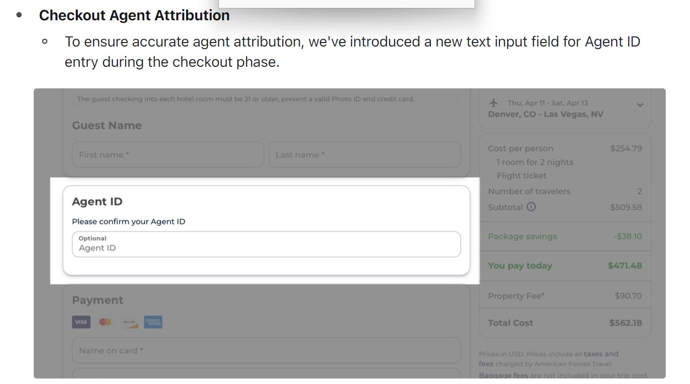
AFT Agent ID Information
  Agent URL: AmericanForcesTravel.com/agents
  How to use Agent ID to Claim Bookings:
  Hotel, Flights, Rental Cars, & Packages:
    Complete Agent ID field prior to completing check-out
  Cruise:
    Agent Must call the cruise support desk to claim the booking
    Can do before or after completing check-out
  Event Tickets & Hotel Planner:
    AFT Currently working with Priceline to implement ability to us agent id to claim bookings
Notes:
The stand-alone agent login process was replaced by a white label URL
Agents will navigate to the Agent URL and assist customers with authentication
- It's important that agents use customer authentication to ensure they are properly registered and eligible to use the AFT website
- The sales will still record the customer status, ie active, retired branch of service, etc.
-At check out the Agent ID input will ensure that the commission recorded for the specific location
Agent ID’s – Authorized Locations are assigned an Agent ID
-Please contact the MWR Board Member for you service for assistance with obtaining your agent ID number
-Note each location only needs one agent ID
Make sure Agents Claim the bookings
For Hotels, Flights, Cars, and Packages:
-Agent ID will only appear for sessions in the Agent URL
-If it is not claimed at the time of booking there is no way to add it after
Cruise:
-Agent ID can only br added by calling the agent cruise support line – 1-877-439-0279
Ticket Network/Event Tickets & Hotel Planner:
-Not currently able to claim with Agent ID’s
-Working with Priceline and these partners to enable Agents to Claim.

Slide 3
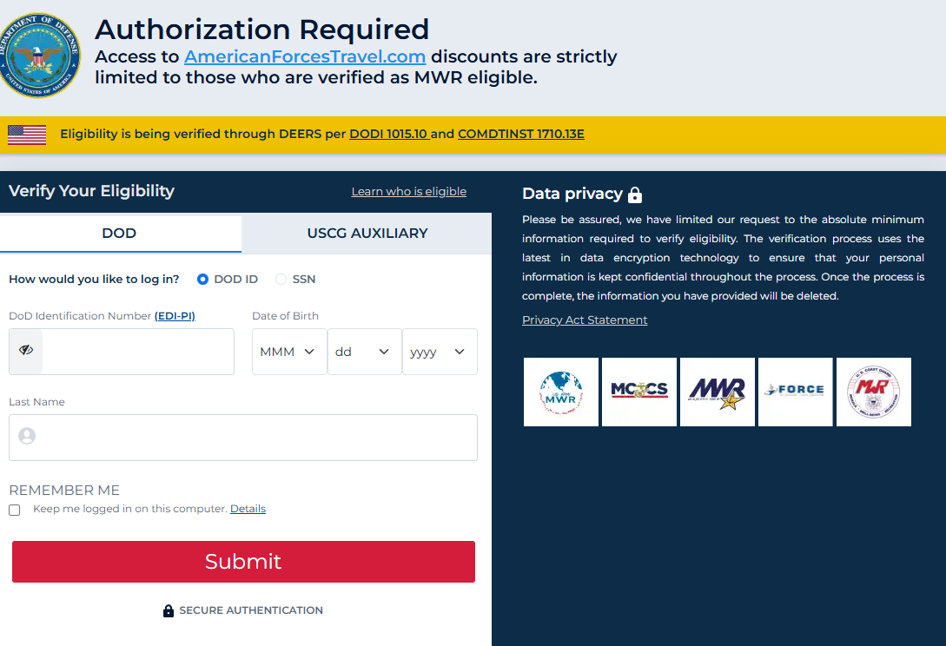
Authentication Updated
🚨 Primary Login Prompt: Users are now prompted to enter their DoD ID (EDI-PI) instead of the last four digits of their SSN.
🚨 Default Field Update: The default login field is now set to DoD ID.
🚨 SSN Option Still Available: Users still have the option to use the last 4 digits of their SSN if necessary.
🚨 New Pop-Up Assistance: A pop-up window has been added to help users locate their DoD ID/EDI-PI.
🚨 New Tabs Added: Tabs for DoD and Coast Guard Auxiliary (CG AUX) users have been introduced.
Notes:
As of Sept 24, 2025
DO NOT CLICK ON REMEMBER ME AS AN AGENT
Privacy link and statement are available
The hyper link informs customers on how we will protect their data
The privacy statement ton the screen if the customer wants to read it.
Users are prompted by default enter their full DOD/EDI Number
Pop-up screen available to assist users in locating the number
If EDI number fails the customer will be prompted to attempt to login with SSN
SSN
Customer like veterans will not have a DODID or EDI number
They can elect to use the SSN Toggle to access with social
Default will ask for the last 4 of the social to start.
Reasons for asking for full SSN
Data not found
Users share the same credentials (since we originally asked for last 4 only)
Users have a JR, III, etc in their name
DMDC Helpdesk (to be given out if a person is eligible and cannot authenticate)
1-800-538-9552

Slide 4
General AFT Tips
  Be transparent:
    AFT is Powered by a DOD Partnership with Priceline
    Unlike traditional travel agencies the booking is not owned or managed by the MWR travel office.
  Communicate with customers:
    Be sure to tell customers your role
    Reiterate that the customer is the owner of the booking.
    Provide customer support desk information.
    Disclose booking terms and conditions/cancellation policies.
Notes:
It Important to be transparent. Be clear about what booking through AFT means.
AFT is Powered by a DOD Partnership with Priceline
Unlike traditional travel agencies the booking is not owned or managed by the MWR travel office.
Be sure to tell customers that you are there to guide them through and facilitate the booking process but once the booking is complete, they are the owner of the booking.
This means that any changes or issues can be addressed with the customer support desk directly by the customer
Be sure to go over the terms and conditions of the booking, noting the cancellation policies.
Discuss the Price Match Guarantee

Slide 5
AFT Cruise Tips
Partnered with through Priceline with World Travel Holdings (WTH)
  WTH was ranked #16 on Travel Weekly's 2025 Power List of the top retail travel agencies in the U.S., based on 2024 performance.
Why Customers should Book a Cruise with American Forces Travel?
  Customers get more every single time they book with the American Forces Travel Cruise program.
All the deals
  WTH gives customers AFT every offer the cruise lines do (like cruise line loyalty points and offers), plus deals you’ll only available through AFT– like an exclusive up to $1,000 to spend on board.
Guaranteed lowest prices
  AFT always offer the best available rates, making it easy to compare and book with confidence – all backed the 110% Price Match Guarantee.
Talk to an expert
  Cruise Experts are available 24/7. Get answers to all your customers cruising questions from booking to boarding (and beyond). Our experts will help find the cruise experience that’s right for your customer.
Notes:
Customer access codes will automatically pass through to World Travel Holding website
Agents have their own telephone number to call for assistance 1-877-439-0279

Slide 6
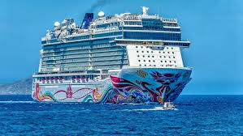
AFT Cruise Tips
Discuss with customers interested in booking a Cruise
The "Fly-In" Day: Never book a flight for the morning of your cruise. Budget for a pre-cruise hotel stay to avoid missing the ship due to flight delays.
The "Sandwich" Rule: To avoid noise, try to book a cabin that has other cabins both above and below it. Avoid being directly under the gym (thumping) or the nightclub (bass).
Motion Sickness: If you get seasick, book mid-ship on a lower deck. This is the ship's center of gravity and has the least movement.
Guarantee vs. Assigned: "Guarantee" cabins (GTY) are cheaper, but the cruise line picks your room. Only do this if you truly don't care where you sleep
Booking Timing (The "Wave" Season)
  Wave Season: Most deals happen between January and March.
  Shore Excursions: Popular tours (like Alaska dog-sledding or European private tours) often sell out months before the ship sails. Have a list of "must-do" ports before you book.

Slide 7
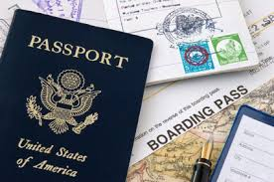
AFT Cruise Tips
Documentation & 2026 Requirements
Paperwork issues are the #1 reason people are denied boarding without a refund:
The 6-Month Rule: Most lines require your passport to be valid for at least 6 months after your cruise ends.
New Visas: In 2026, many countries (especially in Europe and the UK) have implemented mandatory electronic travel authorizations (like ETIAS).
Airline Tickets: For departures from international cruise ports: proof of onward travel, departing and returning.
Closed-Loop Exceptions: Some U.S. cruises (starting/ending in the same U.S. port) allow a birth certificate and ID, but a passport is still safer in case of an emergency evacuation.

Slide 8
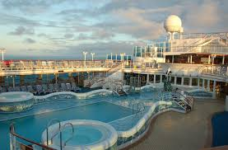
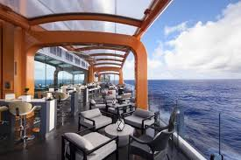
AFT Cruise Tips
Matching Your Customers Personality to the Cruise Line
Every cruise line has a distinct "vibe." Choosing the wrong one can ruin the trip:
High Energy - Royal Caribbean, Carnival - Waterslides, go-karts, lots of families, "mega-ship" feel
Modern Luxury - Celebrity, Virgin Voyages - Chic decor, "foodie" focus, fewer (or zero) kids
Traditional - Princess, Holland America - Live music, classic dining, enrichment lectures, more relaxed
International - MSC Cruises - European flair, multilingual, very budget-friendly

Slide 9

Reminder: Agent ID Training
  Hosting two virtual teams' trainings each Qtr. of FY26
    Thursday, May 7th at 0830 or 1600 ct.
    Thursday, August 6th 0830 or 1600 ct.
  Registration Link: https://forms.osi.apps.mil/r/7RUJsACH0j
  Training is approximately one hour
  Registration will close at 1600 cst. the day prior to the training.

Slide 10
Important Contact Information
PPN Customer | 1- 888-368-5340
PPN Agent | 1-888-837-3797
Cruise Customer | 1-877-937-2452
Cruise Agent | 1-877-439-0279
Notes:
Note agents have a different number. Agents should share customer numbers with their customers to call from home.
617-587-6220 is a toll number for any location that cannot call the 1-877 numbers for cruises
Luxury cruise number is on the website if you select a luxury cruise – you must call them to complete this booking type.

Slide 11
Joint Service Leisure Travel
Operations Board Member’s
AirForce: Ricky Sesco - ricky.sesco@us.af.mil
Coast Guard: Stephen Bishop -Stephen.Bishop@uscgmwr.org
Army: Patrice Johnson Winters - patrice.johnson-winters.naf@army.mil
Marine Corps: Brenda Boardman - brenda.boardman@usmc-mccs.org
Navy: Brooke Haley - brooke.m.haley.naf@us.navy.mil
AFT has a NEW General Email.
This is EMAIL not for distribution to customers.
Please copy your Ops Board Member on all email inquiries.
AFT General Email : AFT@us.navy.mil

