Slide 1

Universal ORLANDO’S
NEW PRINT @ HOME

Slide 2
Universal Orlando Smart order 2.0
Universal has implemented a NEW Ticketing Technology
This new system will allow users to retrieve their tickets via email prior to visiting the parks.
Customers will have the option of printing the paper ticket to carry with them or downloading the tickets for mobile redemption
Price Changes on Florida Resident and Non-Promotional tickets are going into effect on August 18th.
All Ticket Eligibility requirements for Military Promotional Tickets remains the same. That no more than six (6)Military Promo Tickets may be purchased and activated by any Eligible Service Member & spouse. In addition, one of the six (6) Tickets purchased must be used by the Eligible Service Member or his/her spouse. Each Military Promo Ticket must be used by the same person on any and all days. DOD are eligible with DOD ID for 6tickets.
The new order process will go into effect on: August 18, 2020
2

Slide 3
NEW selling requirements
Lead Customer must provide an EMAIL ADDRESS to retrieve their tickets*
  Email will come from: OnlineStoreConfirmations@nbcuni.com
  Recommend customer use personal email and check on their mobile device’s email for instant delivery
  Customer phone number still required
Individual Customer Names required for each person using the tickets - NO EXCEPTIONS
Customer must provide the PRINTED or MOBILE ticket for admission.
  Military Promotional tickets will still require the guest to stop at the customer service window with valid ID to activate their tickets.
  FL Resident and Regular UO ticketed customers can proceed directly to the turn style.
  Ticket offices should not print tickets. The customers are responsible for downloading for mobile redemption or printing the ticket.
*PRO TIP: If a customer refuses to give an email sellers may use a general email box created by the manager to send the tickets to and then print the tickets from the email for the customer.
3

Slide 4
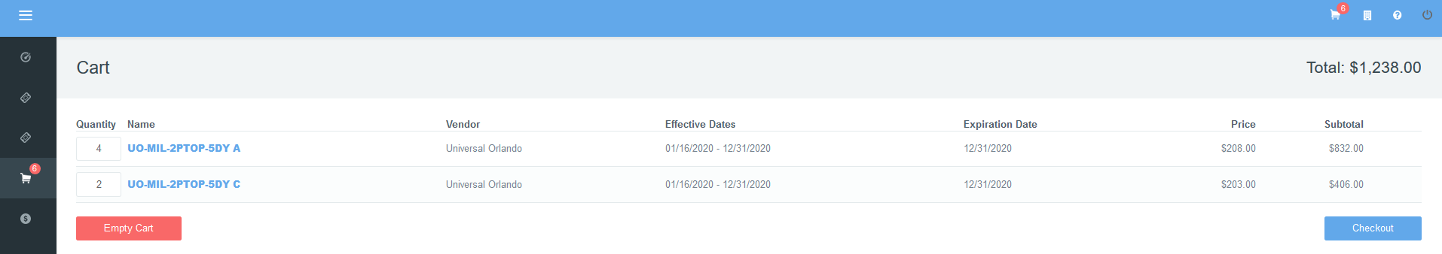
Selling PRINT UO @ HOME
1
2
STEP 1: In the TMS Ticket Portal -LOCATE THE TICKETS FOR THE CUSTOMER AND ADD THEM TO THE SHOPPING CART.
STEP 2: SELECT “CHECK-OUT” TO BEGIN THE ORDER CREATION PROCESS.
4

Slide 5
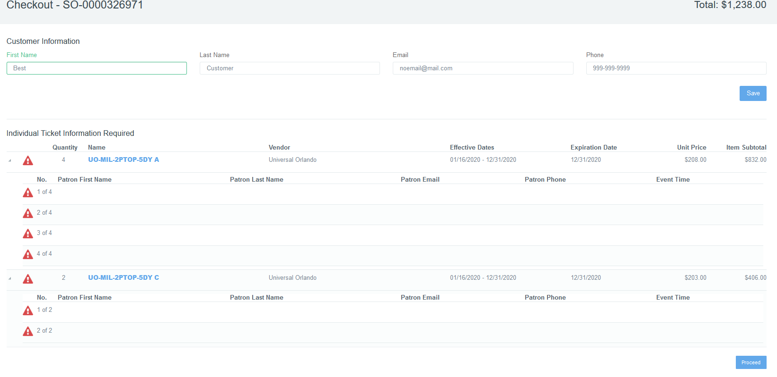

Step 3: *required* input the lead guests first and last name
Step 4: *REQUIRED* guests email and phone number. Tickets will be emailed to the lead guest and the phone number will be a back up way for universal to assist the guest if there is a redemption issue.
Step 5: select save before proceeding to fill-in required fields
3
4
5
5

Slide 6
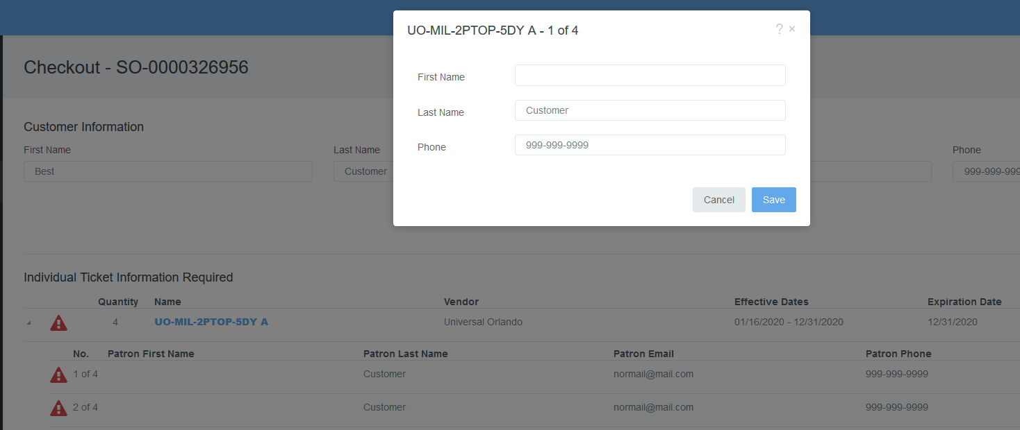
7
8
6
Step 6: SELECT THE ICON NEXT TO EACH LINE THAT IS missing TICKET INFORMATION (I.E. 1 OF 4)
Step 7: *REQUIRED* AFTER SELECTION, a Pop-up window WILL APPEAR COMPLETE WITH THE NAME OF THE PERSON THAT WILL BE USING EACH TICKET. The tickets will default to the lead guests last name, but it is editable.
STEP 8: ONCE YOU HAVE ENTERED THE NAME SELECT “SAVE” REPEAT FOR EACH TICKET IN THE ORDER.
6

Slide 7
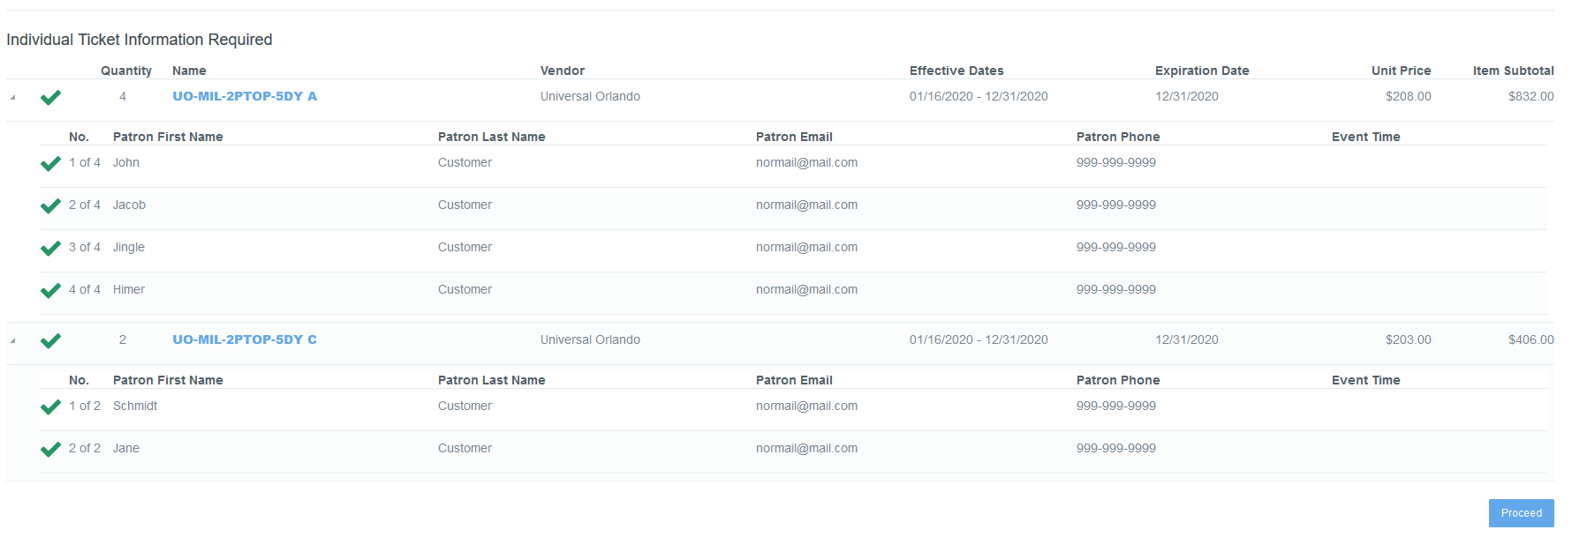
9
10
Step 9: VERIFY THE guests first and last name's ARE CORRECT
Step 10: SELECT “PROCEED” WHEN READY TO COMPLETE AND THEN PROCESS THE ORDER
7

Slide 8
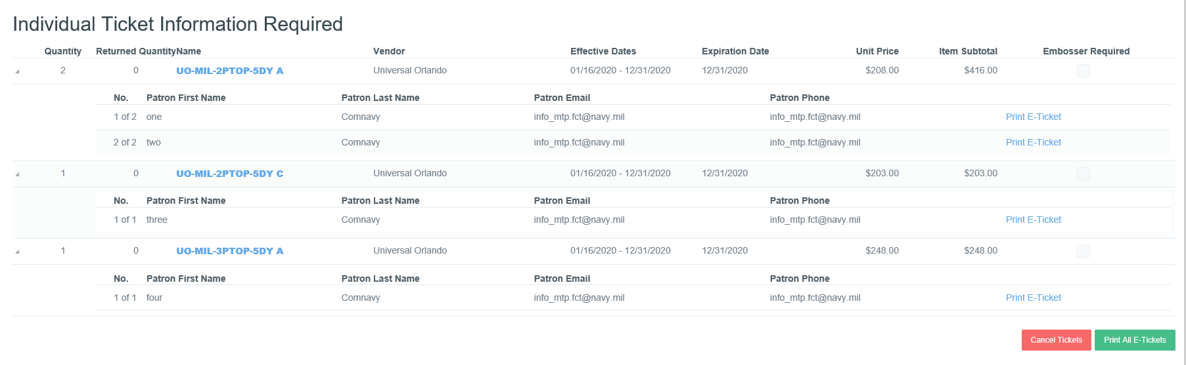
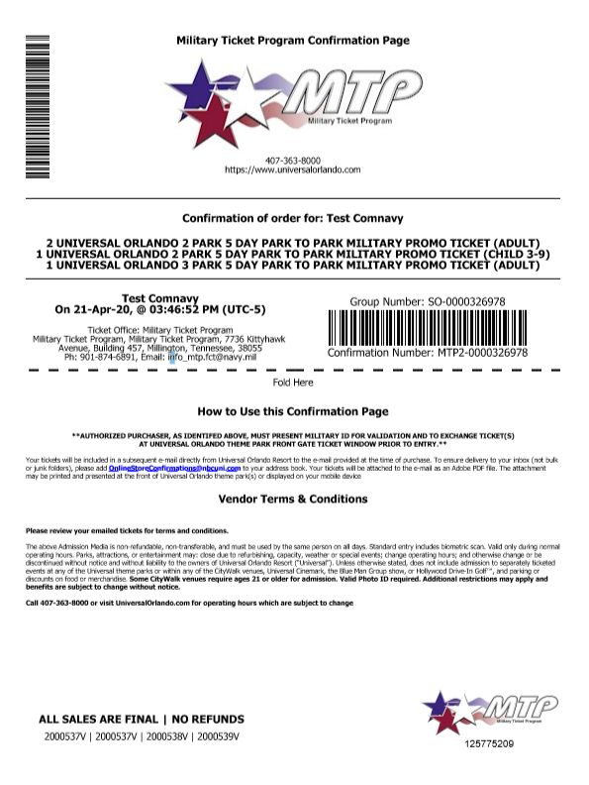
11
Step 11: Once the order is complete select “PRINT E-TiCKET” to generate your customer an order confirmation page
Step 12: hand confirmation page to your customer
*Remind them to retrieve their email with their tickets
Note: If a customer does not have their tickets UO customer service will be able to retrieve their order as long as the customers have their confirmation page and or can recall their phone number they used at the time of their order.
12
8

Slide 9
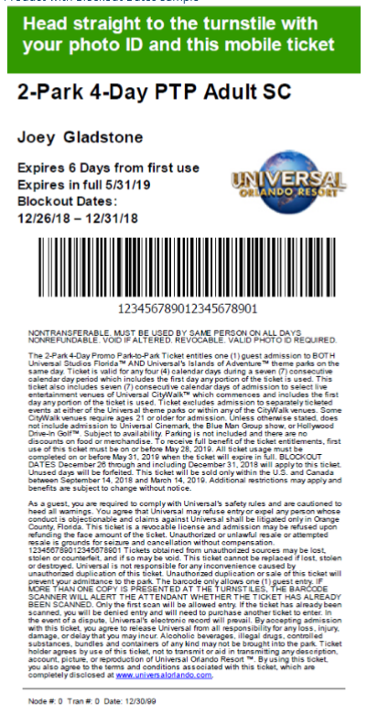
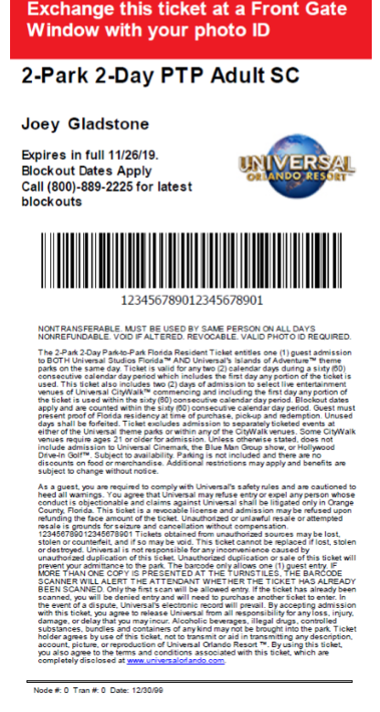
Universal Email and ticket sample's
EMAIL FROM: OnlineStoreConfirmations@nbcuni.com
9

Slide 10
Cancellation policies
The policy has not changed for the TMS system all tickets in the order must be cancelled in full.
TMS and UO API will not allow partial order cancellations.
MTP policy is that tickets are non-refundable, however in the event that a ticket has left your office and the customer refund is approved by your local policy you may process the cancellation in TMS. TMS will only allow authorized cancellations per the system allowances stated above. If you need assistance with a cancellation, contact MTP.
10

Slide 11
QUESTIONS??

