Slide 1

Universal Studios Hollywood Job Aide
One-Day Tiered Product and Pricing
12/20/2023

Slide 2
Universal Hollywood
Training Objectives:
One Day Ticket Changes
  Pricing Calendar
  Black-out dates
  Selling 1-Day tickets in TMS
12-Month Pass Price Change
General USH Guidance
Questions and Answers
.

Slide 3
Universal Hollywood
USH is offering 3 new 1-day tiered tickets:
Tickets must be used by 09/15/2024
Parking not included.
Ticket is non-transferable, non-refundable and non-exchangeable.
This ticket may not be altered, copied, transferred or resold.
Ticket cannot be combined with other offers, separately ticketed events, discounts, Halloween Horror Nights or sightseeing tours.
Tickets cannot be used on black-out dates
  ***SEE TMS and enouncement for full black-out date listings***
Price Code | Printed Description | RecTrac ID | Base Cost | Base Retail | Gate Price w/Tax | Customer Savings* | Start Selling Date | End Selling Date
2400423V | USH 1 DAY NON-PEAK | UHCAGAD3 | $103.55 | $109 | $159 | $50 | 12/21/23 | 09/15/24
2400424V | USH 1 DAY MID PEAK | UHCAGAD4 | $120.75 | $125 | $159 | $34 | 12/21/23 | 09/15/24
2400425V | USH 1 DAY PEAK | UHCAGAD5 | $130.25 | $135 | $159 | $24 | 12/21/23 | 09/15/24

Slide 4
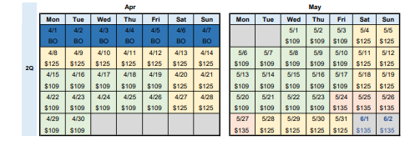
Universal Hollywood
Universal Hollywood – 1-day Calendar:
Calendar Key:
Green - $109 – Ticket Valid Use Dates
Yellow - $125 Ticket Valid Use Date
Orange - $135 Ticket Valid Use Dates
Blue – Black-out dates for all Military One-day products
1-Day USH Black-out date and price calendar will be sent in enouncement and posted in the TMS Support and Documentation
Note: Customers that purchase $135 dollar tickets can use the tickets on a lower priced date. For example, customer was planning on going to the park May 24th. But changes plans to go on May 31. They can use their tickets on the lower priced date.

Slide 5
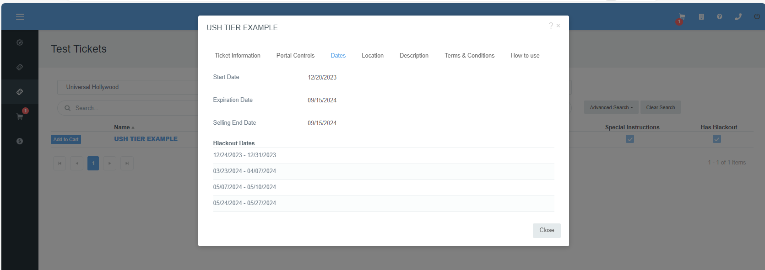
Universal Hollywood
TMS Black Out Dates:
Black-out dates have been added to TMS
Select ticket name to access all ticket details
In pop-up window select tab “Dates” to see all black- out dates
Can also look in the “Terms & Conditions” Tab, which prints on customer's ticket.

Slide 6
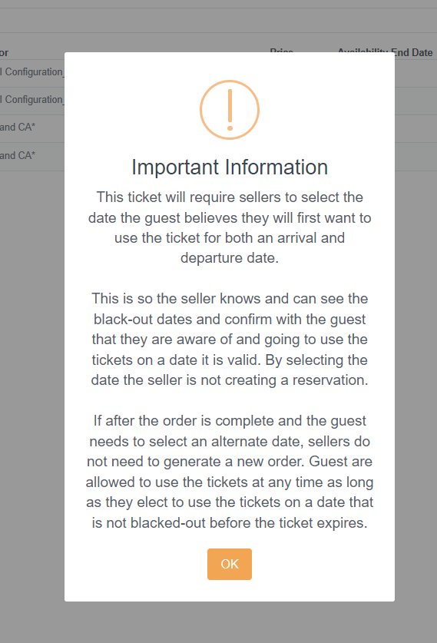
Universal Hollywood
TMS Add to Cart Prompt:
In the TMS Ticket Portal a New Cart Prompt has been added where you will choose a reservation date.
By Selecting the date, the seller is NOT creating a reservation
Use the same date for both the arrival and departure date
Customers can change dates.

Slide 7
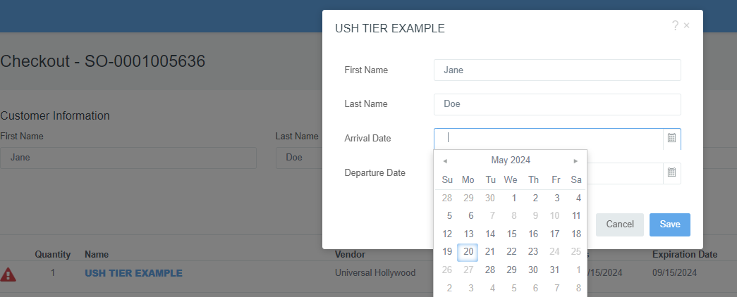
Universal Hollywood
TMS Add Arrival and Departure Dates:
Select the same date for the departure and arrival
Black-out dates are light grey and cannot be selected.
Save to proceed to check-out
Pro-Tip: If you have trouble seeing dates keyboard short cut: select “control and +” on key board to make objects on screen bigger.

Slide 8
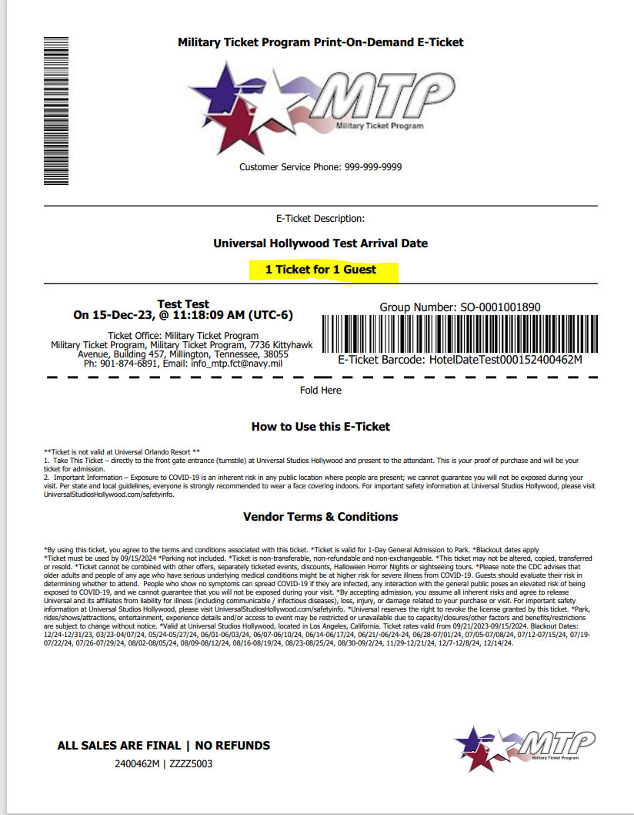
Universal Hollywood
TMS USH Ticket Sample:
Ticket media will not display the customers selected date
Tickets Expire and must be used by 9/15/2023
If the guest needs to select an alternate date after the order is completed, sellers do not need to generate a new order. Guest are allowed to use the tickets at any time as long as they redeem them on a valid usage date or prior to expiration.
If the guest wants to go on a date that is at a higher tiered price, the order will need to be cancelled and tickets re-issued.
Please note the cancellation policy for this vendor is not changing. Bases are required to submit Cancellation Request Forms for processing. If tickets have left the office, please be aware that credit is not guaranteed until MTP receives confirmation from the vendor that the tickets are cancelled and have not been used.

Slide 9
Universal Hollywood
USH is changing price on 12 month passes:
Please expire price code 2400057V on 12/20/23 (retrac id: UHCAGAD2 , base cost 187.07 / retail $199)
Pass is valid for 12 months from the guest's selected 1st visit date. 1st visit must occur on or prior to 09/15/2024.
Blackout dates apply on return visits. For blackout calendar, visit universalstudioshollywood.com/web/en/us/pass-members/black-out-calendars?calendar_name=DDB2
Price Code | Printed Description | RecTrac ID | Base Cost | Base Retail | Gate Price w/Tax | Customer Savings* | Start Selling Date | End Selling Date
2400426V exp: 2400057V | USH 12M SILVR PASS | UHCAGAD2 | $177.77 | $189 | $249 | $60 | 12/21/23 | 09/15/24

Slide 10
Universal Hollywood
Universal Hollywood FAQ :
Tickets are allowed to be gifted. Please use the guests name as the lead guest on the order.
Eligibility tickets may be purchased by anyone with access to MWR services
There are no Purchase limits
Please note the cancellation policy for this vendor is not changing. Bases are required to submit Cancellation Request Forms.
Coming Soon:
MTP is working with Universal Hollywood on a direct ticket integration into TMS.
We are projecting completion of this effort to be ready to launch in Late January to early February.
We will host trainings for this change once dates are available.
Changes will impact TMS

Slide 11
Universal Hollywood
QUESTIONS & DISCUSSIONS

