Slide 1

Universal Studios Hollywood
API Transition
&
MTP Calendar Update Job Aide
12/20/2023

Slide 2
Universal Hollywood
Training Objectives:
API Ticket Changes
  Selling 1-Day Tickets in TMS – dated & variable priced
  Selling 12 Month Passes
Ticket Delivery
General USH Guidance
Calendar updated for all API Capacity Managed Vendors
Questions and Answers
.

Slide 3
Universal Hollywood
USH is offering a 1-Day General Admission Dated Tickets:
Tickets must be used by the date selected at the time of booking
Parking not included.
Ticket is non-transferable, non-refundable and non-exchangeable.
This ticket may not be altered, copied, transferred or resold.
Ticket cannot be combined with other offers, separately ticketed events, discounts, Halloween Horror Nights or sightseeing tours.
Tickets can be cancelled by the ticket office.
Price Code | Printed Description | RecTrac ID | Base Cost | Base Retail | Gate Price w/Tax | Customer Savings* | Start Selling Date | End Selling Date
2400793V exp: 2400423V | USH 1 DAY GEN ADM1 | UHCAGAD6 | $103.55 | $109 | $159 | $50 | 3/18/24 | 09/15/24
2400792V exp: 2400424V | USH 1 DAY GEN ADM2 | UHCAGAD7 | $120.75 | $125 | $159 | $34 | 3/18/24 | 09/15/24
2400794V exp: 2400425V | USH 1 DAY GEN ADM3 | UHCAGAD8 | $130.25 | $135 | $159 | $24 | 3/18/24 | 09/15/24

Slide 4
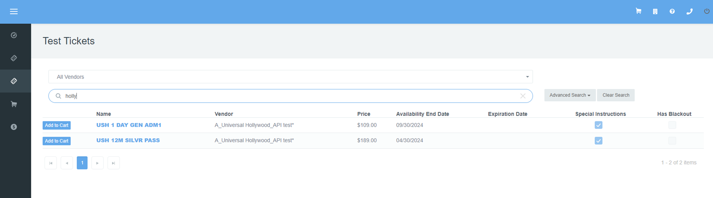
Universal Hollywood
TMS Add to Cart:
For variable priced tickets you will only see one ticket and the lowest available retail price.
Once the ticket information for the guest is loaded you will be required to select the date of use
Prices will vary by date of use; cart will update to price and date selected

Slide 5
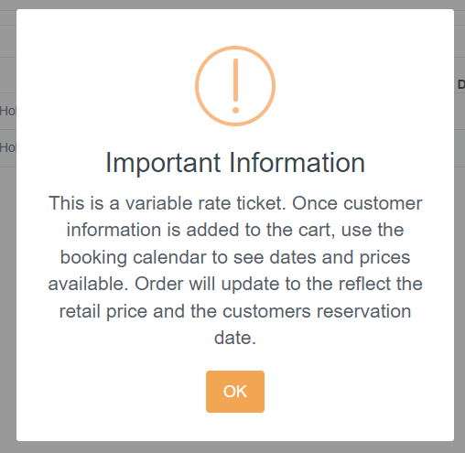
Universal Hollywood
TMS Add to Cart Prompt:
For variable priced tickets a New Cart Prompt has been added
Customer contact information including email is required
Reservation date will be required.
Cart will update with the date and price selected.
Customers cannot change dates on their own, must request change prior to reservation date, new tickets would need to be issued.

Slide 6
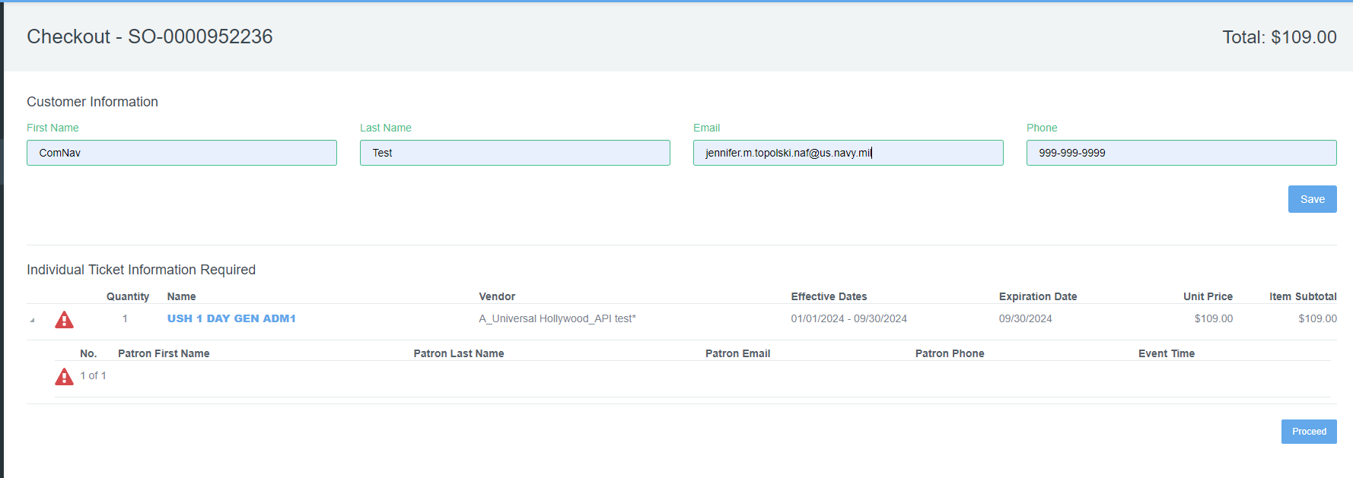
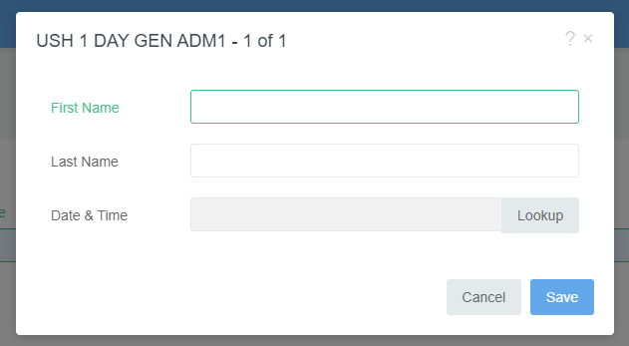
Universal Hollywood
TMS Add Customer Info:
Lead Guest Name REQUIRED for 1-day tickets
Customer Email is REQUIRED for all tickets
Sellers will select the alert icon
Select the “Lookup” button to access the new improved calendar
**PRO TIP: Double check customer email before processing orders. Have customer use an email that they can access on their phone and open the email before they leave the ticket office **

Slide 7
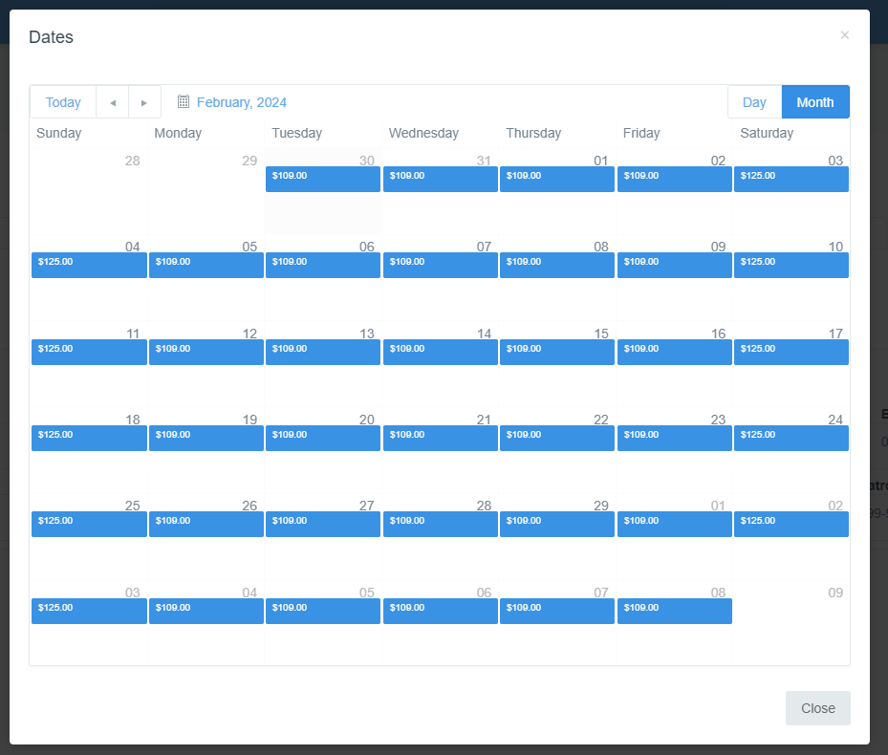
Universal Hollywood
NEW – Date Calendar:
New TMS Calendar will show date is available in BLUE ( If no blue date is not available)
Calendar shows the price for the dates available
Once a date is selected the cart will update to the retail price listed in the calendar
Select a date by mousing over and “Clicking the blue price block.

Slide 8
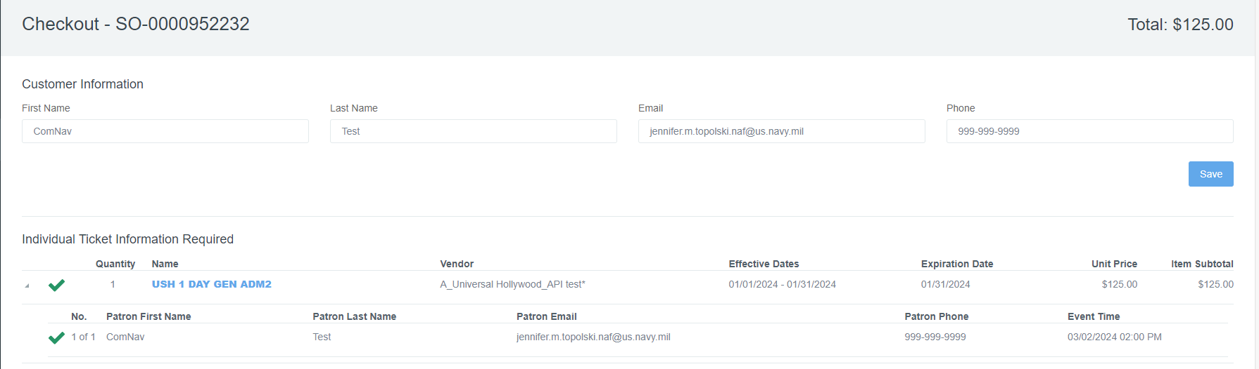
Universal Hollywood
Cart / Price Updates:
Cart will update the name of the ticket to reflect the date and price selected
Unit price will and subtotals will update
Event Time/Date will update

Slide 9
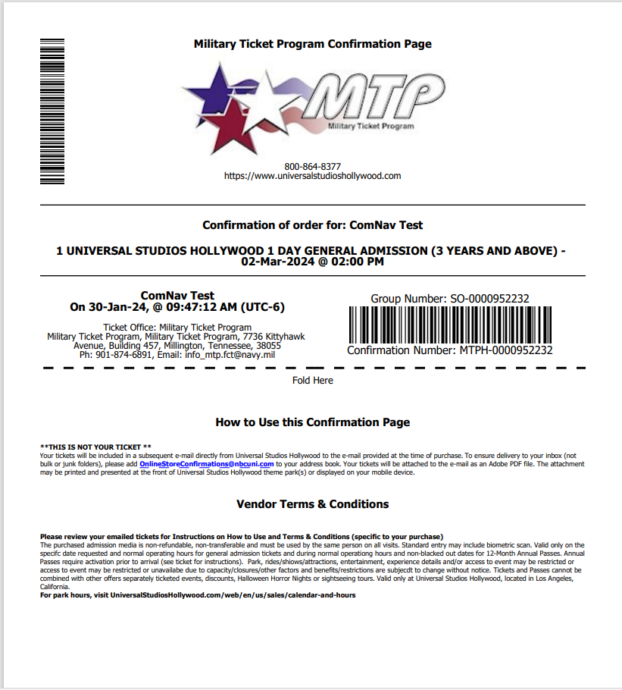
Universal Hollywood
TMS USH Order Confirmation Sample:
Confirmation will display the customers number of tickets, product and selected date
Tickets Expire and must be used by date printed on ticket and in customer’s email
If the guest needs to select an alternate date after the order is completed, sellers MUST cancel the original order and generate a new order. Partial cancellation is not allowed.
Guests will need to use the email provided at the time of booking to access their tickets. If you enter the wrong email cancel and reissue the order.
Cancellation policy, bases are allowed to cancel tickets on the API after they have left the ticket office. If the order will not cancel it TMS it may have been used. Please submit a cancellation request to MTP to verify before issuing refunds. Orders will be cancelled in full no partial cancellations or refunds are allowed.

Slide 10
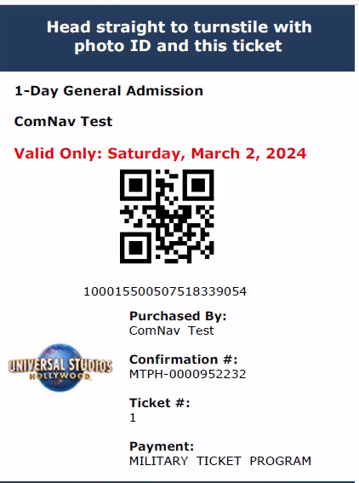
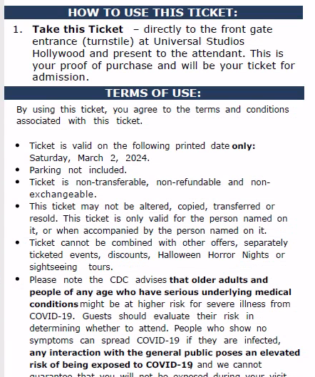
Universal Hollywood

Slide 11
Universal Hollywood
USH API 12 month passes:
Pass is valid for 12 months from the guest's selected 1st visit date. 1st visit must occur on or prior to 09/15/2024.
Blackout dates apply on return visits. For blackout calendar, visit universalstudioshollywood.com/web/en/us/pass-members/black-out-calendars?calendar_name=DDB2
Tickets cannot be cancelled in TMS. Installations must submit a cancellation request form.
Price Code | Printed Description | RecTrac ID | Base Cost | Base Retail | Gate Price w/Tax | Customer Savings* | Start Selling Date | End Selling Date
2400796V exp: 2400426V | USH 12M SILVR PASS | UHCAGAD2 | $177.77 | $189 | $249 | $60 | 3/18/24 | 09/15/24

Slide 12
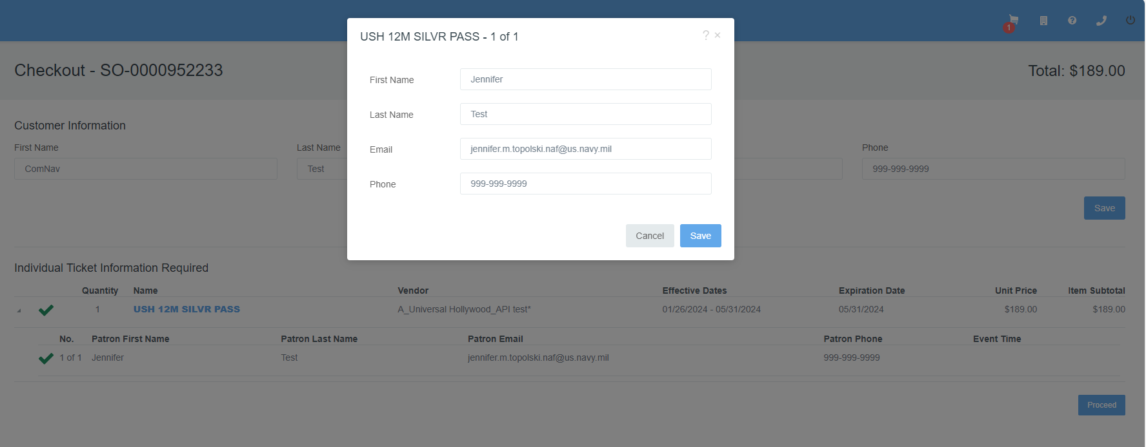
Universal Hollywood
TMS Add Customer Info:
Customer Email is REQUIRED for all tickets
Sellers will select the alert icon
Individual NAME is REQUIRED for each pass

Slide 13
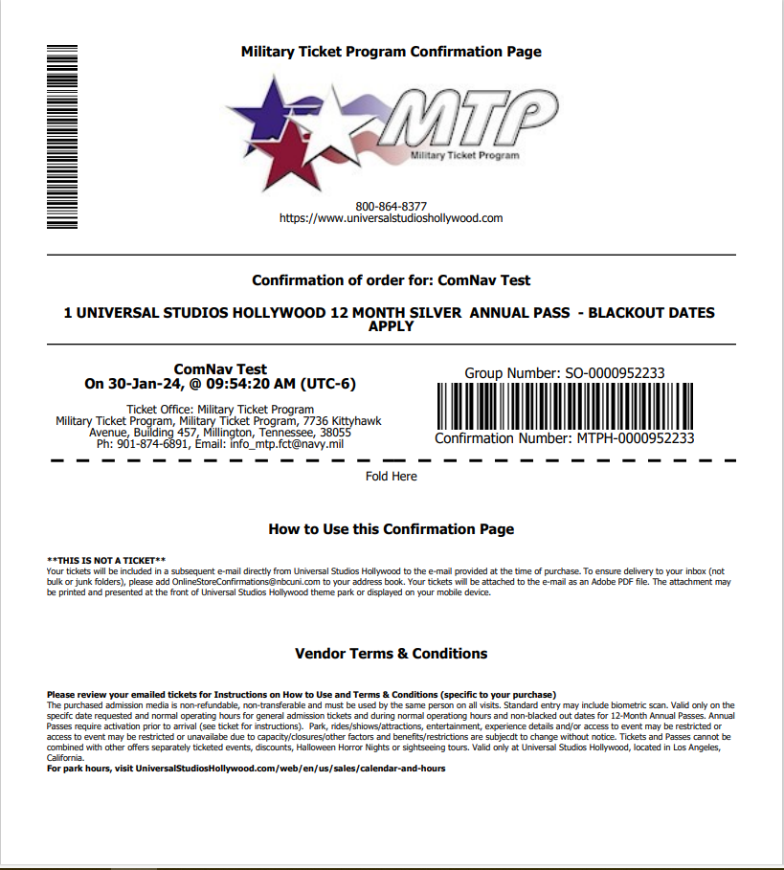
Universal Hollywood
TMS USH Order Confirmation Sample:
Confirmation will display the customers number of tickets, product and selected date
Tickets Expire and must be used by date in customer's email currently that date is 9/15/2024.
If the guest’s names are spelled slightly wrong the tickets do not have to be issued guest will correct the names when they activate the pass.
Guests will need to use the email provided at the time of booking to access their tickets. If you enter the wrong email cancel and reissue the order.
Cancellation policy, bases are NOT allowed to cancel tickets on the API. Please submit a cancellation request to MTP to verify before issuing refunds. Orders will be cancelled in full no partial cancellations or refunds are allowed.

Slide 14
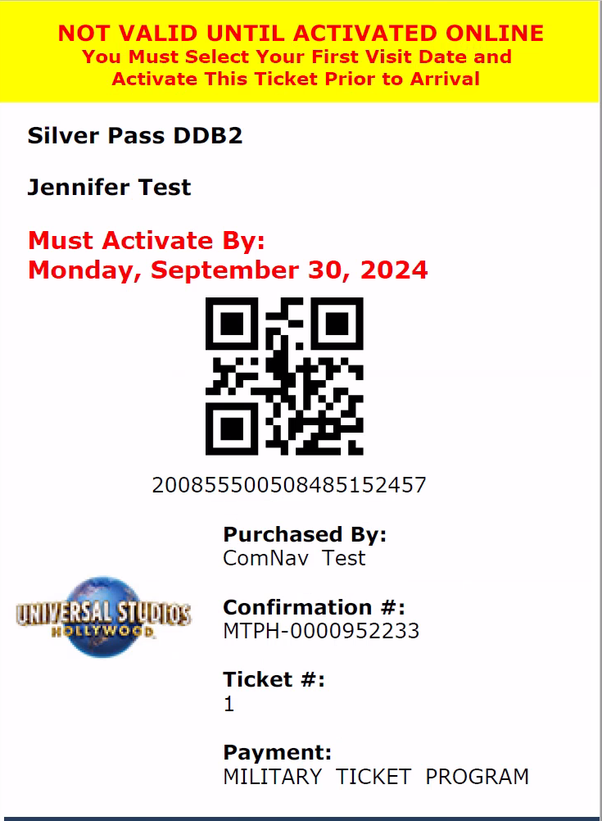
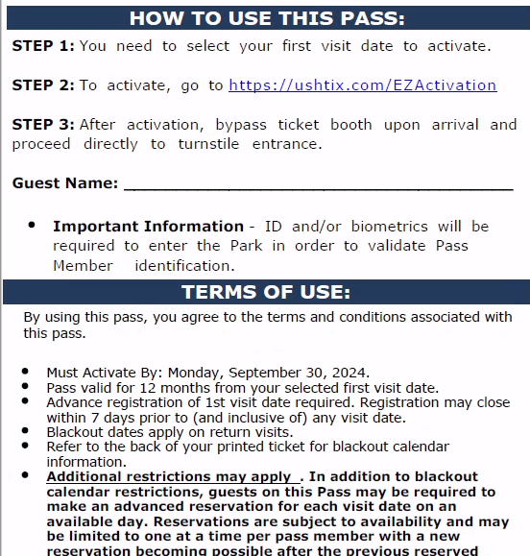
Universal Hollywood

Slide 15
Universal Hollywood
Universal Hollywood FAQ :
Tickets are allowed to be gifted. Please use the guests name as the lead guest on the order.
Eligibility tickets may be purchased by anyone with access to MWR services
There are no Purchase limits
Please note the cancellation policy for this vendor is changing. Bases are allowed to cancel non-PASS tickets, PASS ticket cancellations are not allowed. For NON-PASS tickets even if they have left the office the API will validate usage before allowing a cancellation. If a cancellation is attempted the tickets may have been used or modified. Bases may submit Cancellation Request Forms if they believe an order should be cancelled by it is being denied by TMS.
PROTIP: Always have a guest provide an email they can access on their mobile device, guest check and confirm receipt of their tickets before they leave the ticket office.

Slide 16
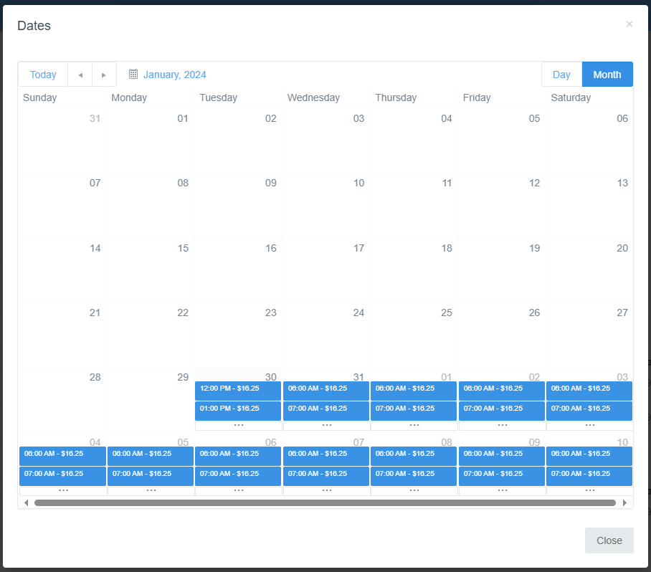
Calendar Updates all API Vendors
All API Vendors with Reservation Date calendar is updating
If date only you will see blue dates and prices available
If date and time you will see blue date & times and can click expand button for more times
If no blue box date and time is not available.

Slide 17
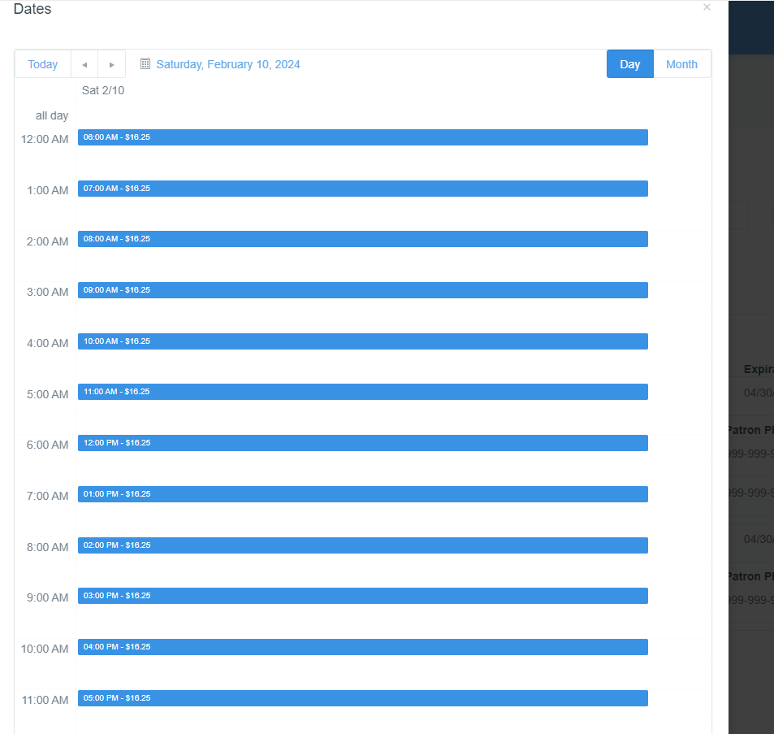
Calendar Updates all API Vendors
Here is the expanded time listing
If no blue line appears a time is not available
Double click the time the customer wants to and the cart will update with the selection.
If customer wants a different date, select the month get back to the main calendar screen

Slide 18
Universal Hollywood
QUESTIONS & DISCUSSIONS

