Slide 1

Universal Orlando
Halloween Horror Nights 2024
How to Sell
Variable Priced Dated Tickets in TMS
7/9/2024

Slide 2
Universal Orlando - HHN
Training Objectives:
2024 Universal Orlando HHN Tickets
Selling Variable Priced Dated Tickets
Date & Price Review before Completing Sale
Ticket Delivery
General Guidance
Questions and Answers
.

Slide 3
Universal Orlando - HHN
Universal Orlando HHN Tickets:
Tickets must be used on the date selected at the time of booking
Parking not included.
Ticket is non-transferable, non-refundable and non-exchangeable.
This ticket may not be altered, copied, transferred or resold.
Tickets can be cancelled by the ticket office.
Price Code | Printed Description | RecTrac ID | Base Cost | Base Retail | Gate Price w/Tax | Customer Savings* | Start Selling Date | End Selling Date
Price Code | Printed Description | RecTrac ID | Base Cost | Base Retail | Gate Price w/Tax | Customer Savings* | Start Selling Date | End Selling Date
2401904V | UO-HHN 2024 T01 | UOERHH01 | $71.48 | $76.75 | $149.08 | $72.33 | 07/25/24 | 11/03/24
2401905V | UO-HHN 2024 T02 | UOERHH02 | $74.27 | $79.75 | $149.08 | $69.33 | 07/25/24 | 11/03/24
2401906V | UO-HHN 2024 T03 | UOERHH03 | $75.20 | $80.75 | $149.08 | $68.33 | 07/25/24 | 11/02/24
2401966V | UO-HHN 2024 T04 | UOERHH04 | $77.06 | $82.75 | $149.08 | $66.33 | 07/25/24 | 11/03/24
2401967V | UO-HHN 2024 T05 | UOERHH05 | $79.84 | $85.75 | $149.08 | $63.33 | 07/25/24 | 11/03/24
2401968V | UO-HHN 2024 T06 | UOERHH06 | $81.70 | $87.75 | $149.08 | $61.33 | 07/25/24 | 11/03/24

Slide 4
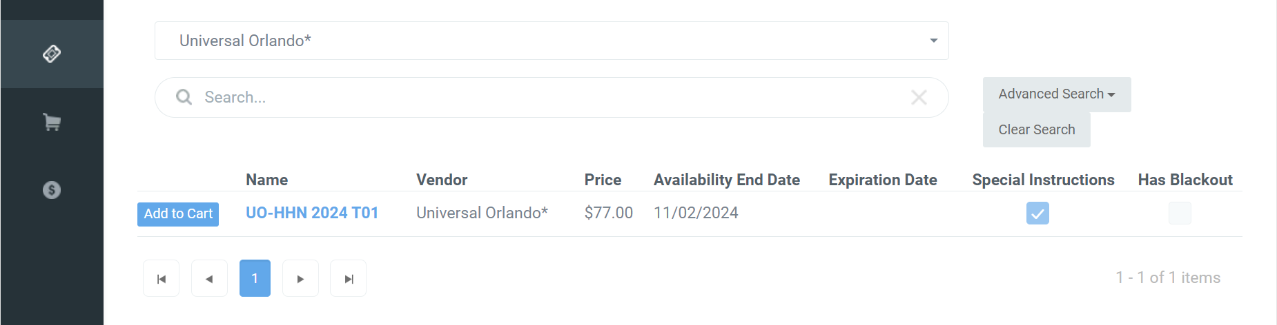
Universal Orlando - HHN
TMS Add to Cart:
For variable priced tickets you will only see ONE product listed and the lowest available retail price – this may not be the final cost of the tickets, clerks will need to select the customers date of travel first to get the final cost.
Once the ticket information for the guest is loaded you will be required to select the date of use
Prices will vary by date of use; cart will update to price and date selected
  We have several bases that have clerks look up the ticket in the POS before finalizing the order in TMS. Please note they will need to make sure to look up the price and ring in the sale after the date is selected and the price and the ticket price is confirmed.

Slide 5
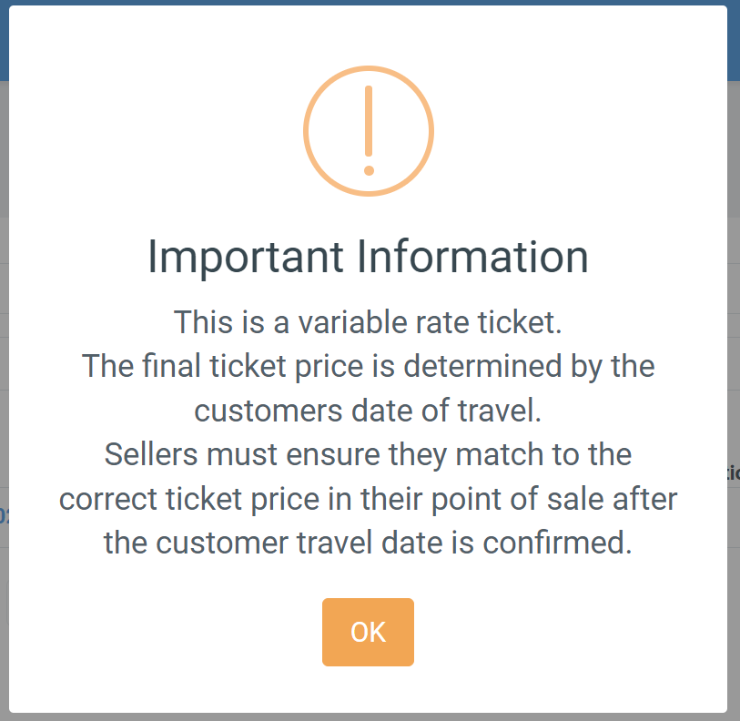
Universal Orlando - HHN
TMS Add to Cart Prompt:
For variable priced tickets a Cart Prompt has been added
Customer contact information including email is required
Reservation date will be required.
Cart will update with the date and price selected.
Customers cannot change dates on their own, must request change prior to reservation date, new tickets would need to be issued.

Slide 6
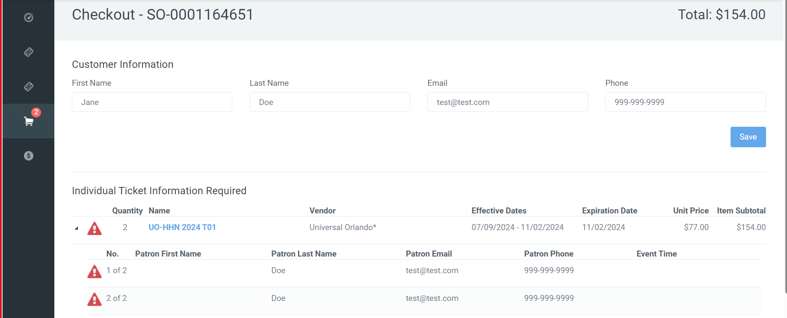
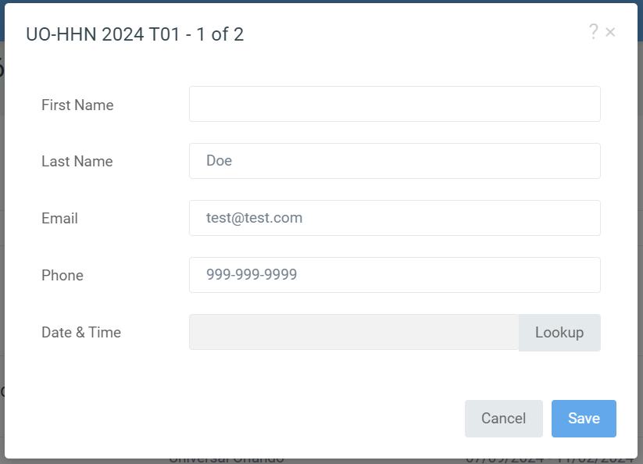
Universal Orlando - HHN
TMS Add Customer Info:
Lead Guest Name REQUIRED for HHN tickets
Customer Email is REQUIRED for all tickets
Sellers will select the alert icon
Seller Input each guests first name is REQUIRED
Select the “Lookup” button to access the new improved calendar
**PRO TIP: Double check customer email before processing orders. Have customer use an email that they can access on their phone and open the email before they leave the ticket office **

Slide 7
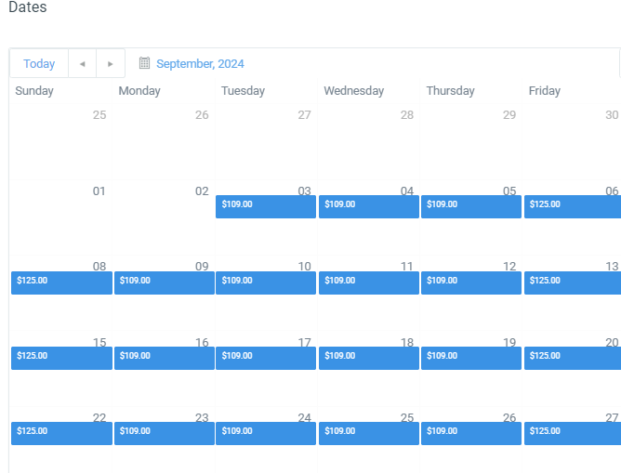
Universal Orlando - HHN
Date Calendar:
TMS Calendar will show date is available in BLUE ( If no blue date is not available)
Calendar shows the price for the dates available
Once a date is selected the cart will update to the retail price listed in the calendar
Select a date by mousing over and “Clicking the blue price block.

Slide 8
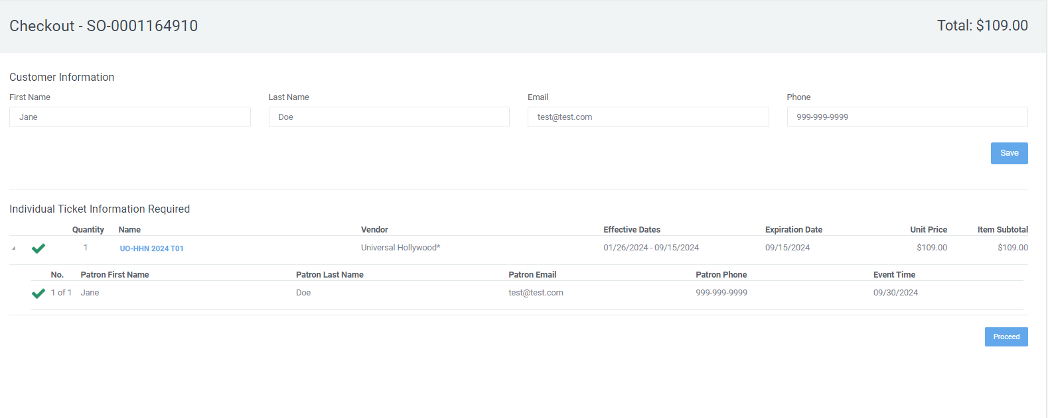
Universal Orlando - HHN
0
Cart / Price Updates:
Cart will update the name of the ticket to reflect the date and price selected
Unit price and subtotals will update
Event Time/Date will update once a date is selected on the calendar

Slide 9
Universal Orlando - HHN
CLERKS NEED TO MAKE SURE THEY SELECT THE CORRECT PRICE IN THEIR POS –
  IF you use the MTP suggested Retail the price in TMS should match the price in your POS
  IF you use the Ticket “NAME” MTP provided the name should also match

Slide 10
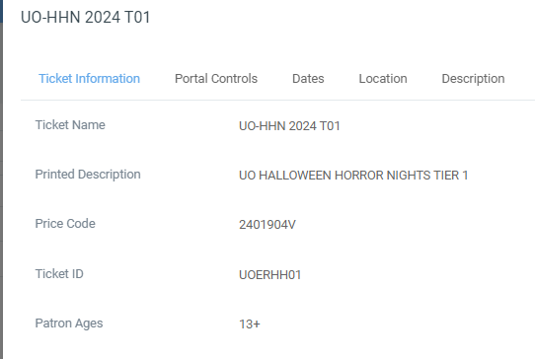
Universal Orlando - HHN
CLERKS NEED TO MAKE SURE THEY SELECT THE CORRECT PRICE IN THEIR POS –
  IF you use our price codes and Rectrac ID you can use the ticket name once the date is selected to verify it in your POS.

Slide 11
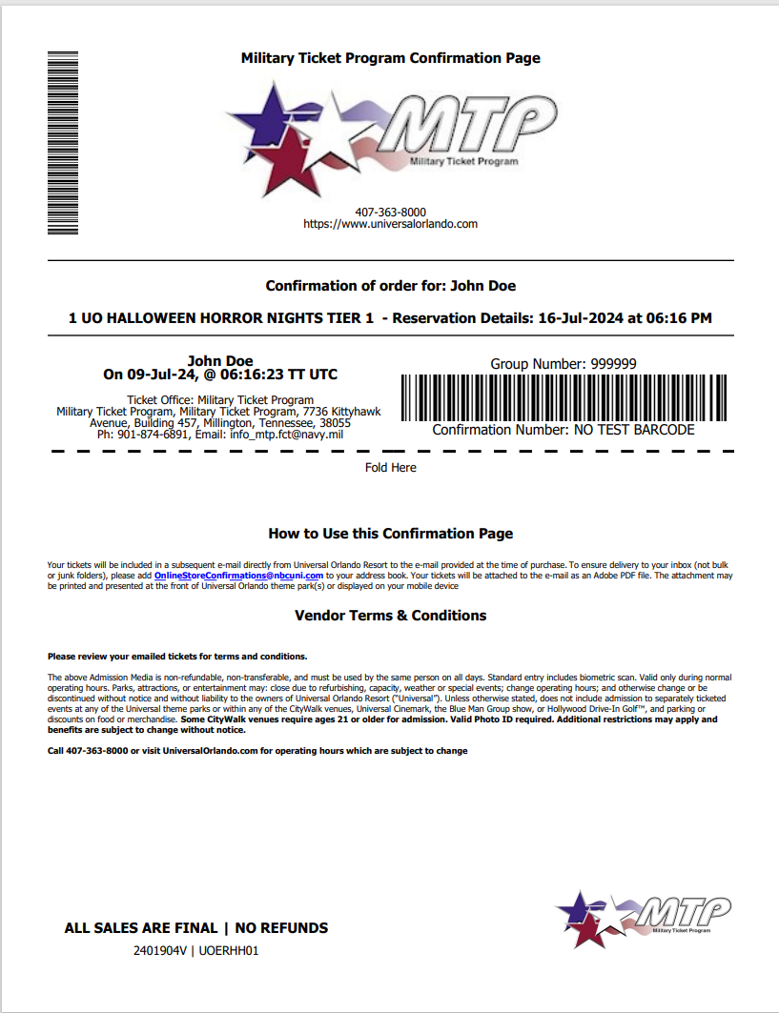
Universal Orlando - HHN
TMS Order Confirmation Sample:
Confirmation will display the customers number of tickets, product and selected date
Tickets Expire and must be used by date printed on ticket and in customer’s email
If the guest needs to select an alternate date after the order is completed, sellers MUST cancel the original order and generate a new order. Partial cancellation is not allowed.
Guests will need to use the email provided at the time of booking to access their tickets. If you enter the wrong email cancel and reissue the order.
Cancellation policy, bases are allowed to cancel tickets on the API after they have left the ticket office. If the order will not cancel it TMS it may have been used. Please submit a cancellation request to MTP to verify before issuing refunds. Orders will be cancelled in full no partial cancellations or refunds are allowed.
Note: The order confirmation page will have the RecTrac ID and Price Code on them on the bottom left side. Clerk can use this to match to the POS if needed.

Slide 12
Universal Orlando - HHN
Universal Orlando FAQ :
Tickets are allowed to be gifted. Please use the guests name as the lead guest on the order.
Eligibility tickets may be purchased by anyone with access to MWR services
There is a Purchase limits of 10 tickets per customer
If guests wish to go to more than one-night TMS limits order to on reservation date per order. Clerks will need to create an additional order for additional dates.
Please note the cancellation policy for these tickets are that the guest may cancel only in advance of their reservation date. Bases can cancel orders in the API, no partial cancellations are allowed.
PROTIP: Always have a guest provide an email they can access on their mobile device, guest check and confirm receipt of their tickets before they leave the ticket office.

Slide 13
Universal Orlando - HHN
QUESTIONS & DISCUSSIONS

