Slide 1

Universal Orlando
Transition to Dated Tickets
Job Aide:
How to Sell
Static Priced Dated Tickets in TMS
7/9/2024

Slide 2
Universal Orlando – Dated Tickets
Training Objectives:
Universal Orlando Transition to Dated Tickets
Selling Dated Tickets
Date Review before Completing Sale
Ticket Delivery
General Guidance
Questions and Answers
.

Slide 3
Universal Orlando – Dated Tickets
Universal Orlando Tickets Transitioning to Dated Admission:
Starting on August 8th
Impacts: Regular Admission and Florida Resident Tickets
Price change enouncement sent Friday, August 2nd
Tickets will also change to date-based admission
Guests Arrival date will be required
One arrival date per ticket type
Ticket prices will be static

Slide 4
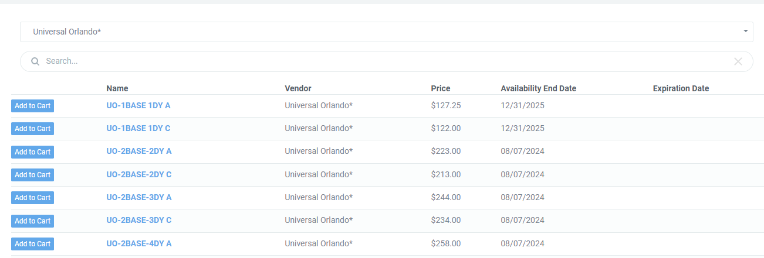
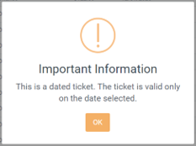
Universal Orlando – Dated Tickets
TMS Add to Cart Prompt:
For dated tickets a Cart Prompt has been added
Customer contact information including email is required
Arrival date will be required.
Customers cannot change dates on their own, must request change prior to reservation date, new tickets would need to be issued.

Slide 5
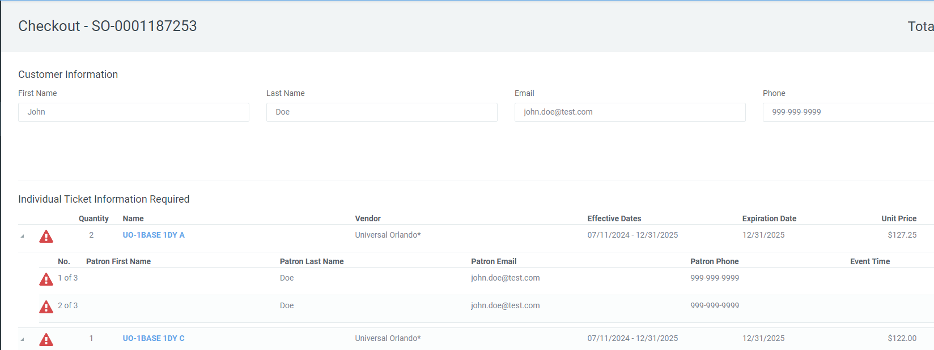
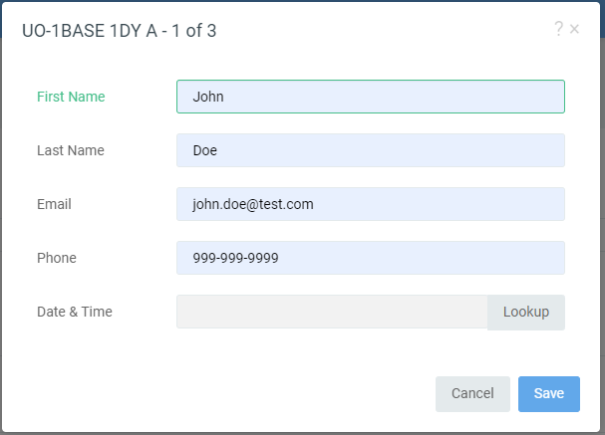
Universal Orlando – Dated Tickets
TMS Add Customer Info:
Lead Guest Name REQUIRED for ALL tickets
Customer Email is REQUIRED for all tickets
Sellers will select the alert icon
Seller Input each guests first name is REQUIRED
Select the “Lookup” button to access the new improved calendar
**PRO TIP: Double check customer email before processing orders. Have customer use an email that they can access on their phone and open the email before they leave the ticket office **

Slide 6
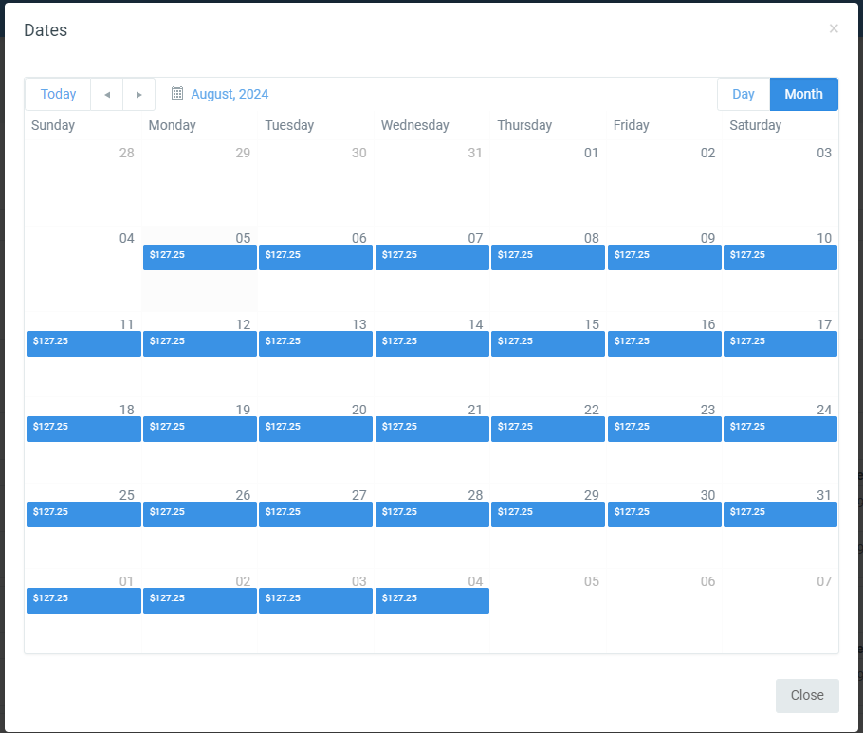
Universal Orlando – Dated Tickets
Date Calendar:
TMS Calendar will show date is available in BLUE ( If no blue date is not available)
Select the guest's arrival date by double clicking on the blue price box.
Once a date is selected the cart will update to show the arrival date selected
NOTE: One arrival date is allowed per ticket type. For Example:
UO-1Base 1DY A – clerk will be prompted to select one arrival date for all adults
In the same order you also have UO-1Base 1DY C – clerk will be prompted to select a separate arrival date for all children
****Be certain to select the same date for each ticket type and confirm dates are correct ****

Slide 7
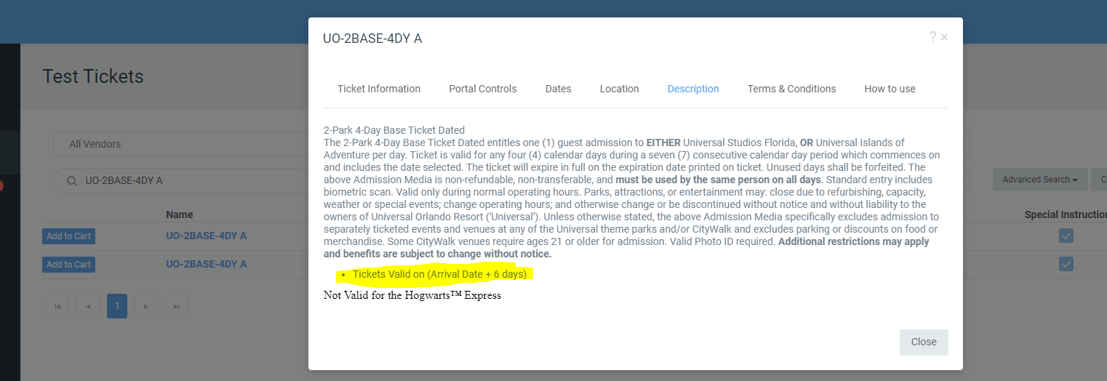
Universal Orlando – Dated Tickets
Selling Tip Review VALID USAGE DATES WITH GUEST
  ALL Tickets Valid Dates will depend upon the number of days of visit.
  In Ticket Portal Click on the ticket name and then description to review.

Slide 8
Universal Orlando – Dated Tickets
VALID DATES BREAKDOWN
ALL Tickets Valid Dates will depend upon the number of days of visit.
For Example: UO-3Base-3DY ticket Arrival ate: 8/9/24 then expiration date would be 8/14/24
1- Day Ticket Dated:
  Arrival Date
2-Day Ticket Dated:
  Arrival Date + 4 days
3-Day Ticket Dated:
  Arrival Date + 5 days
4-Day Ticket Dated:
  Arrival Date + 6 days
5-Day Ticket Dated:
  Arrival Date + 7 days

Slide 9
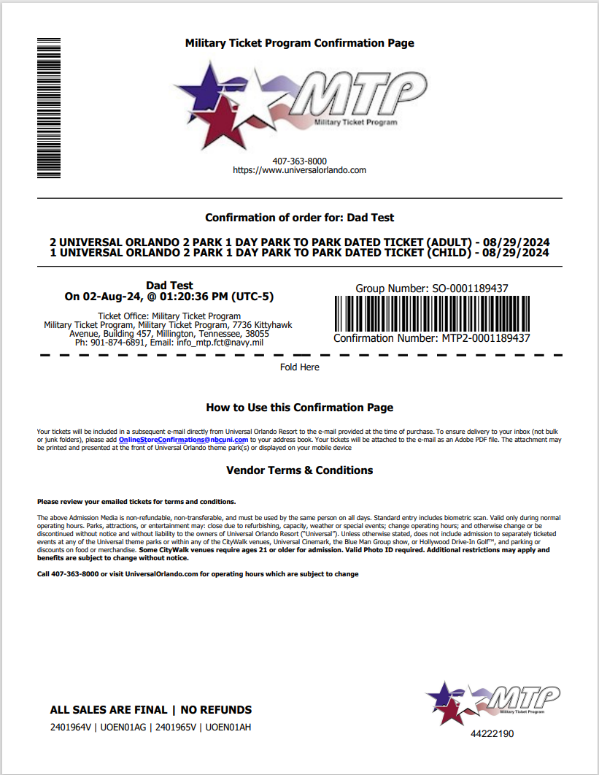
Universal Orlando – Dated Tickets
TMS Order Confirmation Sample:
Confirmation will display the customers number of tickets, product and selected date
Tickets Expire and must be used by date printed on ticket and in customer’s email
If the guest needs to select an alternate date after the order is completed, sellers MUST cancel the original order and generate a new order. Partial cancellation is not allowed.
Guests will need to use the email provided at the time of booking to access their tickets. If you enter the wrong email cancel and reissue the order.
Cancellation policy, bases are allowed to cancel tickets on the API after they have left the ticket office. If the order will not cancel it TMS it may have been used. Please submit a cancellation request to MTP to verify before issuing refunds. Orders will be cancelled in full no partial cancellations or refunds are allowed.

Slide 10
Universal Orlando – Dated Tickets
Universal Orlando FAQ :
Tickets are allowed to be gifted. Please use the guests name as the lead guest on the order.
Eligibility tickets may be purchased by anyone with access to MWR services
If guests wish to go to more than one-day TMS limits order to on reservation date per order. Clerks will need to create an additional order for additional dates.
Please note the cancellation policy for these tickets are that the guest may cancel only in advance of their arrival date. Bases can cancel orders in the API, no partial cancellations are allowed.
PROTIP: Always have a guest provide an email they can access on their mobile device, guest check and confirm receipt of their tickets before they leave the ticket office.
If the guest is already in Orlando and cannot go on the date they had selected and have already uploaded their tickets to their UO app, they can modify their arrival date within the app.

Slide 11
Universal Orlando – Dated Tickets
QUESTIONS & DISCUSSIONS

