Slide 1








SeaWorld Entertainment
API Transition
&
Job Aide
07/23/2024

Slide 2
SeaWorld Entertainment
Training Objectives:
API Transition Dates
SeaWorld Parks and Ticket Types
  Selling Tickets and Passes
  Selling Reservation (Discovery Cove)
  Ticket Example & Cancellation Info
  Reservation Confirmation Example & Cancellation Info
General SeaWorld Guidance
Questions and Answers

Slide 3
SeaWorld Entertainment
MTP is pleased to announce that SeaWorld is now integrated into the TMS application. This means that all sellers with access to the TMS ticket portal will be able to sell Tickets to SeaWorld Parks.
Important Transition Dates:
July 23, 2024 – MTP will send out Enouncement – Prices are not changing but tickets will all be assigned new price codes.
July 31, 2024 - Will be the last day to sell and cancel tickets in EZ Site.
August 1, 2024 -ALL SeaWorld Park tickets will be available for ticket sellers to generate orders in the TMS Ticket Portal.
October 31, 2024 - Access to run end of month reports will be removed -please make sure all your EZ sales are reconciled before this date.
.

Slide 4
SeaWorld Entertainment
For those that sellers that are not currently using EZ site there are several parks and ticket options available.
Parks:
Sesame Place Pennsylvania - (SESAME PA)
Sesame Place San Diego - (SESAME SD)
SeaWorld San Diego - (SWSD)
SeaWorld San Antonio – (SWSA)
SeaWorld Orlando – (SWO)
Busch Gardens Tampa FL - ( BGT)
Busch Gardens Williamsburg VA – (BGW)
Adventure Islands, Tampa (ADVENTRISLND)
Aquatica Orlando (AQ or AQO)
Water Country USA, Williamsburg VA (WC)
Discovery Cove, Orlando FL – (DCOVE)
* The TMS naming abbreviated conventions are in parenthesis
.

Slide 5
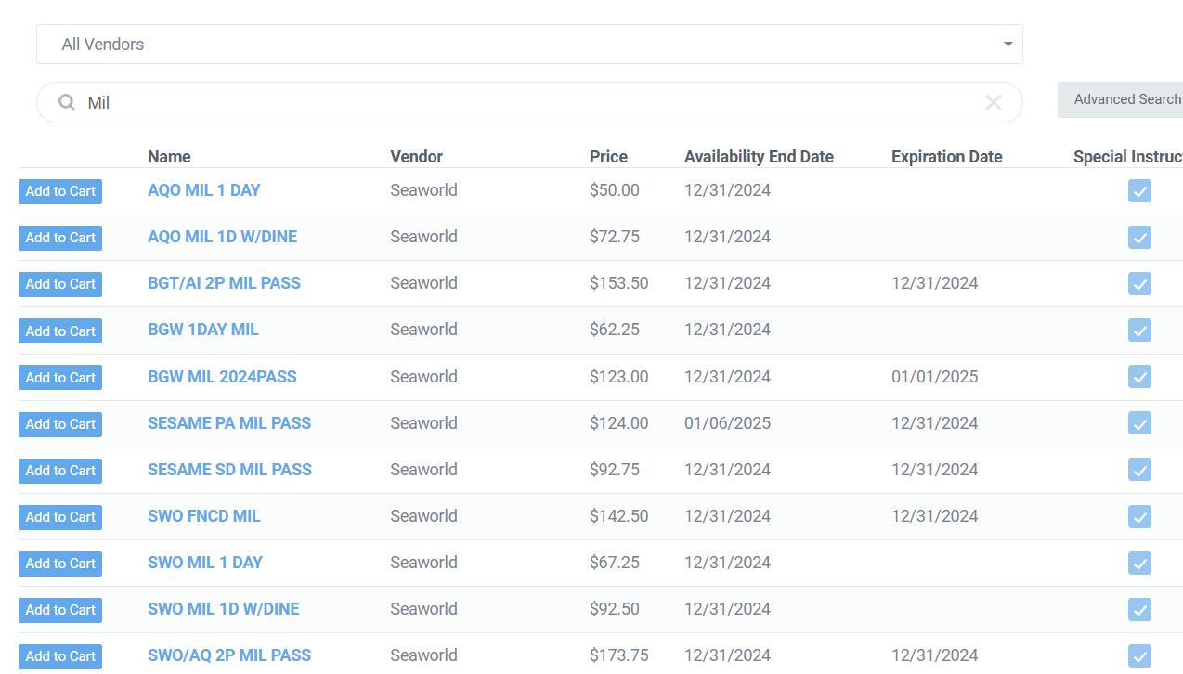
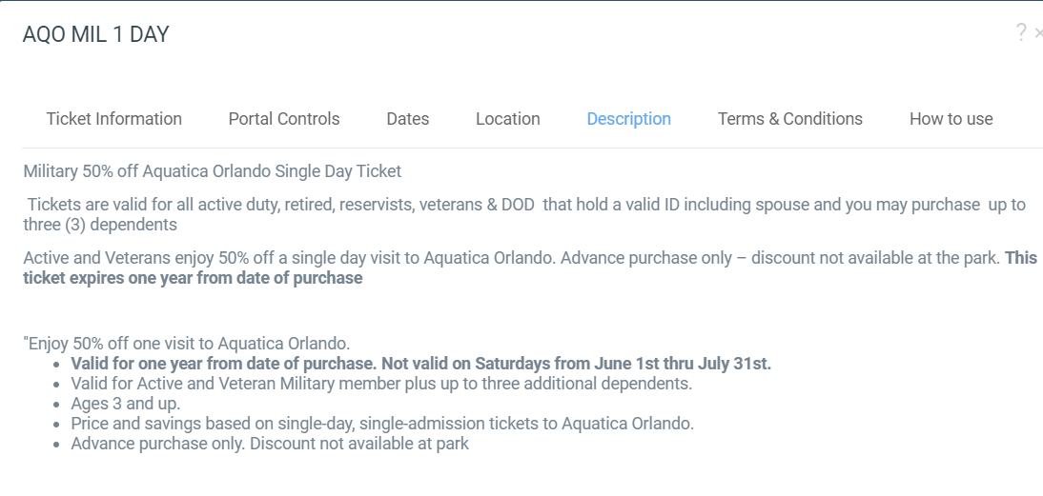
SeaWorld Entertainment
Familiarize yourself with products in TMS
Select the Ticket Name and review the description for more details
SeaWorld will host a training early September on parks. Details to come.
Miliary Special Tickets
Several Tickets will have “MIL” in their name
These tickets have restriction on which patrons can purchase and how many they are authorized.
The ticket description will outline eligibility.
.

Slide 6
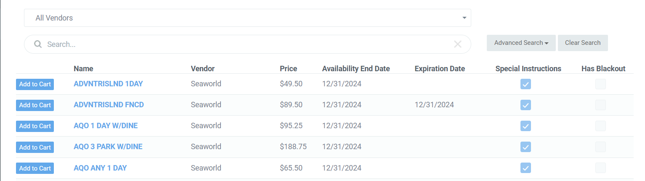
SeaWorld Entertainment
SeaWorld has Three Ticket Types:
Regular admission – Lead Guest /Customer Name is recommended.
Passes – Lead Guest/Customer Name and Individual names for each ticket are required.
Reservation – Lead Guest/Customer Name, Individual names for each guest, and reservation date required (Discovery Cove).
Notes:
Examples ; Some say :
*Active and Veteran Military Members
Active Duty
Active Duty, Retired, Veterans, and DOD.

Slide 7
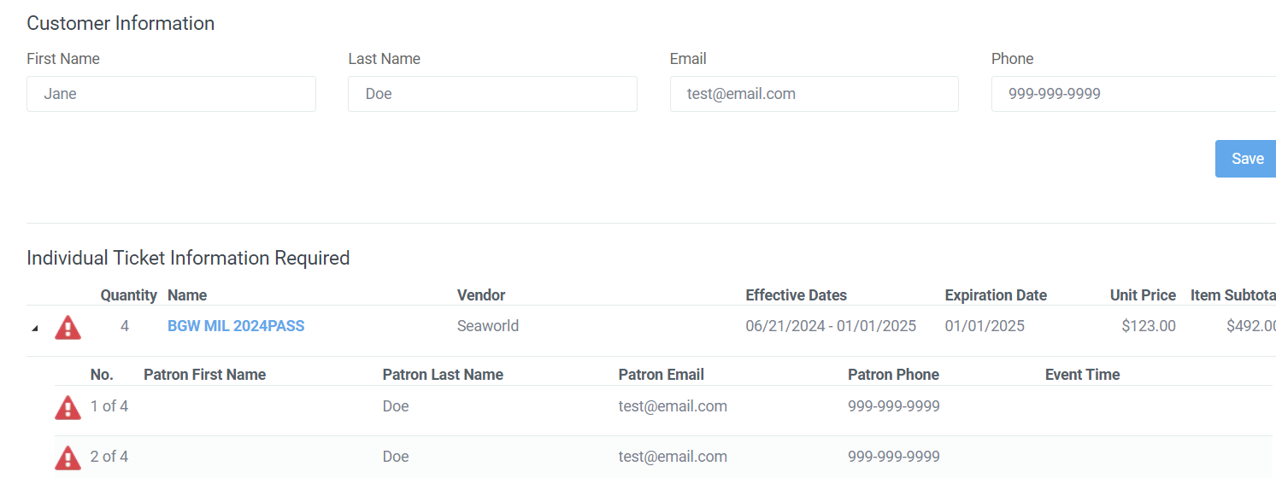
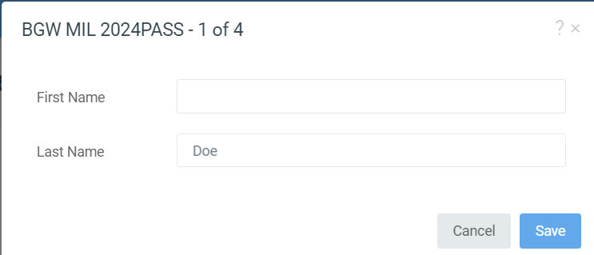

SeaWorld Entertainment
SeaWorld Cart Prompts for Passes:
Once tickets are added to the cart seller will be prompted by the click icon for each pass to add individual pass names to the order before it can be completed.

Slide 8
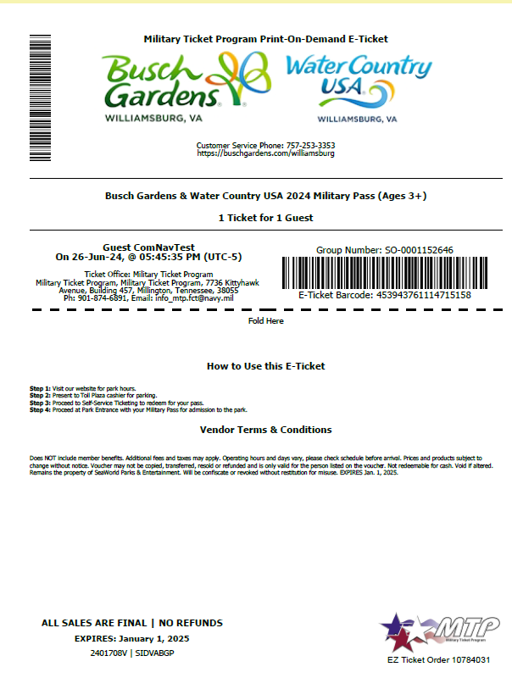
SeaWorld Entertainment
Ticket and Pass Sample:
Individual Tickets will be generated for each guest
Tickets have varying expirations dates. Some will have a set date and it will be displayed on the ticket. Some will expire in six months, or a year from the date of purchase.
Review the terms and conditions with the guest to confirm the expiration date. All tickets will expire.
Cancellation policy, bases are allowed to cancel tickets on the API after they have left the ticket office.
Partial cancellations are not allowed.
Cancellations are not allowed after the expiration date, or the price expires.
If the order will not cancel or you need to request a partial cancellation you must submit a cancellation request directly to MTP.

Slide 9
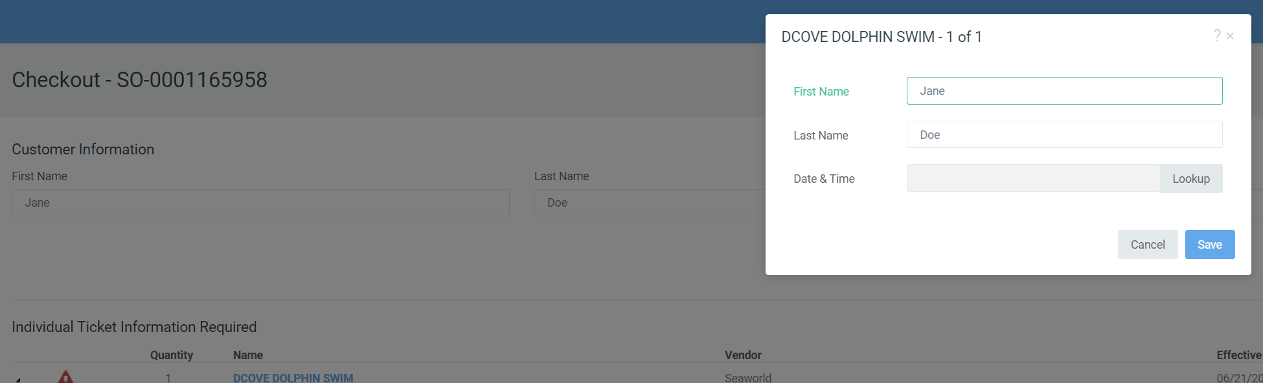
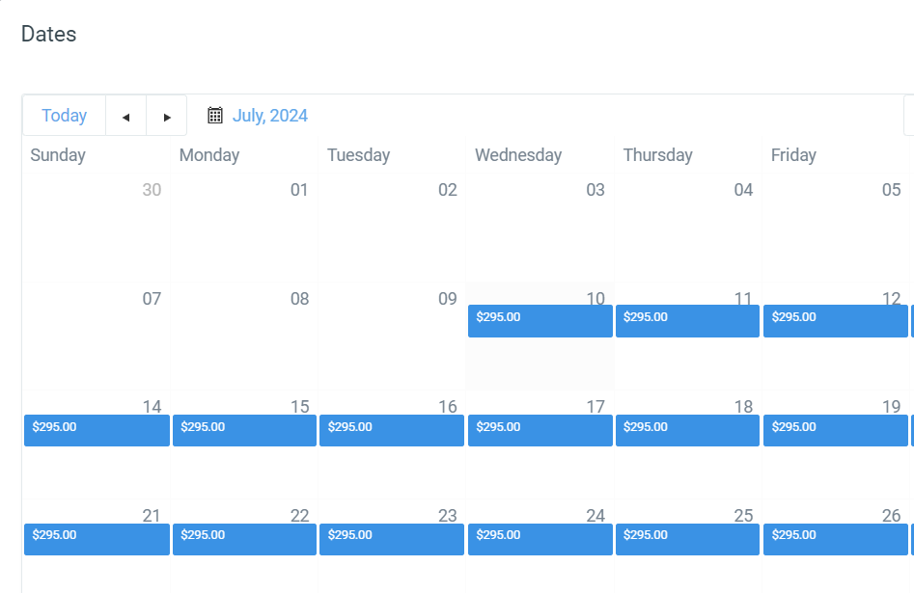
SeaWorld Entertainment
SeaWorld Cart Prompts for Reservations:
Once tickets are added to the cart seller will be prompted by the click icon for each pass to add individual pass names and dates before the order can be completed.
In the prompt pop-up screen, select the loop-up button to access the calendar.
To select the date double click on the blue date box, with the left mouse button.

Slide 10
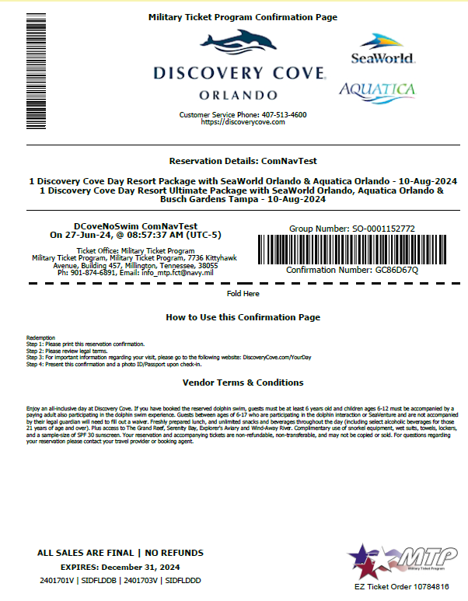
SeaWorld Entertainment
Reservation Tickets Sample:
Confirmation will display the customers number of tickets, product and selected date
Tickets Expire and must be used by the date printed on ticket.
If the guest needs to select an alternate date after the order is completed, sellers MUST cancel the original order and generate a new order. Partial cancellation is not allowed.
Packages will include the park tickets that are part of the reservation these cannot be cancelled. Make sure guest gets both confirmation page and tickets.
Cancellation policy, bases are allowed to cancel tickets on the API after they have left the ticket office. Reservation tickets cannot be cancelled within 7 days of the date of reservation. Bases should call the park to modify the reservation. Notify MTP if it is cancelled through the park.

Slide 11
SeaWorld Entertainment
FAQ :
Tickets are allowed to be gifted. Please use the guests name as the lead guest on the order.
Eligibility will depend on the ticket keep and eye out for tickets with ”MIL” in their names they have restrictions on who can purchase.
Some tickets have limits, click on a ticket name, and portal control or description to see the purchase limits, TMS will also restrict number of tickets in an order if there is a limit.
Partial Cancellations are not allowed. Cancellations not allowed after expiration date or price expires in TMS. Tickets will not cancel in TMS if the tickets are used or if you are attempting to cancel 7 days prior to reservation date for Discovery Cove tickets.
Waves of Honor permits any U.S. active-duty military, activated or drilling reservist, or National Guardsman to one complimentary admission per year to either SeaWorld®, Busch Gardens® or Sesame Place® for military personnel and as many as three direct dependents. Service members and their direct dependents must have a valid active military ID in order to participate. Inactive, standby and retired reserve members, military retirees, U.S. Merchant Marine and civilian Department of Defense workers are ineligible for the program. SeaWorld Parks & Entertainment reserves the right to terminate the program.
Waves of Honor – does not include admission to Discovery Cove, SeaWorld Aquatica, Adventure Island, or Water Country USA.

Slide 12
SeaWorld Entertainment
QUESTIONS & DISCUSSIONS

