Slide 1
Processing STOCK TICKET RETURNS IN TMS

Slide 2
Return Details
Walt Disney World (YEAR) Military Promo tickets will be expiring (FILL IN BLANK) and MTP will be accepting ticket returns for credit. The deadline for MTP to receive the Disney Promo tickets will be (DATE).
Please note, this is a hard deadline, and the Returned Allowed Dates have been set in TMS for (UPDATE) through (UPDATE)
Once the return deadline in TMS has passed, MTP will not extend this date for any reason. This allows MTP to meet our deadline for the vendor to get you all the credits you are claiming in a timely manner.

Slide 3
Return General OVERVIEW
How to Process a Ticket Return:
In TMS Back Office in the Facility Return screen make sure you have highlighted Stock-Prepaid on the far left for Disney to populate
Please select the reason for return as: Price Code Closeout
In the initial return screen, make sure you click the “+” symbol to add all the Disney ticket types you wish to include in your return BEFORE creating your shipment document by clicking “Create Shipment” button.
**New ** This year we are requiring that you include a photocopy of the beginning and ending ticket of each ticket series that you are returning.
If you are returning a ticket that you or a customer had issue with, you MUST include information such as email communication with WDW/MTP in your return package so we can process the Return request correctly.
Notes:
How to Process a Ticket Return:
In TMS Back Office in the Facility Return screen make sure you have highlighted Stock-Prepaid on the far left for Disney to populate
Please select the reason for return as: Price Code Closeout
In the initial return screen, make sure you click the “+” symbol to add all the Disney ticket types you wish to include in your return BEFORE creating your shipment document by clicking “Create Shipment” button.
**New ** This year we are requiring that you include a photocopy of the beginning and ending ticket of each ticket series that you are returning.
If you are returning a ticket that you or a customer had issue with, you MUST include information such as email communication with WDW/MTP in your return package so we can process the Return request correctly.

Slide 4
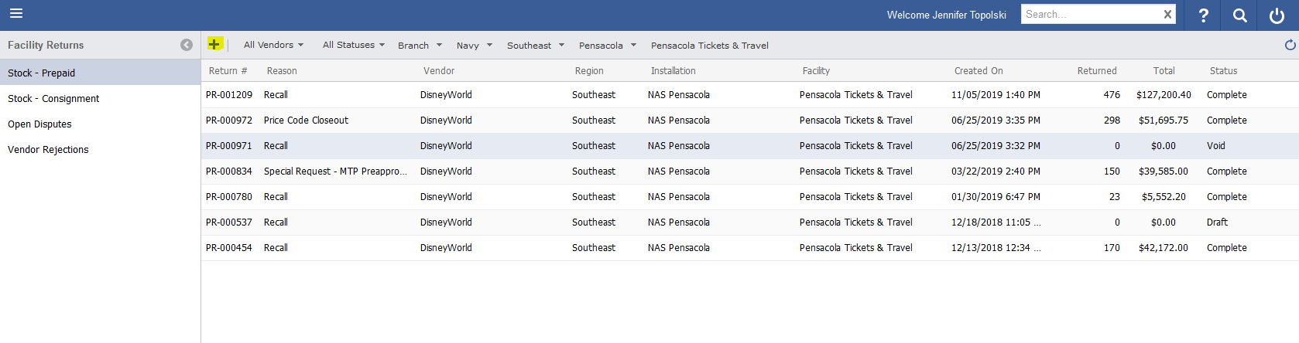
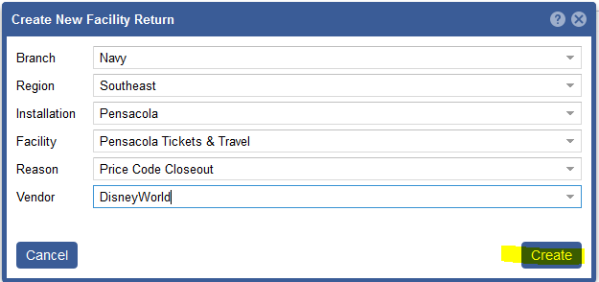
Creating A STOCK TICKET RETURN
1
3
2
4
5
1. Use the Hamburger Menu to locate the Facility Returns Screen
2. Click ‘Stock Prepaid on the ticket to select the type of ticket you are returning. In this case you would select ‘Pre-paid’
3. Use the ‘+’ icon to initiate a return
4. Use the drop down boxes to select the return type in this case the reason is ‘PriceCode Close-out’ and then the vendor
5. Next select ‘Create’
Notes:
1. Use the Hamburger Menu to locate the Facility Returns Screen
2. Click ‘Stock Prepaid on the ticket to select the type of ticket you are returning. In this case you would select ‘Pre-paid’
3. Use the ‘+’ icon to initiate a return
4. Use the drop down boxes to select the return type in this case the reason is ‘PriceCode Close-out’ and then the vendor
5. Next select ‘Create:
Note: It is critical that you select to correct reason for the return. This is how the system validates that the tickets your are trying to return are authorized by the vendor and MTP

Slide 5
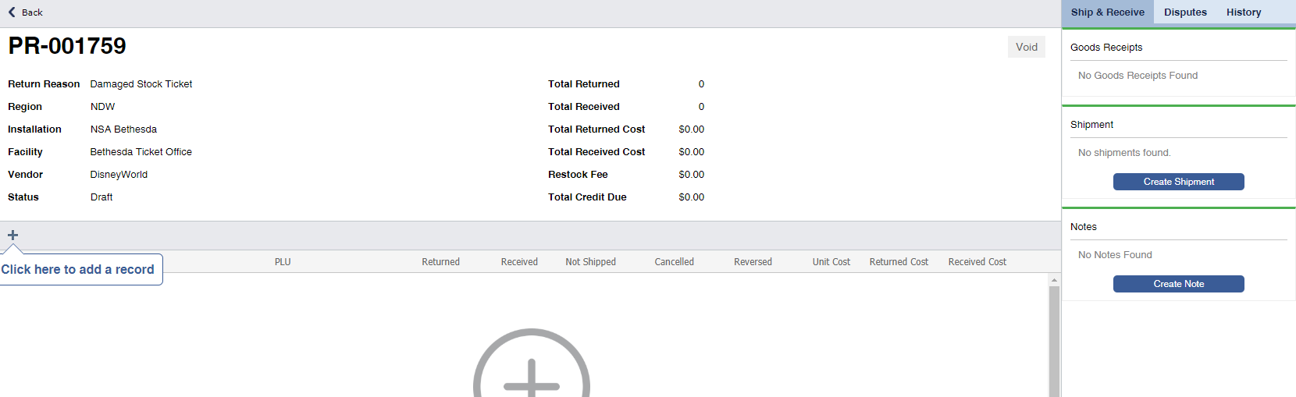
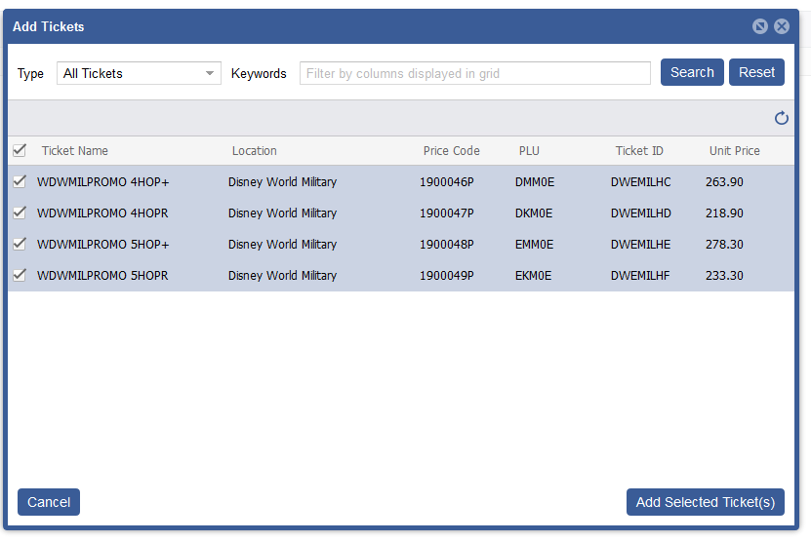
Initial RETURN SCREEN
2
4
1
3
1. Click on the ‘+ ’plus icon on the screen
2. In the Pop-up window select the ticket types that you need to return. Use the select all icon or check each ticket individually
3. Hit ‘Add Select Tickets save to the return.
4. Next select “Create Shipment”
Notes:
To start the return you must select the tickets that you will be returning first.
1. Click on the ‘+ ’plus icon on the screen
2. In the Pop-up window select the ticket types that you need to return. Use the select all icon or check each ticket individually
3. Hit ‘Add Select Tickets save to the return.
4. Next select “Create Shipment”
Note: You will not be inputting the number of tickets here. The total number will be determined based off of the barcode numbers you will add to the shipment.

Slide 6
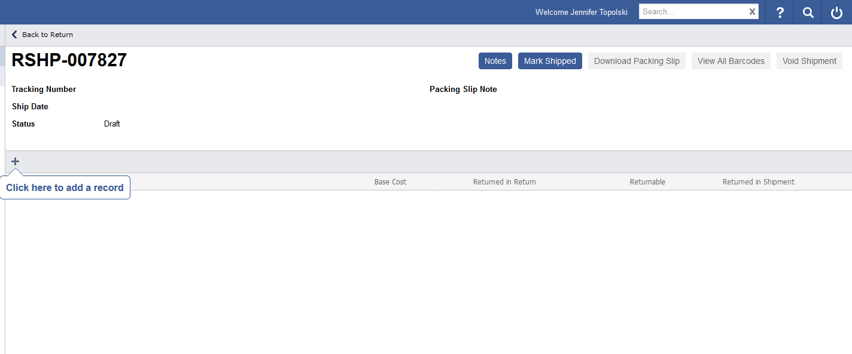
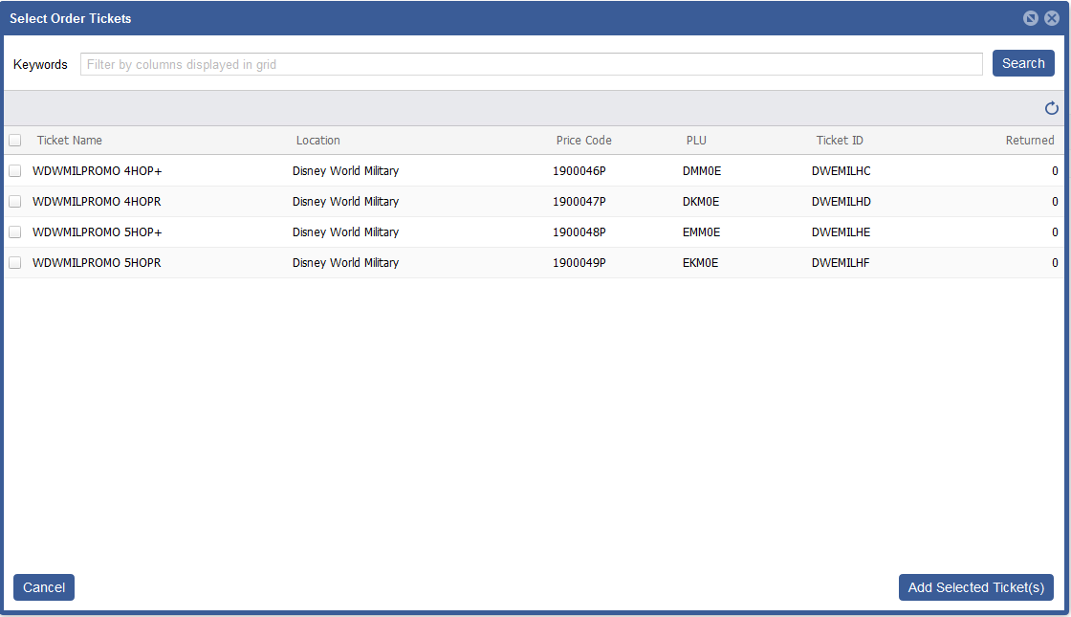
Create the Return SHIPMENT
2
1
3
To start the return you must select the tickets that you will be returning first.
1. Click on the plus icon on the screen
2 . In the Pop-up window select the ticket types that you need to return or use the select all icon or check each ticket individually and hit save to add to the return.
3. Click ‘Add Selected Tickets’
Notes:
To start the return you must select the tickets that you will be returning first.
1. Click on the plus icon on the shipping screen
2 . In the Pop-up window select the ticket types that you need to return or use the select all icon or check each ticket individually and hit save to add to the return.
3. Click ‘Add Selected Tickets’

Slide 7
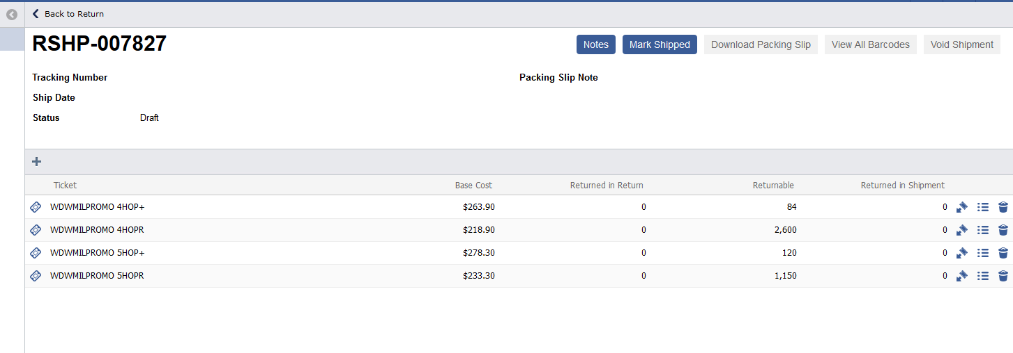
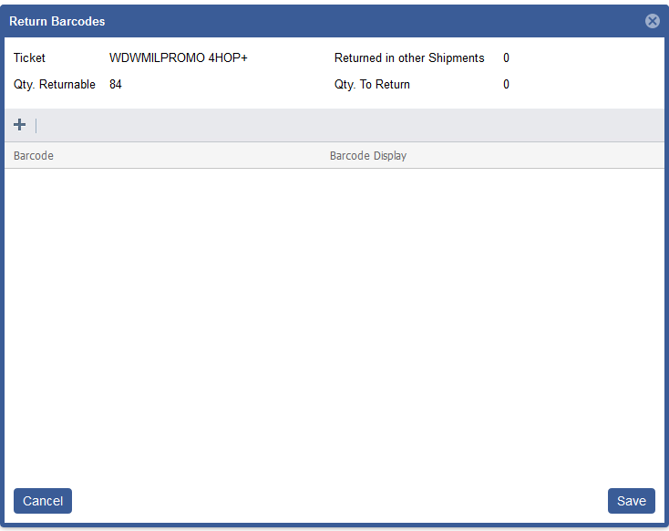
Adding Tickets to the return
2
1
Tickets must be returned to the system via barcode serial number, this is how MTP and the vendor track tickets and credits.
1. Use the “ticket and arrow’ icon to select the barcodes you need to add to the order
2. Select the ‘+’ icon to get to the barcode list of available tickets
Notes:
Tickets must be returned to the system via barcode serial number, this is how MTP and the vendor Track the tickets and your credits
1. Use the “ticket and arrow’ icon to select the barcodes you need to add to the order
2. Select the ‘+’ icon to get to the barcode list of available tickets

Slide 8
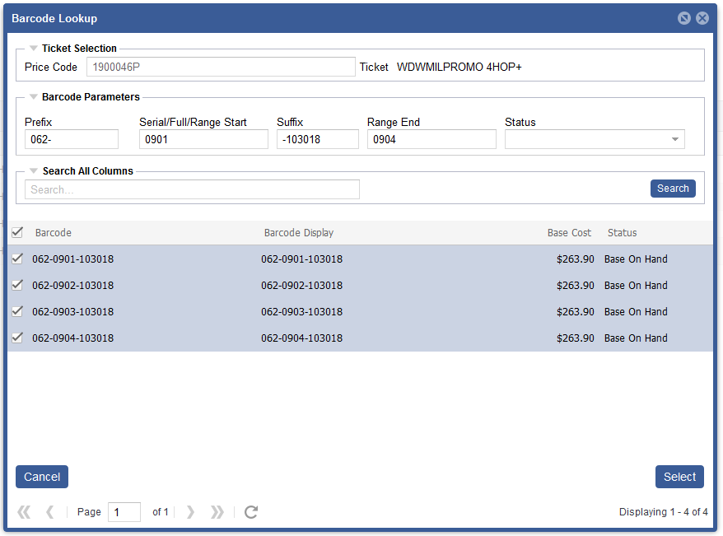
Barcode selection filters
For Disney World there is a specific entry method to search for the barcodes :
In the ‘Prefix’ field you will put the WTS number and a dash mark such as “063-”
In the “Serial’ field you would input the starting number it must represent at least a 4 digit value (“0000”) for instance : “0092” or “3450”
For the “Suffix’ you will input the date in a mmyydd format with a leading dash mark such as “-031519”
For a range you can input the ‘Range end’ number
The select barcode list will appear. Use the ‘Check Box ‘ to select all
Use the “Select” button to add to return.
Note you must include the leading or ending zero in the sequences to locate the barcode successfully. It is imperative that you note the dates correctly as there additionally, there is a count of the number of barcodes returned in the bottom right side of the screen match that value to the number of tickets in your sequence.
1
2
3
4
5
6
Notes:
For Disney World there is a specific entry method to search for the barcodes :
In the ‘Prefix’ filed you will put the WTS number and a dash mark such as “063-”
In the “Serial’ field you would input the starting number it must represent at least a 4 digit value (“0000”) for instance : “0092” or “3450”
For the “Suffix’ you will input the date in a mmyydd format with a leading dash mark such as “-031519”
For a range you can input the ‘Range end’ number
The select barcode list will appear. Use the ‘Check Box ‘ to select all
Use the “Select” button to add to return.
Note you must include the leading or ending zero in the sequences to locate the barcode successfully. It is imperative that you note the dates correctly as there additionally, there is a count of the number of barcodes returned in the bottom right side of the screen match that value to the number of tickets in your sequence.

Slide 9
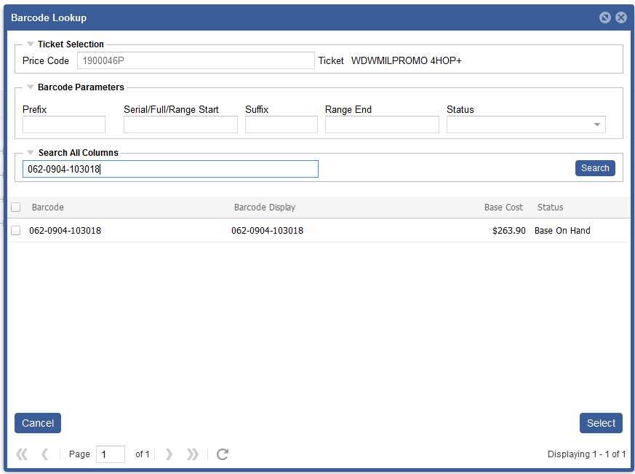
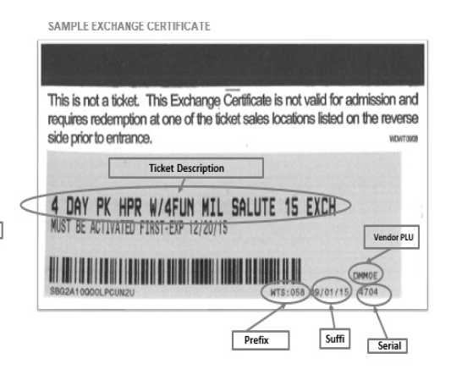
Barcode selection filters
For Disney World there is a specific entry method to search for the barcodes
Be sure to use the correct format to also search for single barcodes.
Input the serial number into the ‘Search all Columns’ Example: 062-0901-103019
Use the check mark ‘add’ to order
Next click “Select’
1
2
Notes:
ALL of the barcodes that were shipped to your installation for the duration of the price code will appear.
Be sure to use the correct format to also search for single barcodes.
Input the serial number into the ‘Search all Columns’ Example: 062-0901-103019
Use the check mark ‘add’ to order
Next click “Select’
In the next pop-up it shows you what barcodes are in the return. I recommend hitting save at this point and then reopening barcode load screen to work on the next sequence. That way if you do not lose your place in your order.

Slide 10
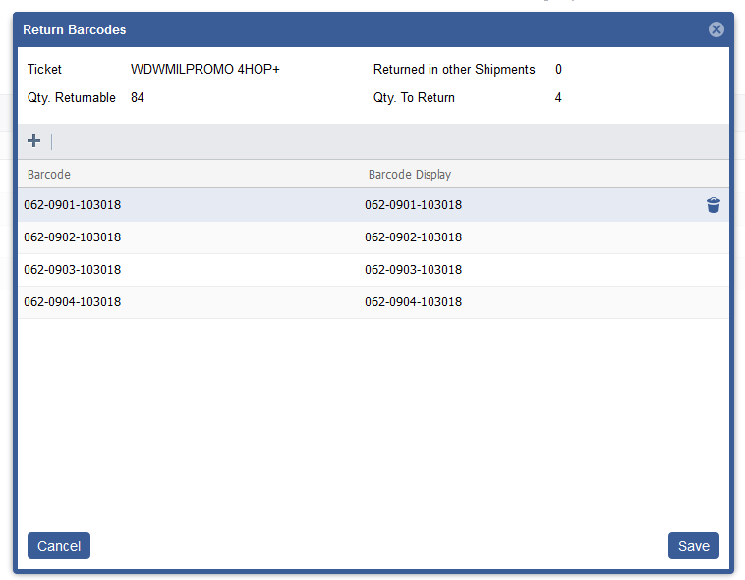
Barcode selection filters
In the next pop window it will display all barcodes for that ticket type are in the return.
The screen summarizes the quantity you have put into the return.
Additionally, if you have selected a barcode incorrectly you can delete it.
1. Select the line with the wrong barcode
2. Use the trash can to delete
3. Select “SAVE’ to add the barcodes to your return,
Note: We recommend hitting save at this point and then reopening barcode load screen to work on the next sequence. That way if you do not lose your place in your order.
1
2
3
Notes:
In the next pop window it will display all barcodes for that ticket type are in the return.
The screen summarizes the quantity you have put into the return.
Additionally, if you have selected a barcode incorrectly you can delete it.
1. Select the line with the wrong barcode
2. Use the trash can to delete
Select “SAVE’ to add the barcodes to your return,
Note: We recommend hitting save at this point and then reopening barcode load screen to work on the next sequence. That way if you do not lose your place in your order.

Slide 11
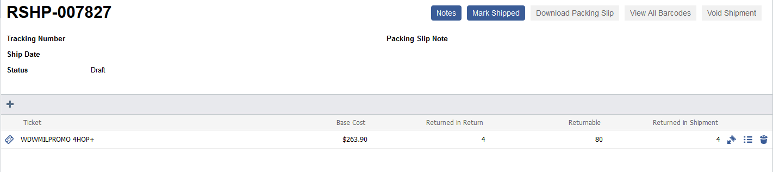
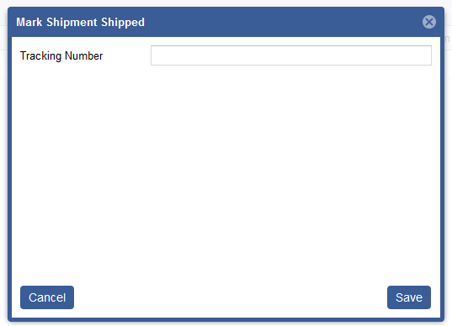
Mark Shipped and download Packing Slip
3
2
4
1
5
Once ALL the tickets are saved to the return
Validate the number in the return is correct
Download and review the packing slip to make sure the barcodes are correct
Select ‘Mark Shipped”
In the pop-up add the FedEx tracking number
Then ’Save’
In your shipment envelope include the tickets, packing slip and copies of the serial number ranges.
Notes:
Once ALL the tickets are saved to the return
Validate the number in the return is correct
Download and review the packing slip to make sure the barcodes are correct
Select ‘Mark Shipped”
In the pop-up add the FedEx tracking number
Then ’Save
’
In your shipment envelope include the tickets, packing slip and copies of the serial number ranges.

Slide 12
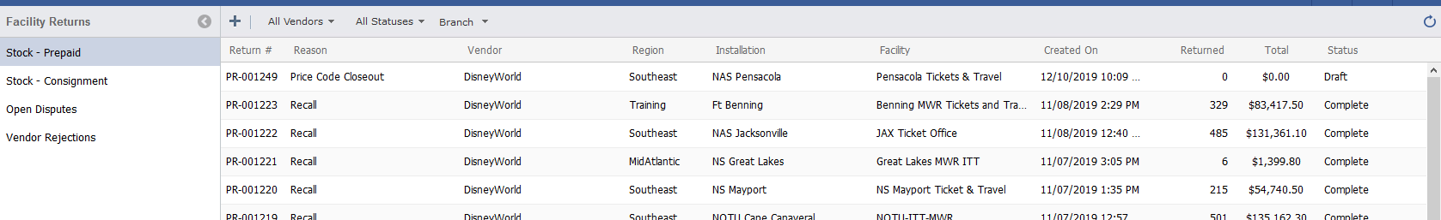
Review RETURNS IN TMS
1
2
To Review your return in TMS
Navigate to the hamburger Menu and select “Facility Returns’
Select the ticket type ie ‘Stock – Prepaid’
Review the Status once marked shipped the status would be “Open (In Process)
Once MTP has a chance to validate your return it will update to the status of “Completed’
Note: MTP will be finalizing the returns in January
Notes:
To Review your return in TMS
Navigate to the hamburger Menu and select “Facility Returns’
Select the ticket type ie ‘Stock – Prepaid’
Review the Status once marked shipped the status would be “Open (In Process)
Once MTP has a chance to validate your return it will update to the status of “Completed’
Note: MTP will be finalizing the returns in January

Slide 13
Thank YOU!

