Slide 1

Notes:
Hi, how is everyone! I going to take the next several minutes to explain a little more about what your guests will experience when they visit Gatorland and some of our extra adventures they can purchase while in park.

Slide 2

AFFORDABLE
FAMILY FRIENDLY FUN SINCE 1949
Notes:
Gatorland opened as a roadside attraction in 1949, we are one of the original theme parks in Florida, way before Disney. And we are still owned by the same family today!
Here at Gatorland we truly believe it is all about the guest… we provide FUN, SMILES and SPECIAL MEMORIES!

Slide 3

TOP SELLING POINTS
Everyone wants to see a GATOR! We have THOUSANDS!
One of Orlando’s Best Half Day Attraction!
110-acre theme park and wildlife preserve
Open 365 days a year from 10am – 5pm!
Parking is FREE
WWW.GATORLAND.COM
Notes:
Top selling points for Gatorland
FREE Admission for active, retired and veterans.
Family members can buy discounted tickets at their local Military ITT/MWR office
Everyone wants to see a GATOR! We have THOUSANDS!
One of Orlando’s Best Half Day Attractions!
110-acre theme park and wildlife preserve
Open 365 days a year from 10am – 5pm!
Parking is FREE and we are

Slide 4
FREE ADMISSION
Gatorland offers FREE Admission for active, retired and military veterans.
Please check their military ID and print the free military admission ticket through the MTP.
Family members can buy discounted tickets at their local Military ITT/MWR office
Gatorland admission tickets are available at a huge discount at your offices – Gatorland Adult and child and Gatorland Florida Resident Adult and Child.
Zipline tickets – this includes the full zipline and Free admission to Gatorland. The free military person can buy zipline only when calling reservations.
Reservation MUST be made 48 hours in advance by calling 407-856-3226
These tickets are non-transferrable and only valid for military families. Tickets available through the MTP.
WWW.GATORLAND.COM

Slide 5
Gatorland admission
Gatorland admission includes our 3 exciting shows and all animal exhibits.
Additional activities are available at the park.
WWW.GATORLAND.COM

Slide 6

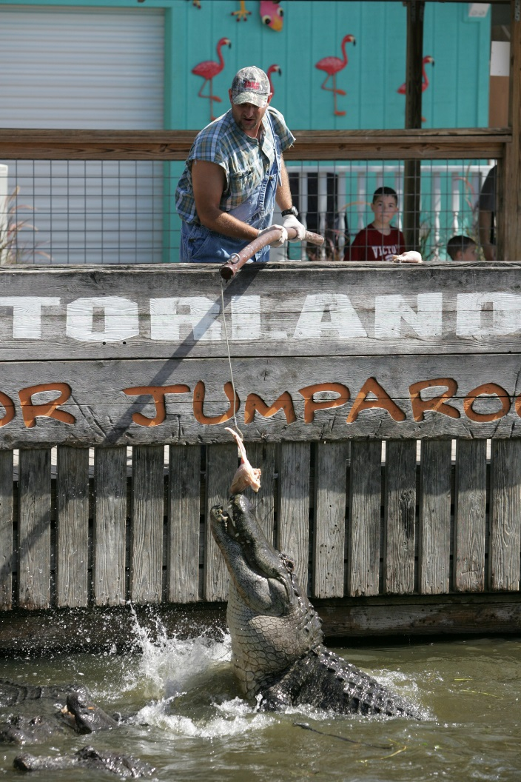
3 great shows …
GATOR JUMPAROO SHOW
This is one of our original shows. Watch these amazing alligators jump four to five feet out of the water to retrieve food in this famous one-of-a-kind show. Learn more about alligators and crocodiles and their awesome powers.
Notes:
Gator Jumparoo show
Watch these amazing alligators jump four to five feet out of the water to retrieve food in this famous one-of-a-kind show. Learn more about alligators and crocodiles and their awesome powers.

Slide 7

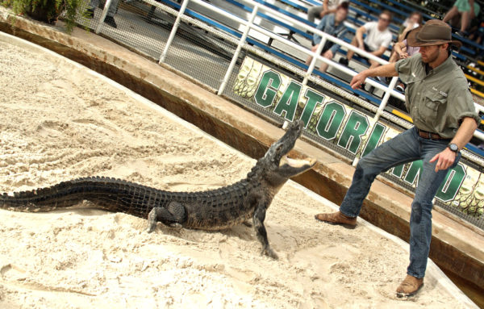
Alligators: Legends of the Swamp Show
Watch as one of the bravest daredevils at Gatorland takes the stage with a 6–8-foot alligator in order to demonstrate the amazing survival features of this legendary creature!
Notes:
Alligators Legend of the Swamp show
Watch as one of the bravest daredevils at Gatorland takes the stage with a 6–8-foot alligator in order to demonstrate the amazing survival features of this legendary creature

Slide 8

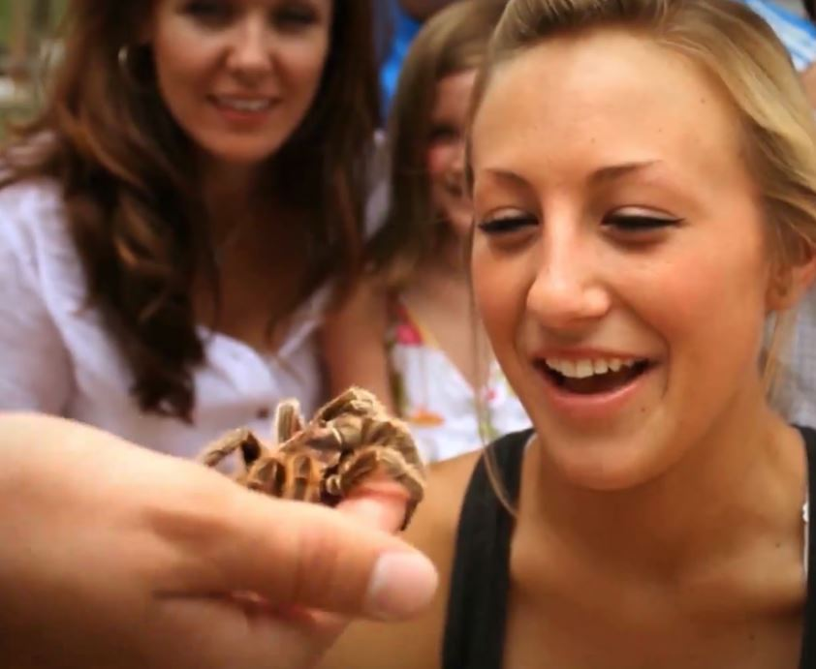
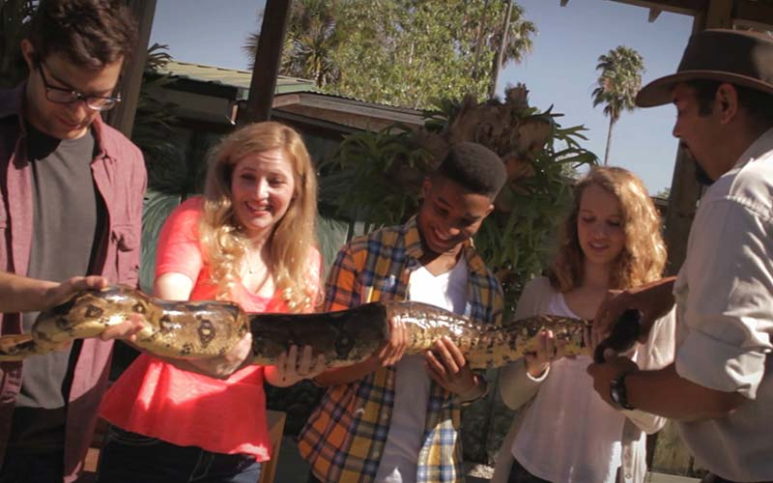
UPCLOSE ENCOUNTERS
You never know what kind of animals you might meet at the Upclose Encounters Show!
You will see fascinating creatures from around the globe, including some of the most dangerous snakes alive!
Notes:
Upclose Encounters
You never know what kind of animals you might meet at the Upclose Encounters Show!
You will see fascinating creatures from around the globe, including some of the most dangerous snakes alive!

Slide 9

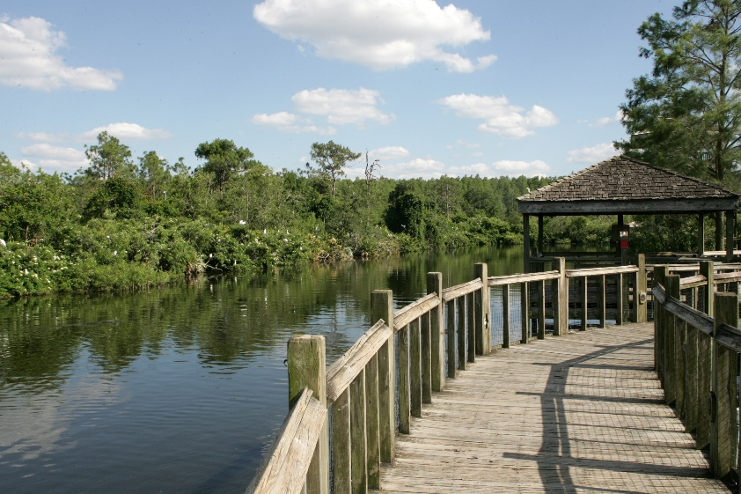
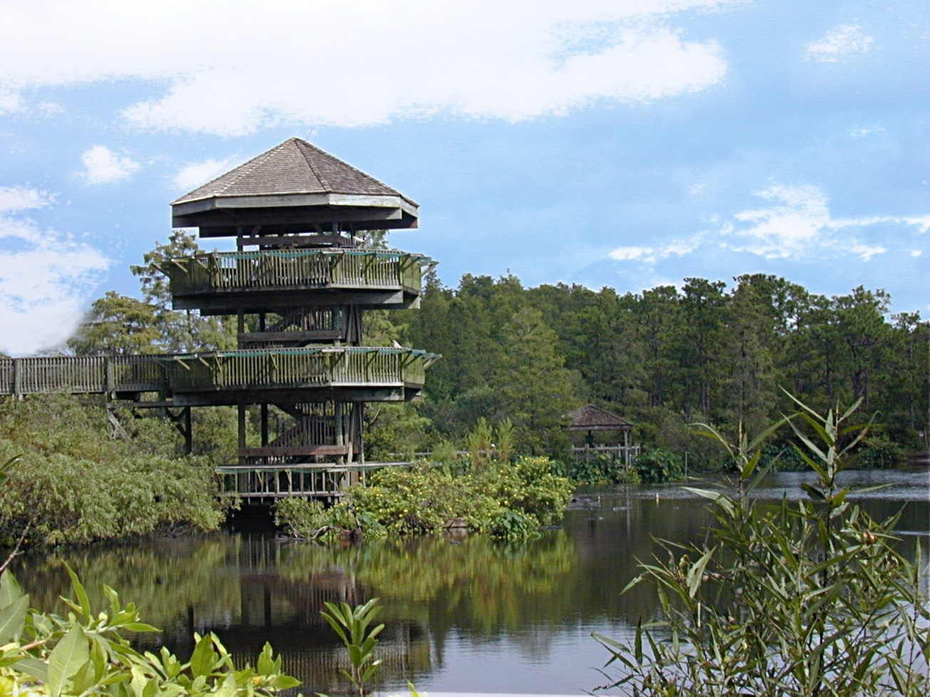
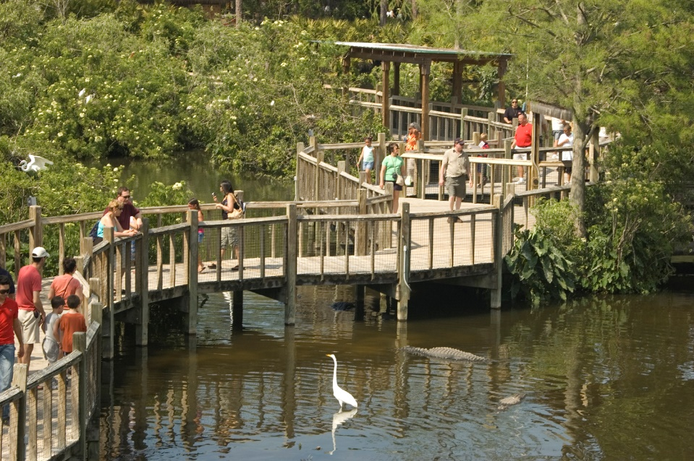
BREEDING MARSH
Notes:
Our breeding marsh is home to over 14 species of birds and more and more come every year to Gatorland.
They choose Gatorland as their nesting ground because the alligators protect the nests and keep the area free from natural predators. It is a great place to observe and take amazing photos.

Slide 10

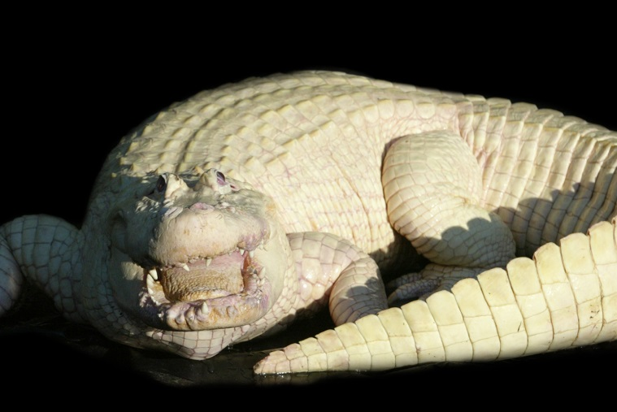
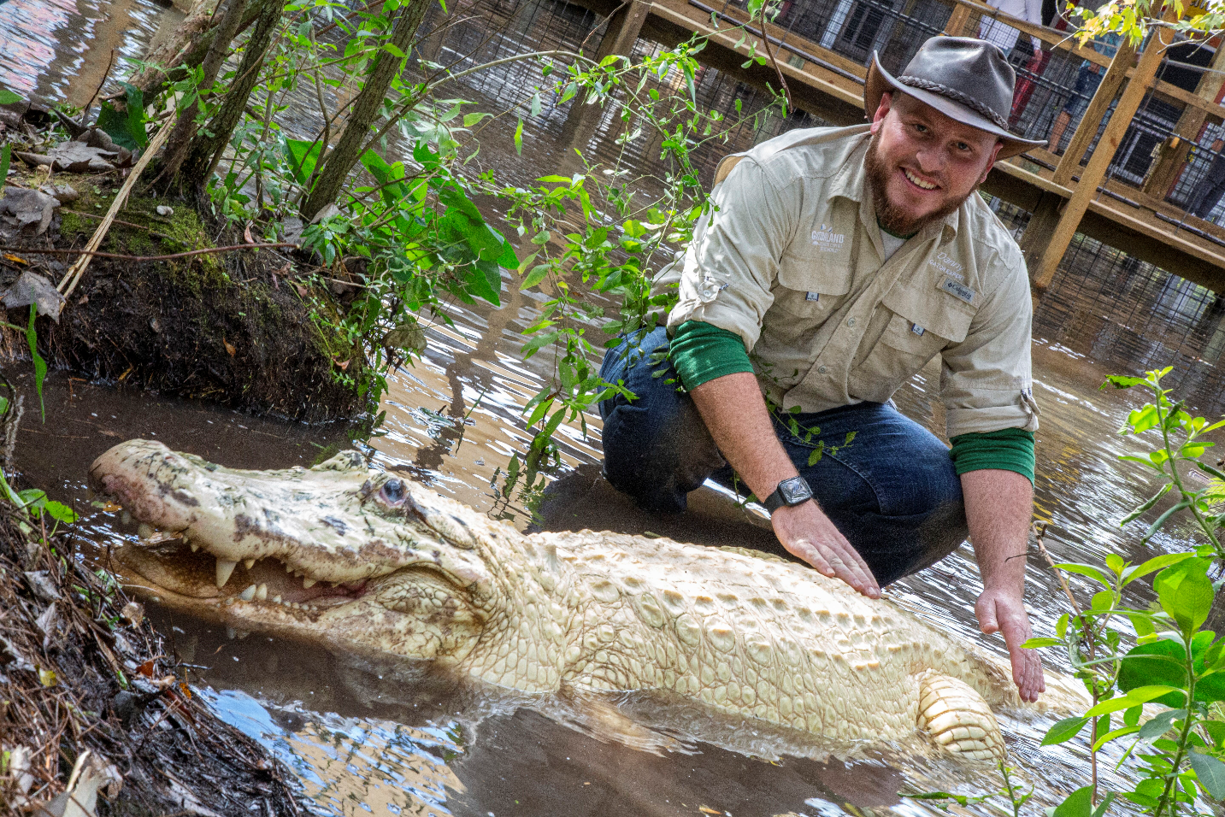
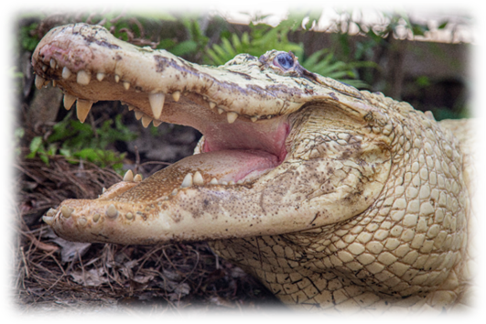
RARE LEUCISTIC WHITE GATORS
Notes:
Gatorland has the world’s largest white leucistic and Albano alligators. These amazing animals are ten to twelve feet in length and weigh over 800 pounds.

Slide 11
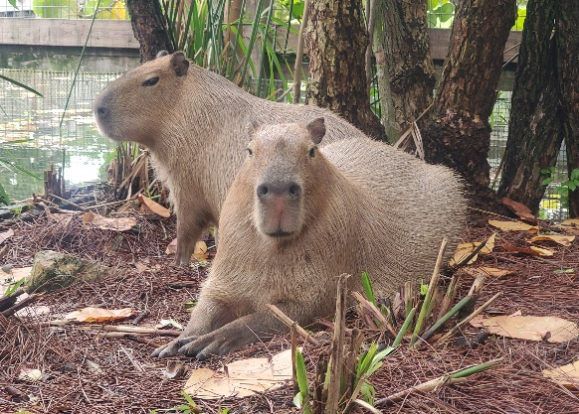
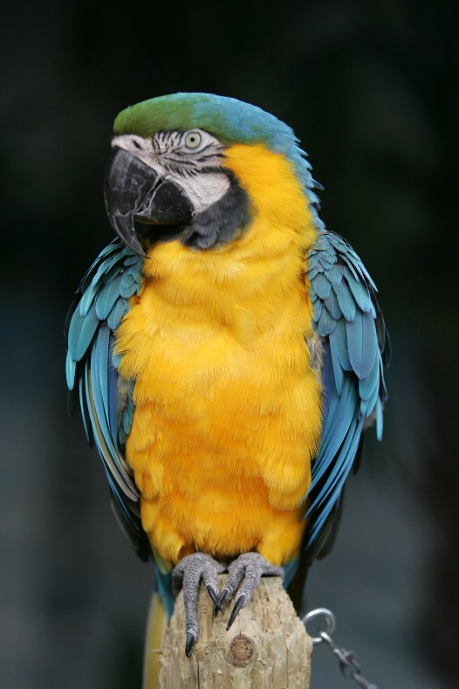
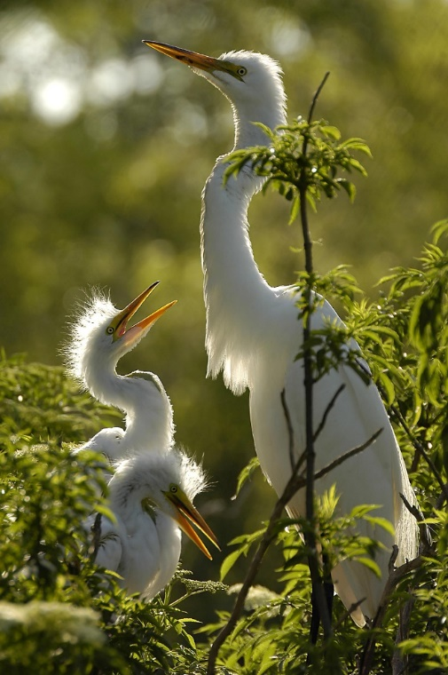
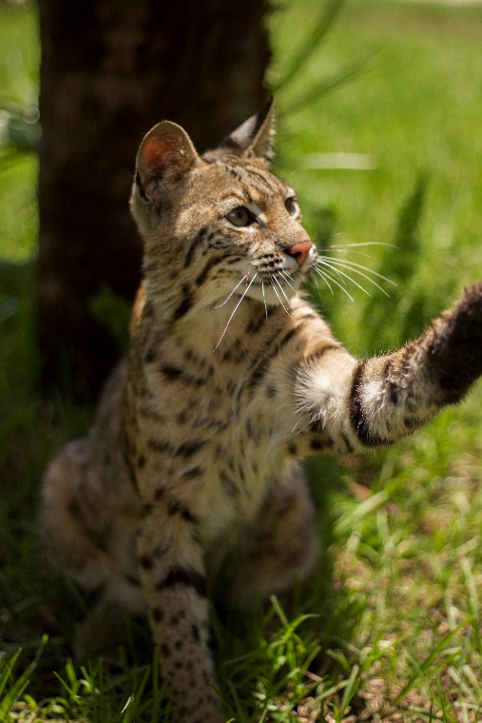
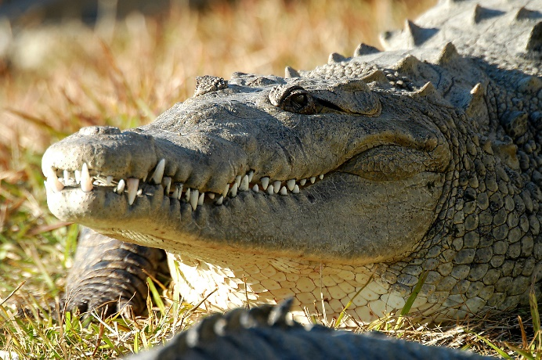
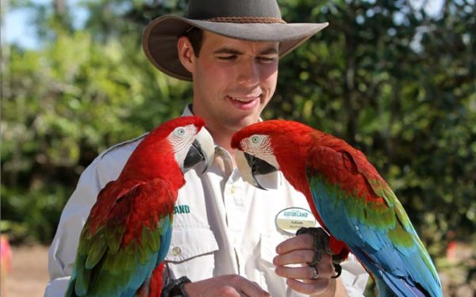
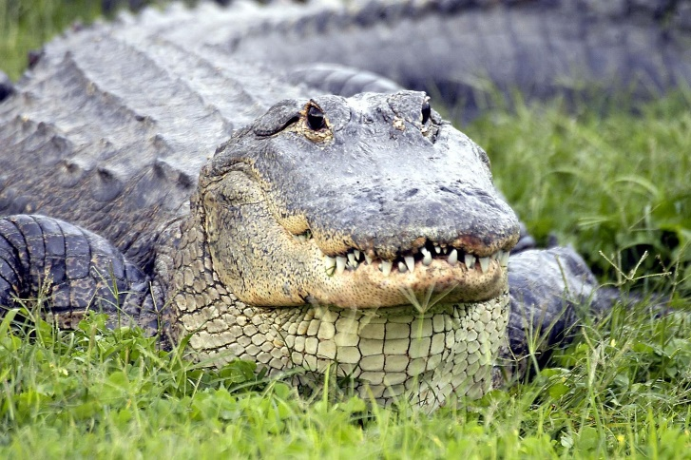
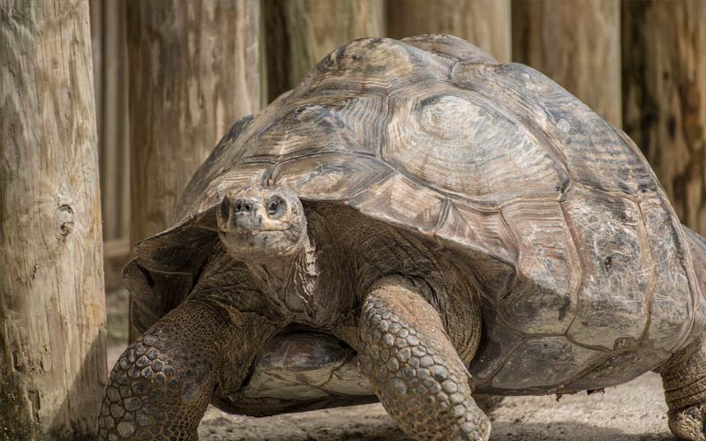
MEET OUR RESIDENTS
Notes:
Gatorland isn’t home to just Alligators. You will find all kinds of birds, bob cats, tortoises, capybaras and many more animals.

Slide 12
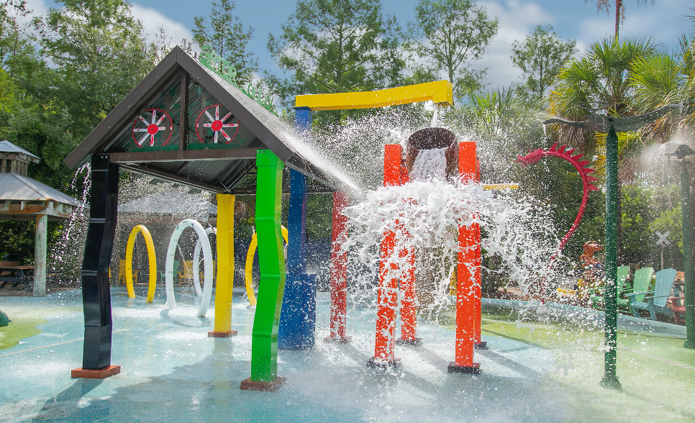
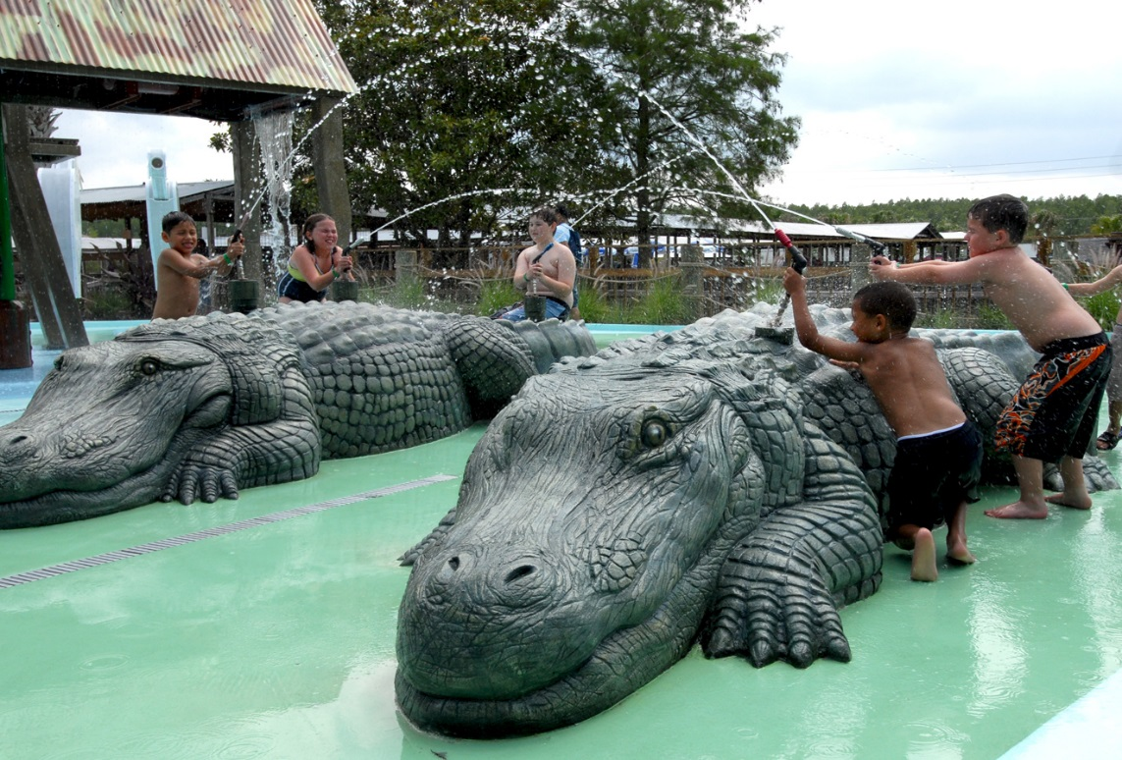

COOL OFF AT
GATOR GULLY SPLASH PARK
Notes:
We offer fun things for the kids including our Gator Gully Splash Park

Slide 13
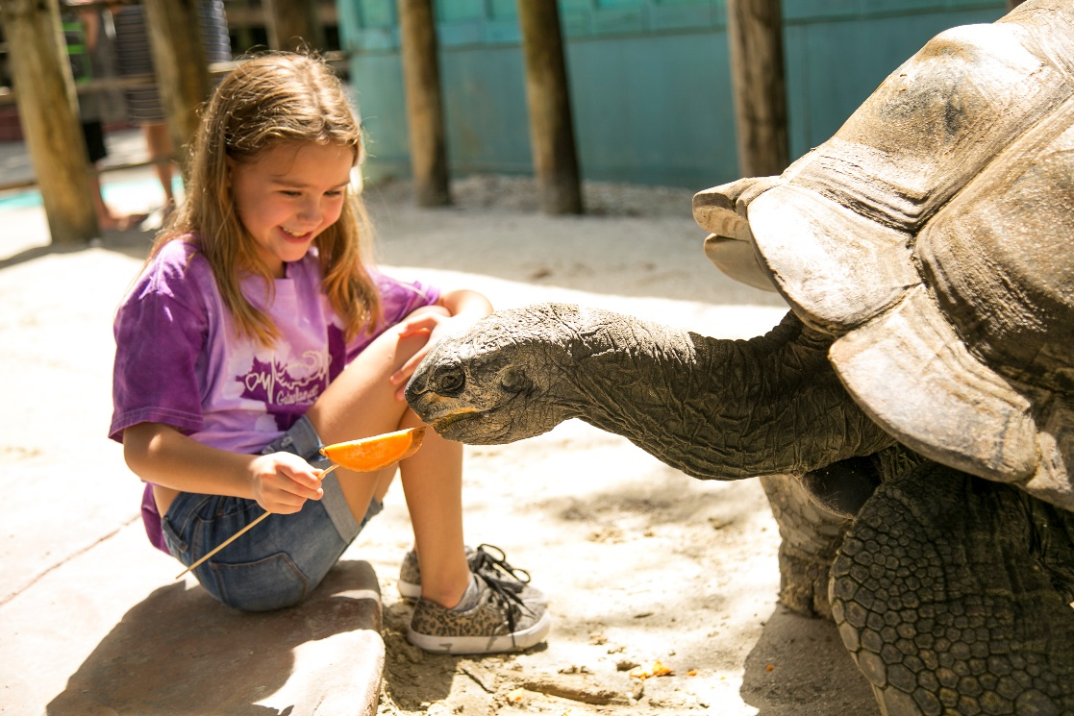
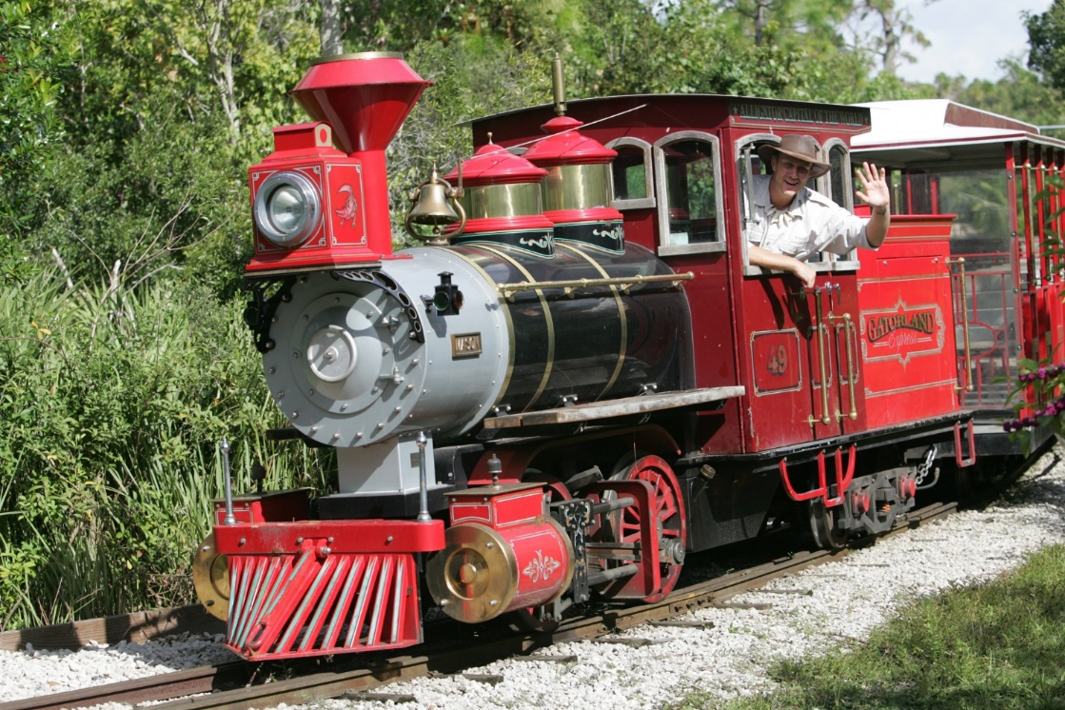
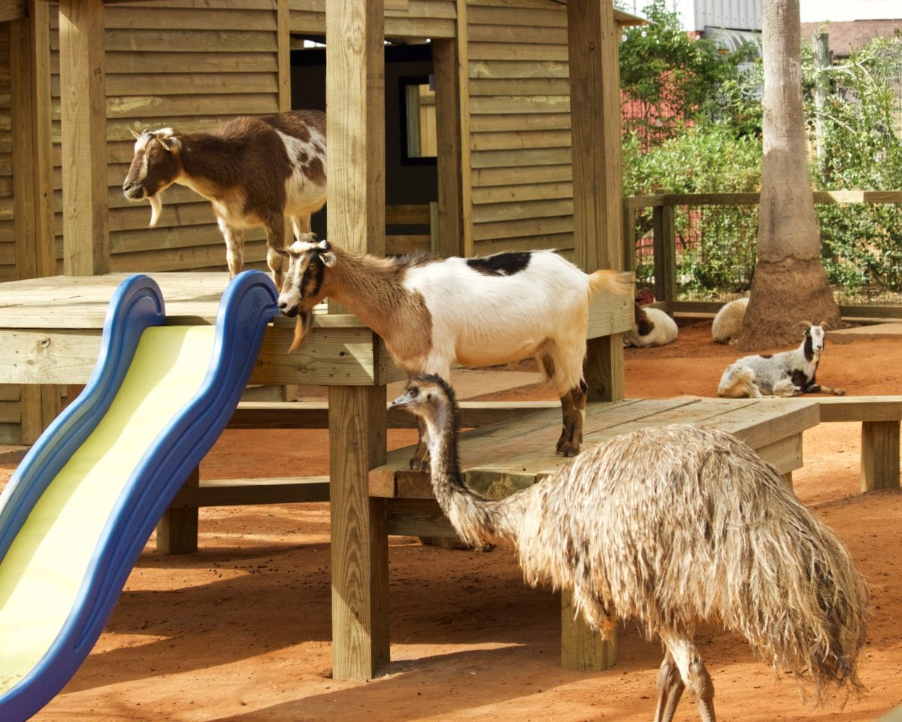
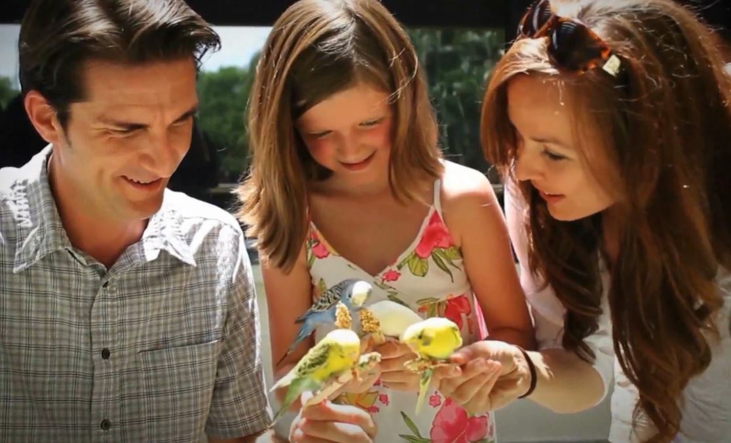
FUN ACTIVITIES FOR THE KIDS
Notes:
Other fun activities for kids include:
Our Gatorland Express train that runs from one end of the park to the other, you will learn interesting history of Gatorland on this ride. Or experience our petting zoo and animal encounters. Great for all ages!

Slide 14

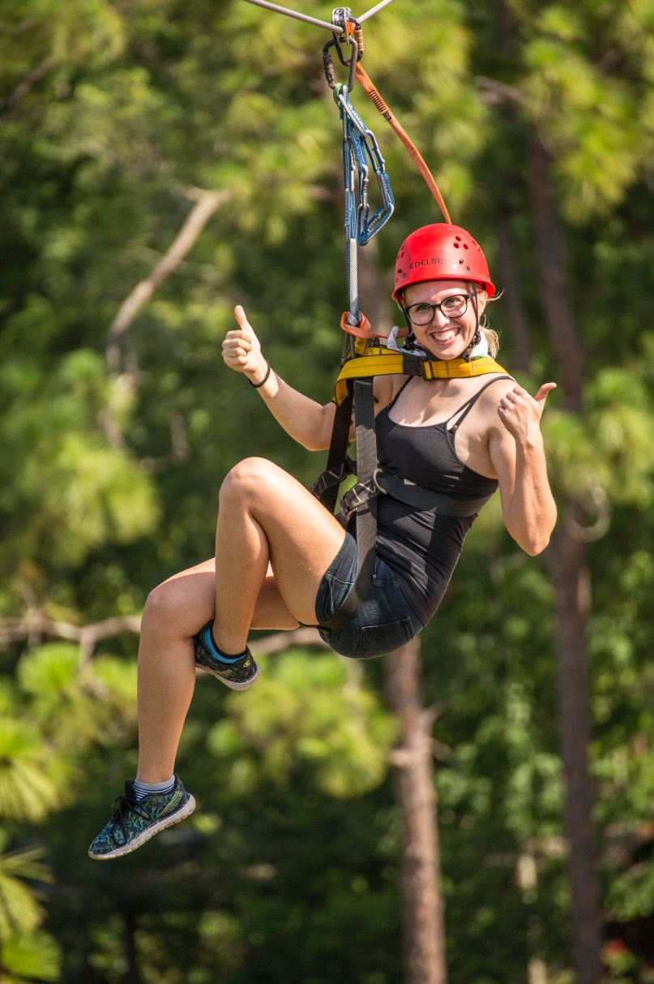
SCREAMIN’ GATOR ZIPLINE
ADDITIONAL
ADVENTURES
1 ½ hour – 2 hour experience
5 intense lines with a suspension bridge! 1200 feet of thrills!!
Requirements: Weigh up to 275 lbs and must be over 36” tall.
This includes FREE admission to Gatorland!
Reservations required 48 hours in advance.
GATOR GAUNTLET ZIPLINE
This is one wild ride right over the gators and wheelchair accessible.
This is only sold in the park.

Slide 15
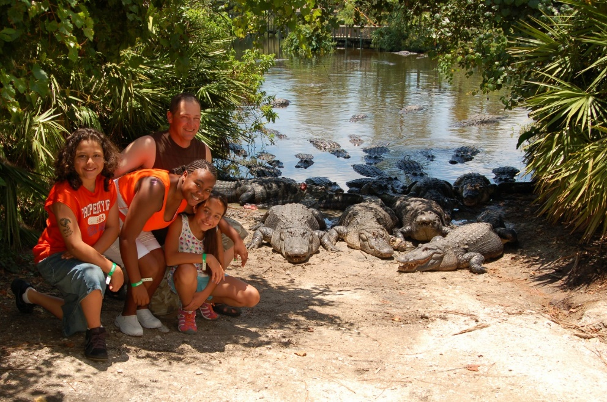
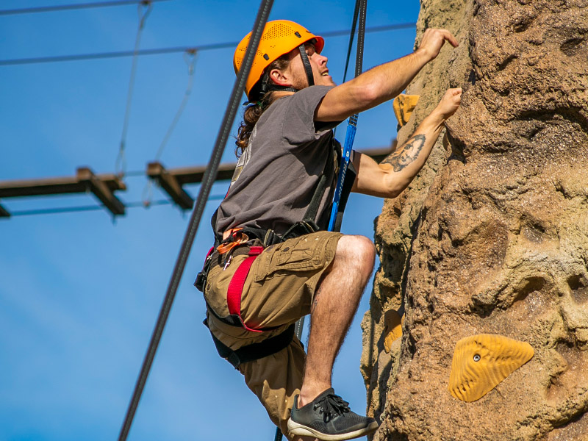
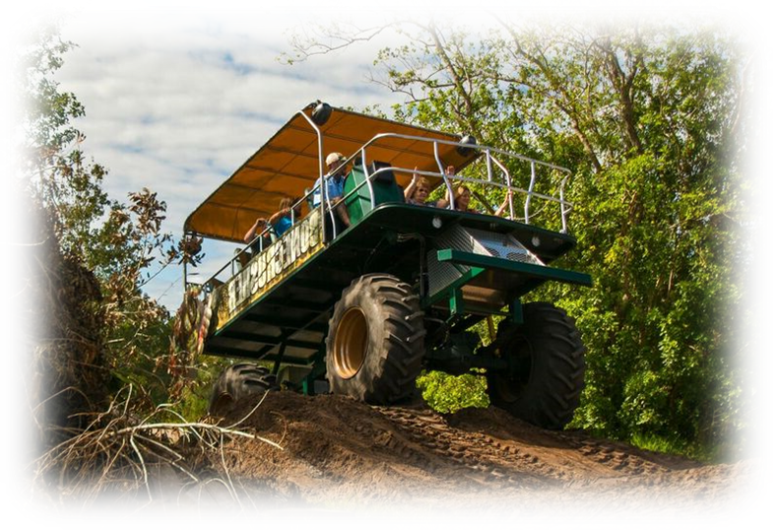
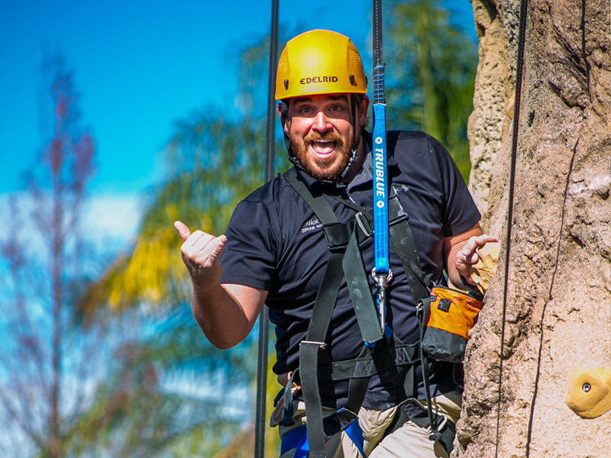
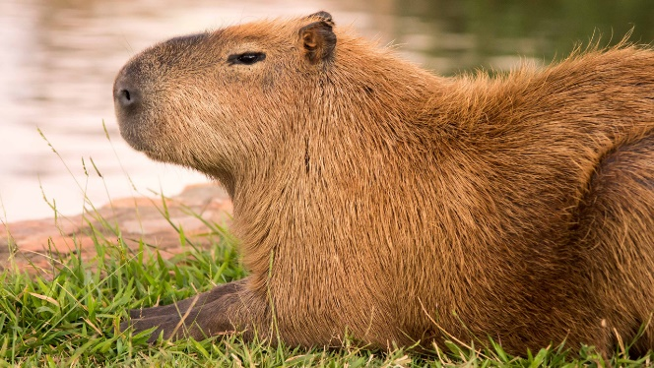
Adventure Hour
NEW Croc Rock Adventure
Stompin’ Gator off-road adventure
Capybara feeding experience
ADDITIONAL
ADVENTURES
Notes:
Additional Adventures at Gatorland include:
Adventure Hour where you will go beyond the gates and feed these huge animals.
Our NEW Croc Rock Adventure that includes a rock-climbing wall, crossing a swinging bridge and a single zipline experience.
Our Capybara experience and Stompin’ Gator off road adventure
These experiences can be purchased at the park

Slide 16
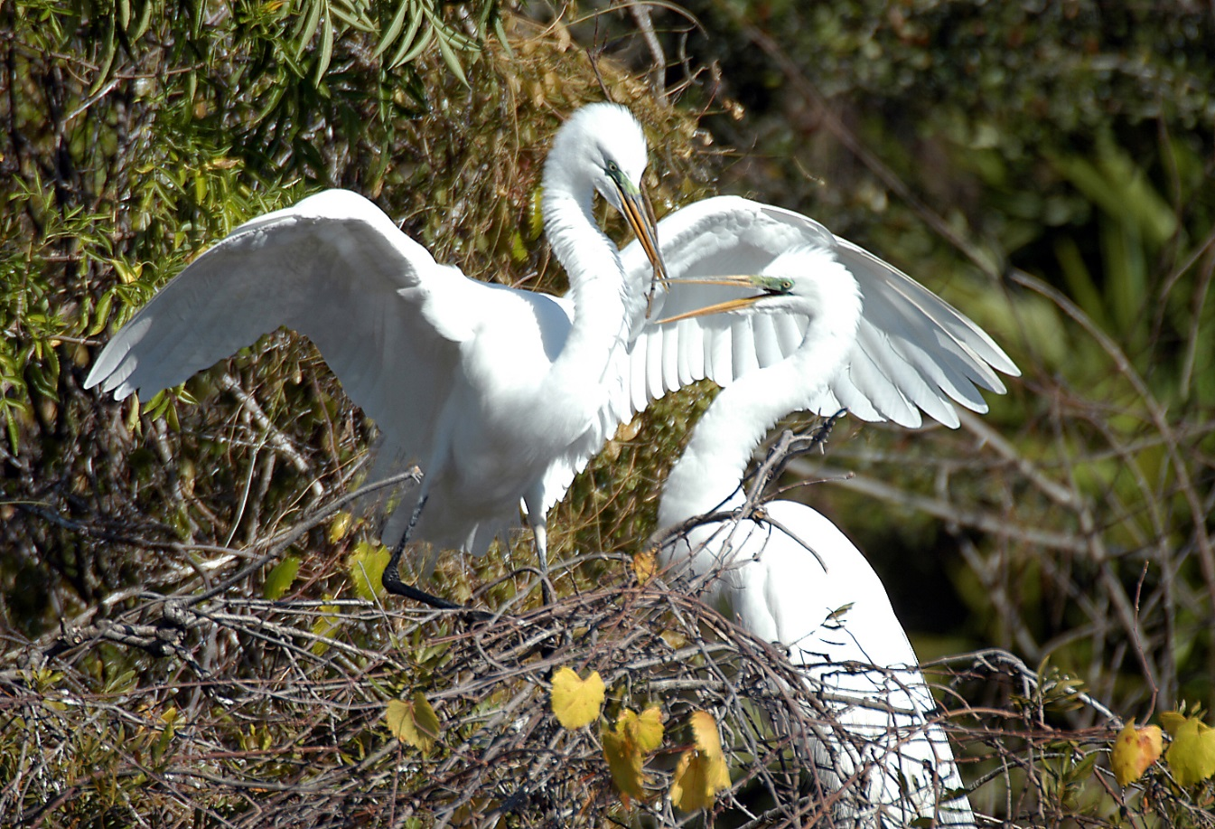
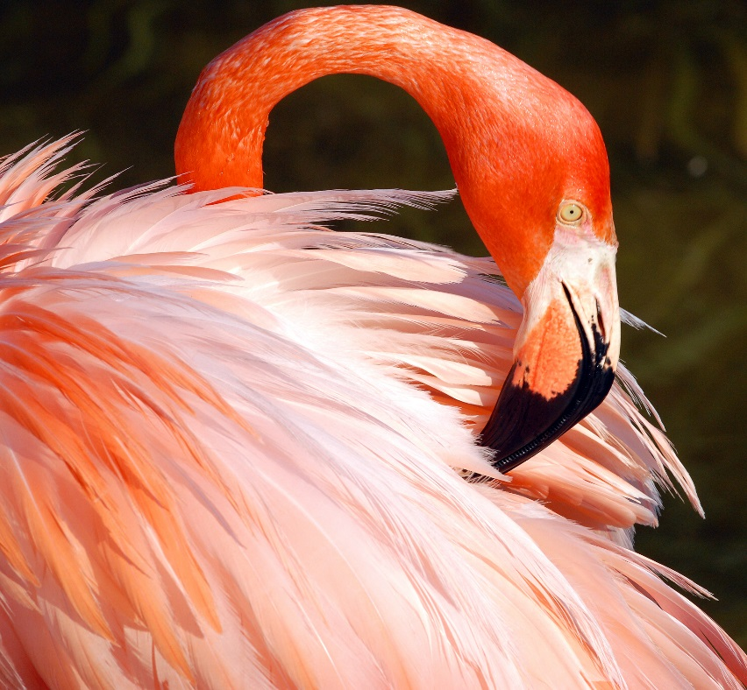
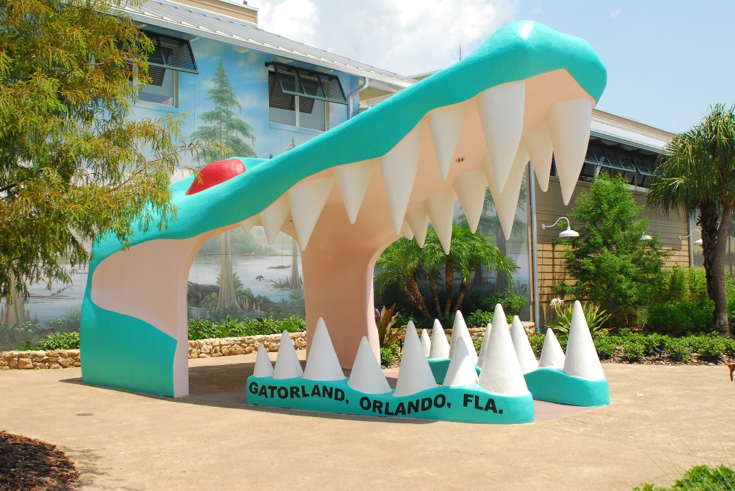

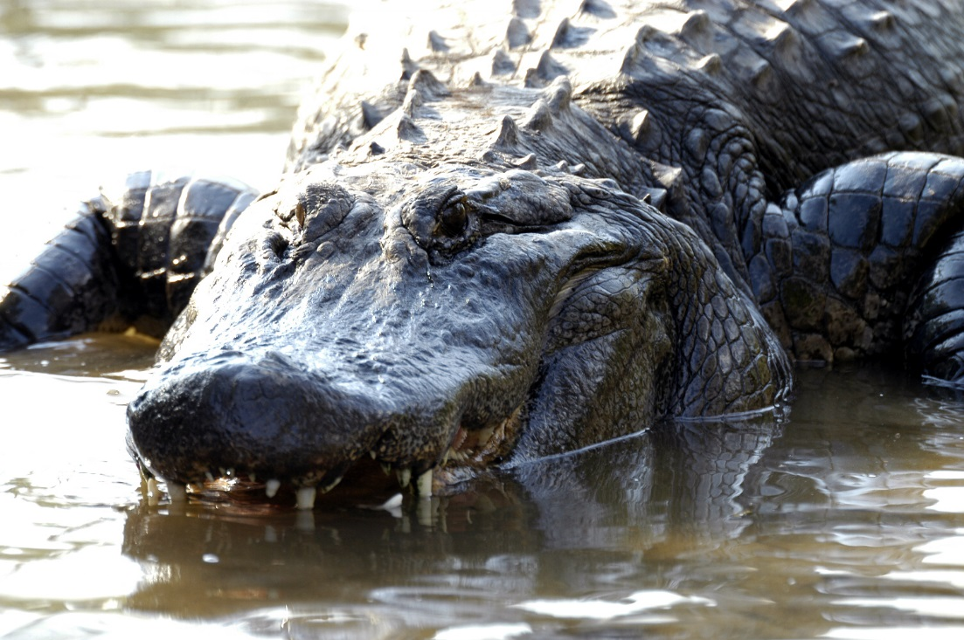
SandySweatt@Gatorland.com
Notes:
. Thank you and if you have plans to visit us at Gatorland in the near future, feel free to contact me at the email on the screen and I am happy to extend a comp admission to you and a discount admission for your family.
Now for a video
Okay now we are going to go live to Danny from in the park to introduce you to some of our Gatorland friends.

