Slide 1

Consignment Program
Scott Barr & Emma Sunderman

Slide 2
Summary
• About the National Aquarium
• Consignment Program Overview
•Helpful Tips for Your Visit
• Q&A

Slide 3
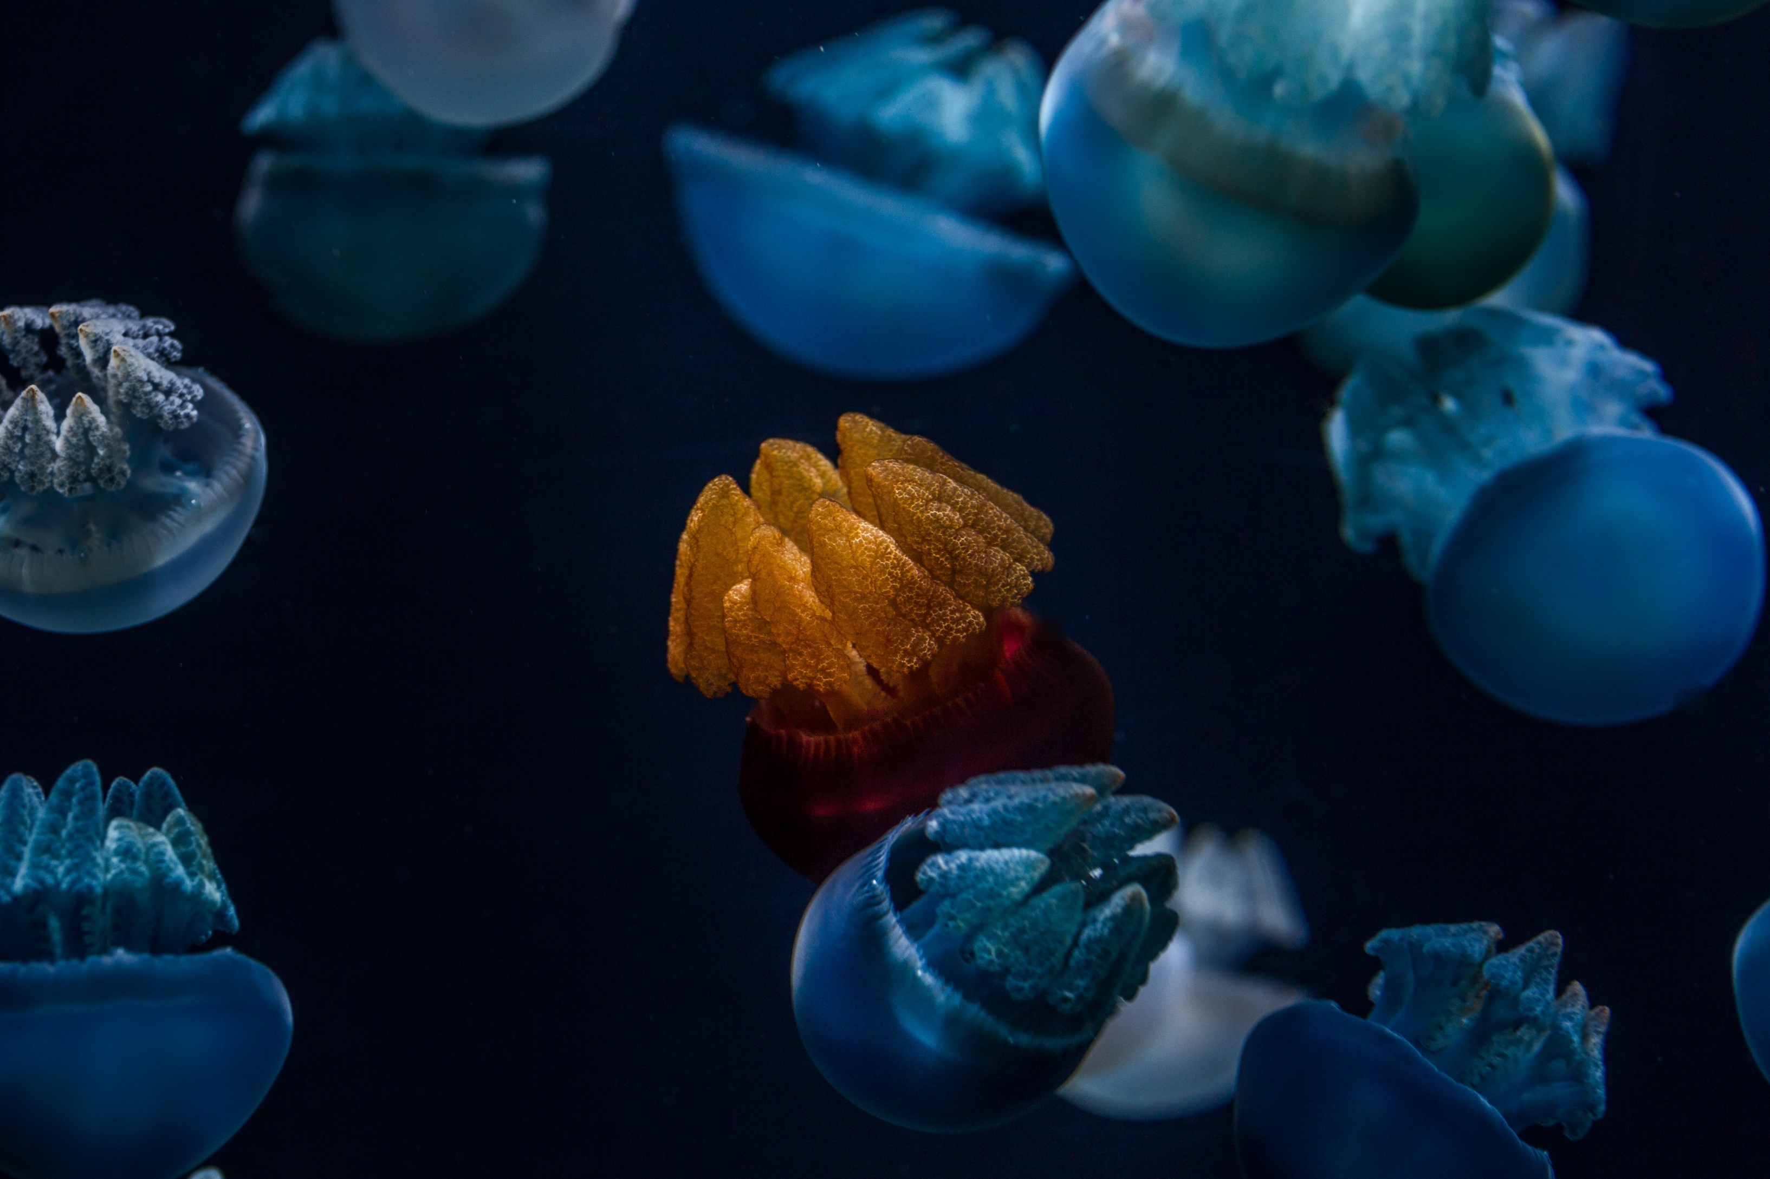
About Us

Slide 4
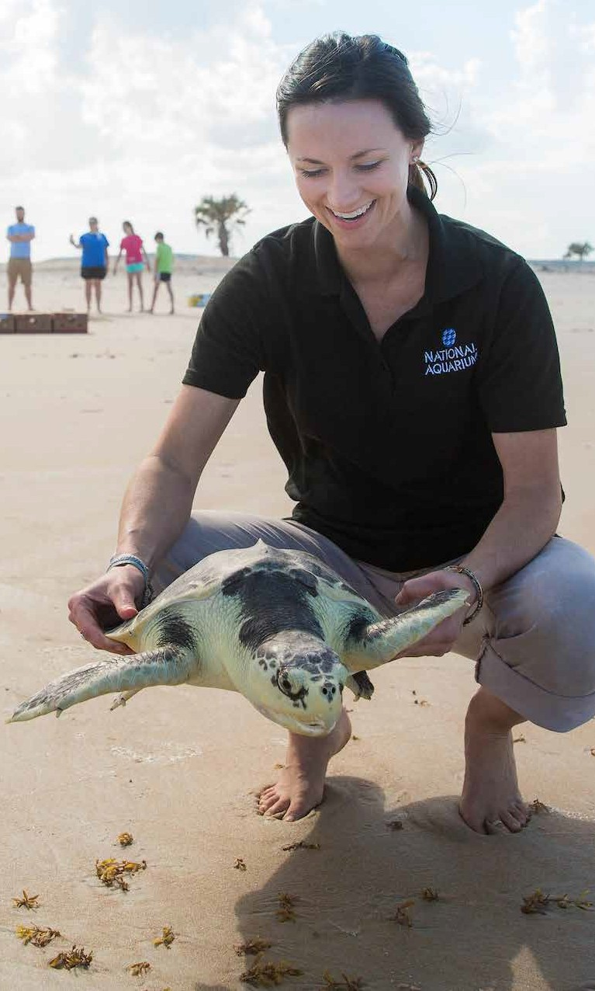
Mission
The National Aquarium is a nonprofit organization whose mission is to inspire conservation of the world’s aquatic treasures.
October 01, 2018
Notes:
This is where we will also mention that we are a top 3 Aquarium in the US (according to IMPACTS reports – need permission to quote them), and some of our initiatives (floating wetlands project, dolphin relocation, sea turtle and seal rescue).

Slide 5
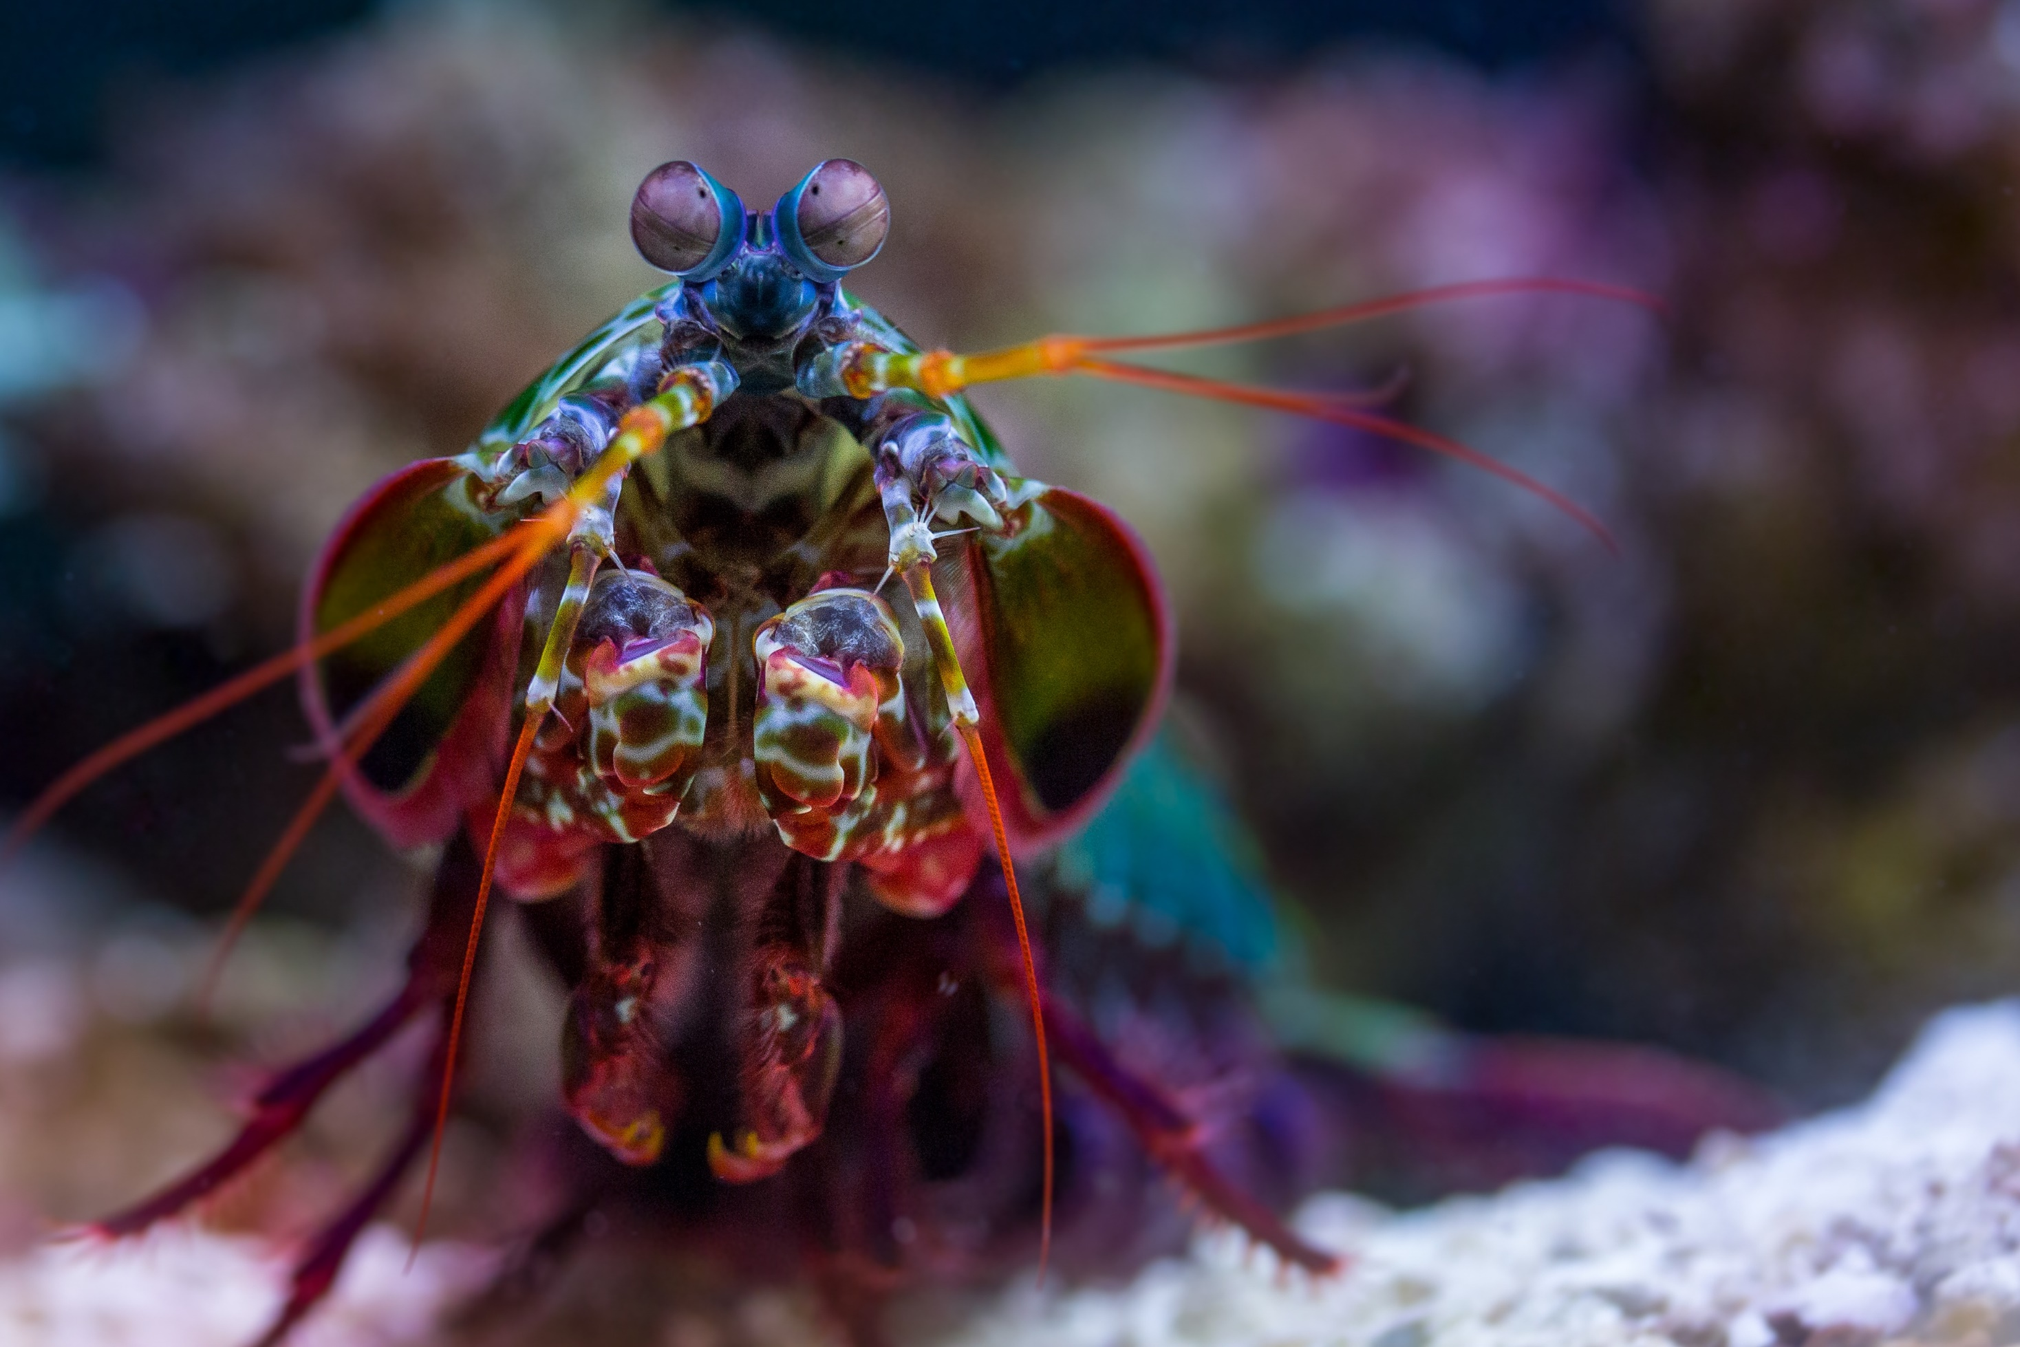
Consignment Program
Overview, Redemption Process, & Exclusive Perks

Slide 6
Program
Overview
Savings on admission tickets
MTP partnership
Not public-facing/ exclusivity
Consignment Ticket
Perks
No reservations needed
Expire Dec 31st (single use)
No-cost marketing materials
Redemption
Process
National Aquarium generated barcodes
MWR/ITT teams pull tickets upon request
Print or redeem digitally at NA will call
Next available entry time
  Operational Calendar
Notes:
**Under MTP partnership: one stop shop for all attraction ticketing – including MD’s top attraction!

Slide 7

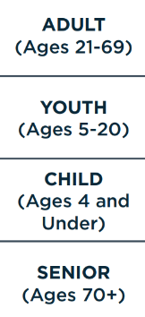
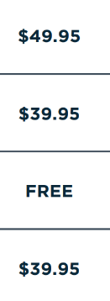
Pricing
Gate Rates
The National Aquarium is also proud to offer special year-round, on-site ticket pricing of $39.95 for guests with active military ID or veteran ID. Active military personnel and their adult dependents can receive this pricing by presenting their military ID in person at our box office.
October 01, 2018
Notes:
Insert chart with MTP price breakdown vs gate rates – add in new age groups (how to get free under 5 tickets)

Slide 8

Plan Your Visit
Helpful Hints

Slide 9
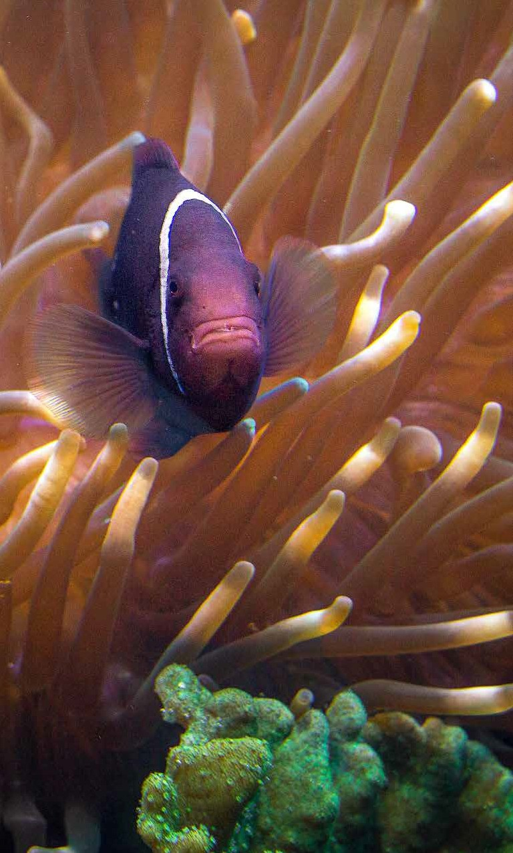
FAQs
Know Before You Go
Parking
On-Site Cafés
4D Films, Magic Memories, & Tours/Experiences
Amenities & Accessibility
Stroller Policy
Membership
October 01, 2018
Notes:
Takes notes on amenities & accessibility here: https://aqua.org/visit#amenities-accessibility – add slide after with group video attached – how to purchase add ons (call CR or purchase onsite)

Slide 10
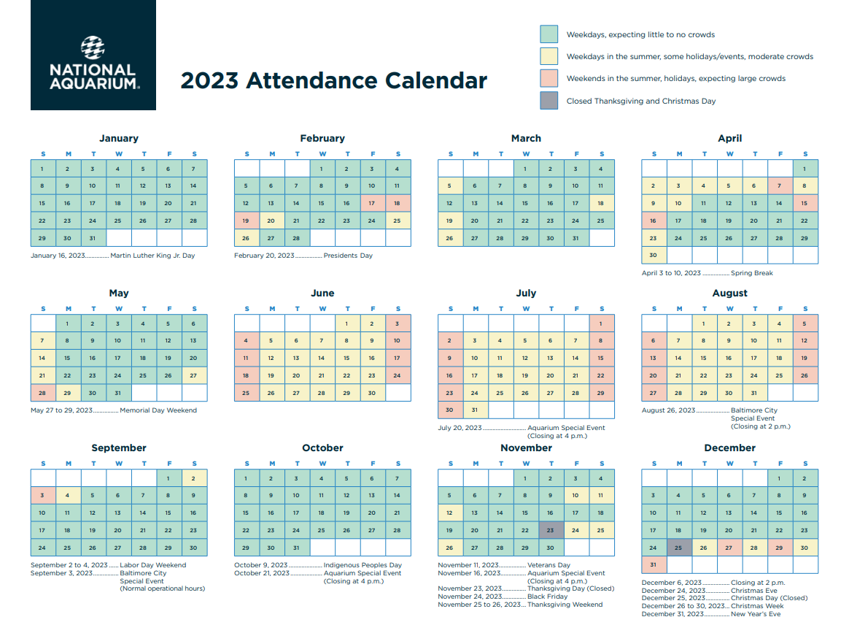

Slide 11
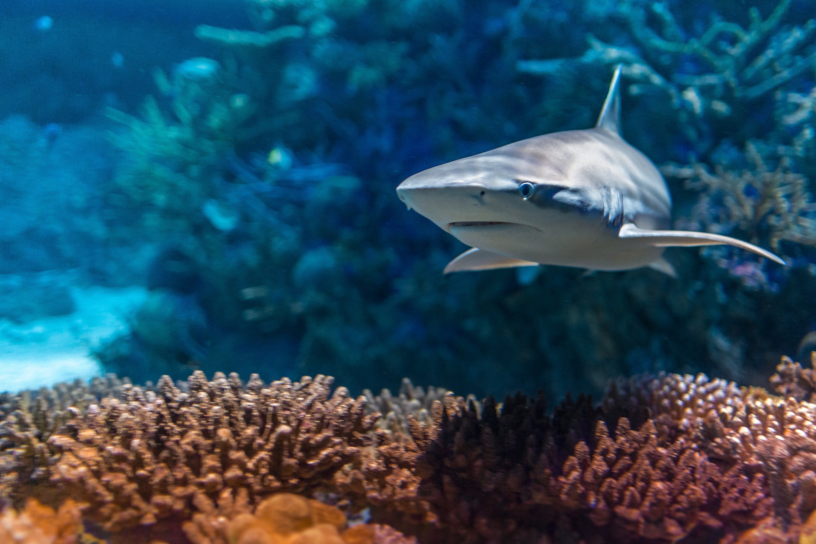
Questions

Slide 12

For you!
What kind or collateral/marketing materials would be helpful for your bases?
What is an example of successful marketing tools used on your bases?
Do you receive any FAQs that we have not covered?
October 01, 2018

Slide 13
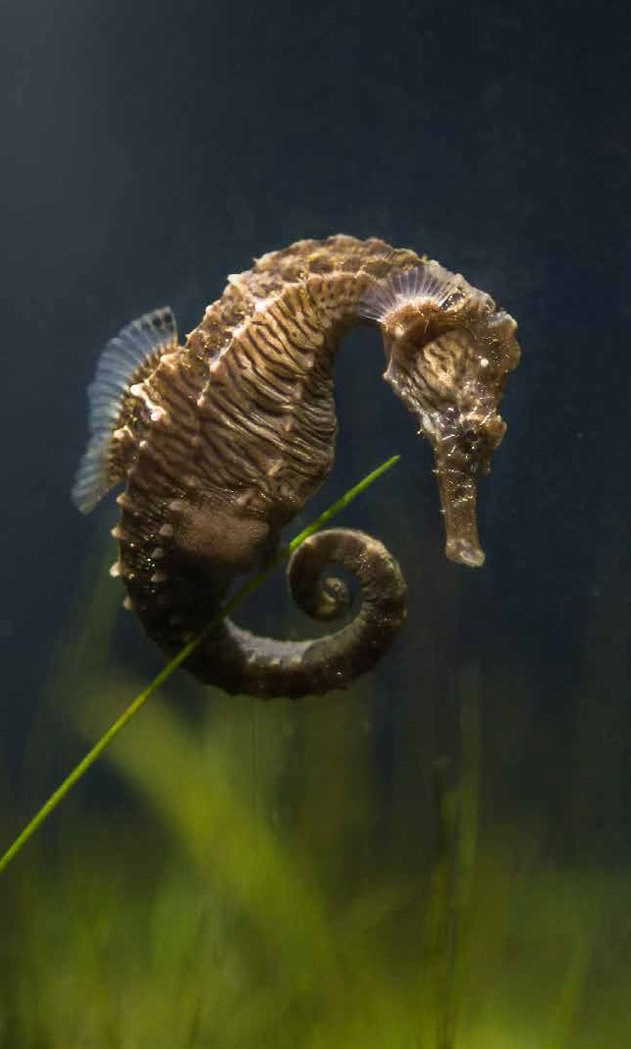
For Us?
esunderman@aqua.org
sbarr@aqua.org
October 01, 2018
Notes:
Add contact information

Slide 14
Thank you for your time!
We appreciate your partnership and support.

