Slide 1

Military Ticket Program (MTP)
Information & Training on Redeam Reseller Portal for
Disney Trade Ticket Connect (DTTC)
Notes:
Bonnie Gray, N922 MTP Manager
Jennifer Topolski, N922 Program Analyst
Joann Halbach, Redeam Partner Integrations Lead
Jenna Einhorn, Walt Disney World Sales Strategy & Integration

Slide 2
Redeam Guidance for Managers
Agenda
Training
Cancellations
Reporting
Reconciliations
Issues & Trouble Tickets
Questions

Slide 3
Redeam Access Overview
Redeam info:
Redeam Reseller Portal; aka: Disney Trade Ticket Connect (DTTC).
New Locations, MTP must send request to add new location to the Disney Channel Manager. This can take a few weeks to be loaded to the Redeam site
MTP will assign the Manager on file on the address update the role and ability to add new uesers.
The location manager is responsible for assigning all users own login.
Redeam Reseller General Training Link: https://redeam-2763550.hs-sites.com/knowledge/reseller-portal
Use training link to access training videos and instructions at any time. The portion of the application used by our tickets offices is the Reseller Portal (Resources in the “Redeam Central” training catalog will not apply)

Slide 4
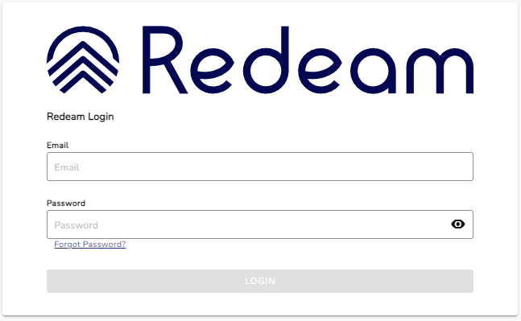
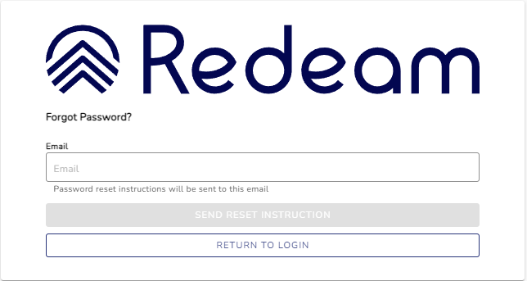
Login & Change Password
Login & Change Password:
Managers will receive an email from Redeam to login into Redeam.
The username is the managers email address
Login and change password.
  Select forgot password.
  You will receive an email from Redeam with a password reset.
  If you do not receive an email, check your SPAM folder before starting the process again.
Managers must set-up an initial password for each new user account
MTP recommends, per DOD guidance, ALL users then set their own unique passwords using the password reset feature.
Redeam URL: https://resellerportal.redeam.io/login

Slide 5
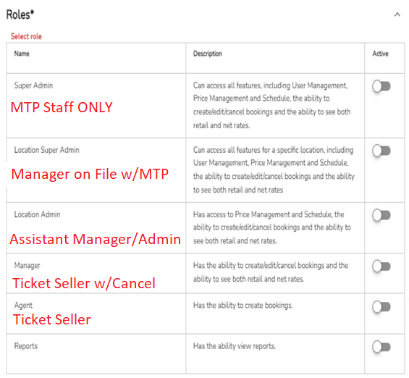
User Management
Training Link: https://redeam-2763550.hs-sites.com/knowledge/reseller-portal-company-user-management
User Management:
Managers will be given a new Role “Location Super Admin”, this role allows bases to set-up and manage their own local users.
  See suggested user roles in RED.
  Only ONE role is needed for each user
Ensure your Users in Redeam match those listed on your Office Update Request form.
Per DOD security requirements ALL Staff must use their own personal login. Logins CANNOT be shared.
Locations will be assigned a new Disney Customer Number/ POS Location Number for their Redeam store.
  The MTP Ticket Management System (TMS) facility information shows the Disney Customer number
Reminder: Please notify MTP immediately of staff changes by sending in the Office Update Request form.
Notes:
Company and POS Location phone numbers will be managed by MTP
MTP will add new manager accounts and deactivate accounts for managers as they leave

Slide 6
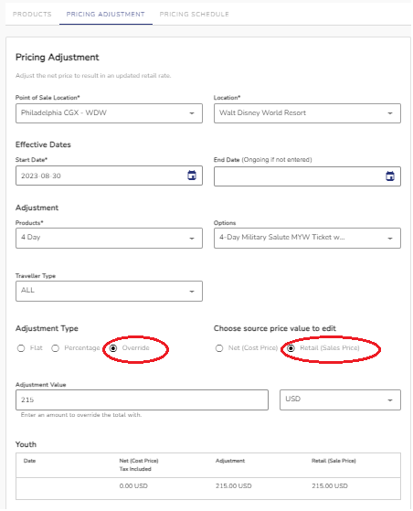
Retail Price Adjustments
Training Link: https://redeam-2763550.hs-sites.com/knowledge/reseller-portal-price-adjustments
Price Adjustments in Reseller Portal:
Redeam will pre-load the MTP suggested retail prices for all existing and new products.
Any changes after pre-load will be sent to the installation Manager to adjust in the system.
  Use the “Override“ and “Retail” Toggle to set the correct rate
Any updates to Redeam pricing, will be sent in an Enouncement and posted as an alert on the TMS Dashboard.
Do NOT sell tickets that do not have an active price in your POS.
ALL Prices listed in Redeam will be the MTP retail rate.
For POS/RecTrac Users –RecTrac ID’s and price codes will NOT be changed at this time.
Notes:
NOTE: “Retail Price” will appear on all customer confirmations. Agents MUST toggle this feature OFF prior to completing the order.

Slide 7
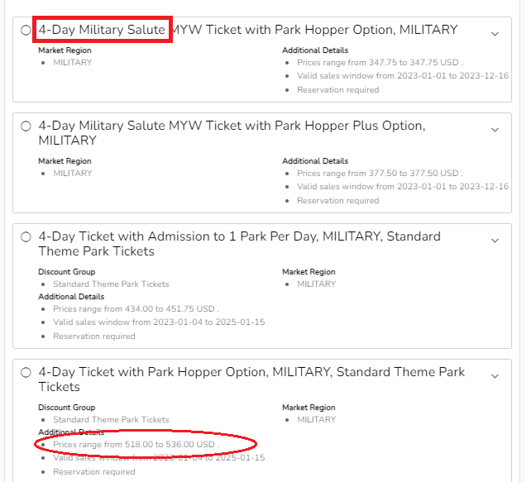
“Making Bookings”
Training Link: https://redeam-2763550.hs-sites.com/knowledge/reseller-portal-bookings
“Making Bookings” in the Reseller Portal:
Start Date – suggest the first date guest wants to travel
Once you select number of days you will see ALL products
Pay close attention to the ticket product names.
  ALL tickets will have “MILITARY” in their rate names
  For “Salute” & “FL Resident” make sure it is in the name
Price Range will reflect the MTP suggested retail.
  Price ranges will display retail price for General admission or both the Adult and Child (if applicable)
  After ticket selection input the desired number guests for each patron type
  For children be sure to have the guest confirm what the child ages will be at their anticipated time of travel and purchase their tickets accordingly

Slide 8
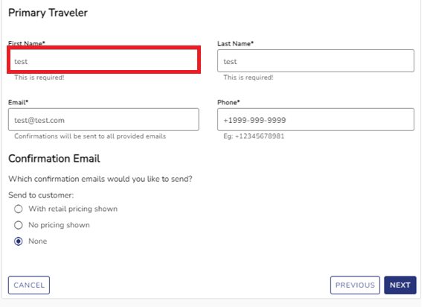
“Making Bookings” Cont.
Training Link: https://redeam-2763550.hs-sites.com/knowledge/reseller-portal-bookings
“Making Bookings” in the Reseller Portal:
Guest Name: Primary Traveler guest name is REQUIRED for DTTC transactions.
  NOTE: Primary guest should be person who will activate tickets on site at the park.
All bookings will automatically default to send the customer the retail rate of tickets on the confirmation email.
Client Reference Number is required for booking
  This value is up to each locations discretion
  Suggestions: location name, agent name, “MWR”
All users are able to resend or print the confirmation email & Will Call Certificate.

Slide 9
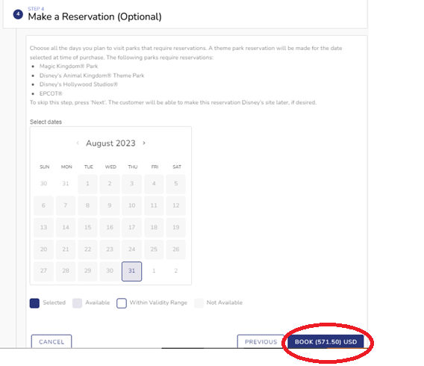
Park Reservations
Training Video Link: https://redeam-2763550.hs-ites.com/knowledge/reservations
Park Reservations:
Reservations are required for the parks
Making guest reservations at the time of booking in Redeam is optional
  Skip making reservations by selecting “Book”
  To make reservations use calendar and select dates and parks
Guests may make or modify their reservations through the startyourdisneyexperience.com or in the My Disney Experience app.
NOTE: The reservations feature does not allow for non-consecutive reservation dates. Military Salute tickets are not required to be used concurrently; so, it is recommended that guests who purchase Salute tickets make their own park reservations to allow for maximum flexibility.

Slide 10
Cancellations
Cancellations:
Super Location Admin, Local Admin & Managers are responsible for the cancellation of bookings.
  The standard Agent Role cannot process cancelations.
  Cancelling the booking will trigger a cancellation confirmation email.
  Bases are responsible for processing cancellations in Redeam before the end of the month.
  As long as the cancellation is processed within Redeam then the MTP Cancellation Request Form is not needed.
  If the cancellation cannot be processed within Redeam then DO submit the MTP Cancellation Request Form.
  Manual Cancellations – MTP will post in TMS, then the credits will appear on the bases monthly invoice.
  Bookings must be cancelled in full – be sure to create whole new orders

Slide 11
Cancellation Policy
Cancellations:
Any ticket booking is "able" to be cancelled, when a cancellation request is placed in Redeam, an internal "query" is performed to essentially see if the ticket "qualifies" to be cancelled. If it fails or is deemed "not voidable" it is because of one of the reasons below:
  Ticket was previously cancelled.
  Ticket was upgraded.
  Ticket was already used.
Tickets are not eligible to be voided:
  If past 30 days after the expiration date.
  If the ticket has no expiration date and is after 90 days of the ticket activation.
  If used or modified by Guest.
  There is no need to check usage when the ticket can’t be voided. If not eligible to be voided, the void will not be completed.
Bookings must be cancelled in full, no partial order cancellations are allowed

Slide 12
Reporting
Redeam Reporting:
Super Users & Location Super Admin can pull the “All Bookings Report”.
Location Super Admin (Ticket & Travel Manager) can run the Redeam report daily and verify to sales against their POS reports.
Prices on the Redeam reports will not reflect the BASE COST.
Each order will reflect the total retail price of the whole order.
Each order will display the number of days but not detail ticket amenities.

Slide 13
Reporting Cont.
Disney Base Next Day Reporting & Emails:
Disney will still generate and send a Next Day Report
  – MTP will support the updating of the Bases Next Day Reporting email for these reports
New fields include:
  Res Num - The Disney reservation number is Alpha Numeric and 12 characters. This is the number provided to Guests for linking their tickets.
  CMD Operator (Currently the agent seller id) in DTTC sends sales transactions, the value is TradeOrderSvc. When Voids are performed for orphan cleanup process, the value will be TradeUtilitySvc. Orphan bookings will rarely happen.
  Guest name – Lead guest name is required for all Bookings

Slide 14
Reporting Continued
TMS Vendor Direct Reports:
MTP will load the Redeam (DTTC) NEXT Day Sales Report to TMS every business day following sales by 10 a.m. CST.
Managers should run the TMS Vendor Direct Report to reconcile their point of sale system for previous days Redeam Sales
MTP Naming Convention for WDW Tickets will remain “DTC 1DAY BASE A” at this time. We are not changing the name of the tickets & there is no price change at this time.
For RecTrac users the RecTrac ID’s will also remain the same at this time, example, “DC”

Slide 15
Reconciliation
  End Of Month Invoicing:
  ALL DTC and DTTC Redeam Sales will be included in your TMS Vendor Direct Month End Invoice.
  The “TMS AR Reconciliation” report can also be used after invoicing to reconcile your end of month.
  Managers can pull their location invoices from TMS, under the Administration tab.
  Invoices will be provided from MTP after reconciling is complete, usually by the 5th business day of the month.
  If you have questions or concerns about your invoice, please contact MTP Accounting: mtp_accounting.fct@navy.mil

Slide 16
Trouble Tickets and Support
Issues & Support:
MTP will be your main support POC for the Redeam. ALL Support Requests should contain your location name, web browsers used, a picture of the error message received, & a brief description of what you were doing when the error occurred
Examples of when to contact MTP:
If you do not received a password reset email.
If users run into an issue while using Redeam email MTP Info Box or AIMS
Try logging in & out; Use a Different Browsers; Speak to your Manager
You can submit a trouble ticket to MTP through AIMS our 24/7 support desk or by contacting MTP.
    AIMS: 1-844-697-4357 or support@cniffr.org
    MTP: 901-874-6891 or info_mtp.fct@navy.mil
    Disney Customer Support
    If your customer has issues making park reservations, they can call My Disney Experience Support.
      Phone (407) 939-4357

