Slide 1

N922 Community Recreation
Military Ticket Program (MTP)
Disney Variable Price Briefing
Ms. Bonnie Gray, MTP Program Manager
Ms. Jennifer Topolski, Community Recreation Program Analyst

Slide 2
Disney Transitioning to Variable Prices
Walt Disney World will be changing to variable priced products starting February 1, 2025
  This means ALL prices will be determined at the time of each customer's order
  Disney will provide a percentage-based discount rate for each product.
  With this NEW requirement MTP has determined that the best route forward is to integrate the Disney tickets in TMS as an API Vendor.
    This will allow TMS to capture the orders and calculate prices in real time on demand
      Calculated Rates will include:
        Base Retail Rates
        Base & MTP Cost
        Base Commission
        Customers Saves
Notes:
We looked at the current Redeam platform and it could not provide all the necessary mark up rates.

Slide 3
Disney Transition to Impact to Sales
  Impacts to how Sales are Recorded
    No Set Pricing is available prior to sale*
    TMS will no longer be able to support a RecTrac Export file for Walt Disney World Product
    Bases will have to rely on reporting from TMS to Reconcile
  Bases will still be the merchant of record
  Base will process and record each transaction in their local POS
*Pending confirmation on Military Salute variable pricing.
Notes:
We do not have confirmation yet if the Salute tickets will also be variably priced.

Slide 4
Disney Transition Recommendations
  Navy Planned Courses of Action
    Installations will use an open key to record their transactions.
      Recommend configuring open buttons by type of product and a button for each ticket type.
      Will enable Agents to input the retail price and number of tickets sold for reconciliation against TMS reports.
      Open Key is a temporary mitigation until alternative technology become available.
Notes:
We do not have confirmation yet if the Salute tickets will also be variably priced.
Navy has determined a way to set up Open Keys for RecTrac 10.3
POS or Ecommerce

Slide 5
Disney Transitioning to MTP Actions
  Additional Actions MTP is Taking
    NEW reports in TMS:
      Daily Order Summary Report like the RecTrac DAR
      Daily Disney Order Summary Report just for the review and research of Disney sales
      Monthly Sales Invoice.
    TMS will now display the retail cost per ticket and retail price for the order
      Enables Agents to correctly input retail prices for each sale into the POS.
    Current TMS reports will now include Disney (i.e., E-ticket Details, Sales Order Detail and AR Recon)
    MTP will host several training sessions prior the transition to walk through the new sales process, and reports for bases to use in their sales reconciliations.
Notes:
We do not have confirmation yet if the Salute tickets will also be variably priced.

Slide 6
Questions?
Notes:
We do not have confirmation yet if the Salute tickets will also be variably priced.

Slide 7
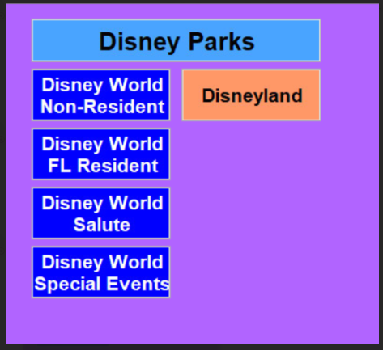
RecTrac Touch Screen Examples
  Main Button: Disney Parks
  Sub-Buttons: See Example
Notes:
We do not have confirmation yet if the Salute tickets will also be variably priced.

Slide 8
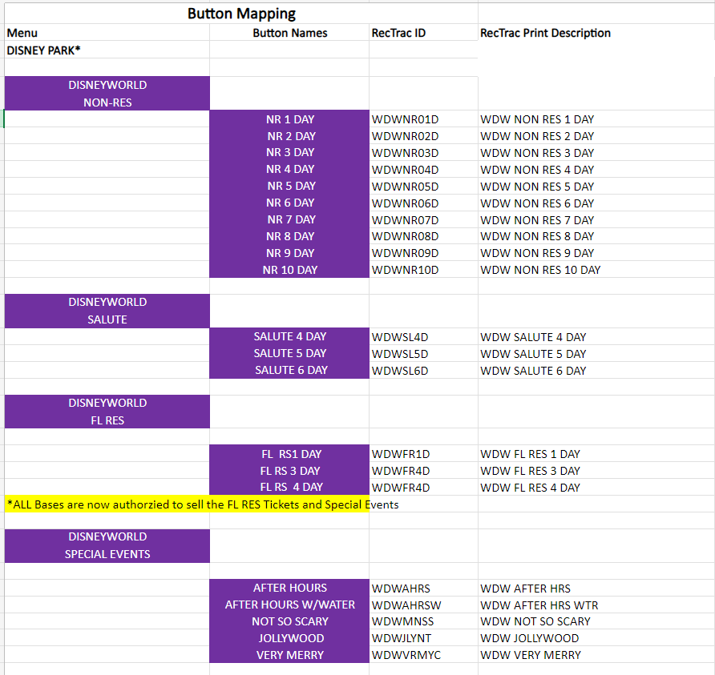
RecTrac Touch Screen Examples
  Product -Buttons:
Notes:
We do not have confirmation yet if the Salute tickets will also be variably priced.

Slide 9
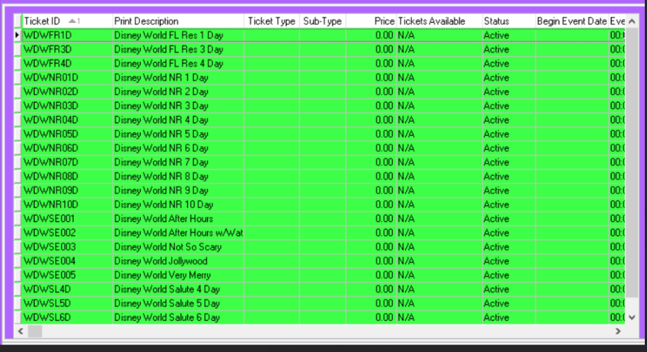
RecTrac Examples
  Pick List:
Notes:
We do not have confirmation yet if the Salute tickets will also be variably priced.

Slide 10
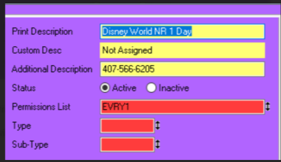
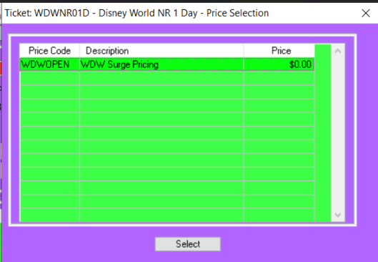
RecTrac Examples
  Print Description:
  Block Configuration:
Notes:
We do not have confirmation yet if the Salute tickets will also be variably priced.

