Slide 1

Disney Ticket Connect (DTC)
MTP Guidance for Installation Managers

Slide 2
DTC Guide for Managers
Overview
Login to DTC
Magnetic Card Readers
Agent Email
Shell Management
    Void/Disposal
DTC Reports
TMS Ticket Portal
  Dashboard
  Facility Info
  Shell Ordering
  Ticket Reconciliation
    Vendor Direct Reporting
    TMS Invoicing
    End of Month Checklist
  Trouble Tickets

Slide 3
DTC Overview
DTC Information:
Start Date will be Monday February 15th, 2021 – Ahead of Schedule
DTC Price Changes going into effect Feb 15th & 16th – pricing enouncement sent on 2/8/2021
Manager Access MTP will begin approving Mangers today
Shipping Delay
Return information for WDW tickets will be provided after DTC launch and authorization from Disney.
DTC Advantages:
No More WDW Ticket Stock
No More Monthly Counting of WDW Tickets
No more waiting for new stock when the price changes.
No More Waiting to be restocked by when tickets sell out
Print on Demand Access to all ticket types
Installations that stocked only specific tickets, like the Military promotion, or 3, 4, & 5 day tickets will now have on demand access to all tickets to better meet customer needs.

Slide 4
Login Access DTC for Installation Staff
Managers will receive access to DTC after they complete DTC training the week of Feb 8th – 12th
  Managers will login to www.disneytripexplororer.com and request an account. By Friday Feb 12th. After the manager receives access, they will instruct staff on submitting their requests for access.
  For you will see me * MTP Admin* as a user. Please do not modify/remove this role.
  ALL Staff should have their own personal login
  Each user will need to use their own unique email to create login. They will use the same email that is used for TMS SSO access.
  Managers will approve staff access
  Managers are responsible for assigning staff roles
  Installations are responsible for managing their own users.
    Remember to remove users when they leave your employment and submit notices of change to MTP.
    Reminder: Users should never share login information

Slide 5
Magnetic Card Readers
Magnetic Card Readers do not require any special software to add to your workstations.
Use of Magnetic Card Readers on your workstations were approved through your Joint Service Program Managers.
Magnetic Card Readers are for DTC Use Only
Sellers should NEVER swipe a Credit Card through the magnetic readers
Magnetic Readers should never be removed from the computer without consulting the Manager.
For Navy - Magnetic Card Readers are not authorized for use on ANY NMCI computers.
Installations will be responsible for the cost of replacement card readers or additional card readers.
  Reminder – shipments came with stickers (Do not swipe credit cards) ensure these are affixed to magnetic readers before connecting.

Slide 6
Sale Process –Confirmation, Customer & Agent Email
Agent Emails:
When processing a DTC sale an Agent Email is Required
The agent email will default to the email used to create the login account for DTC – see slides 11 &12 to see what email is used
** Managers should advise sellers on the email to use. **
Customer Emails:
When creating a sale a Customer Email is Required
Input and double check the email with the customer before processing the order, emails are able to be sent once.
The email will contain important information for the customer usage and linking of their tickets.
  There is no way to resend a confirmation if the initial email was invalid
Confirmation Pages:
Print Customer Confirmation Page and issue to the customer for every order.
We recommend printing two copies one for the customer and one for back-up.
** If your location is missing the generic email we have used info_mtp.fct@navy.mil for your default, your agents should change this to an email that you designate for every transaction. Once you provide the generic email the system will be updated.

Slide 7
Shell Management
Shell Inventory:
Shells have no cost/value until they are loaded. They are considered a supply.
Shells do not NEED to be inventoried
Shells should be secured where only staff can access them
Recommend shells are stored in a cool dry place out of direct sunlight.
Managers should maintain plenty of stock on hand
Orders for shells will be processed through the MTP TMS Back Office every Tuesday
Shells are only available in packs of fifty (50) by type (i.e., Military Salute, Magic Your Way Adult, Magic Your Way Child, and FL Resident Adult & Child (when applicable)).
MTP sends orders to a Disney 3rd Party distributor, orders are direct shipped to the installations at no cost.
Rush orders are not allowed, so place orders at least 3 weeks in advance.
Initial Shell inventory for installations will contain 3 months of Military Salute Shells and 9 months of Magic Your Way & Florida Resident Shells (if in Florida). Amounts were based off 2019 sales. If your installation never sold a type of ticket i.e., Magic Your Way Adult you will receive a pack of shells to get started.

Slide 8
Shell Management
Voiding Shells:
Managers will assign users ability to VOID tickets in DTC
DTC allows voiding of a ticket shell up to ninety (90) days from the original creation date.
DAMAGED shells should be turned into the manager for validation. If a user is creating an order and receives an error the shells swiped will need to be set aside and new shells used for the order. Damaged shells may be checked by attempting to void, and than validated on the reports.
VOIDED shells should be turned into the manager. The manager should validate shell voids when reconciling the DTC NEXT Day Reports and the TMS Vendor Direct Report.
For Invoicing all VOID’s must be completed before the end of the month to receive credit.
Once shells are validated as VOIDED on the reports follow local guidelines for ticket destruction.
If there is an error in DTC while voiding Managers may submit a “Ticket Cancellation Request” to MTP for support.
  Voiding Error on issued tickets normally means the ticket is used, has been modified by Disney or it has been over 90 days from the creation of the ticket.
  MTP will validate requests and send to Disney Destinations for support and processing
  MTP will notify bases once approved/denied and if a credit is processed.

Slide 9
DTC Reporting
End of Day Summary: ***Delayed***
  Each Seller Should can print out their end of day report and it will display what they have processed that day.
  Managers can print a report for their entire store for all users
Next Day Sales Summary Report/Next Day Detail Report:
  This will be emailed to the generic email on file provided during the DTC Data Call**
  These reports can be used to reconcile the number of tickets sold
  Prices on these reports will not reflect the base cost.
TMS Vendor Direct Report:
  MTP will load the DTC NEXT Day Sales Report every business day following sales by 10 a.m. CST.
  This report should be used to reconcile your daily sales to your point of sale system.
  A new pop-up has been added to this report which includes the transaction data from the DTC Next Day Detail report, to help with reconciliation.
** If your location is missing the generic email we have used info_mtp.fct@navy.mil for your default, your location will need to use the End of Day Reports and the TMS Vendor Direct Report to reconcile. Once you provide the generic email the system will be updated and you will receive the email directly.

Slide 10
TMS Back Office
TMS Dashboard:
When there is an update to DTC pricing MTP will send an enouncement and post an alert on the TMS Dashboard.
  Reminder: Check the Dashboard every time you login to TMS
  There are No Prices listed in DTC so if you see an alert notice of a price change in TMS make sure your point of sale is reflecting the new price.
DTC Customer Number:
  Installation DTC Customer Number should be the same as your MTP Customer Number. You can find your customer number in TMS Back Office Administration >Facility, select you location and then Select “Edit” > Contact & Address. ADD “ML” in front of your DTC # to create your agency ID for example if your DTC # is :12354 your AgencyID is: ML12354
DTC Generic Email:
  DTC Next Day Reporting Generic Email field will be added to TMS Back Office Administration > Facility> Details
Shell Ordering:
  In TMS Back Office Facility Orders >Prepaid Tickets
    Search for “DTC” to find the Packets
    MTP will update the Order as Shipped once it is placed.
    Processing every Tuesday
    Installations Should Complete the Goods Receipt once the shells are received.

Slide 11
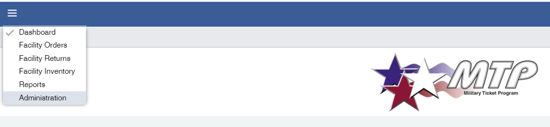
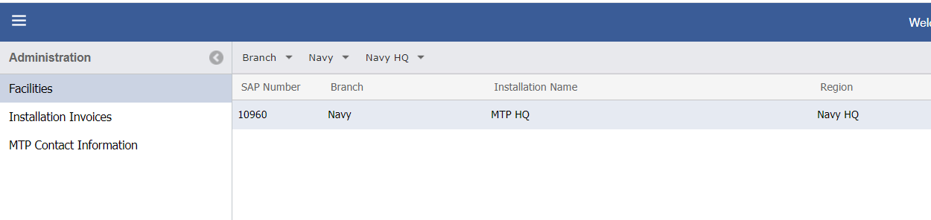
Find our DTC Number and Generic Email
TMS Back Office > Administration> Facility > “Click” to Select your location on right

Slide 12
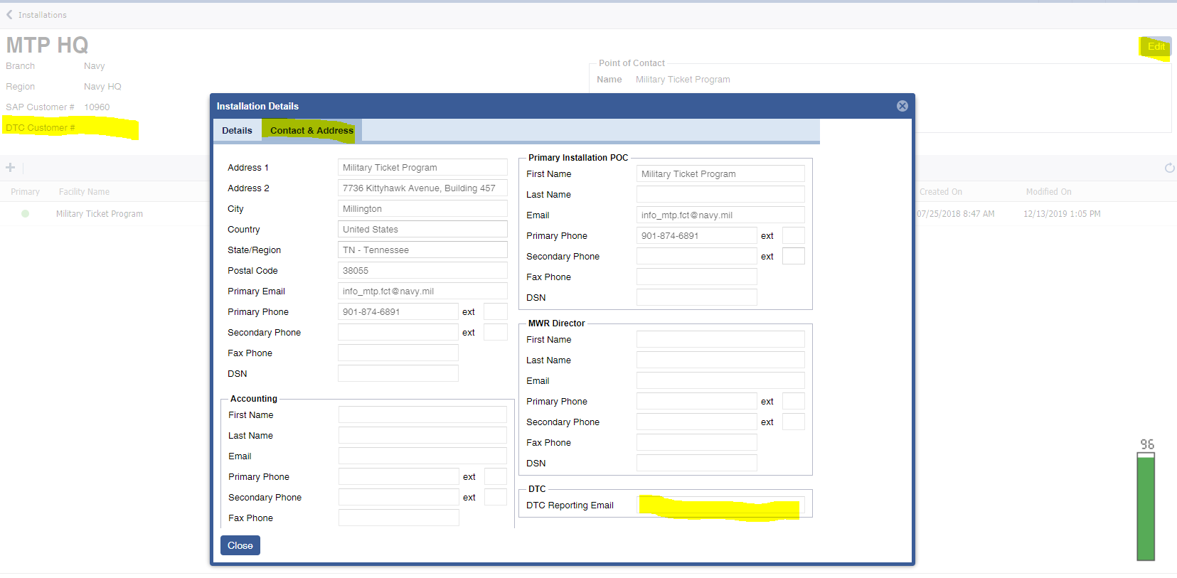
Find our DTC Number and Generic Email
Once you Select You location you will see your DTC #
Select > “Edit” to access your Installation Details
Select > Contact & Address to access the DTC Email for your store

Slide 13
TMS Back Office
Vendor Direct Report – Review Configuration:
DTC Next Day Detail Reports will be loaded into TMS every business day by 10 a.m. CST. For example Friday/Saturday will be loaded the following Monday.
MTP Changed Naming Convention for WDW Tickets. They will change from the traditional “WDW 1DAY BASE A” to “DTC 1DAY BASE A”
For RecTrac users the RecTrac ID’s will also shift from starting with “DW” to “DC”
Vendor Direct Report will be modified it will include the Vendor PLU to assist in the comparison to the DTC Next Day Sales Report.
Vendor Direct Report Pop-up will have the DTC Transaction ID & DTC Seller ID Added
Managers should run the Vendor Direct Report to reconcile their point of sale system for previous days DTC Sales.
DTC does not offer a monthly sales report – the Vendor Direct Report can be run for the month to complete end of month reconciliations.

Slide 14
TMS Back Office
Month End Checklist:
Reminder to review and complete the month end checklist
This is confirmation for you and MTP that your end of month totals were correct.
End Of Month Invoicing:
ALL DTC Sales will be included in your TMS Vendor Direct Month End Invoice.
The “TMS AR Recon” report can also be used after invoicing to reconcile your end of month.

Slide 15
Point of Sale
Point of Sale
  A Disney Ticket Import was provided on Monday, Feb 8th , 2021
    Managers should ensure all tickets with identifier of DTC are loaded into their point of sale by Friday 12th , 2021
  Navy sent out to all Joint Service Managers and had Button Configurations loaded to RecTrac Jan 4th, 2021
    Navy Users should see DTC Buttons added to their DISNEY Button
  Non-Navy please check with your Joint Service Manager for Point of Sale configuration concerns.

Slide 16
DTC Trouble Tickets
Technical Issues & Support:
If a user receives an error before they receive a confirmation, or if the DTC process freezes or stops, the user will need to put the ticket shells to the side and not use again. They will need to use new shells for a new transaction.
ALL trouble tickets should be directed to MTP for the first 3 months of using DTC.
  This will allow us to track frequently asked questions and also mitigate problems for all users not just single locations.
If users run into an issue while using DTC
  Try logging in and out
  Use a Different Browsers
  Speak to your Manager
  If manager is not available you can submit a trouble ticket to MTP through AIMS our 24/7 support desk or by contacting MTP.
    AIMS: 1-844-697-4357 or support@aimshelp.com
    MTP: 901-874-6891 or info_mtp.fct@navy.mil
    ALL Requests should contain your location name, web browsers used, a picture of the error message received, and a brief description of what you were doing when the error occurred.

Slide 17
Questions?

