Slide 1


Military Ticket Program
GO CITY SIGHTSEEING PASSES
Oct 15, 2025

Slide 2
GO CITY SIGHTSEEING PASSES
Training Agenda:​
Overview​
Key Transition Dates & Timeline
Sell A Ticket
Ticket Delivery
Confirmation Email Sample
Cancelations
Special Notes for Reconciliation
Q&A

Slide 3
GO CITY SIGHTSEEING PASSES
OVERVIEW:
Go City is discontinuing sales through the current API platform and is transitioning to sales through the upgraded API Platform which will go live on Monday, October 27th.
What changes will you see:
Once the sale is complete, customers will receive the email confirmation which will prompt them to print or download their passes.
Passes are mobile friendly.
Customers will use the app to make their reservations.

Slide 4
GO CITY SIGHTSEEING PASSES
KEY TRANSITION DATES:
  MTP will send an enouncement this week confirming the Go City products with new Price Codes.
  The old Price Codes on the existing API will show a selling end date of October 26, 2025.
  The new API/New Price Codes will go live on Monday, October 27, 2025. (Note: There will be no changes to products or pricing, only the Price Codes will be updated.)
  Bases should pull the Rec Trac Import on October 27, 2025 and load the file to prepare for sales starting that day. The export will reflect the new Price Codes, while product and pricing remain unchanged.
  Any requests for cancellation of tickets sold on the old API should be sent to the MTP info box for processing. Credit for cancellation requests is not guaranteed. Once a response is received from the vendor, MTP will inform the bases of the vendor’s decision.

Slide 5
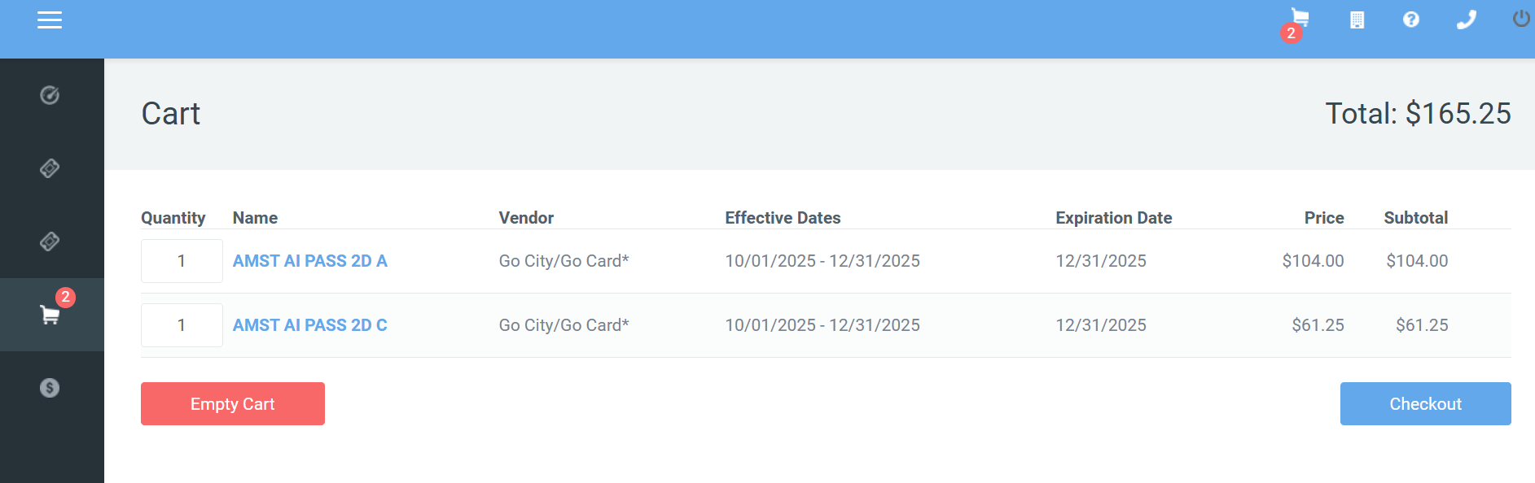
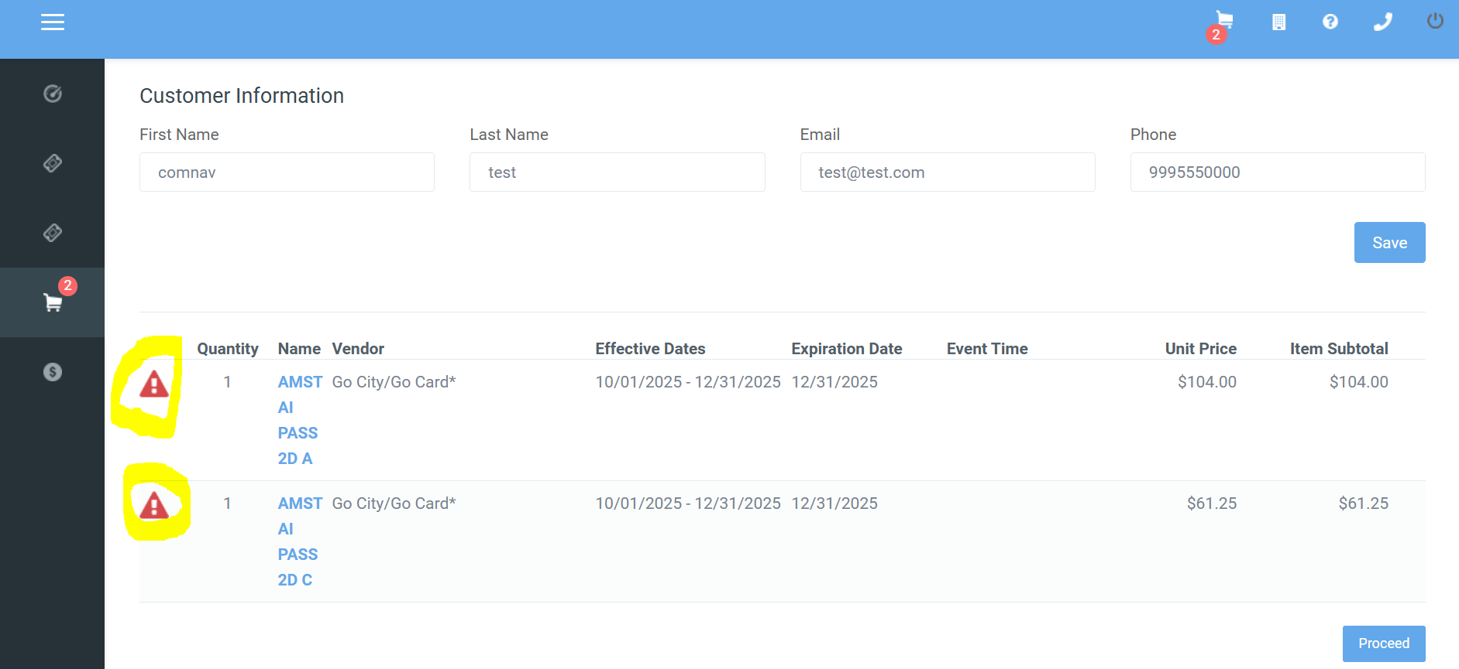
GO CITY SIGHTSEEING PASSES
SELL A PRODUCT. Choose the product and add to the cart
Proceed to checkout. Note the warning icons indicating more info is required.

Slide 6
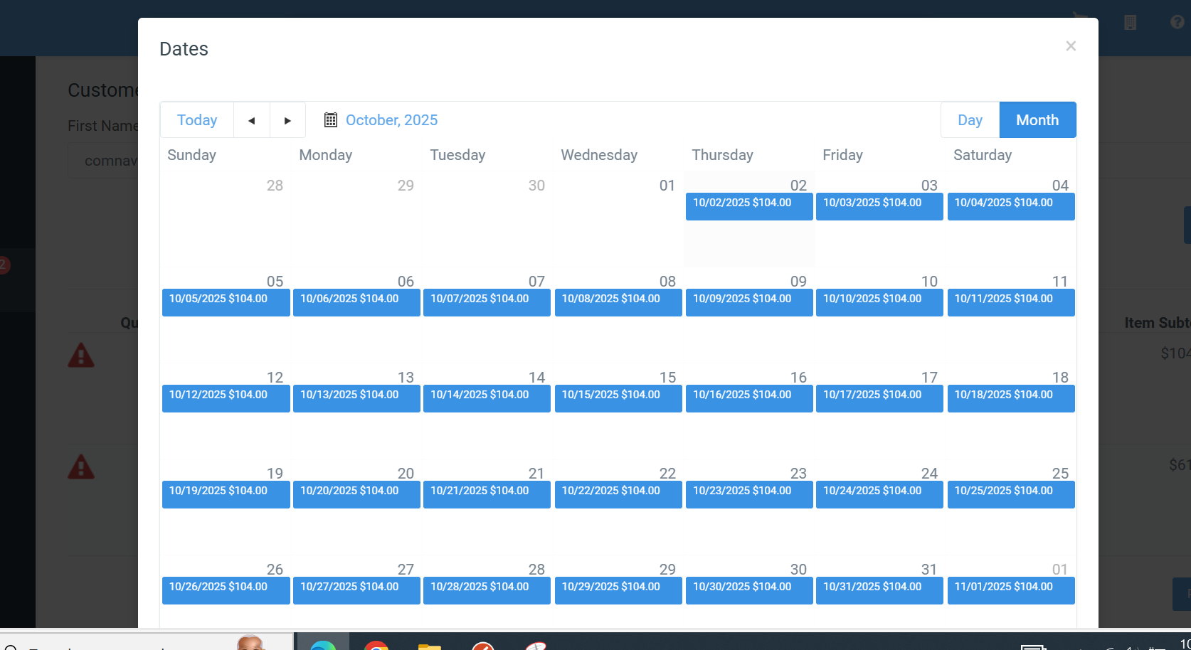
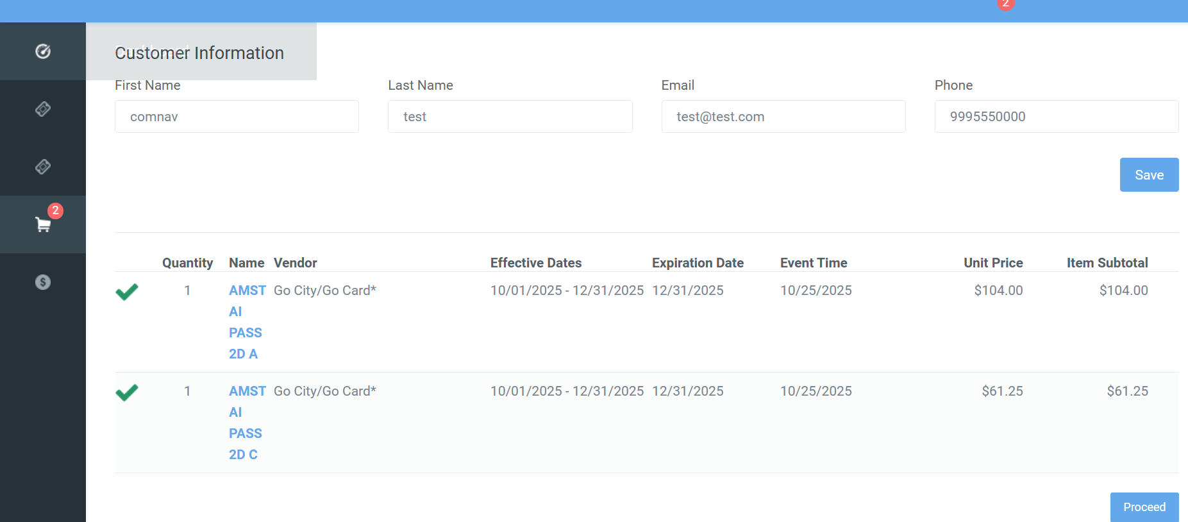
GO CITY SIGHTSEEING PASSES
After completing required info you will see the calendar popup.
Choose the dates requested by the customer.
After you choose a date for the AD ticket, all in the cart will
be populated with that same date

Slide 7
GO CITY SIGHTSEEING PASSES
TICKET DELIVERY & ETICKET EXAMPLE:
Advise your customers that an email has been sent with a copy of your ticket(s) & to see the attached .pdf document in the email. Please read all details on your ticket(s) for usage instructions.
Once received, the customer should then proceed to the app to make reservations.
*PROTIP: Always have a guest provide an email they can access on their mobile device. The guest should check and confirm receipt of their confirmation before they leave the ticket office.

Slide 8
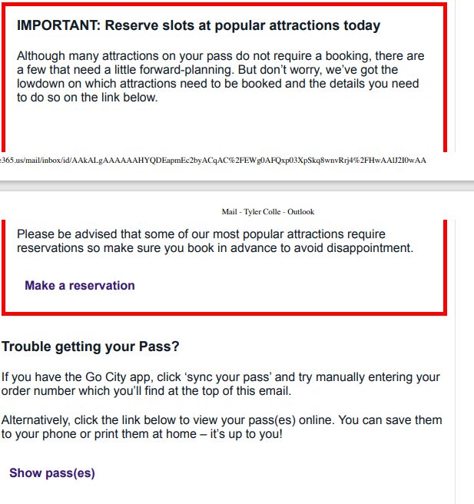
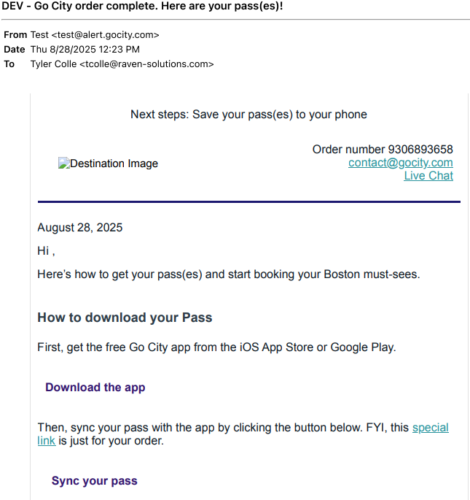
GO CITY SIGHTSEEING PASSES
TICKET DELIVERY & ETICKET EXAMPLE: con’t

Slide 9
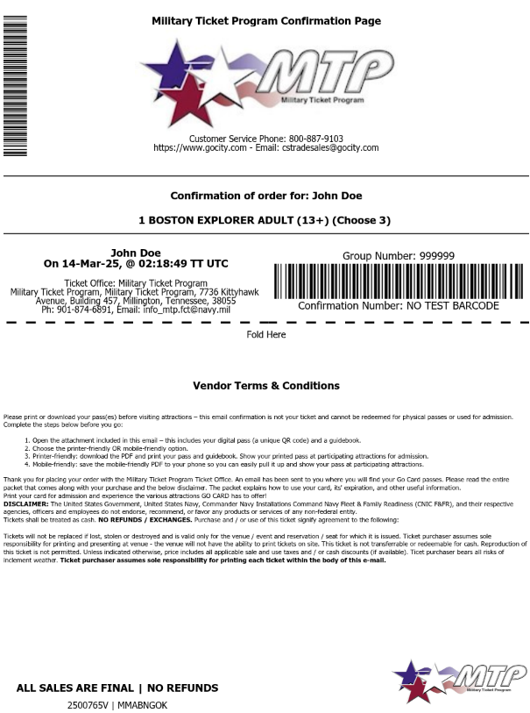
GO CITY SIGHTSEEING PASSES
TICKET DELIVERY & ETICKET EXAMPLE cont’d:
The customer will receive 2 emails, 1) with the MTP order details and 2) with links required to access their Go City Pass
Tickets will be delivered through the link included in the email confirmation and can also be printed. For customers, accessing tickets via email is the easiest option, as it provides direct access to the embedded ticket links.
Advise customers to get the GoCity APP on their phone so they can sync their pass. This info is also provided in the email confirmation.
Ensure the customer can identify the Sales Order Number in case they need to call in to Go City.

Slide 10
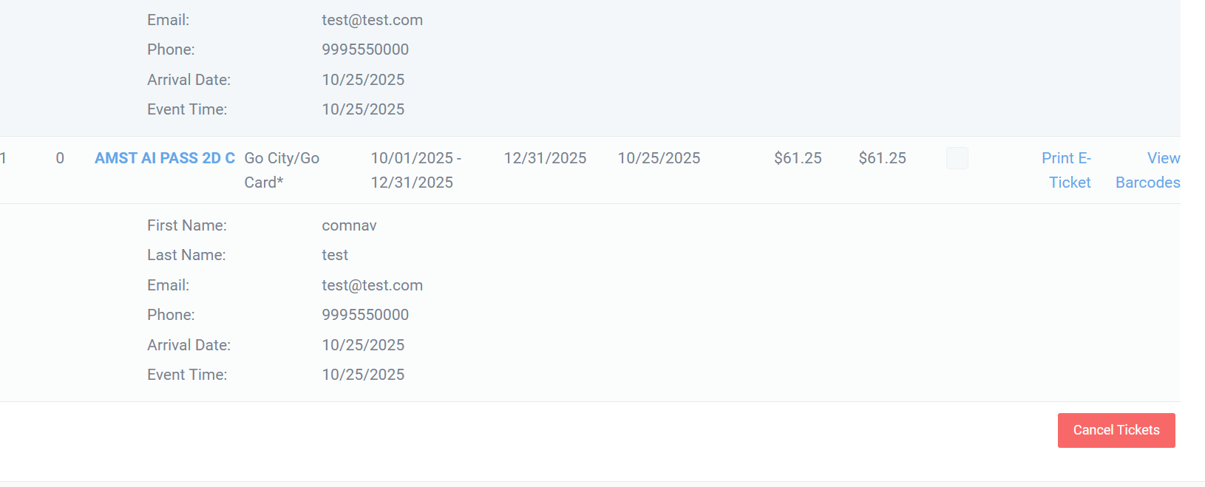
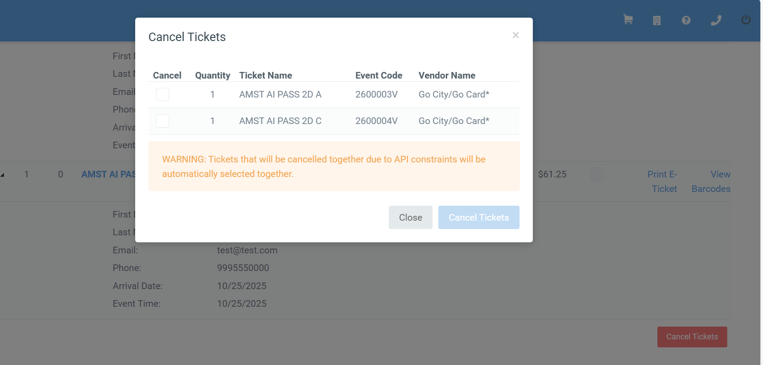
GO CITY SIGHTSEEING PASSES
When needing to cancel tickets sold through the new API, if tickets have not left the office, click the RED cancel button
Next, you will see this pop up indicating that to cancel one ticket is to cancel all like tickets on the order.

Slide 11
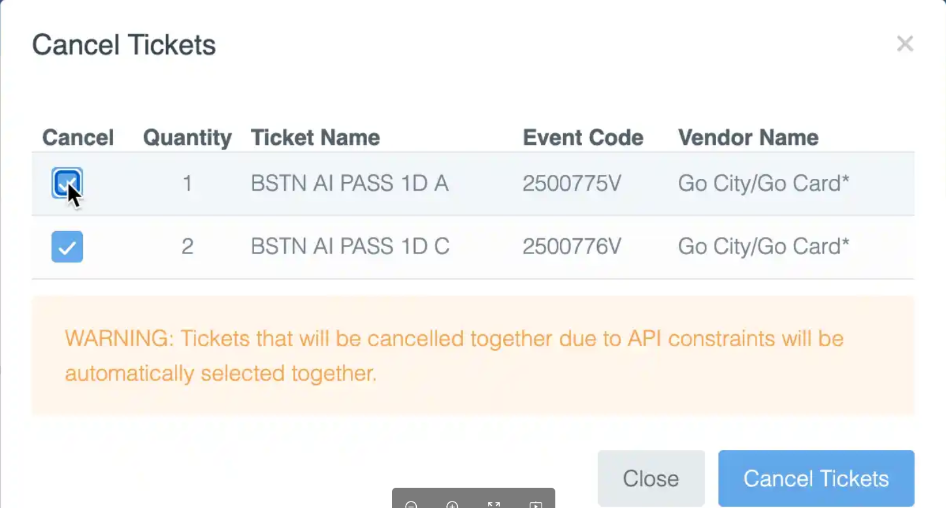
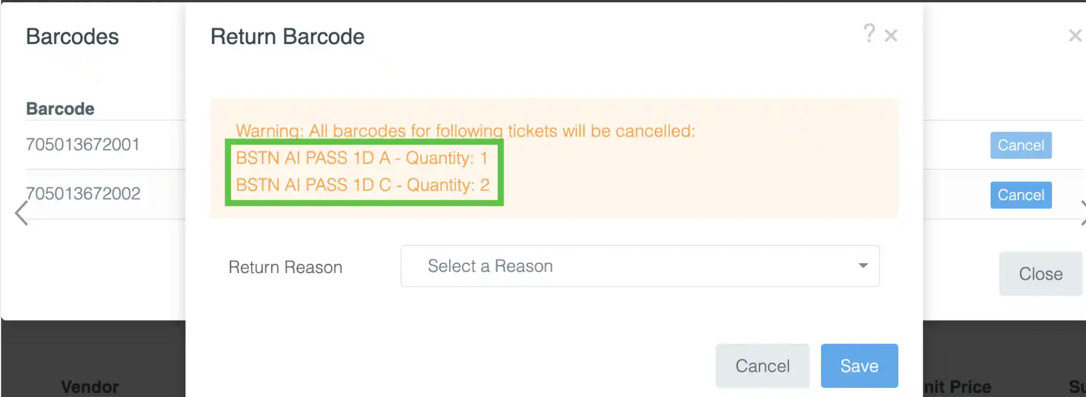
GO CITY SIGHTSEEING PASSES
CANCELATIONS:
New API Redeam Cancelations: When cancelling tickets, you have two ways to do so.
Click the red Cancel Tickets button at the bottom which will bring up a pop up with boxes you can select for which ticket you would like to cancel. The system will then look for any other tickets that have matching variant and attraction IDs as the selected ticket and automatically select those as well.
2. Select View Barcodes and then click the Cancel button next to one. This will cause a pop up to appear that informs you which tickets will also be cancelled along with that ticket
Partial cancelations per ticket type are not allowed meaning Adult & Child tickets of same ticket type will all be canceled.

Slide 12
GO CITY SIGHTSEEING PASSES
CANCELATIONS CONT’D:
Cancelations are not allowed if any ticket within the reservation has been used, expired beyond the selling end date, or modified through the vendor.
Complete a “Cancellation Request Form” for those that do not process and submit to info_mtp.fct@us.navy.mil
MTP will reach out to the vendor to request the cancelation and will respond to bases with the vendor’s decision.

Slide 13
GO CITY SIGHTSEEING PASSES
Special Notes for Reconciliation:
Changing price codes for tickets on the new API will allow you to clearly identify tickets sold through the deadline of Oct 26, 2025 (old API) vs tickets sold on the upgraded API beginning Oct 27, 2025.
Reminder – any cancelation requests of tickets sold on the old API should be submitted on the Cancelation Request Form through info_mtp.fct@us.navy.mil
Bases should reconcile ALL sales daily & especially reconcile at COB on the 26th after your final sale on the old API.

Slide 14
GO CITY SIGHTSEEING PASSES
QUESTIONS?

