Slide 1
Disneyland
PRINT ON DEMAND TICKETS NOW AVAILABLE THROUGH TMS!

Slide 2
Disneyland:
Print on Demand E-Tickets Live April 15, 2021!
Now Available on the Sales Portal on the MTP Ticket Management System (TMS)
Your Disneyland tickets will flow through to your E-Ticket Report!
Currently Sales are restricted to CA Residents
Use the Disneyland Availability Calendar prior to selling to ensure your guest will be able to go on their date of choice: www.disneytraveltradeinfo.com/dlrcalendar

Slide 3

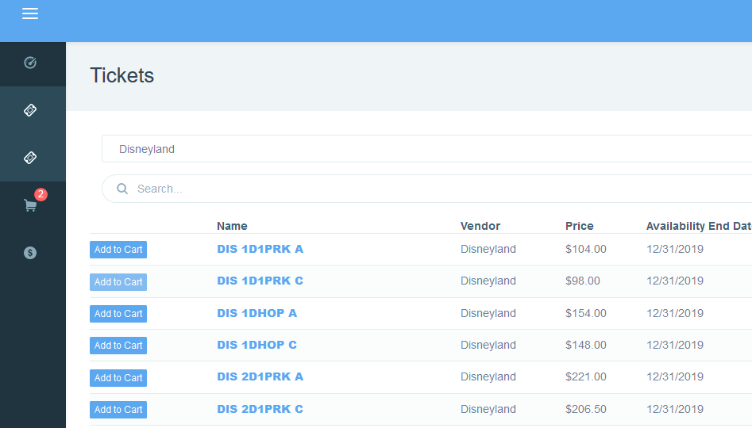
Selling Disneyland products in TMS
Print on Demand Ticket will have ‘Add to Cart” button

Slide 4


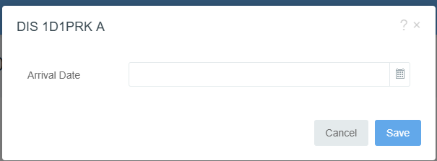
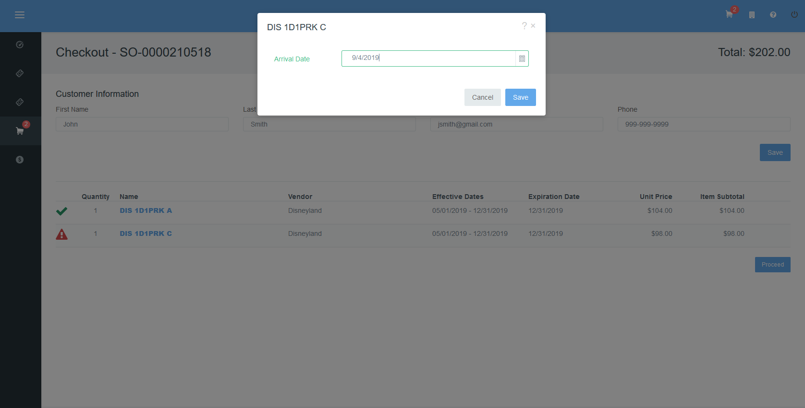
Selling Disneyland products in TMS
Once you have located the tickets and have entered and saved the customer’s information into the order you will need to provide the customers approximate “Arrival Date”
Select the Alert
When pop-up appears use the calendar to select approximate date of first use. There is no penalty if the patron does not use it on the date input, but ticket validity dates still apply.
You will have repeat the “Arrival Date” input for each ticket type. Once all the alert icons are resolved you may click to finalize the order.

Slide 5
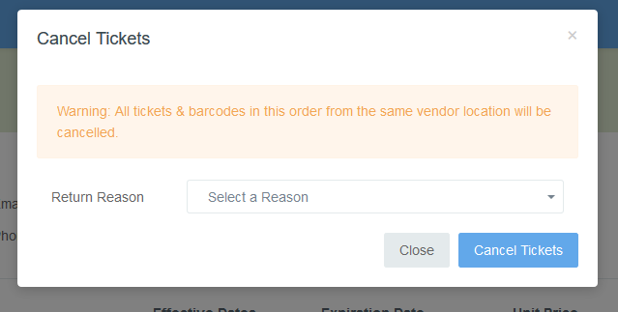
Cancelling Disneyland products in TMS
Disneyland Print-on demand Cancellation Policy
All tickets in an order must be cancelled at the same time
Disney will not authorize partial credits/refunds for unused tickets.

Slide 6
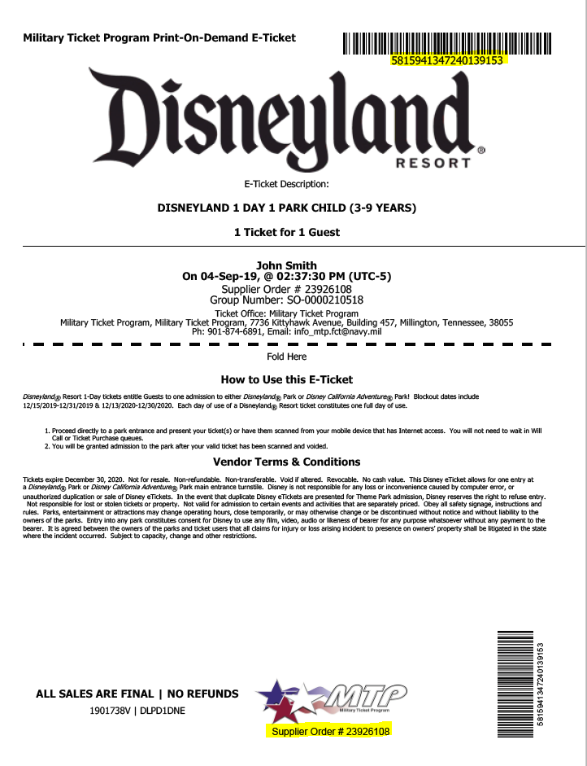
Selling Disneyland products in TMS
Disneyland Print-on demand Ticket Sample
Unique Layout Barcodes at Top of page and bottom right, barcode numbers also specific to each ticket
Supplier Order number is provided in the event there is an issue with the tickets. Customer service at Disneyland will be able to locate the order
Selling Tips
  Review :Ticket Description, Usage and terms and conditions with customer before they leave the office
  Validate children’s ages if purchasing, since children under 3 do not need a ticket.

Slide 7
Disneyland Ticket Types & Details
One Park Per Day Tickets : Tickets entitle guest to admittance to either Park each day over the specified number of days of the ticket. Tickets not valid for visits to both Theme Parks on the same day.
  Currently Disneyland offers a 1, 2, 3, 4, or 5 day ticket options.
  All multi-day tickets expire 13 days after first use or January 12,2023
  1Day 1Park tickets – have Blockout dates include 12/18/21-12/31/21; 12/16/22 – 12/31/22.
Hopper Tickets : Guests with a multi-day ticket must make a park reservation for each date of their visit. Guests with a Park Hopper ticket will choose which theme park they wish to start their day - they may visit the other park on the same day after 1:00 p.m.
The ability to visit a park is subject to the park's capacity limitations. Limit one park reservation per Guest, per day. Theme park reservations are limited and subject to availability, capacity, restrictions, change and cancellation at any time. Visit disneytraveltradeinfo.com/dlrws to learn more about important information you need to know before your Disneyland® Resort visit.
Currently Disneyland offers a 1, 2, 3, 4, or 5 day ticket options.
  All multi-day tickets expire 13 days after first use or January 12,2023
  No Black-out dates.

Slide 8
2021 – Park Reservation Required for Park Entry & Limited to California Residents
Sellers can use the Disneyland Availability Calendar prior to selling to ensure your guest will be able to go on their date of choice: www.disneytraveltradeinfo.com/dlrcalendar
  *Dates selected in TMS at time of order do not meet guest reservation requirements
GUEST RESERVATIONS REQUIRED
Guest goes to : StartYourDisneylandExperience.com to make a reservation
  Guests will manage their own reservation
  If guests travel date selected at the time of booking changes it is fine, and will have no impact on their reservation, they can arrange reservations as needed.
  CALIFORNIA PROOF OF RESIDENCY
  Guest will be required to show proof of CA residency for entry to the Parks.
  Every adult age 18 + should have proof with them
  Official Listing – Government State Issue ID, or a Utility Bill
  Guess should visit: disneytraveltradeinfo.com/dlrws

Slide 9
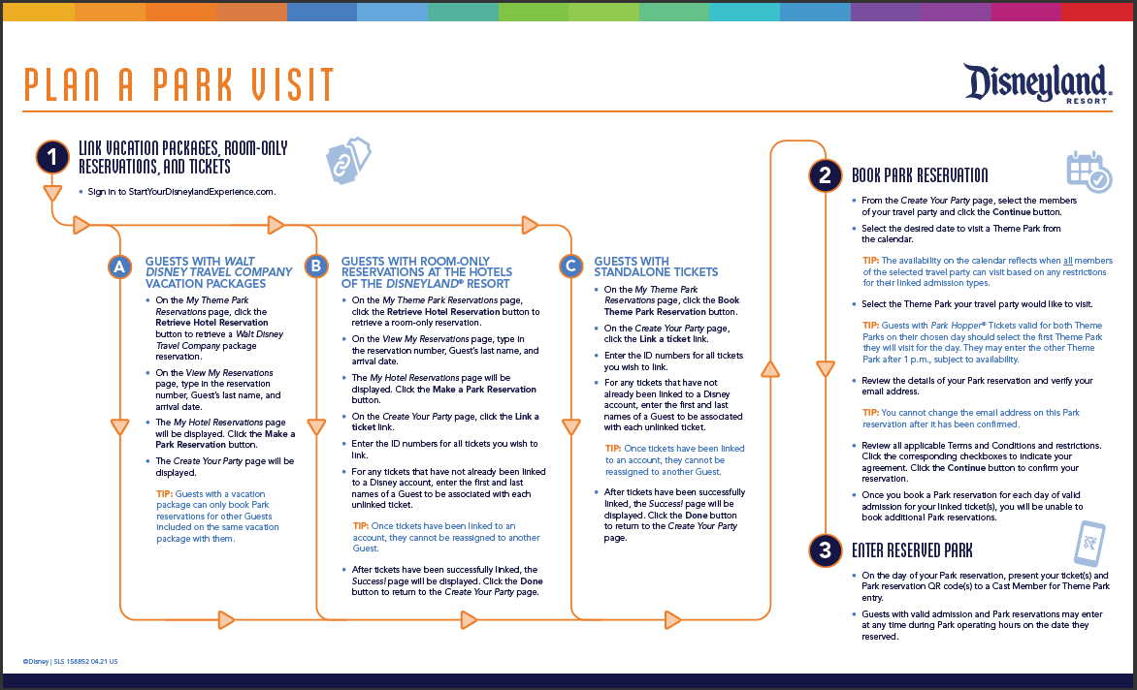

Slide 10
Usage Extension Information for 2020 Military Salute tickets
ALL Tickets Retain Value if Unused for exchange guests are encouraged to login to the Disney website to validate their unused tickets purchased prior the park closure due to
COVID-19
2020 Military Promotional Dates: Salute is valid through 12/16/21. The usage window of "2020 Disneyland 3 and 4 day Military Salute Promotional Tickets" previously sold are extended through December 16, 2021 with the block-out dates of 12/19/20 - 1/4/21 and 3/26/21 - 4/11/21.
If the guest is unable to visit by December 16, 2021, Disney will allow the guest to apply the value of a wholly unused Ticket toward the purchase of a ticket for a future date

Slide 11
Disneyland Resort Park
Disneyland Park is where it all began. Two parks make up the Disneyland experience. There is Disneyland Resort and Disney California Adventure Park.
Discover a thrilling planet during your Star Wars-themed expedition on Star Tours—The Adventures Continue and meet Chewbacca, Darth Vader and Kylo Ren at Star Wars Launch Bay.
Explore Mickey’s Toontown, the longtime home of some of our favorite Characters. Here you can meet Mickey—and take a self-guided tour of his house.
Celebrate more than 50 years of swashbuckling fun with Pirates of the Caribbean.
Visit exciting worlds of imagination during Mickey and the Magical Map—a live musical show featuring beloved Disney Characters.
There is a Haunted Mansion, a creepy estate home to ghosts, ghouls and all sorts of supernatural surprises.

Slide 12
Disneyland California Adventure Park
Discover a whimsical boardwalk where beloved Pixar stories and Characters come to life when you visit Pixar Pier, home to the newly reimagined Incredicoaster.
Embark on a thrilling, free-fall adventure with the Guardians of the Galaxy – Mission: BREAKOUT!.
Meet cool Super Heroes like Black Panther, Spider-Man, Captain America, Thor and Groot.
Gear up for high-octane action in Cars Land with zippy attractions such as Radiator Springs Racers and Mater’s Junkyard Jamboree.
View riveting entertainment like Frozen—Live at the Hyperion.

