Slide 1
Disneyland
PRINT ON DEMAND TICKETS NOW AVAILABLE THROUGH TMS!

Slide 2
Disneyland:
Print on Demand E-Tickets Live OCTOBER 1, 2019!
Now Available on the Sales Portal on the MTP Ticket Management System (TMS)
No more Waiting for sales load and invoice each month!
Your Disneyland tickets will flow through to your E-Ticket Report!

Slide 3

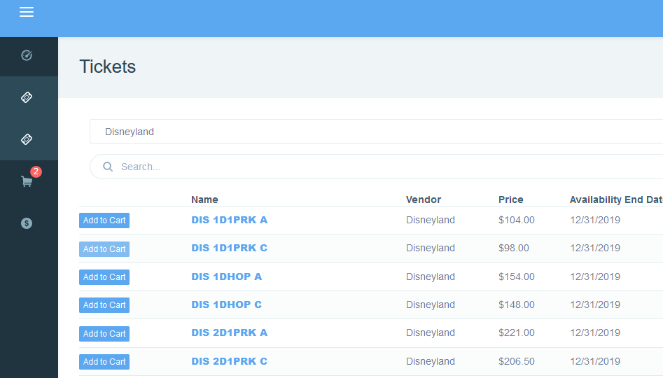
Selling Disneyland products in TMS
Print on Demand Ticket will have ‘Add to Cart” button

Slide 4


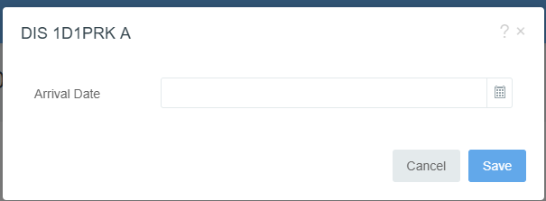
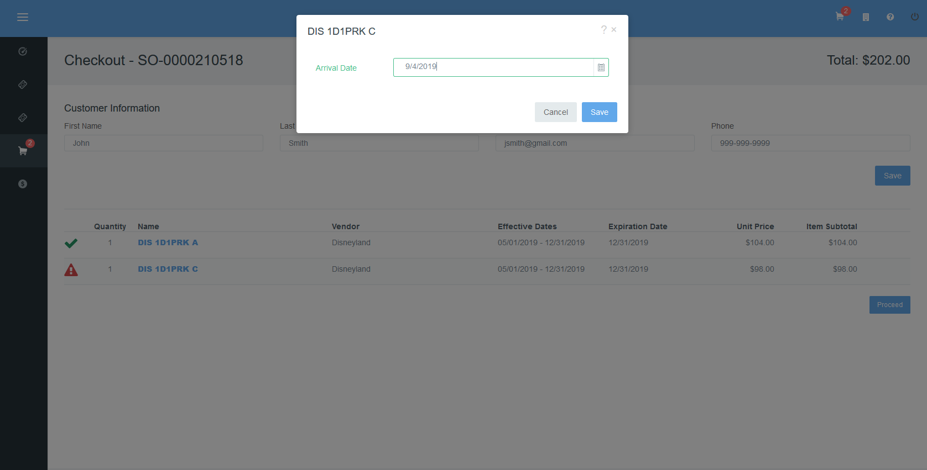
Selling Disneyland products in TMS
Once you have located the tickets and have entered and saved the customer’s information into the order you will need to provide the customers approximate “Arrival Date”
Select the Alert
When pop-up appears use the calendar to select approximate date of first use. There is no penalty if the patron does not use it on the date input, but ticket validity dates still apply.
You will have repeat the “Arrival Date” input for each ticket type. Once all the alert icons are resolved you may click to finalize the order.

Slide 5
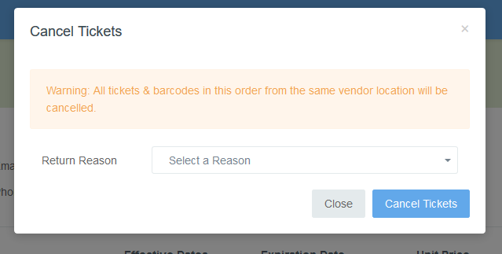
Cancelling Disneyland products in TMS
Disneyland Print-on demand Cancellation Policy
All tickets in an order must be cancelled at the same time
Disney will not authorize partial credits/refunds for unused tickets.

Slide 6
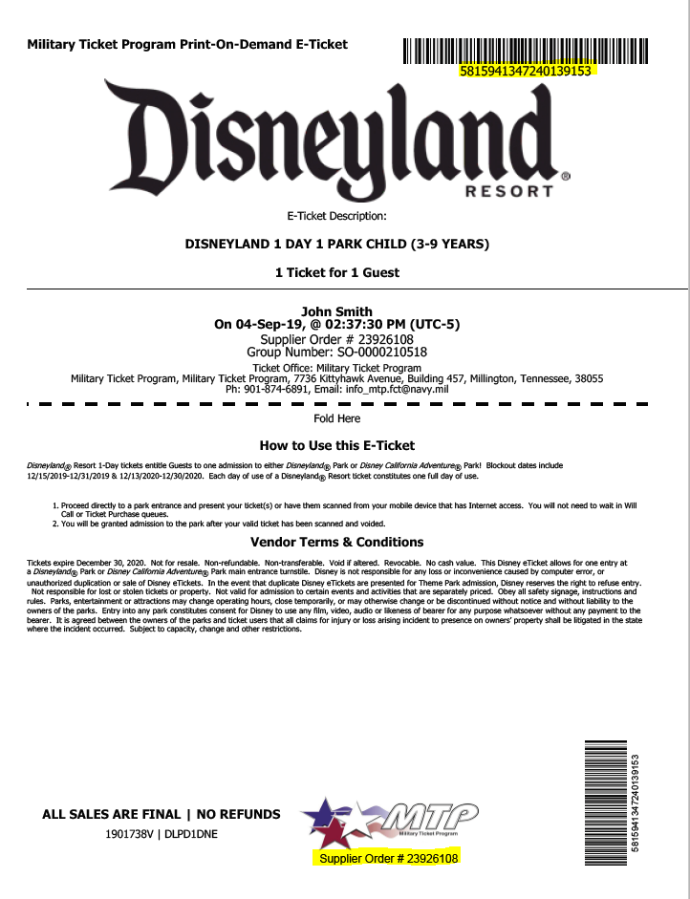
Selling Disneyland products in TMS
Disneyland Print-on demand Ticket Sample
Unique Layout Barcodes at Top of page and bottom right, barcode numbers also specific to each ticket
Supplier Order number is provided in the event there is an issue with the tickets. Customer service at Disneyland will be able to locate the order
Selling Tips
  Review :Ticket Description, Usage and terms and conditions with customer before they leave the office
  Validate children’s ages if purchasing, since children under 3 do not need a ticket.

Slide 7
Walt Disneyland Resort Park
Disneyland Park is where it all began. Two parks make up the Disneyland experience. There is Disneyland Resort and Disney California Adventure Park.
Discover a thrilling planet during your Star Wars-themed expedition on Star Tours—The Adventures Continue and meet Chewbacca, Darth Vader and Kylo Ren at Star Wars Launch Bay.
Explore Mickey’s Toontown, the longtime home of some of our favorite Characters. Here you can meet Mickey—and take a self-guided tour of his house.
Celebrate more than 50 years of swashbuckling fun with Pirates of the Caribbean.
Visit exciting worlds of imagination during Mickey and the Magical Map—a live musical show featuring beloved Disney Characters.
There is a Haunted Mansion, a creepy estate home to ghosts, ghouls and all sorts of supernatural surprises.

Slide 8
Walt Disneyland California Adventure Park
Discover a whimsical boardwalk where beloved Pixar stories and Characters come to life when you visit Pixar Pier, home to the newly reimagined Incredicoaster.
Embark on a thrilling, free-fall adventure with the Guardians of the Galaxy – Mission: BREAKOUT!.
Meet cool Super Heroes like Black Panther, Spider-Man, Captain America, Thor and Groot.
Gear up for high-octane action in Cars Land with zippy attractions such as Radiator Springs Racers and Mater’s Junkyard Jamboree.
View riveting entertainment like Frozen—Live at the Hyperion.

Slide 9
Disneyland Ticket Types & Details
One Park Per Day Tickets : Tickets entitle guest to admittance to either Park each day over the specified number of days of the ticket. Tickets not valid for visits to both Theme Parks on the same day.
  Currently Disneyland offers a 1, 2, 3, 4, or 5 day ticket options.
  All multi-day tickets expire 13 days after first use or January 12,2021
  1Day 1Park tickets – have blackout dates 12/15/19-12/31/19 and 12/13/2020-12/30/2020
Hopper Tickets : Tickets entitle guest to admittance to either Disneyland theme park each day over the specified number of days of the ticket.
  Currently Disneyland offers a 1, 2, 3, 4, or 5 day ticket options.
  All multi-day tickets expire 13 days after first use or January 12,2021
  No Black-out dates.

Slide 10
Disneyland Ticket Types & Details
MAXPASS: Option available for all ticket types.
  Allows guests to get FASTPASS reservations on their mobile device
  FASTPASS times are subject to availability
  All members in the party must have the MaxPass option to register for FASTPASS Times
  Also allows guests access to the PhotoPass downloads take by Disney photographers on select rides.
  Great options for guests attending on a shortened time schedule who don’t want to have to wait in long lines.

Slide 11
Disneyland Products - Ticket Options
Military Promotional 3- and 4-Day Park Hopper Tickets or Military Promotional 3- and 4-Day Park Hopper Tickets with MaxPass. Service members and families can visit both theme parks each day on their ticket!
Purchase from November 1, 2018 through December 18, 2019 and receive admission:
  3 days for just $175.25 or w/MaxPass for $219
  4 days for $194.75 or w/MaxPass for $253
Tickets Valid for use from January 1 through April 13 and April 23 through December 21, 2019.
Disneyland offer is available to active and retired U.S. military personnel or their spouses including active or retired members of the National Guard, Reservists, the U.S. Coast Guard, the Commissioned Corps of the Public Health Service (PHS), and the Commissioned Corps of the National Oceanic and Atmospheric Administration (NOAA) (“Eligible Service Members”). Valid military identification will be required for purchase and use.
Limit (6) Tickets per eligible service member (or Spouse but not both unless both qualify as a member)
If service member is an Annual Pass holder they are not required to have the Military promotional ticket but they are limited to purchase (5) five promotional tickets total.

Slide 12
Questions?

