Slide 1

Military Ticket Program
Disney World Transition
TMS & Date-Based Tickets
February 18, 2025
2/18/2025

Slide 2
Disney World Transition
Training Agenda:
Overview
Key Transition Dates
Pricing Structure Overview
  Static Tickets, Dated Based, and Peach Pricing (dynamic)
  Price Information
Ticket Selling Examples
  Static
  Dynamic
  Data to Review before Completing Orders
Ticket Delivery
Cancellations
TMS Reporting
  New Reports
End of Month Reconciliation & Invoicing
FAQ & QA
.

Slide 3
Key Dates
February 17-21, 2025
- MTP will send an enouncement email outlining price and product changes
February 25, 2025 (Estimated Date)
- New Disney World pricing live in TMS
- RecTrac team will be updating 10.3 in the morning
-Redeam website user accounts will be modified to only access reports
- ALL Cancellation Requests will need to be sent to MTP for processing
March 3rd-8th, 2025
- First E-ticket Invoices with API Sales will be generated
- Last Invoices for Vendor Direct sales will be generated
May 31, 2025
- Access to the Redeam website will be discontinued

Slide 4
Key Definitions
Static (Fixed Pricing): Applies to -
  Military Salute Tickets,
  FL Resident Promo Tickets,
  Special Event Tickets (i.e., After Hours, H2O, Mickeys Not So Scary Halloween Party)
Date-Based Pricing:
  The price will change depending on the date or time and is influenced by factors such as seasonal demand, special events, holidays, or time-specific promotions.
  Currently, Non-Resident (also known as Magic Your Way products) will transition to date-based pricing.
  Reservations no longer required – arrival date is the customer reservation start date.
Flexible Pricing (dynamic pricing – coming soon):
  The price will change depending on the date of travel, as well as the date of booking (guests' an airline ticket).
  The further in advance the guests' books, the chances the price will be lower (but not guaranteed).
Notes:
Definition Notes:
Static: Also known as fixed pricing, is a strategy where the price of a product or service is set at a consistent level and does not change based on market conditions or demand. This pricing model provides stability and predictability for both businesses and consumers.
Date-Based Static: Pricing is a pricing strategy where the price of a product or service remains fixed regardless of the date it is purchased or used. This means that the price does not change based on factors like demand, seasonality, or special events. But product could become unavailable once attraction capacity level is reached.
Date based variable pricing: (Disney Term for what MTP Defined as Variable or Dynamic pricing since we handle static priced Date Based and Timed tickets for other API vendors). Date-based pricing is a strategy where the price of a product or service changes depending on the date or time. This can be influenced by factors such as seasonal demand, special events, holidays, or time-specific promotions. In Disney’s Case they have 300 products that could shift prices several times in any given month and or calendar year. Potential for over 3000 to 5000 different prices throughout the year.
Disney will launch Peach for Magic Your Way in the next several weeks. MTP will provide notice of when and which products are impacted.

Slide 5
Pricing Structure Impacts
Price Codes: All tickets will be getting new price codes, naming conventions, and RecTrac ID’s.
Static Tickets:
  MTP will continue to send set ticket pricing structure.
  Rectrac Ticket imports will be manually created and provided by MTP with the pricing enouncement emails.
Date-Based and Dynamic Pricing:
  Disney is transitioning to percentage-based discounts.
  Disney will set a discount percentage on each product and will vary based on the travel date at the time of purchase.
  All 3-10 day tickets will have at a minimum a 20% discount off the gate price + tax.
  1-2 day tickets will have a discount average of 11-12% off the gate price + tax.
  Water park tickets not be discounted; however, bases will receive an average 5% commission.
  Each time a new price is sold in TMS a new price code will be automatically generated.
Retail Price:
  Based on the pricing configurations, Resale and Total Retail price will be displayed in the TMS Ticket portals for sellers.
  These should be used at the time of order to input into their POS systems to complete the sale.
Base Cost and Base Net (Commission): Will be available in a new Disney Sales Detail Report.
Notes:
In Order to support the creation of prices on demand Disney World, MTP had to transition Disney World to and API Vendor
TMS has been modified to generate the prices on demand
We have added new reports
Sellers will have to use the retail prices in TMS at the time of sale in order to administer for the correct rate
As of October 2023, the use of mag-readers and ticket shells has been discontinued.
Managers will have access to reports to see important ticket pricing information once orders are placed
Base Cost: Will be calculated by TMS at the time of order.
Base Suggested Retail Mark-Up: MTP will uphold the current mark-up standard of 10-12%, ensuring the retail price does not surpass the gate price with tax.
Base Commission: Will be calculated based on the base cost and suggested retail price.
Gate Price w/Tax : TMS will calculate the gate price with tax at the time of order to show true real time guest savings.
guest Savings: TMS will calculate based on gate price and retail price.

Slide 6
Product Changes
One Day Products
Removing | Adding
1 Day Base | 1 Day Animal Kingdom
1 Day Seasonal Hopper | 1 Day Epcot
1 Day Seasonal Hopper Plus | 1 Day Hollywood Studios
 | 1 Day Magic Kingdom
Name Changes
Current: | New:
Magic Your Way | Theme Park
  Enouncement: TBD
Notes:
In Order to support the creation of prices on demand Disney World, MTP had to transition Disney World to and API Vendor
TMS has been modified to generate the prices on demand
We have added new reports
Sellers will have to use the retail prices in TMS at the time of sale in order to administer for the correct rate
As of October 2023, the use of mag-readers and ticket shells has been discontinued.
Managers will have access to reports to see important ticket pricing information once orders are placed
Base Cost: Will be calculated by TMS at the time of order.
Base Suggested Retail Mark-Up: MTP will uphold the current mark-up standard of 10-12%, ensuring the retail price does not surpass the gate price with tax.
Base Commission: Will be calculated based on the base cost and suggested retail price.
Gate Price w/Tax : TMS will calculate the gate price with tax at the time of order to show true real time guest savings.
guest Savings: TMS will calculate based on gate price and retail price.

Slide 7
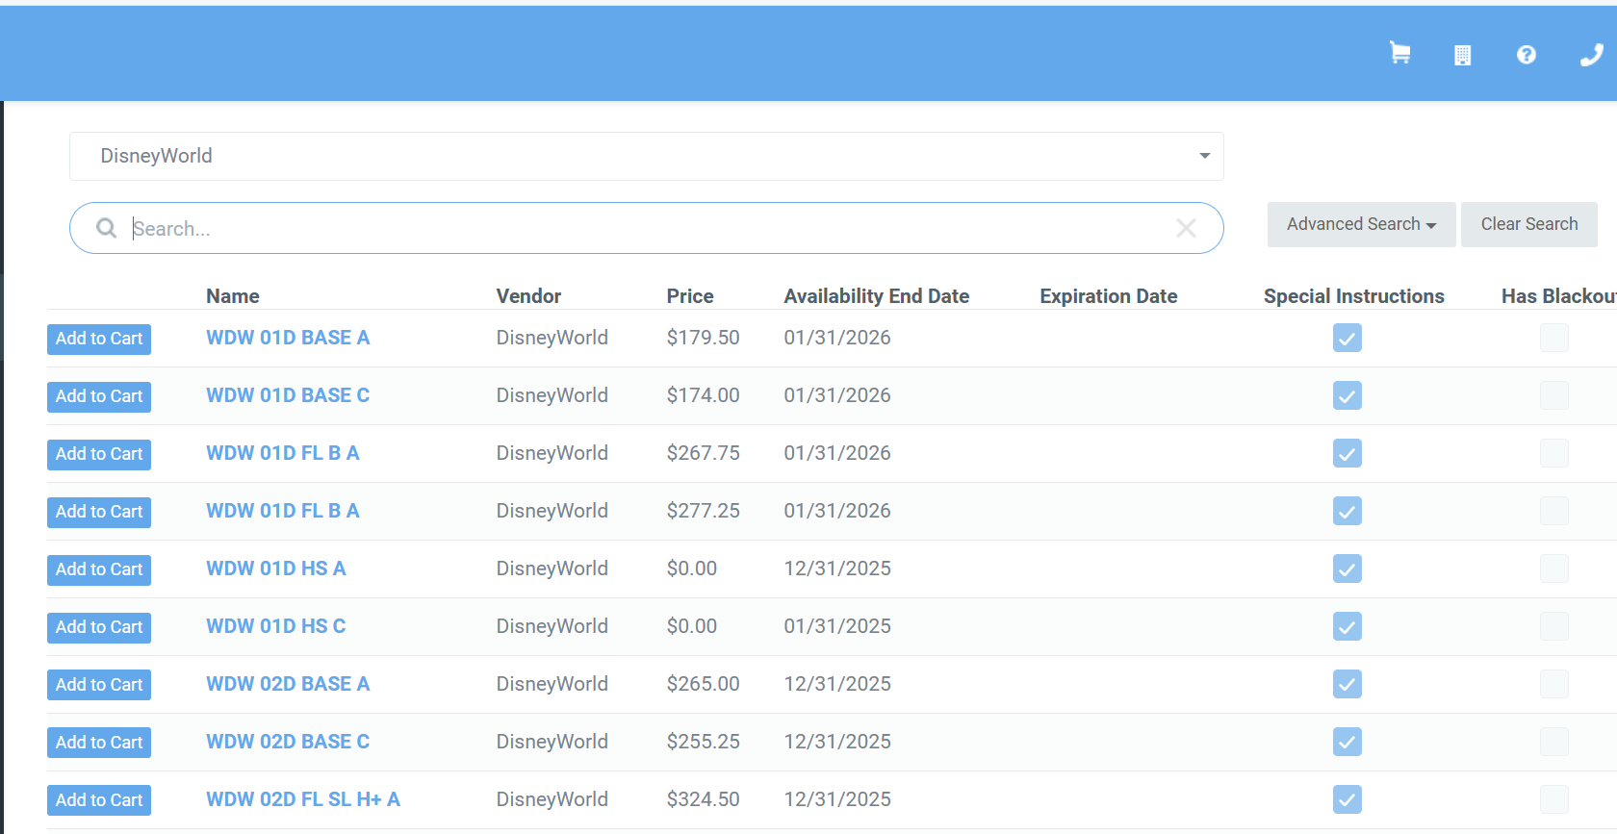
Selling Tickets in TMS
TMS Ticket Portal:
Use the drop down to filter to the Vendor
Use the “Search” filter to easily find tickets
  “4D” will return all 4D products
  “MIL” will return all Salute Tickets
Date-Based Variable and flexible price tickets will have a price displayed as $0.00
Static-Priced Products will have the retail price displayed
Notes:
MTP TMS Portal uses a Pick List
Dropdown filter - Can type name or Scroll down
MTP ticket names are improved for filters to locate tickets.

Slide 8
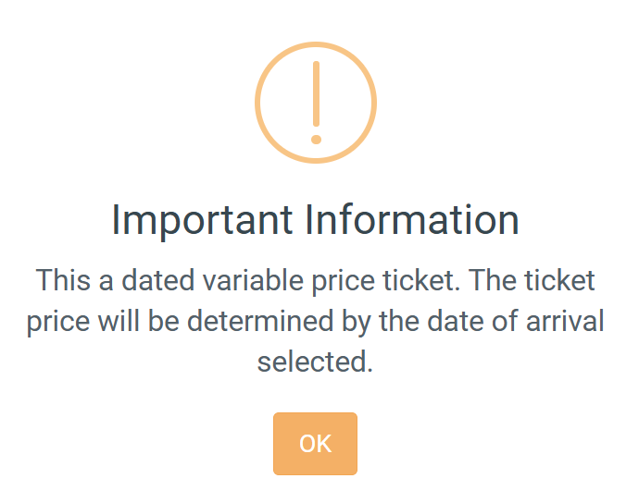
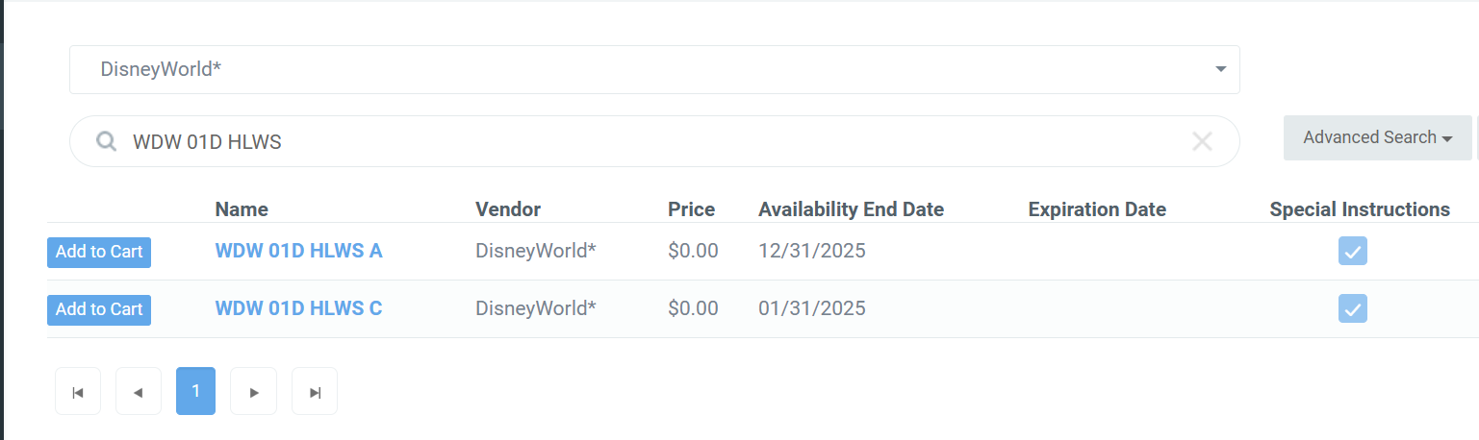
Dated Tickets
TMS Add to Cart Prompt:
For dated variable priced and peach priced tickets a Cart Prompt has been added
guest contact information including email is required
Arrival date will be required for all tickets

Slide 9
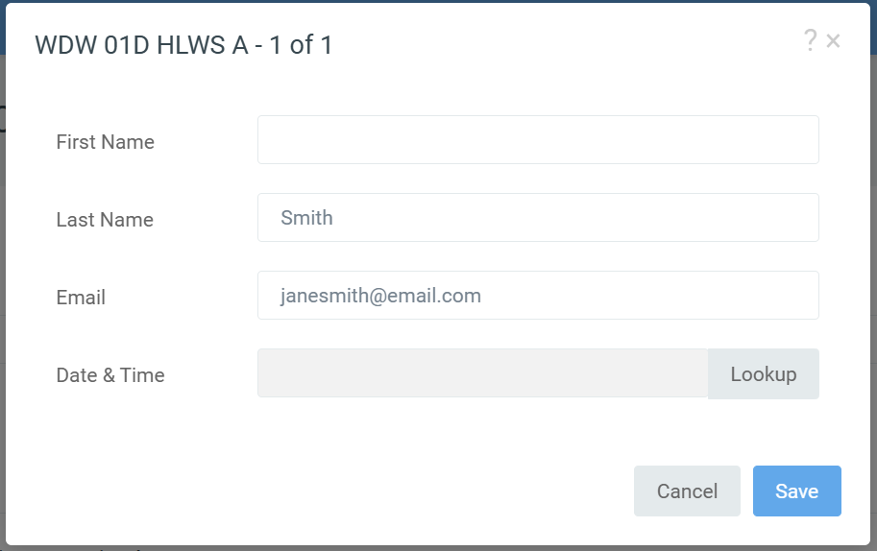
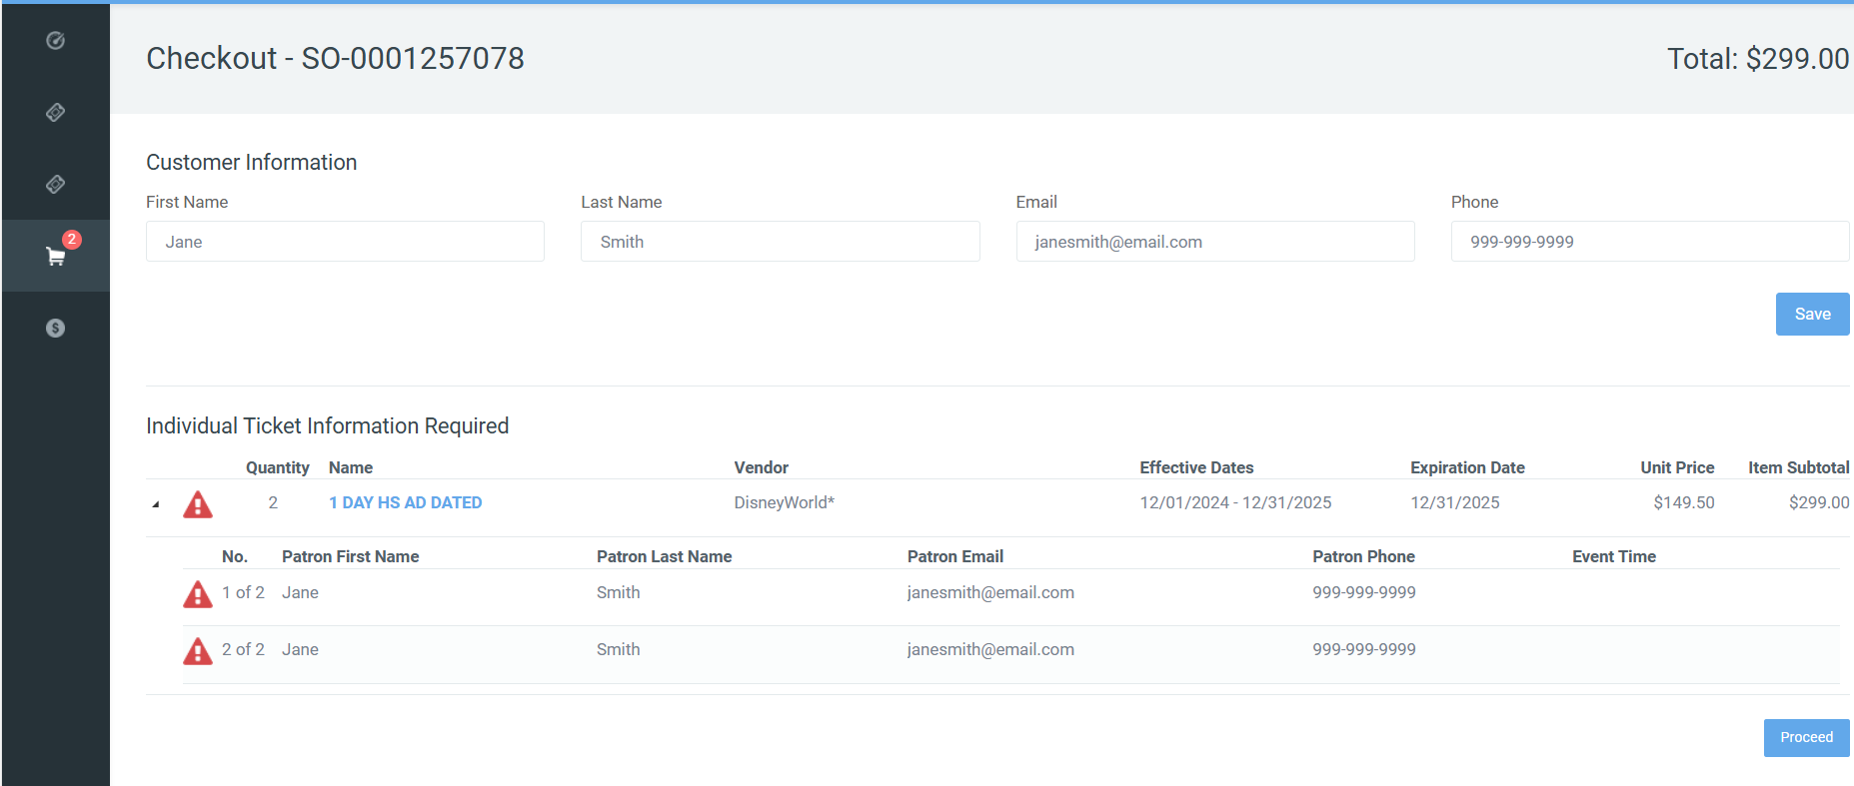
Dated Tickets
TMS Add guest Info:
Lead Guest Name REQUIRED for ALL tickets
guest Email is REQUIRED for ALL tickets
Sellers will select the alert icon
Select the “Lookup” button to access the date and price calendar
Verify dates for adult and child tickets match prior to processing orders.
Verify guest email is accurate prior to processing order.
**PRO TIPS:
Have guest use an email they can access on their phone.
Have guest verify email receipt before leaving the ticket office.
Have guest verify age of all children prior to processing tickets.**

Slide 10
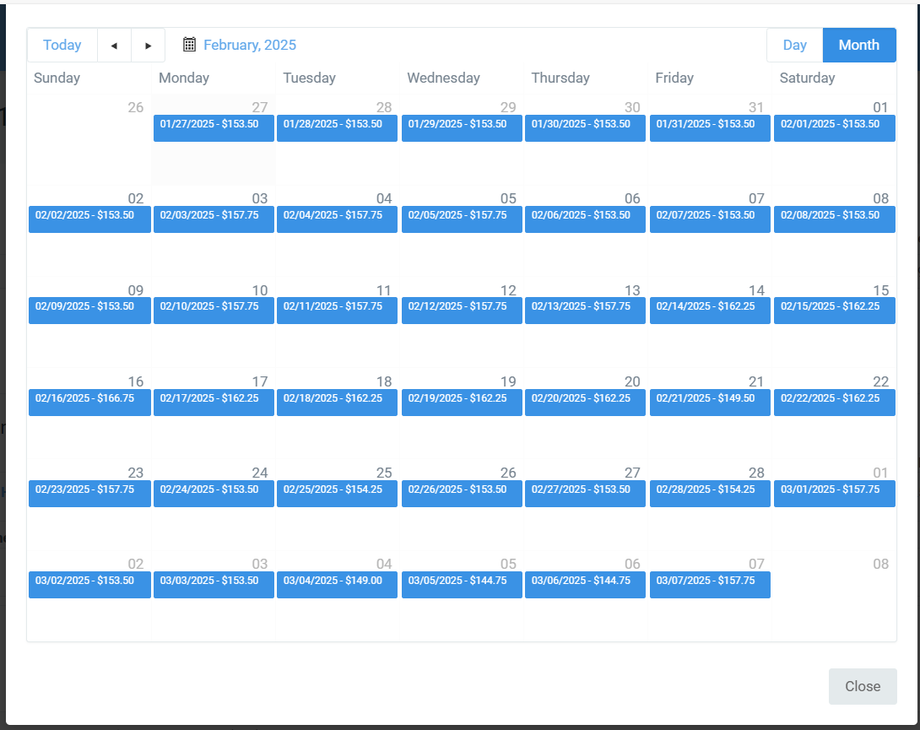
Date Required for ALL
TMS Calendar will show date is available in BLUE (If no blue date, ticket is not available)
Select the guest's arrival date by double-clicking on the blue price box
Once a date is selected, the cart will update to show the arrival date and price selected
NOTE: One arrival date is allowed per ticket type. For Example:
–WDW 01D HLWS A: clerk will be prompted to select one arrival date for all adults
In the same order if it has WDW 01D HLWS C– clerk will be prompted to select the arrival date
*Critical to ensure the clerk selects the same date for each ticket type and confirm dates are correct*

Slide 11
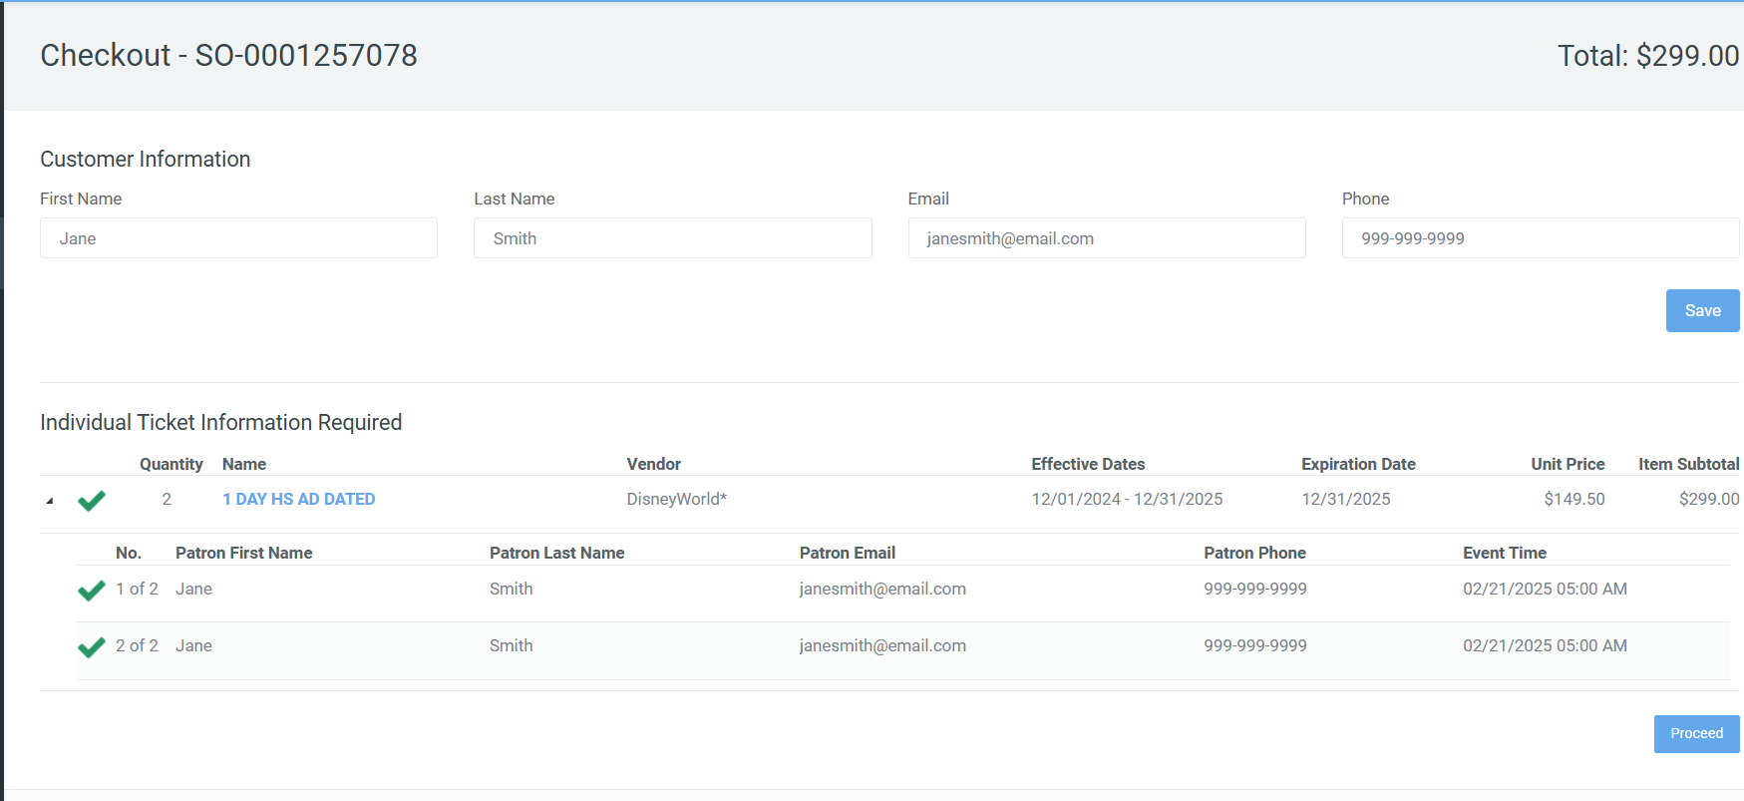
Dated Tickets
Until Price: The retail price charged per ticket
  MTP recommends sellers ring in each ticket by type, price and quantity
Subtotal: The unit price times the quantity of tickets
  Check the item subtotals match in the POS
Total: Reflects the entire order total
  Ensure the guest is charged the Total amount displayed.
Date-Based Variable Priced Tickets:
Notes:
Navy Specific Info to update:
Selling Process Changes in RecTrac
For the open dated tickets
Seller will need to use the pick list to locate the correlating products in RecTrac
Seller is required to input the Qty and the Unit Price as it appears in TMS for each type of ticket in the order
Seller is required to confirm that the order total matches the Total to TMS before completing the transaction

Slide 12
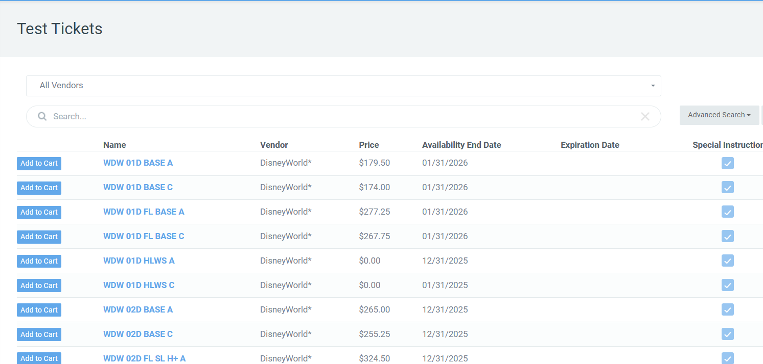
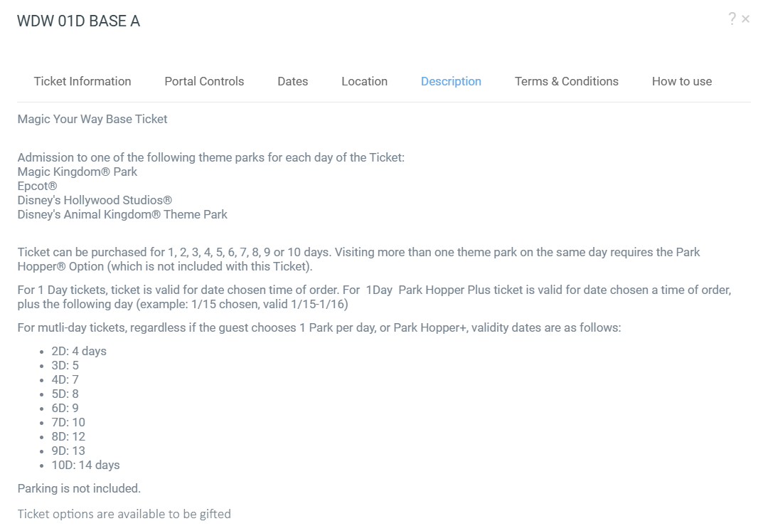
Dated Tickets
**Selling Tip**
Review VALID USAGE DATES WITH GUEST
  ALL Ticket Valid Dates will depend upon the number of days of visit
  In Ticket Portal, Click on the ticket name and then description to review

Slide 13
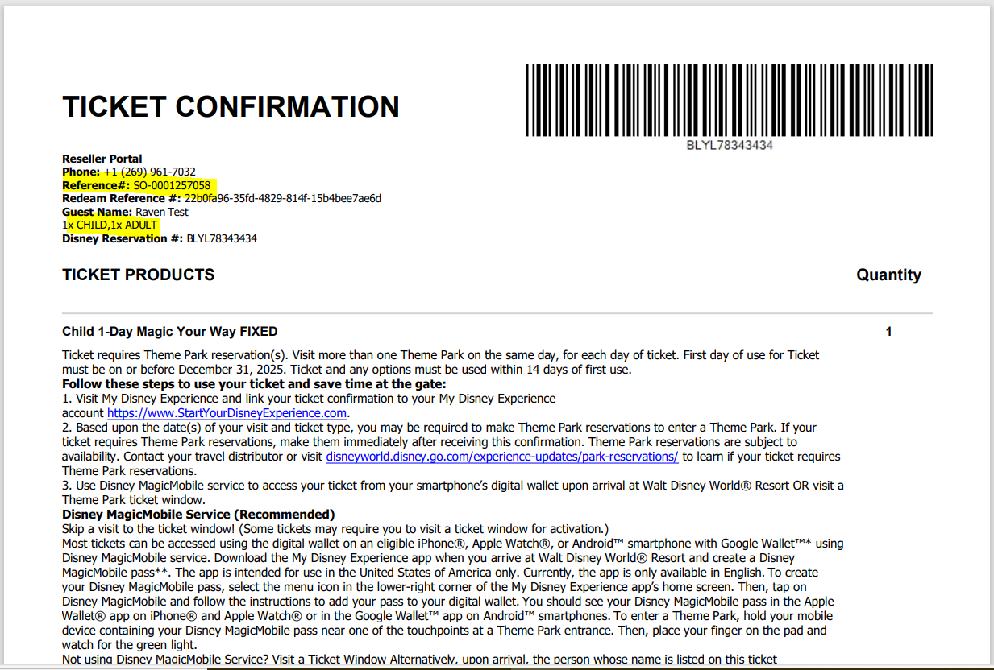
Confirmation Pages
TMS Order Confirmation Sample:
Confirmation will display the guest's number of tickets, product selected and reservation arrival date
Tickets Expire and must be used by date printed on guest confirmation page
If the guest needs to select an alternate date after the order is completed, sellers MUST cancel the original order and generate a new order. Partial cancellation is not permitted.
guests CAN use the email provided at the time of booking to access their confirmation page.
If A seller enters the wrong email, cancel and reissue the order.
Cancellation policy: Bases are allowed to cancel tickets on the API after they have left the ticket office.

Slide 14
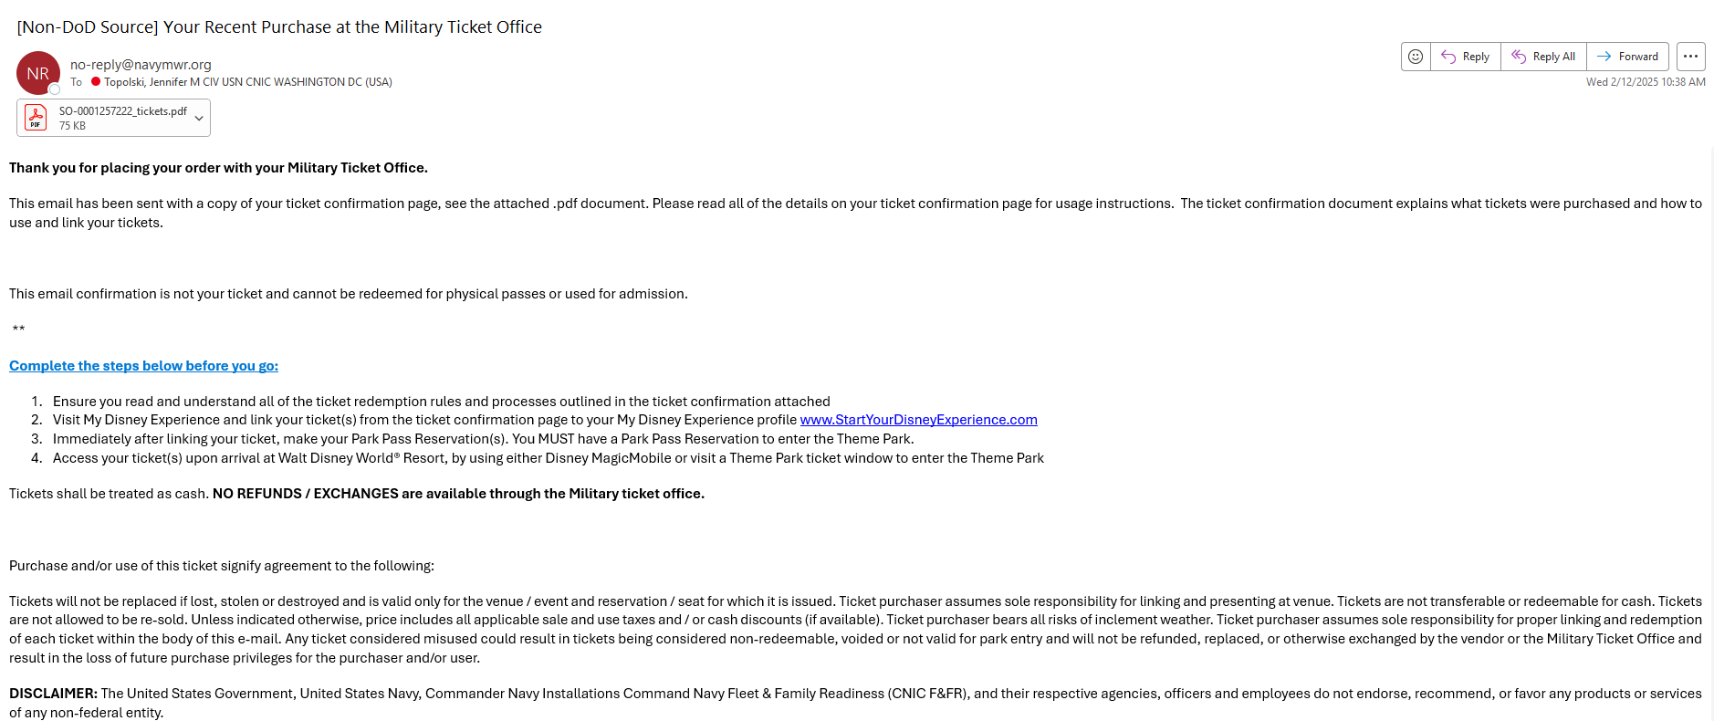
Confirmation Emails
TMS Email Confirmation Sample:
Email with the confirmation page will be sent as an attachment to each guest for ease of access
Email is sent from: no-reply@navymwr.org
Please make sure guests check their email and spam folder

Slide 15
Ticket Cancellations
  Cancellations in TMS:
  Cancellations are allowed to be processed in the TMS Ticket Portal
  No partial cancellations permitted
  TMS Order will update once tickets are cancelled
  Managers can use TMS reports to reconcile cancellations
  Credit for cancellations is posted on the day the tickets are cancelled. Be sure to reconcile daily, so cancellations can be processed in a timely manner.
  If you have issues processing a cancellation, please complete a “Cancellation Request Form” and submit to MTP at: info_mtp.fct@navy.mil

Slide 16
Dated Ticket Cancellations
  Cancellations in Redeam Reseller Store (after Feb 25th):
  Bases will not be allowed to process cancellations in Redeam after API go-live
  Bases will need to complete a “Cancellation Request Form” and submit MTP at: info_mtp.fct@navy.mil
  Bases will receive a confirmation email from MTP when the cancellation is processed
  Cancellations will be posted and viewable on the “Vendor Direct Recon Report –Base view”
  Bases will receive an End of Month Vendor Direct invoice for cancellation credits

Slide 17
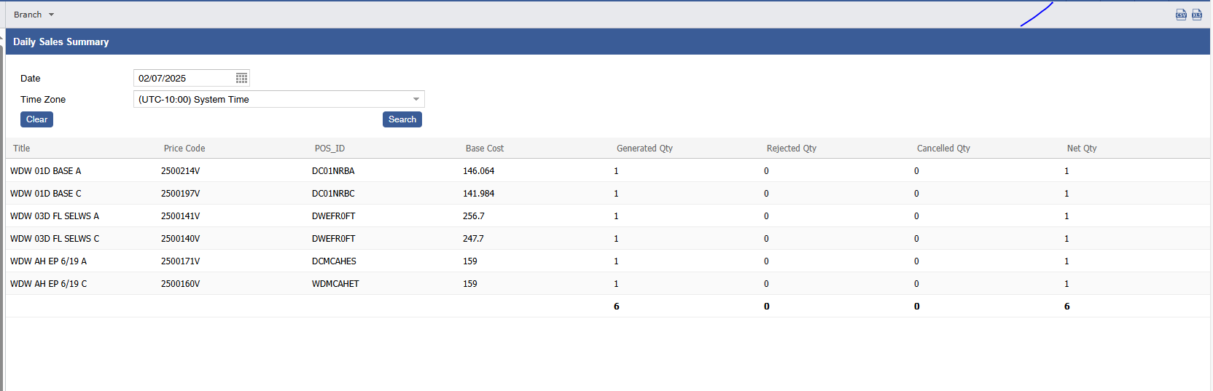
TMS Reporting - New Reports
Two new reports to assist in Daily & Monthly Disney Reconciliations.
Daily Sales Summary:
  This report summarized the total tickets sold by Price Code on any given day.
  Bases that have Retrac can compare this report to the total quantity of tickets sold and cancelled on any given day
  If you have Local and National Tickets in Retrac recommend adjusting your TC Ticket Range Perimeters to only seen National Sales.
    Example Ticket Range: MZZZZZZZZZ-ZZZZZZZZZZ
  Base Net Retail should match to the Net Sales Amount if users utilize the MTP Provided Retail Rates.
Notes:
Need to find out if this report will be completed by the launch date -

Slide 18
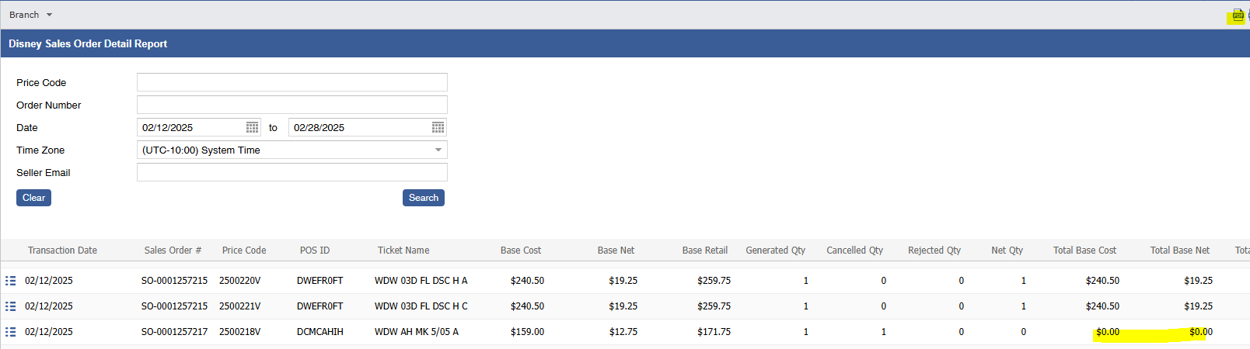
MTP Reporting
Disney Sales Order Detail Report
  This report shows every sales order by price code generated.
  Bases that have can compare this report to the total quantity of tickets sold and cancelled on any given day or run it for a longer period to assist in researching any reconciliation issues.
  If you have Local and National Tickets in Retrac recommend adjusting your Ticket Commission Ticket Range perimeters to only seen National Sales.
    Example Ticket Range: WD0000000-WDZZZZZZZZZ
  Base Net Retail should match to the Net Sales Amount if users utilize the MTP Provided Retail Rates.
  This report includes the Base Cost and the Base Net (or Base Commission Amount) since we do not know the commission available until the time of order for date-based products.
Notes:
Base Cost: Calculated by TMS at the time of order
Base Retail: MTP will uphold the current mark-up standard of 10-12%, ensuring the retail price does not surpass the gate price with tax.
Base Net(Commission): Calculated based on the base cost and suggested retail price
Gate Price w/Tax : TMS will calculate the gate price with tax at the time of order to show true real time guest savings.
guest Savings: TMS will calculate based on gate price and retail price.
mpleted by the launch date -

Slide 19
MTP Reporting
TMS Reporting – MTP Existing Reports will also have sales details
The E-ticket Report and the Sales Order Detail Reports are not changing. Bases can still use these to help reconcile.
The AR Recon Report will still be available at the end of the month once invoices have been processed by MTP Accounting
The AR Statistics Report will still be available after invoicing
Notes:
Need to find out if this report will be completed by the launch date -

Slide 20
End of Month
  End Of Month Invoicing:
  ALL DTTC Redeam Sales will be included in your TMS Vendor Direct Month End Invoice.
  The “AR Reconciliation- Base View” report can also be used after invoicing to reconcile your end-of-month.
  Managers can pull their location invoices from TMS, under the Administration tab.
  Invoices will be provided from MTP after reconciling is complete, usually by the 5th business day of the month.
  Special Notes for February End-of-Month Reconciliation:
  For POS/ Rectrac Users – we will be changing all Rectrac ID’s and price codes.
  Sellers will need to refer to the TMS E-ticket Reconciliation Reports, Disney Sales Order Detail for specific reconciliation sales details.
  Disney World Tickets will NOW appear on the E-Ticket Invoices
  Base should reconcile ALL sales daily after your final order, process any booking cancellation errors to reduce any confusion when reconciling all sales at the end of the month.
  Bases will need to refer to the Reports for February 1 -24, 2025, for specific reconciliation sales details.
  If you have questions or concerns about your February Vendor Direct invoice, please contact MTP Accounting: mtp_accounting.fct@navy.mil
  **After February, Bases will use TMS reports to complete all future invoice reconciliations**

Slide 21
Dated Tickets FAQ
MWY Tickets are allowed to be gifted. Please use the guests name as the lead guest on the order.
Be diligent in double checking the arrival date is correct, especially if you have both adult and child tickets in the same order.
Note the cancellation policy for tickets is that they are non-refundable or exchangeable
If circumstances warrant a cancellation, tickets may only be cancelled in advance of their original booking arrival date.
If guests needs to change their arrival date they are encouraged to do so through Disney.
Bases can cancel orders in the API, no partial cancellations are permitted.
**PROTIP: Always have a guest provide an email they can access on their mobile device. The guest should check and confirm receipt of their confirmation before they leave the ticket office. Guest will be required to use the MyDisney Experience Application to access and manage their tickets**

Slide 22
Dated Tickets
QUESTIONS & DISCUSSIONS

