Slide 1
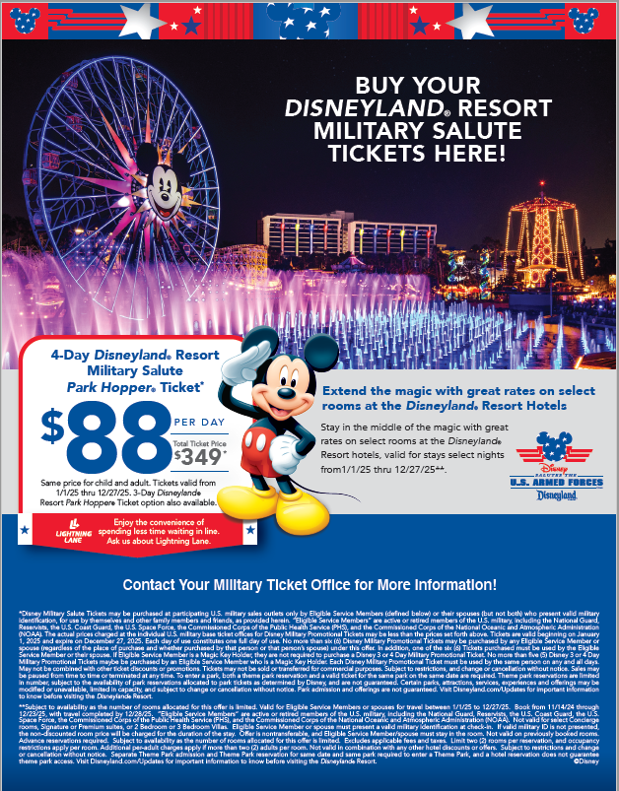
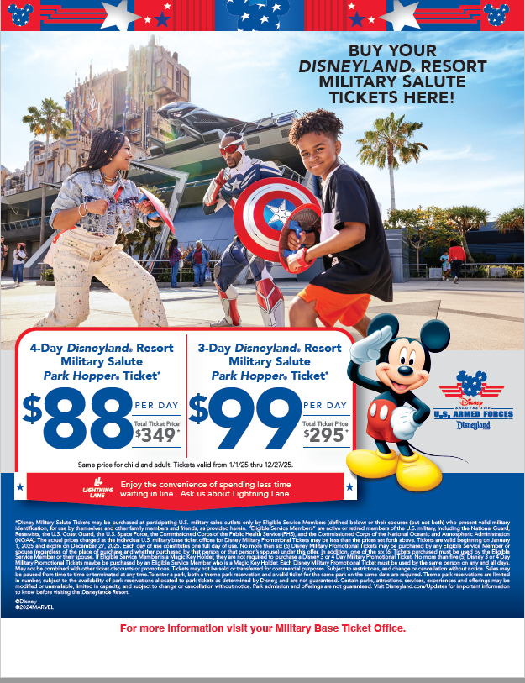
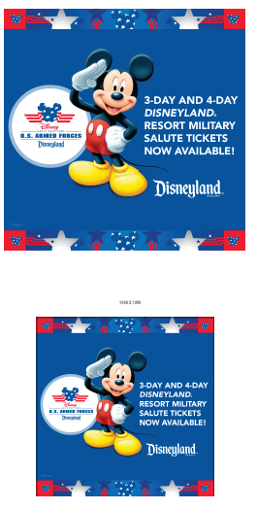
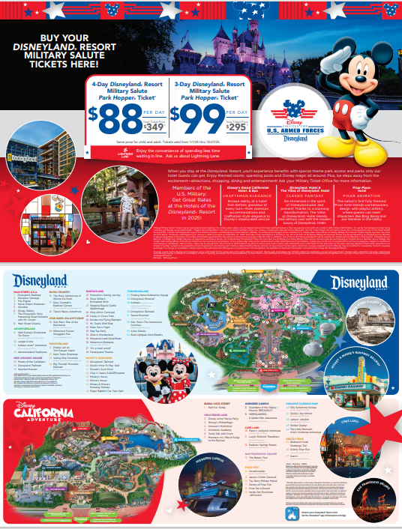
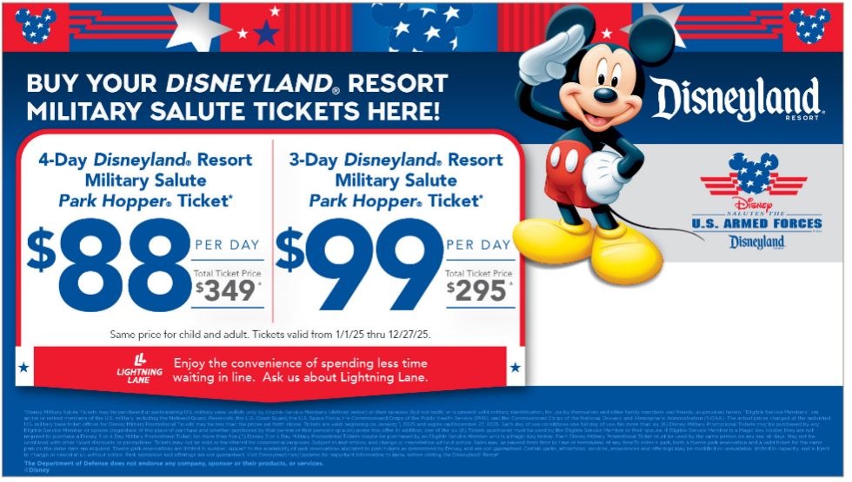
2025 Disneyland® Resort - Military Suite of Assets
Flyers, Social, Digital, Theater Slides & More
Sample Flyers
Sample Social Assets FB & IG
Sample Placemats
Sample Theater Slide

Slide 2
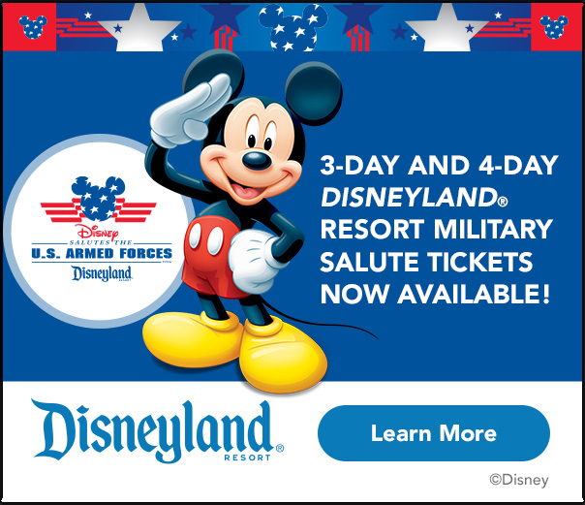
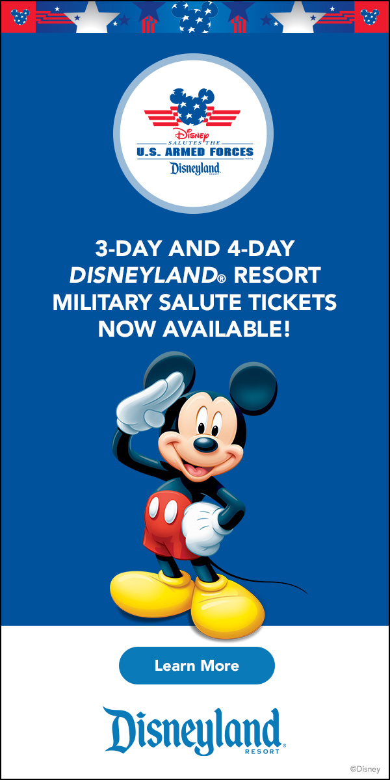



Web Banners – Variety of sizes

