Slide 1

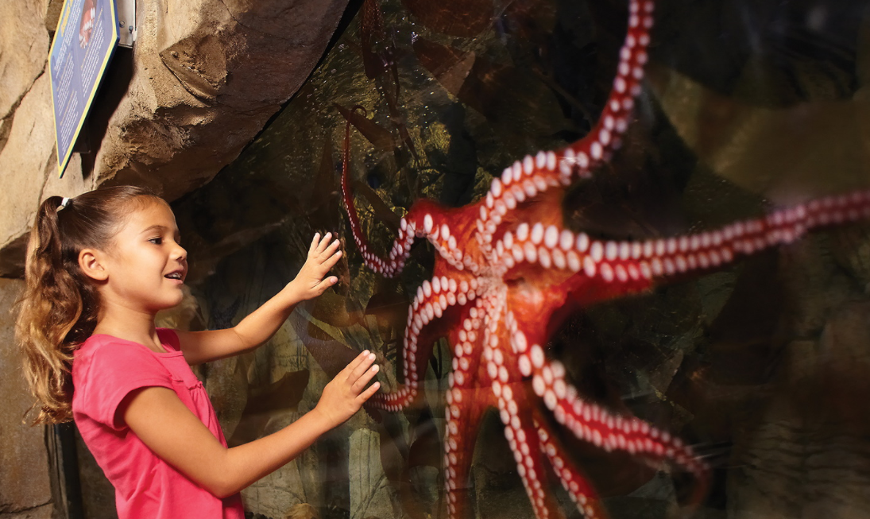
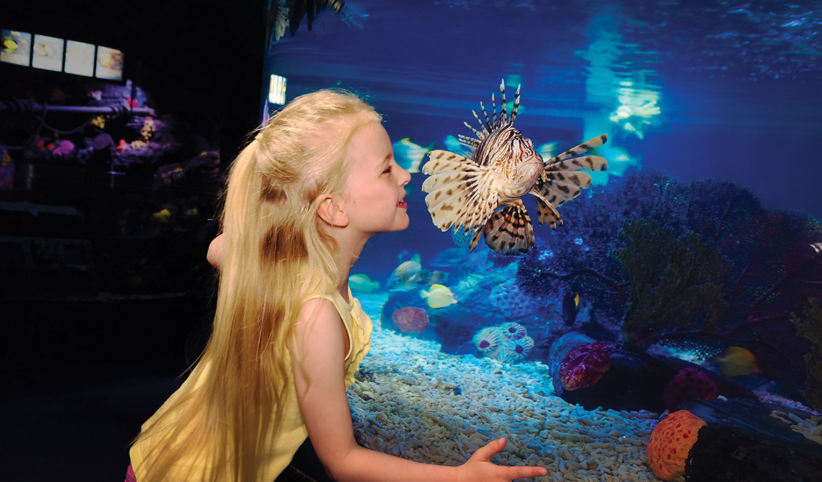
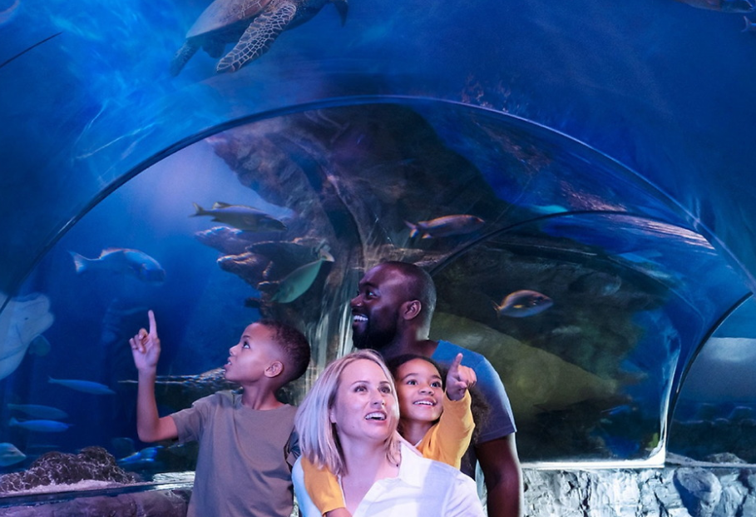
    Features: 360 Degree Ocean Tunnel, Sting Ray Lagoon, Sea at Night Experience, Southern California Rock Pool
Notes:
Add some of our conservation info on SEA LIFE Trust

Slide 2
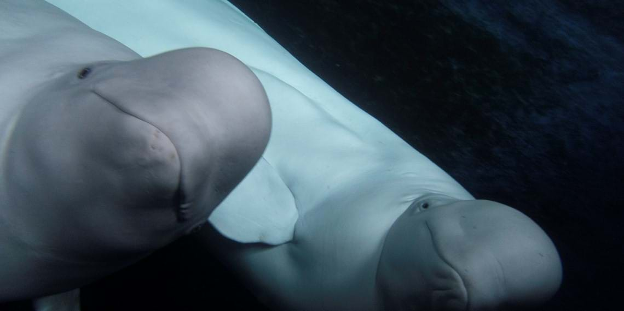



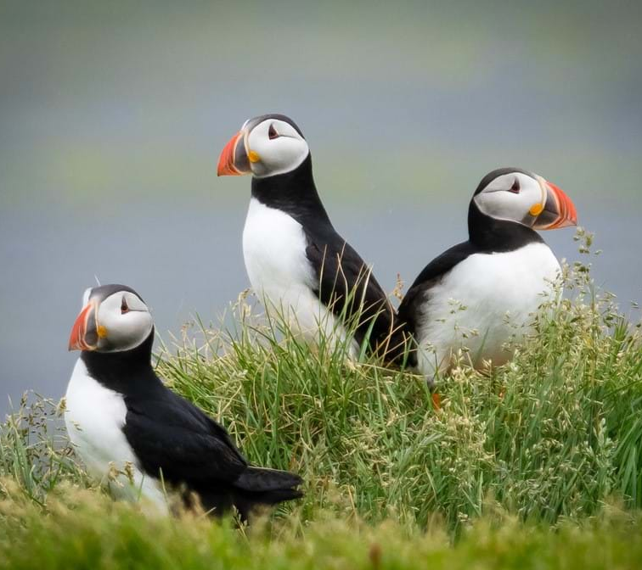
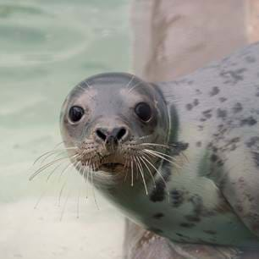
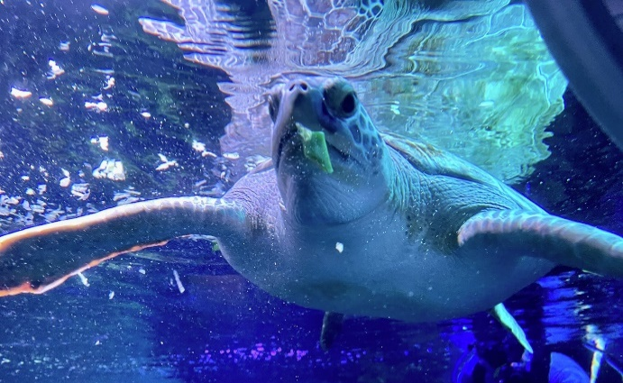
    What is the SEA LIFE Trust?
    The SEA LIFE Trust is a registered charity (no. 1175859) working globally to protect the world’s oceans and the amazing marine life that lives within them.
    Our vision is of a world where our oceans are healthy, properly protected and full of diverse life.
    We champion the need for plastic-free oceans and an end to over-exploitation of marine life through our global projects and campaigns, as well as at our marine animal sanctuaries.
    For more info visit: https://www.sealifetrust.org/en/
The world's first Beluga Whale Sanctuary!

Slide 3
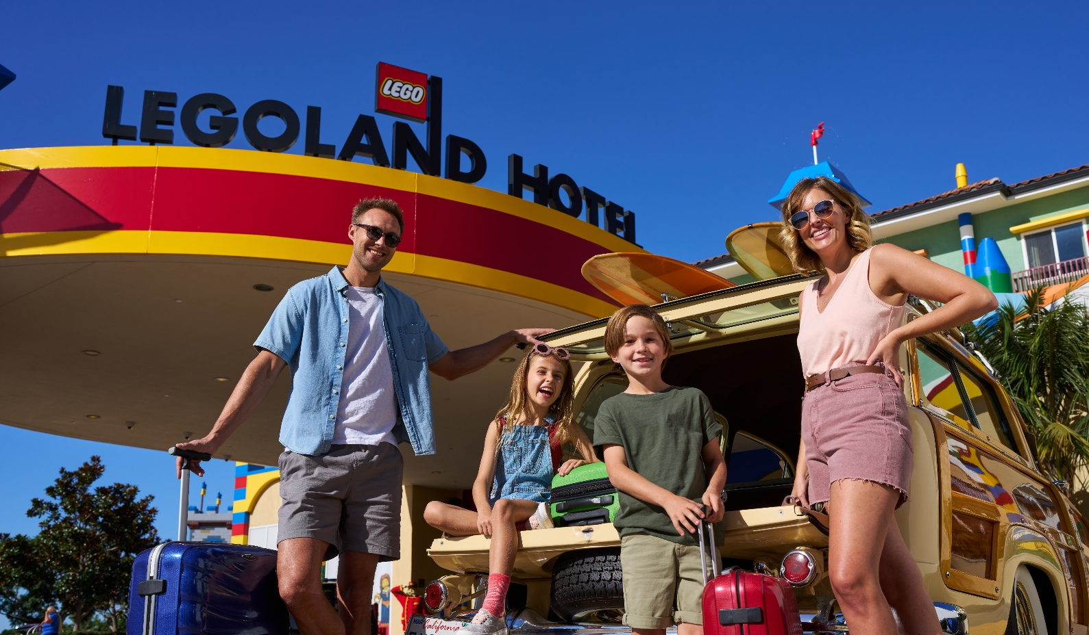


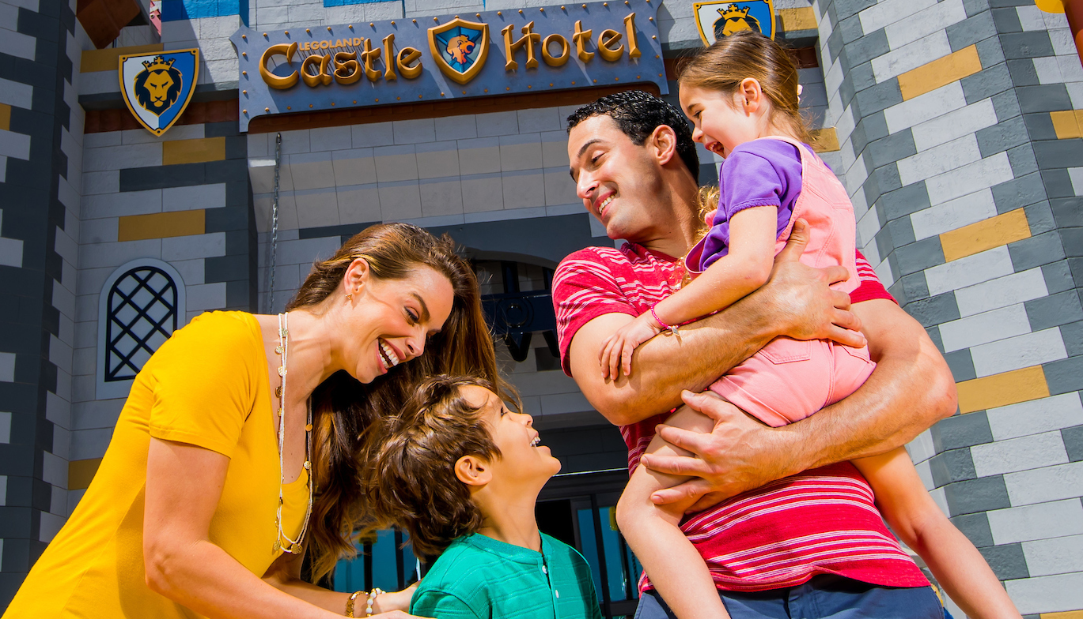
  Located right at the main entrance of LEGOLAND ® California.
  Themed hotels with interactive LEGO ® features throughout.
  FREE Breakfast!
  Nightly children's entertainment.
  LEGOLAND Hotel 250 themed and fully themed rooms: Pirate, Kingdom, Adventure, LEGO NINJAGO, LEGO Friends.
  Castle Hotel 250 deluxe themed rooms: Knights & Dragons, Royal Princess or Magic Wizard
  Enhanced Pool Area- featuring interactive water play features
  Entertainment Courtyard- Play zones for kids of all ages including a DUPLO tot spot, slides, an outdoor stage and cinema with seating

Slide 4
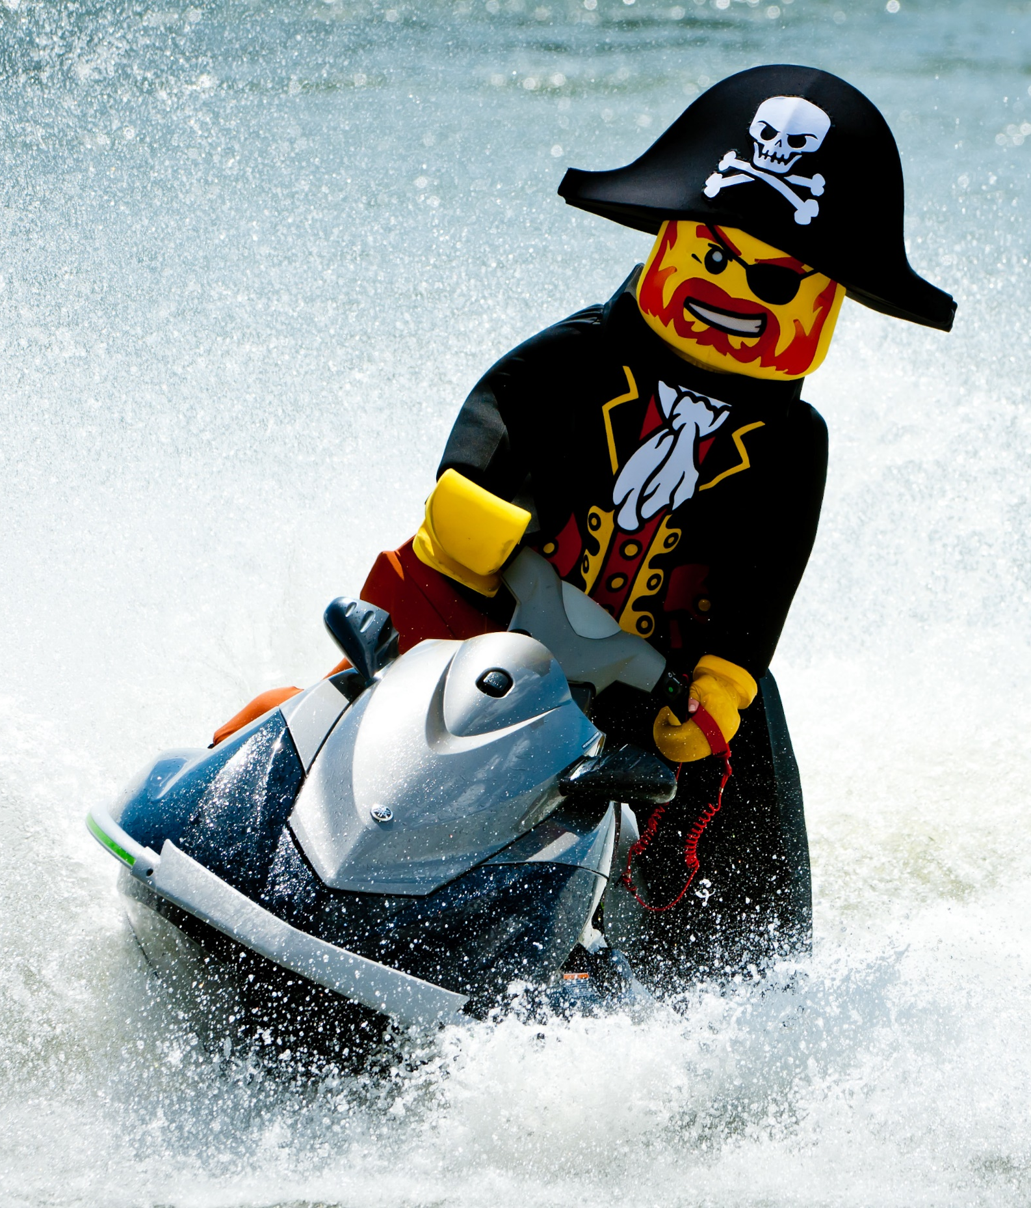

Legoland®
Florida
Resort

Slide 5

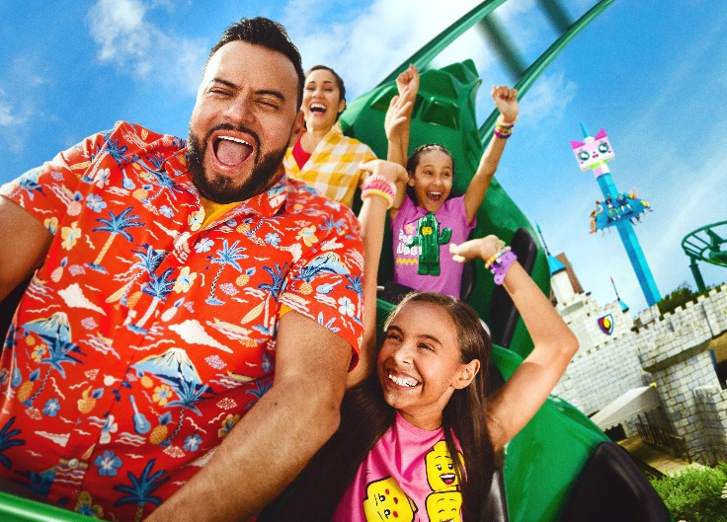
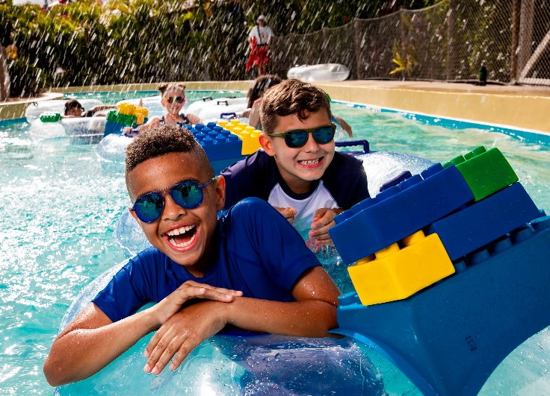
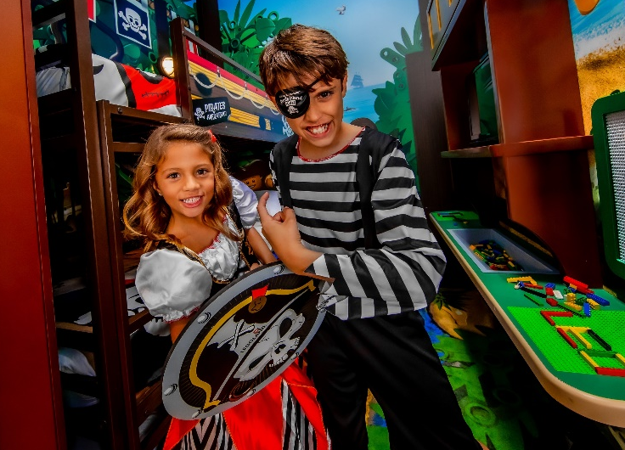
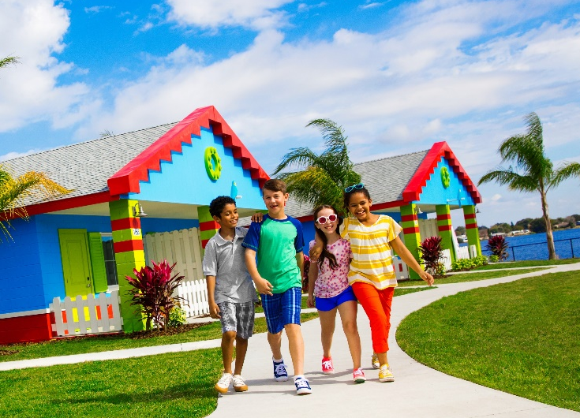



A multi-day vacation destination located just 45 minutes from Orlando and Tampa – Winter Haven, FL.

Slide 6
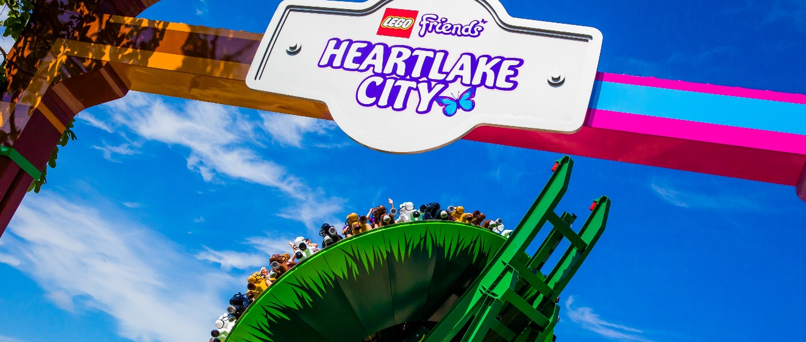
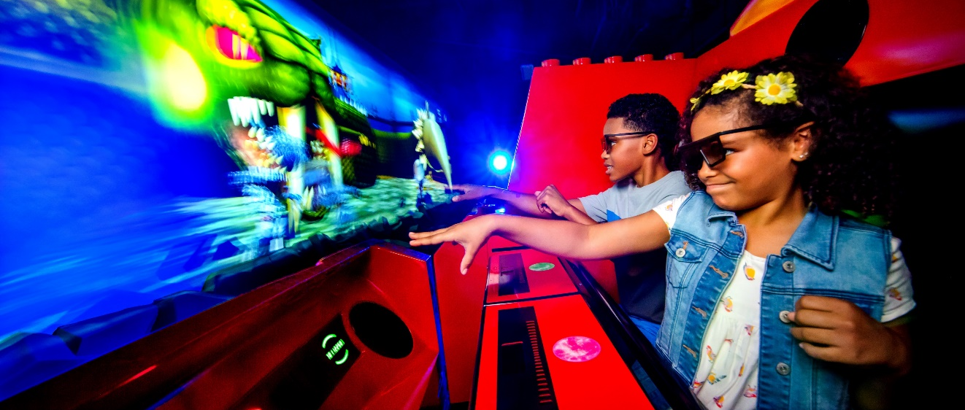
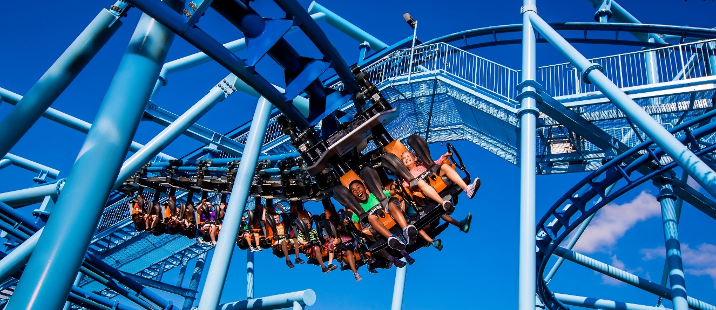
  LEGOLAND® Florida Resort Rides
  Mia's Riding Adventure
  LEGO® NINJAGO® The Ride
  The Great LEGO® Race
  THE LEGO® MOVIE™ Masters of Flight
  Unikitty’s Disco Drop
  The Dragon
  Flying School

Slide 7
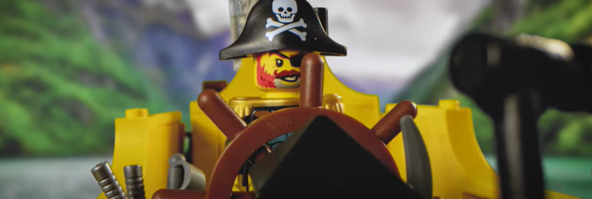
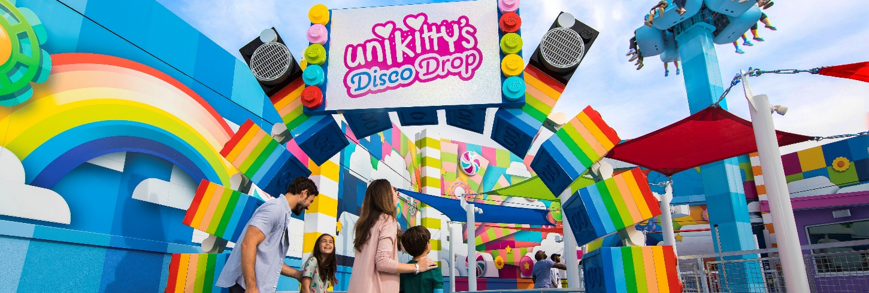
  PIRATE RIVER QUEST: COMING SOON- Set sail with a rowdy crew of LEGO® pirates on Captain’s orders to explore the murky waters and retrieve the lost treasure, stolen by a troop of mischievous monkeys.
  THE LEGO® MOVIETM WORLD - Step into the town of Bricksburg, home to three new interactive rides, a taco shop and a meet and greet experience with beloved characters.
Notes:
It overviews some stuff not covered in the previous slide & 1 new thing I think it’s okay

Slide 8
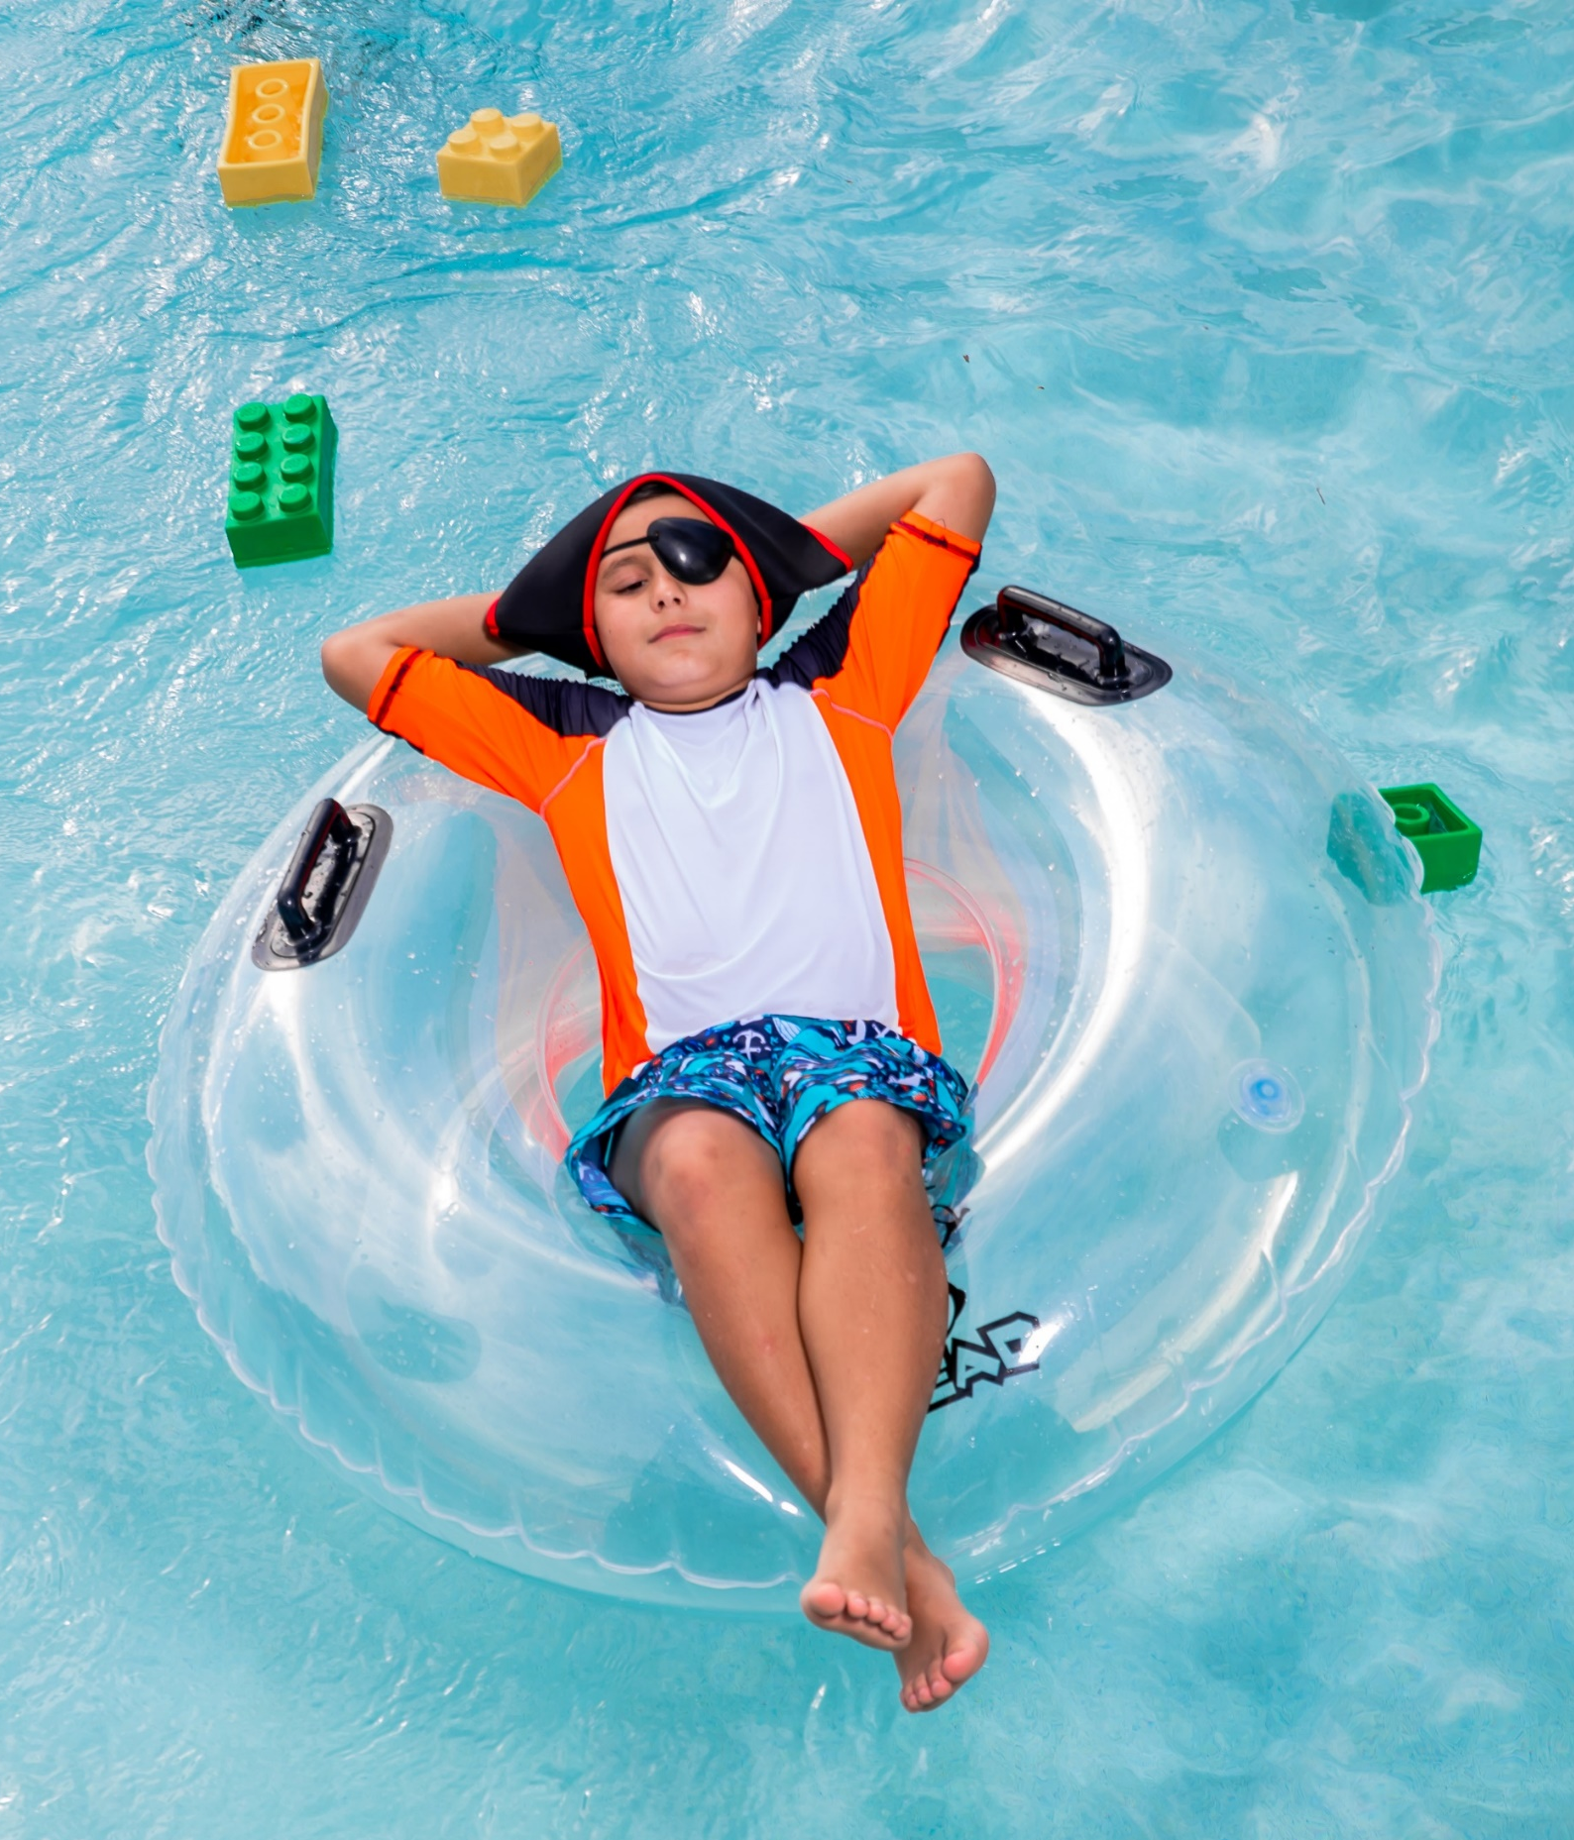
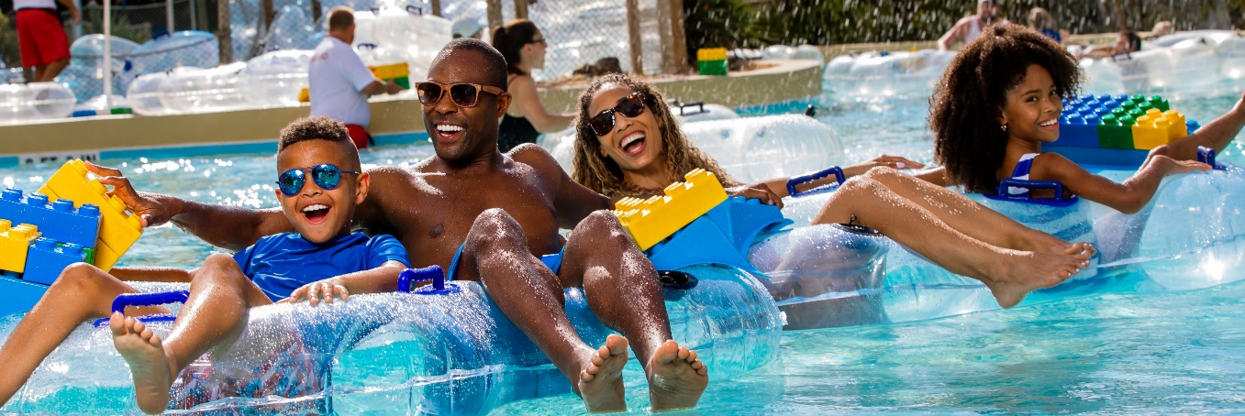
  LEGOLAND® Water Park
  Get ready to slide, splash and build your way to fun at LEGOLAND® Water Park. From the LEGO® wave pool to the Build-A-Raft lazy river, tube slides, body slides and interactive water-play structures -Joker Soaker and DUPLO® Safari - your kids will soak up tons of fun!

Slide 9
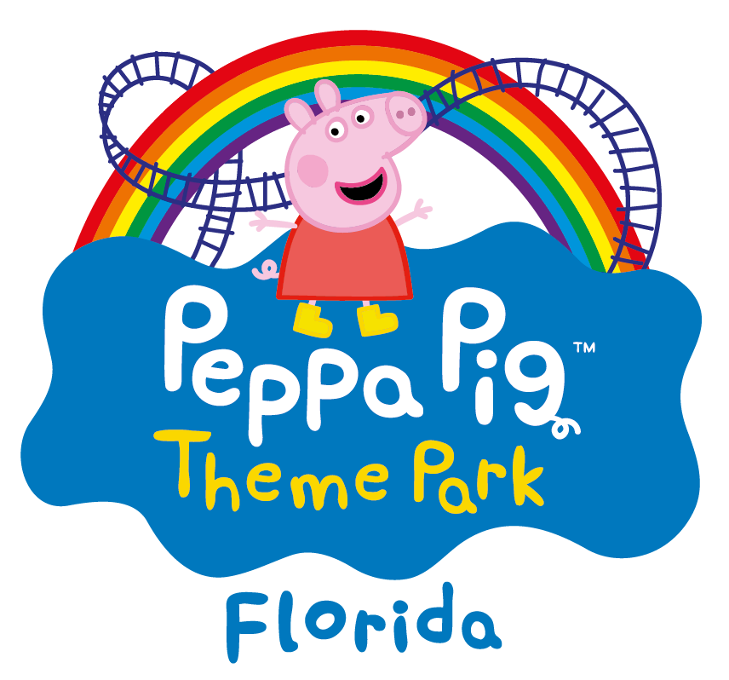
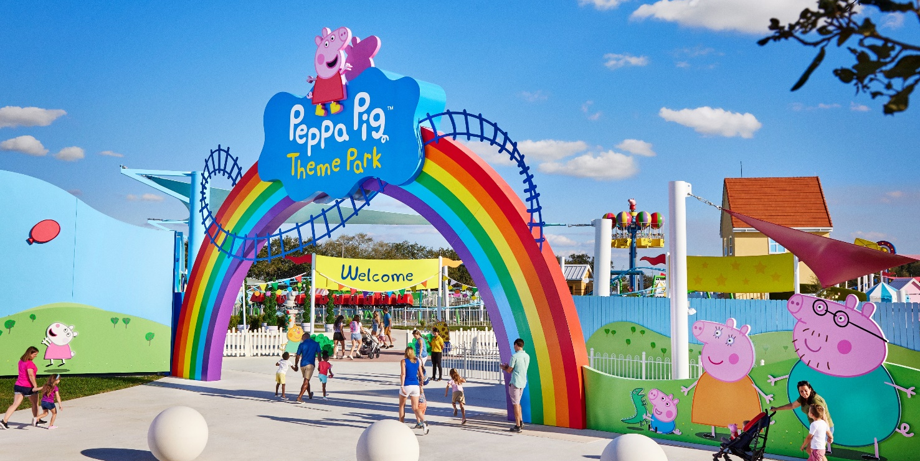
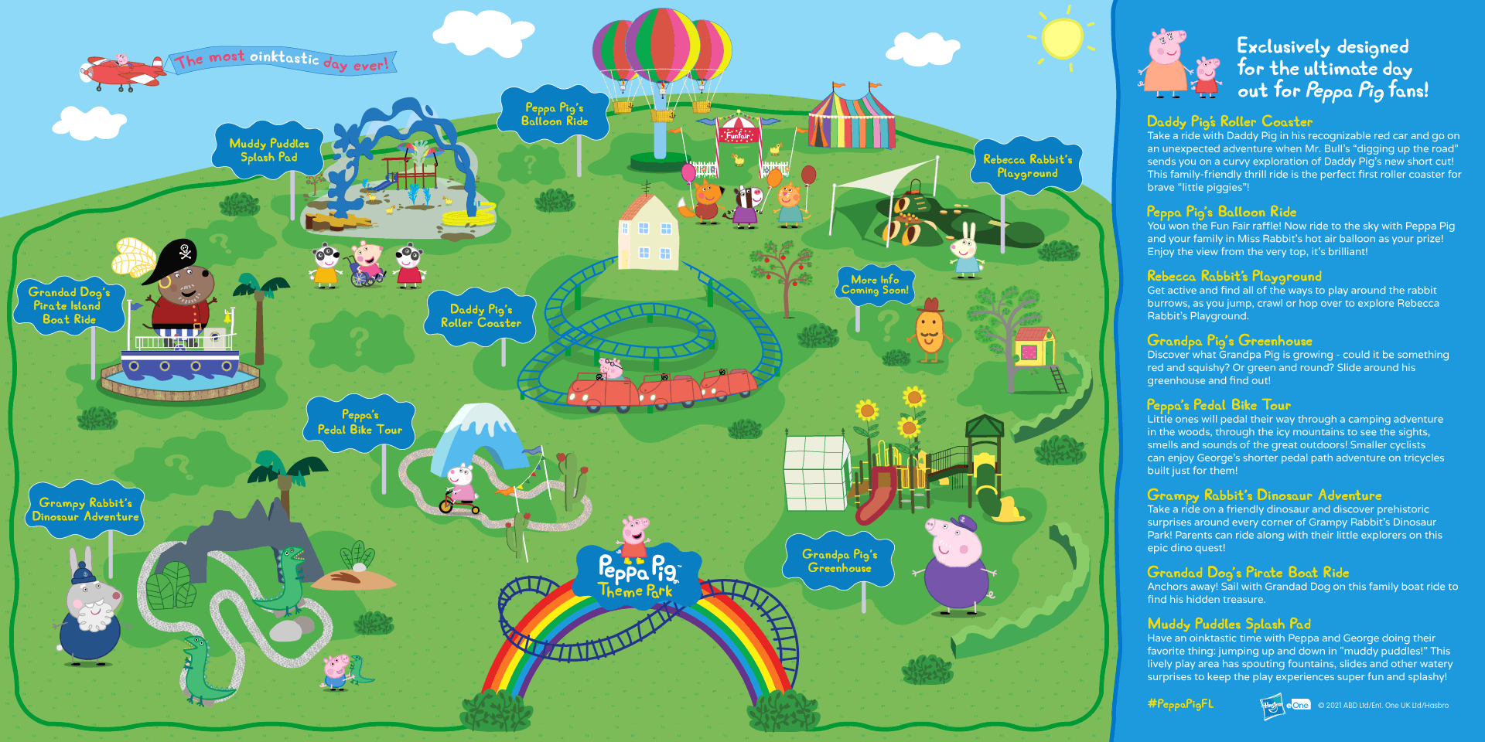
NOW
OPEN!
    Join Peppa Pig and her friends at the World’s First Peppa Pig Theme Park steps away from LEGOLAND® Florida Resort!
    Step into the playful World of Peppa Pig for the ultimate day
    of adventure! Snort, giggle & play in a theme park, exclusively designed for “little piggies” with six interactive rides & attractions, six themed play areas complete with “muddy puddles” water play and fun live shows. Every corner of this charming new park has been designed with preschoolers in mind!

Slide 10
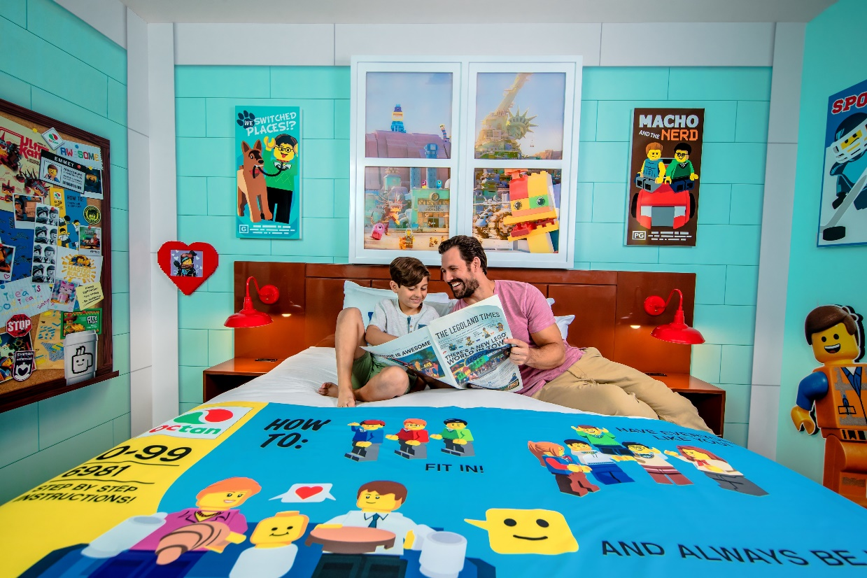


  LEGOLAND Hotel and Pirate Island Hotel are located right at the main entrance of LEGOLAND Florida.
  Beach Retreat is located 1 mile from the Park.
  LEGO® Themed hotels with interactive features throughout.
  FREE Breakfast!
  Nightly children's entertainment.

Slide 11
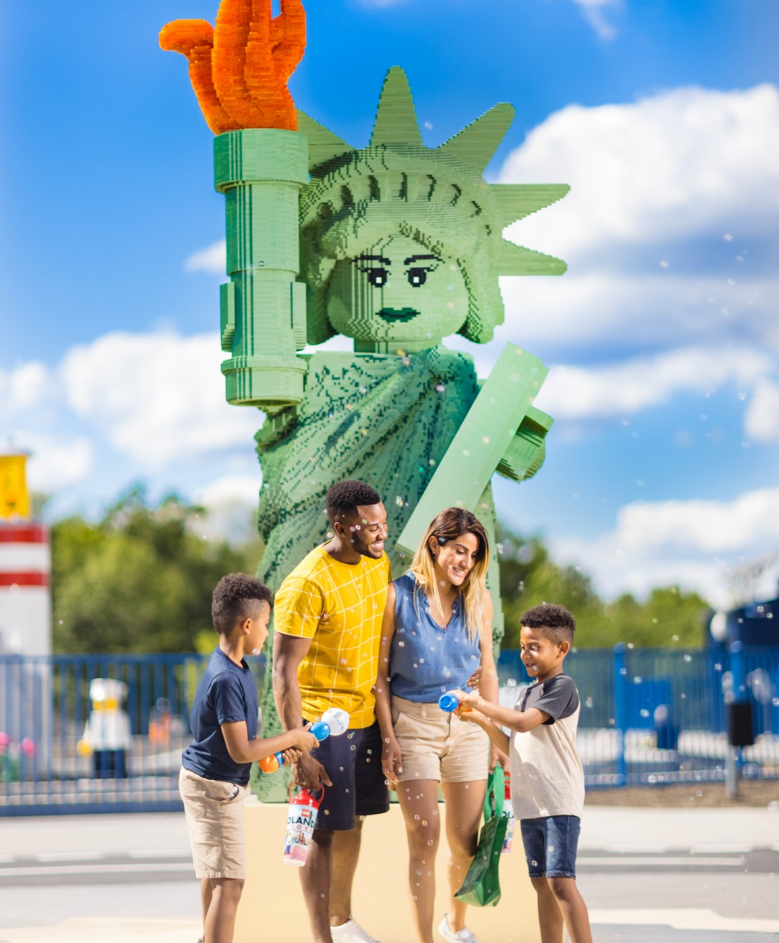

Legoland®
New York

Slide 12

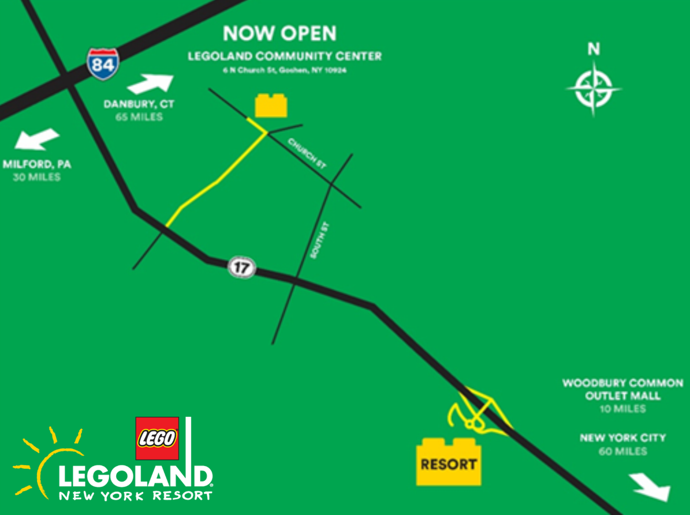
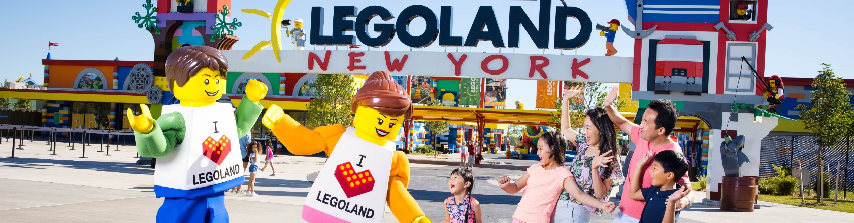
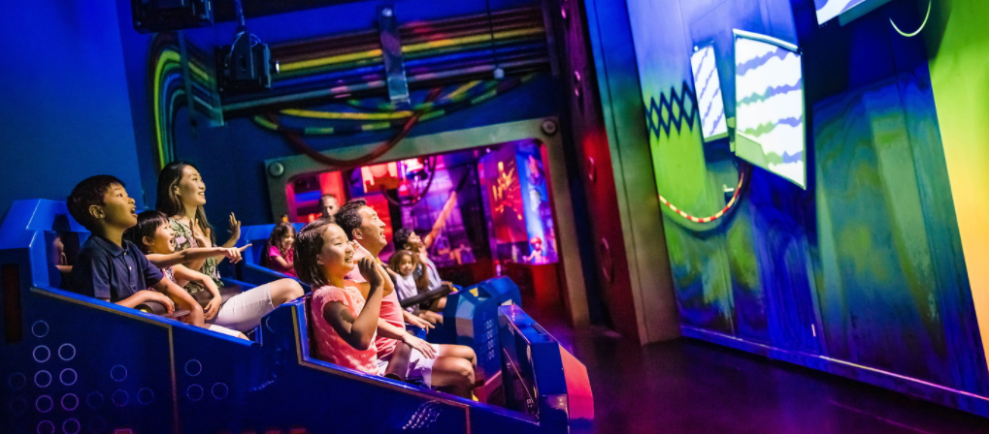
OPEN
APRIL 8TH
    A brand-new park featuring: Brick Street, Brick Party, Bricktopia, LEGO® Factory Adventure Ride, LEGO® NINJAGO® World, LEGO® NINJAGO® The Ride, LEGO® Pirates, Anchors Away!, LEGO® Castle, Dragons Apprentice, Miniland USA
    Nestled in more than 150 acres of beautiful landscape just outside Goshen in New York’s Hudson Valley. Seasonal Park: Open from Early Spring through Late Fall
    Push, pull, steer, squirt, splash, crawl, climb, and yes – build your way through over 50 rides, shows and LEGO® themed attractions

Slide 13
Stay in touch!
Deanne.Jaconette@LEGOLAND.com
LEGO, the LEGO logo, the Brick and Knob configurations, the Minifigure and LEGOLAND are trademarks of the LEGO Group. ©2021 The LEGO Group.
THE LEGO® MOVIE 2™ © & ™ Warner Bros. Entertainment Inc., & The LEGO Group. All rights reserved. (s21)
© 2021 ABD Ltd/Ent. One UK Ltd.
LEGOLAND®, SEA LIFE® and Madame Tussauds are part of Merlin Entertainments Ltd.

