Slide 1


Merlin
North America
Overview
Notes:
corrected

Slide 2
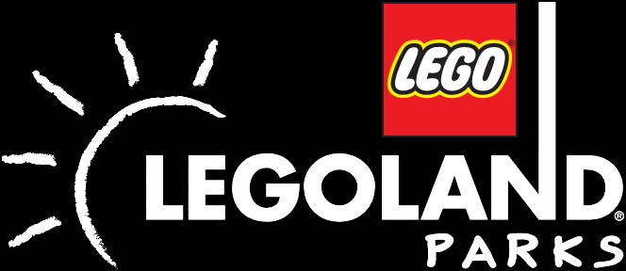
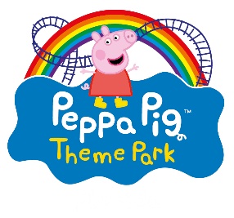


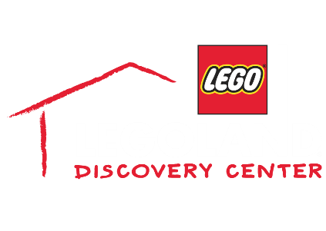

NORTH AMERICAN
ATTRACTIONS
THEME PARKS & RESORTS
    Interactive resorts, appealing to younger families with children aged between 2-12, Incorporating on-site themed accommodation.
MIDWAYS
    High quality, branded, indoor attractions with
    a typical 1-2 hour dwell time – located in city centres, shopping malls, and resorts.
Notes:
Removed arrows and rearranged to prioritize theme parks

Slide 3
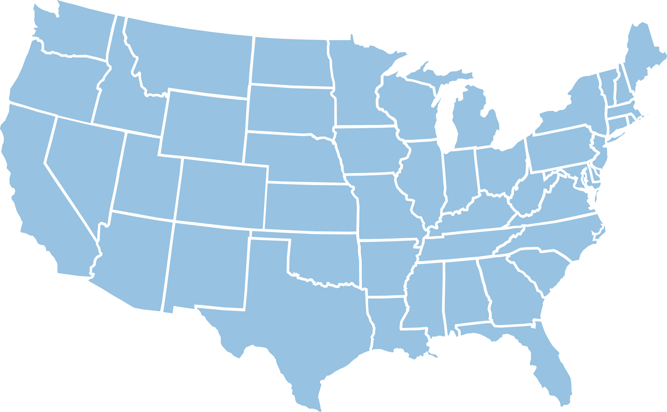
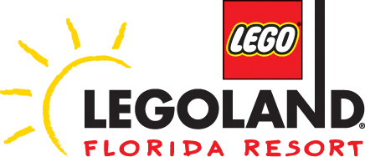
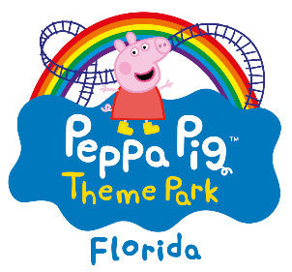


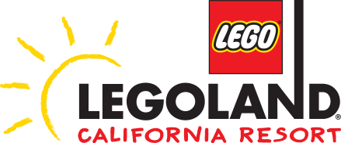








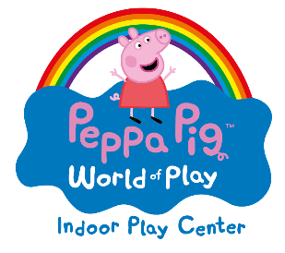

NORTH AMERICAN ATTRACTIONS
Notes:
Yes all are current

Slide 4
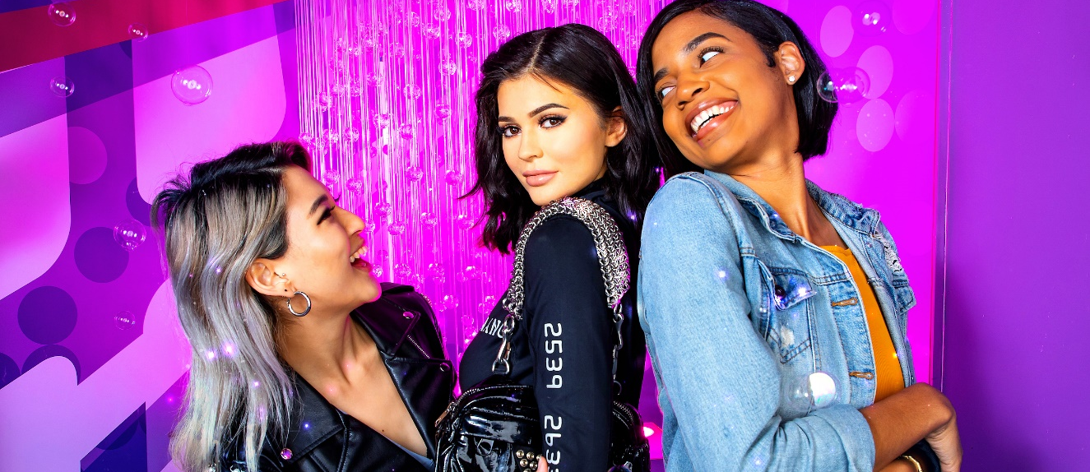


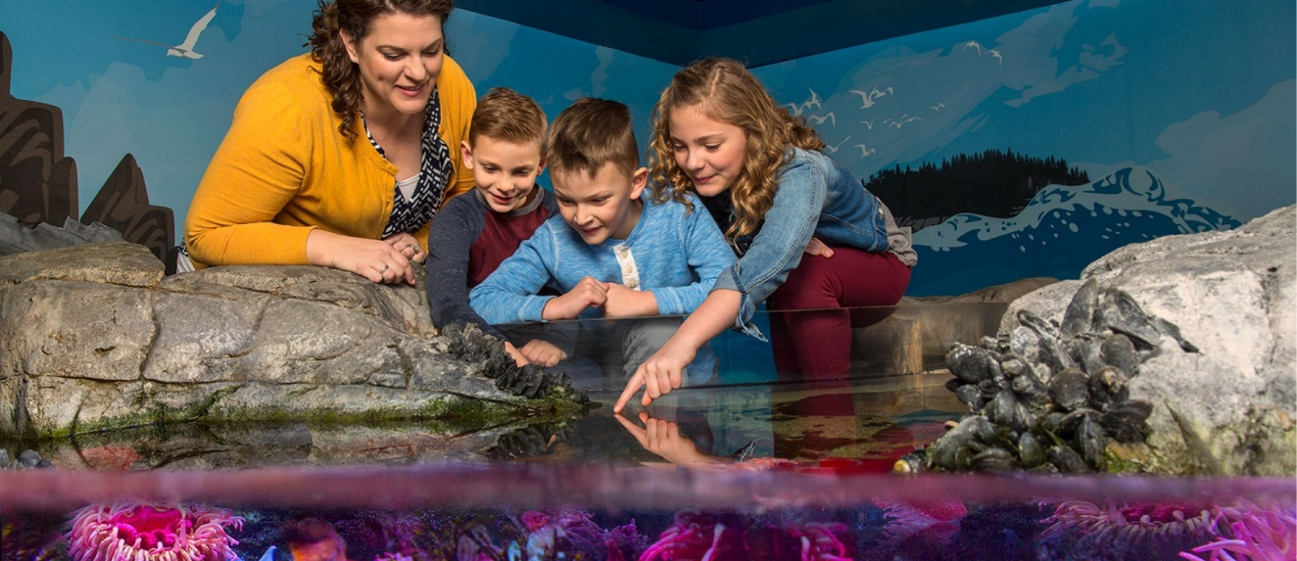
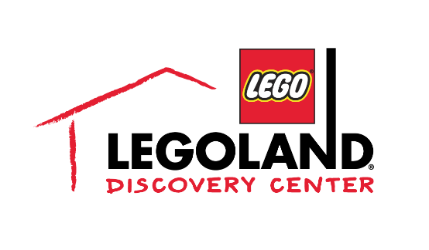
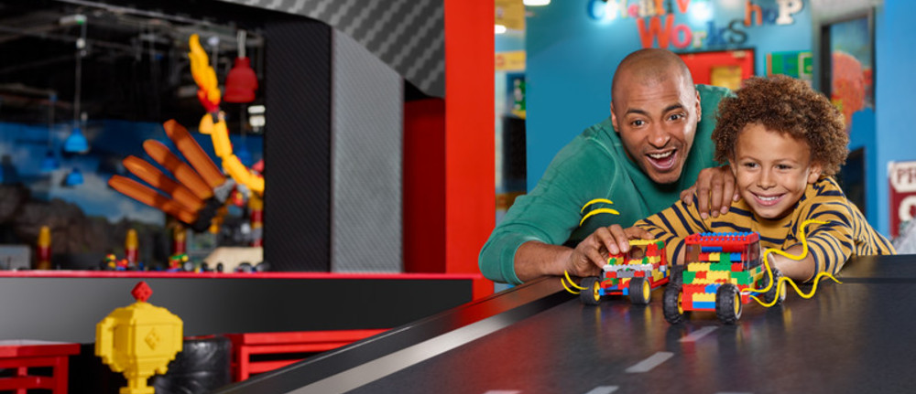
    Experience the world’s greatest wax museum at Madame Tussauds. Strike a pose for paparazzi and mingle with movie stars at your own A-list party.
    Locations: Hollywood, Las Vegas, Nashville, New York, Orlando, San Francisco
    Dive beneath the waves and enter a world of glittering scales, humungous tentacles and razor-sharp teeth at SEA LIFE Aquariums.
    Locations: Hollywood, Las Vegas, Nashville, New York, Orlando, San Francisco, New Jersey
    The Ultimate Indoor LEGO® Playground! It’s the ultimate place for families with children 3-10 years old!
    Locations: Arizona, Atlanta, Bay Area (Now Open!), Boston, Chicago, Columbus, Dallas, Kansas City, Michigan, Philadelphia, New Jersey (Now Open!), San Antonio (Now Open!), Toronto, Westcthester

Slide 5
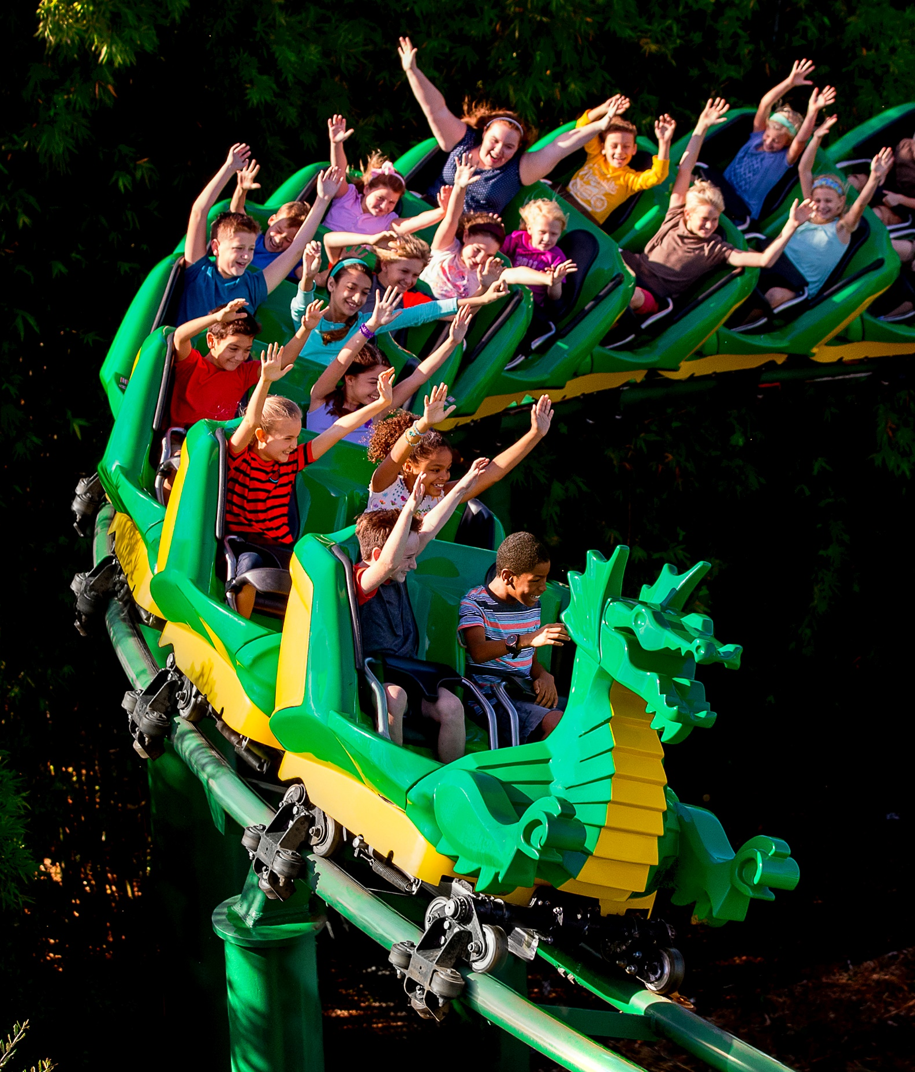

North America
Legoland®
PArks

Slide 6
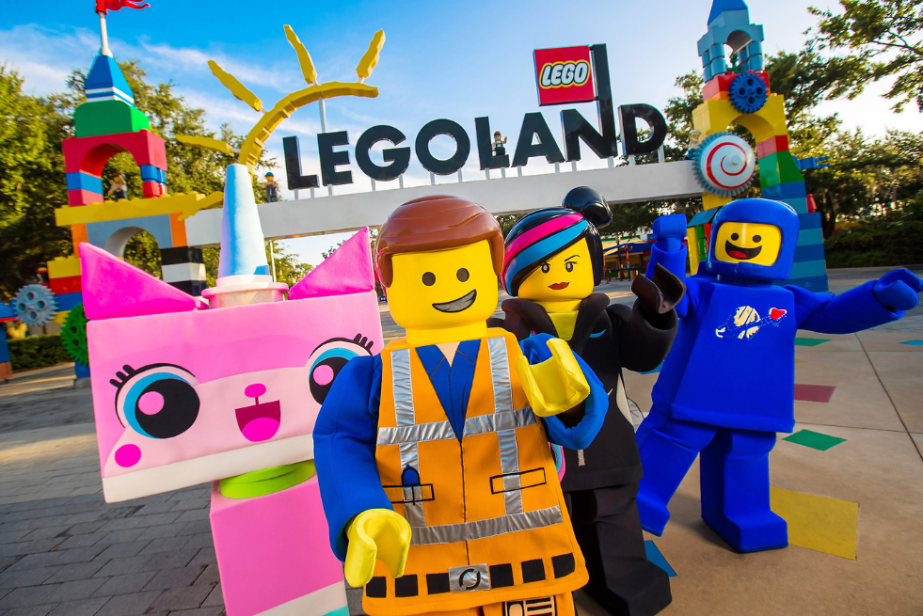


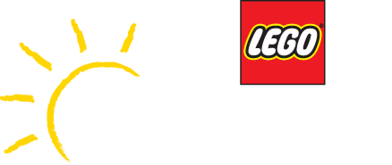
Awesome awaits at our 3 North American theme park attractions
Designed specifically for families with children aged 2-12 years old.
The parks bring the imagination of LEGO® and its brands to life
Fun, colorful and inspirational.
Bursting with fun rides, attractions, and entertainment

Slide 7
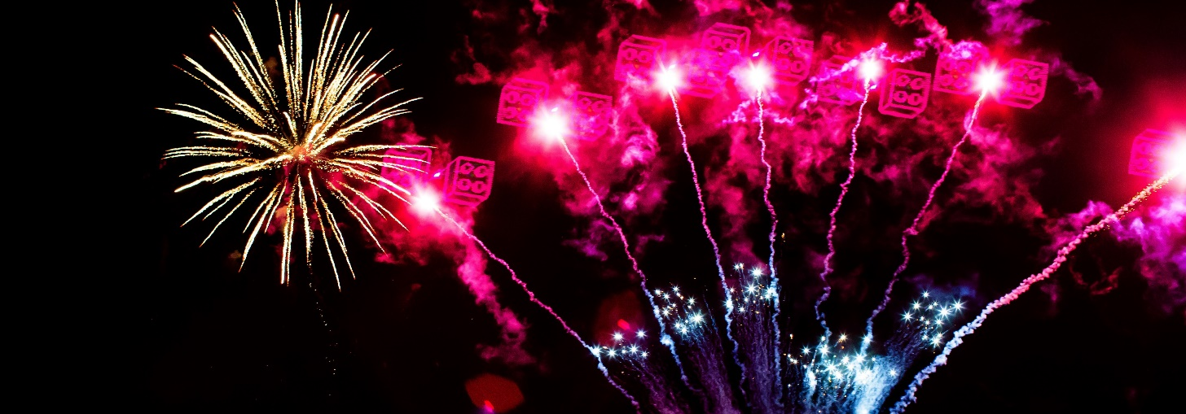
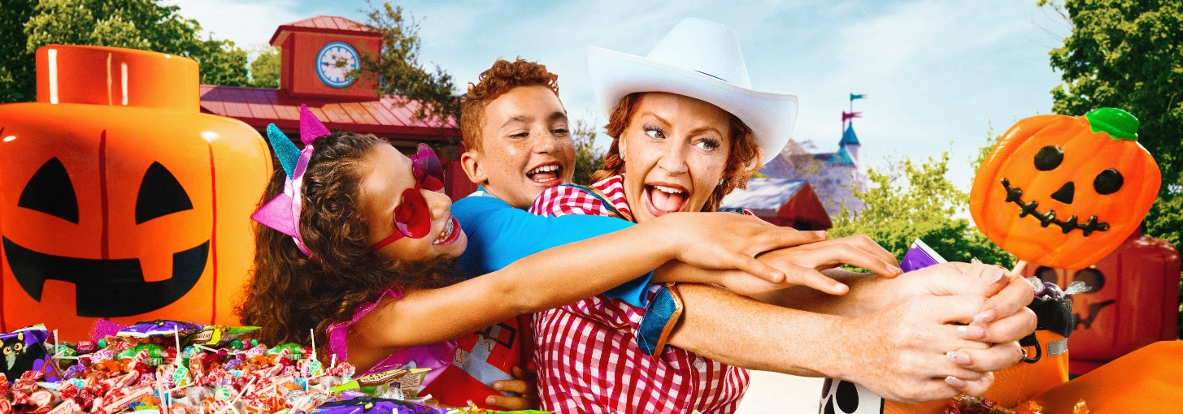
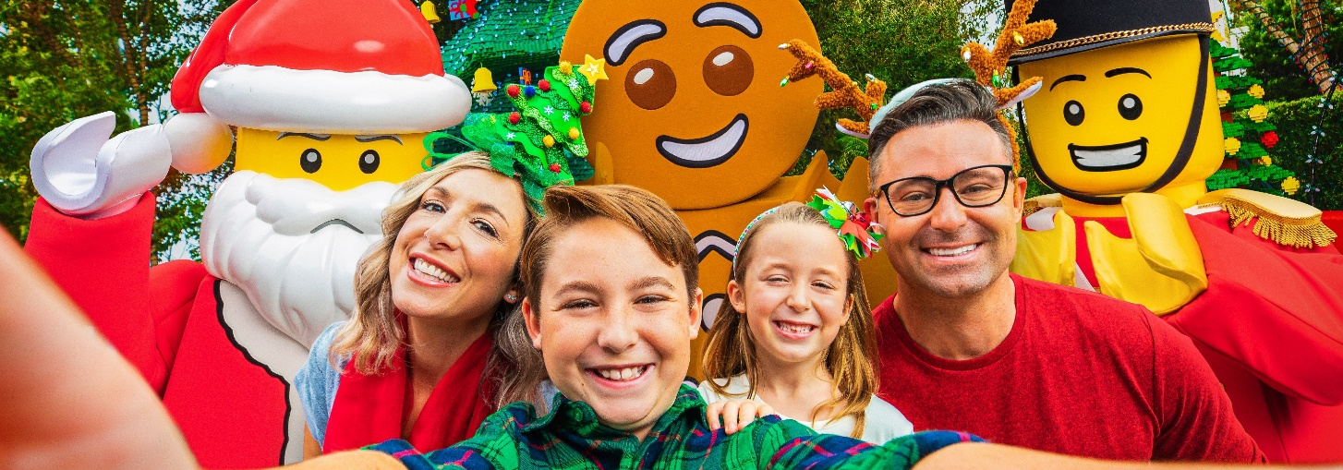
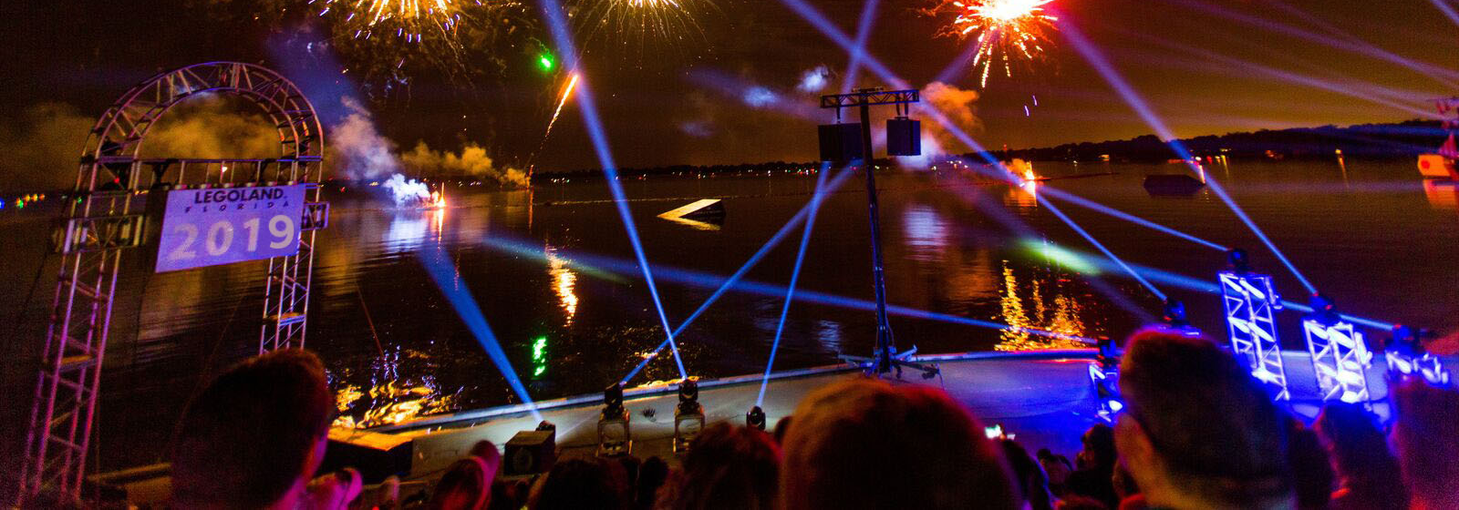
Seasonal Events At Legoland Park!
    Red White & Boom
    Brick-or-Treat*
    Holidays at LEGOLAND
    Kids New Years Eve!
*Special Event Ticket

Slide 8
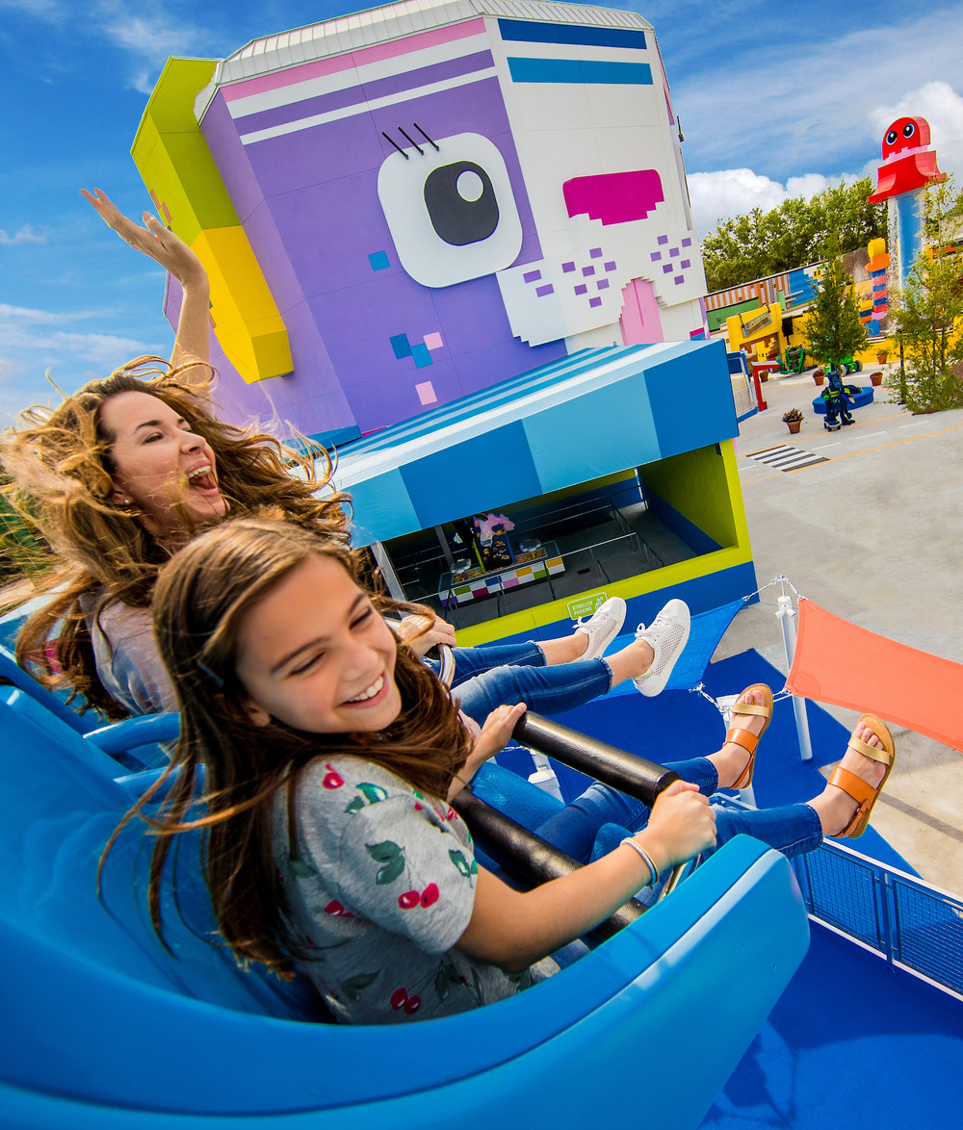
Legoland®
California
Resort

Slide 9
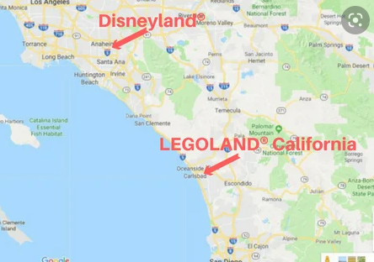
Location
    LEGOLAND® California Resort is east of the I-5 Freeway, just 30 minutes north of San Diego and one hour south of Disneyland/ Anaheim Resort area. Exit the I-5 Freeway at Palomar Airport Rd.
Notes:
Add map to slide following with reference to Disneyland to LEGOLAND with logos and distance.

Slide 10
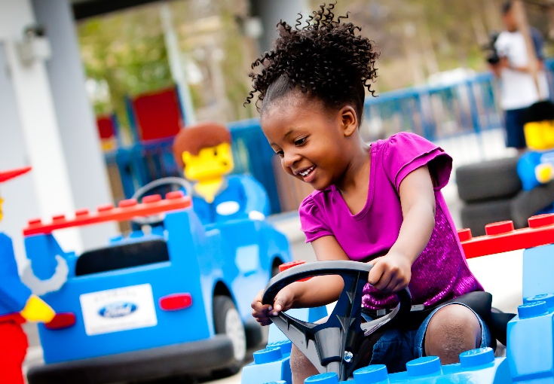
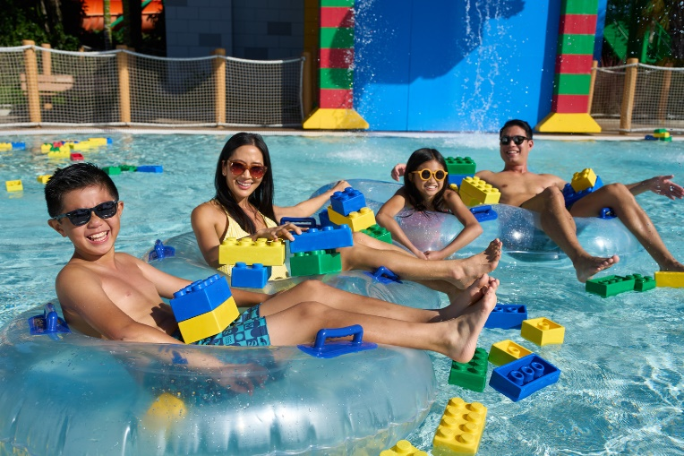
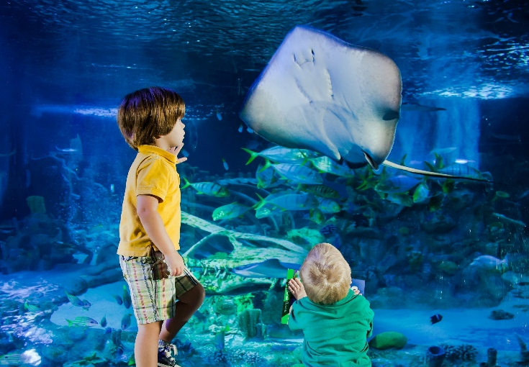
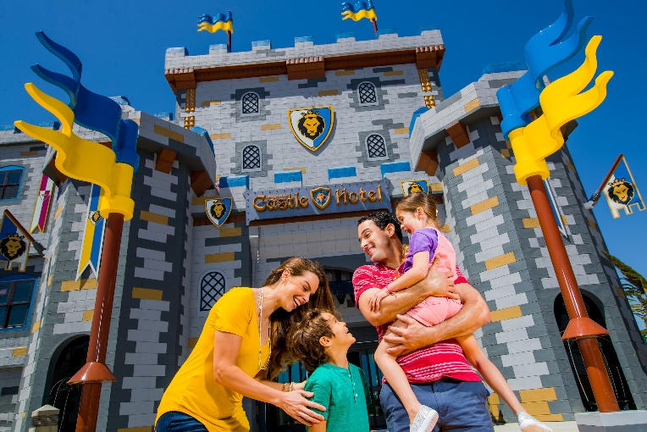
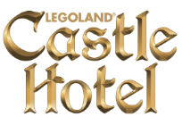



    AWESOME AWAITS at LEGOLAND® California Resort, Carlsbad, CA.

Slide 11
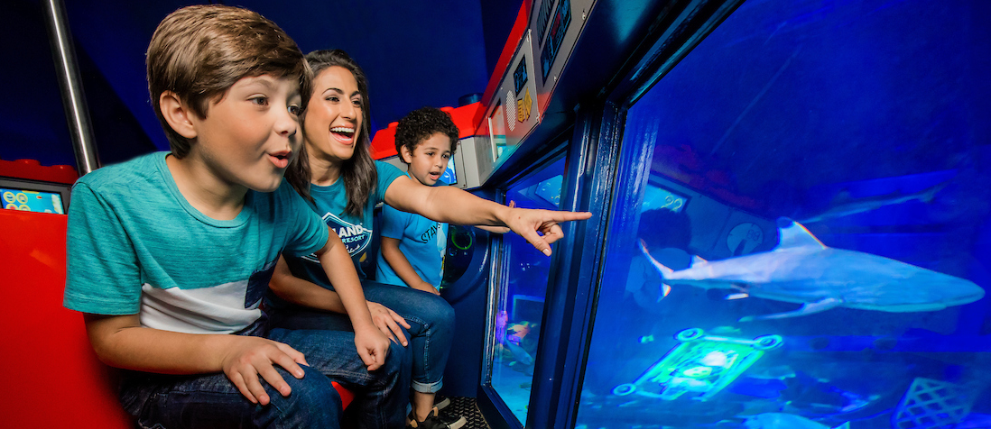
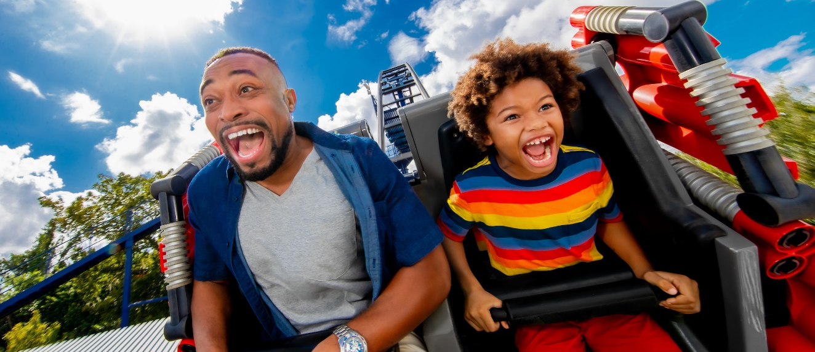
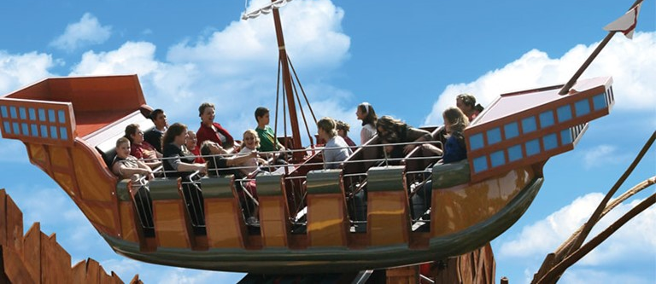
  LEGOLAND® California Resort Rides
  LEGO® NINJAGO® The Ride
  LEGO® CITY: Deep Sea Adventure
  BIONICLE® BLASTER
  LEGO® Technic Coaster
  Captain Cranky’s Challenge
  Coastersaurus
  The Dragon

Slide 12
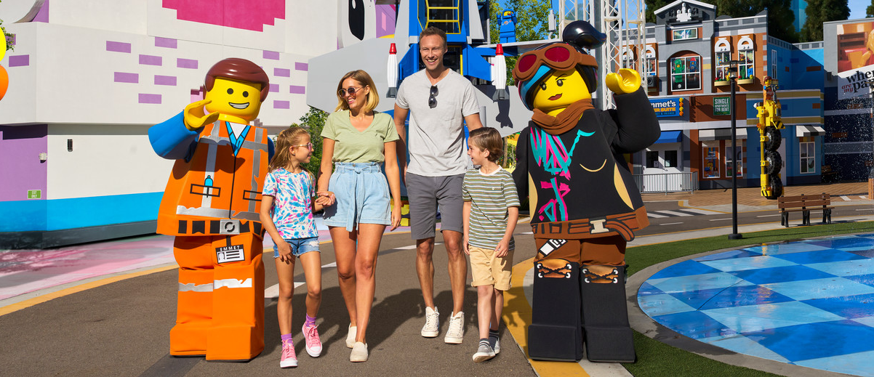
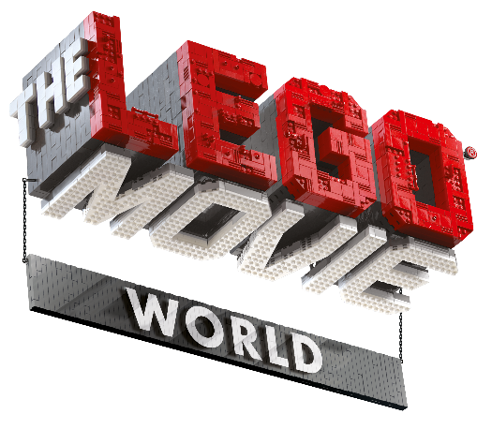
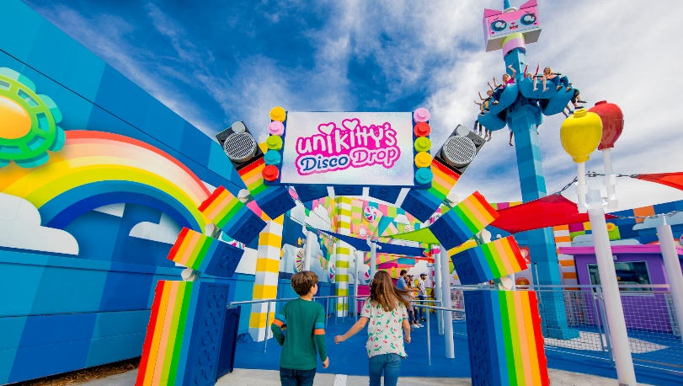
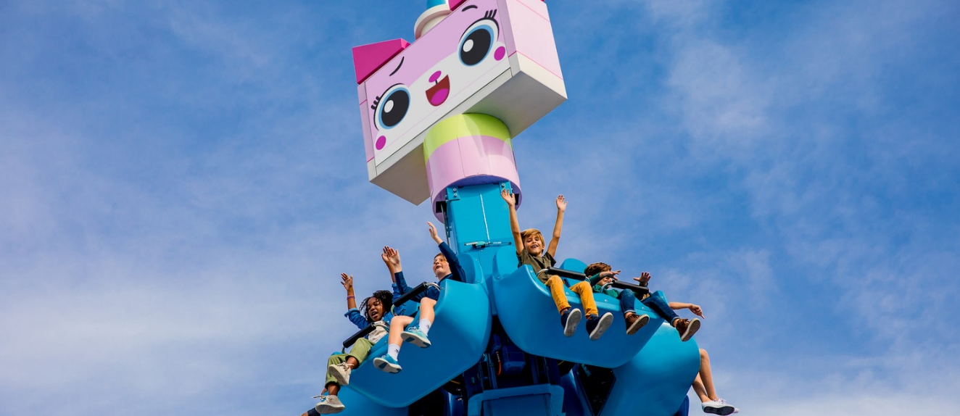
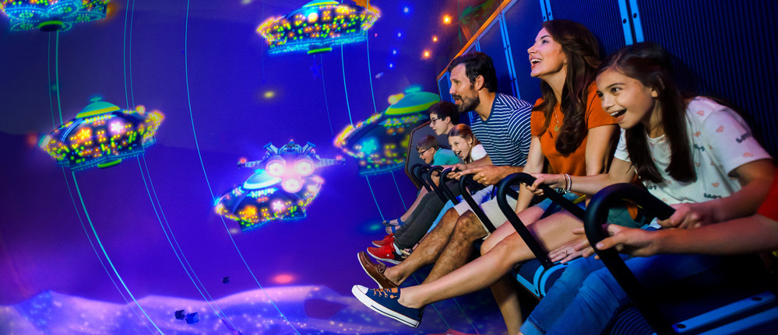
NEW!
    Experience new rides, attractions, restaurants, shops, and more in THE LEGO® MOVIE™ WORLD, where the immersive world of the hit movies come to life!
  THE LEGO® MOVIE™ WORLD Rides & Attractions
  Emmet’s Flying Adventure
  Unikitty’s Disco Drop!
  Queen Watevra's Carousel
  Emmet’s Super Suite
  Benny’s Playship
  Build Watevra You Wa’Na Build

Slide 13
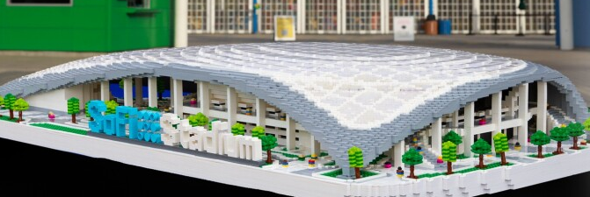
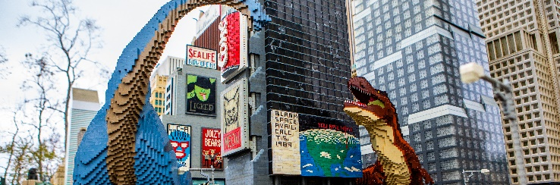
  SOFI STADIUM - a 1:50 scale LEGO® model inspired by the first indoor-outdoor stadium to be constructed will make its debut this spring in Miniland U.S.A. at LEGOLAND® California Resort.
  PREHISTORIC TAKEOVER - Have you ever imagined massive dinosaurs running wild through the streets of New York City? That’s exactly what’s happening at LEGOLAND® California Resort as more than 30 of the massive creatures have taken over the Big Apple in Miniland U.S.A.

Slide 14
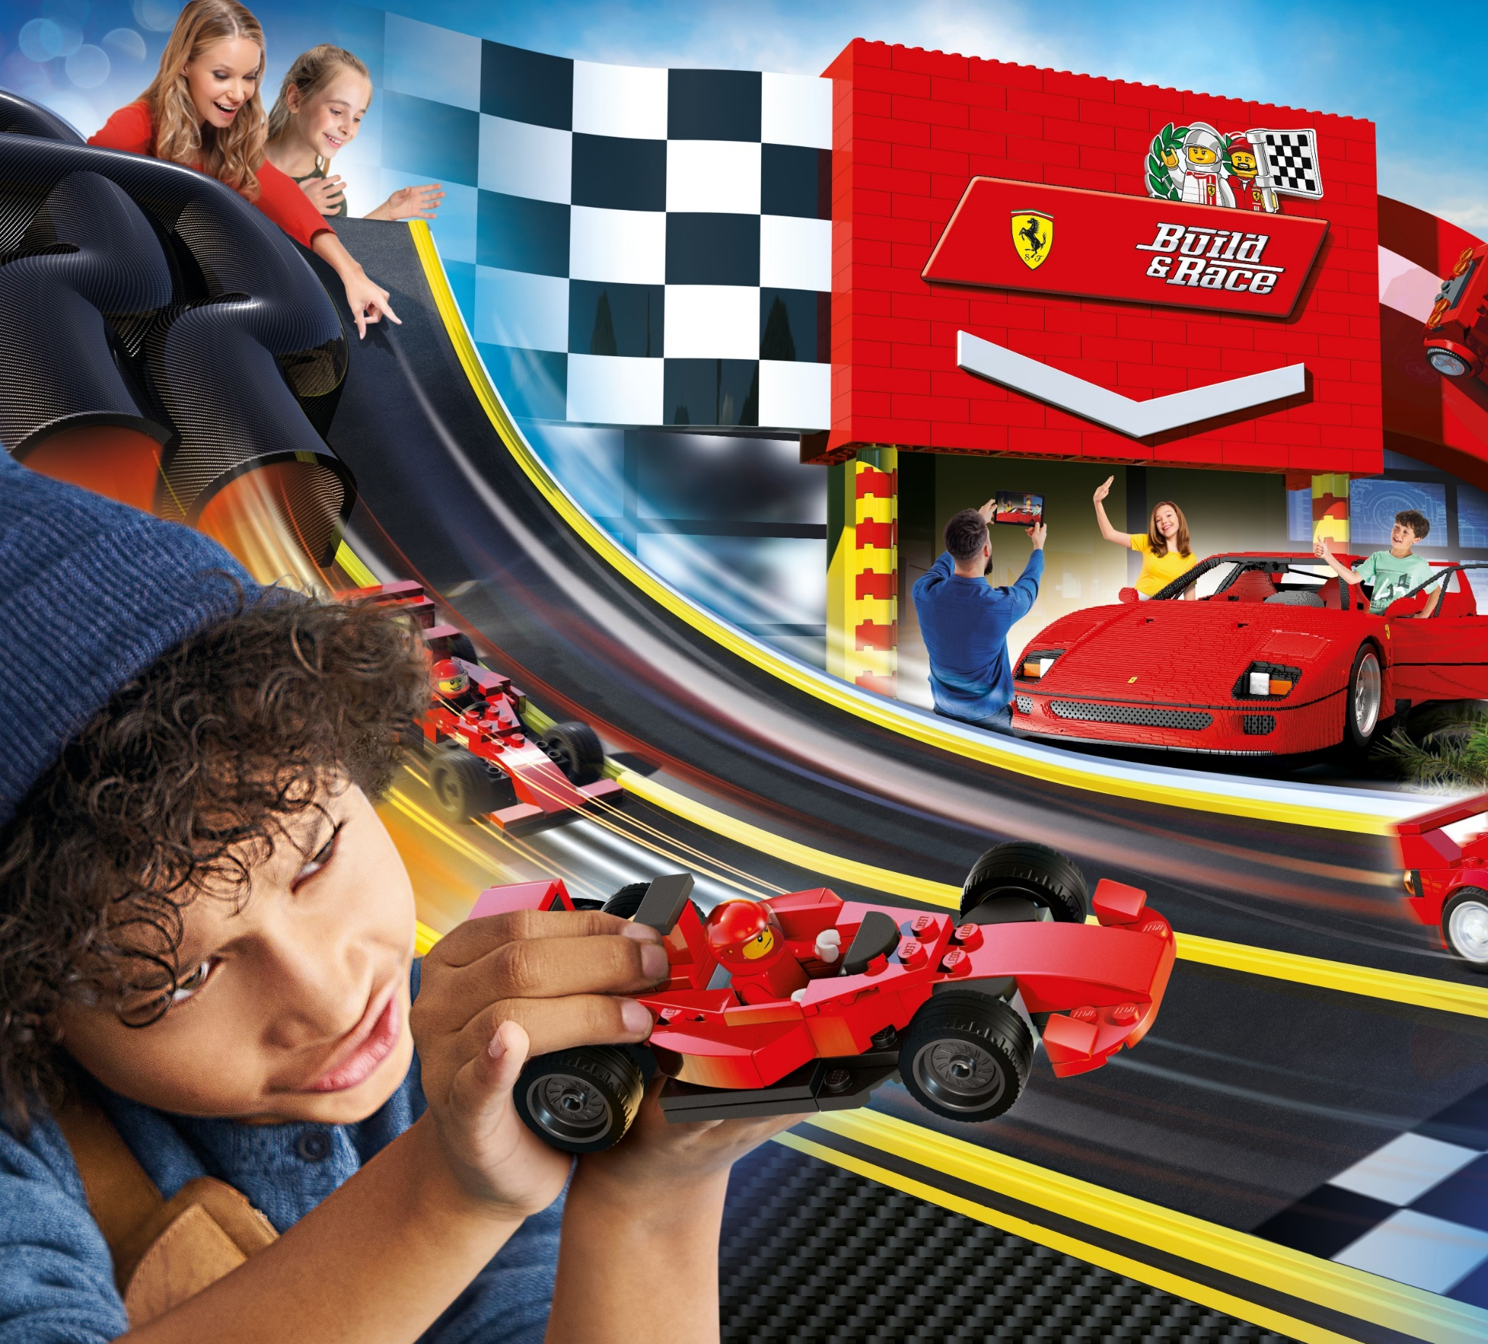
LEGO® Ferrari
Build & Race
NEW!
Opening
Spring 2022
The world’s first LEGO® Ferrari “Build and Race” interactive attraction is coming to LEGOLAND® California Resort in spring of 2022. Featuring a life-size Ferrari F40 model developed by the LEGO® Group, Build and Race puts guests in the driver’s seat as they make their way through the “garage” to the “racetrack” using their creativity and imagination to build, test and race their own LEGO Ferrari.

Slide 15
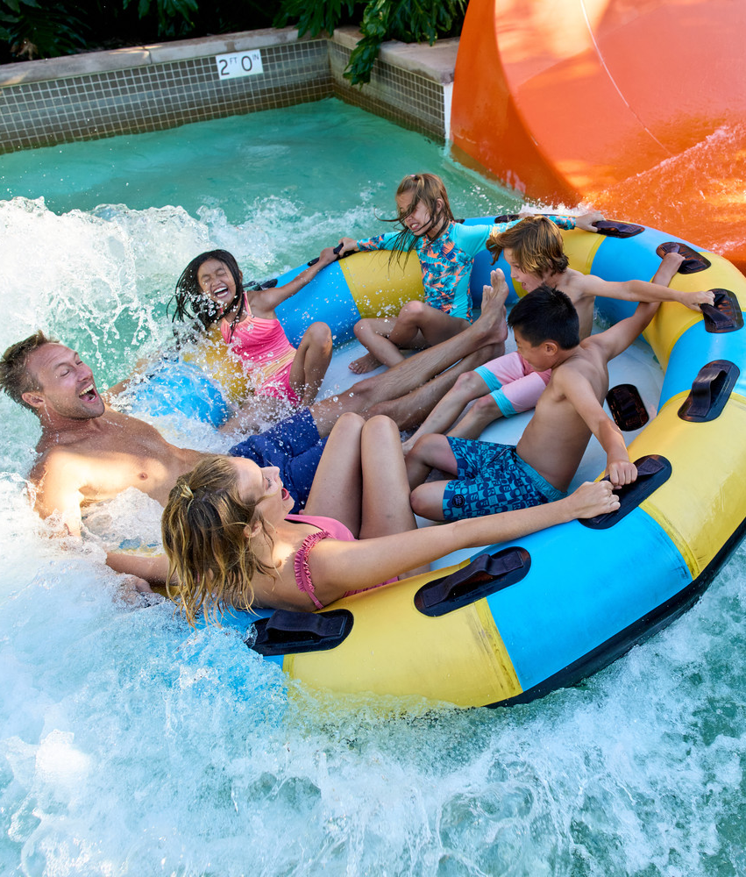
  LEGOLAND® Water Park
  OPENING MARCH 26TH! *
  LEGOLAND® Water Park features more than seven slides, sandy beaches and the unique Build-A-Raft River plus Pirate Reef for more than 7 acres of water fun!
  *Water Park is open seasonally. Visit LEGOLAND.com/hours for days and hours of operation

