Slide 1
TICKET SELLER 101
AN over VIEW OF SSO, MTP /TMS and PRODUCTS and and introduction to AFT
Notes:
Introductions – Trainers & Students – 5 minutes
Give the overview of MTP and AFT
MTP Started in the 1970’s after soldiers began returning from Vietnam a lot of vendors in the San Diego region wanted to give veterans a discount or free admission to their attractions. In order for these tickets to be distributed to a large audience the vendors sought out a way to enable centralized ticket distribution and MTP was created. This program has become an integral part of Community Recreation Programs ever since.
Today MTP contracts with over 120 vendors and offers close to 1100 different ticket options. We are a joint service program, working with close to 180 ticket offices worldwide from all DOD Branches and the Coast Guard. We have gone from a primarily physical ticket distribution office to almost 98% electronic print on demand ticket. This means that almost all tickets we offer are available at the click of a button.
In 2017 MTP moved from its original location in San Diego CA, to Millington TN. In October 2018 we launched our new Ticket Management System. This system has been designed to improve the ticket office sellers experience and allow them easier and quicker access to the tickets for our Military patrons.
In addition to the Military ticket program we are also here to discuss the new American Forces Travel application. In mid-2000’s the Joint Service Travel program was formed. This program is geared toward integration of travel options into the ticket office sales platform. The objective is to offer travel accommodation in addition to ticket sales. In the past couple of years the travel industry has grown and thrived off of the ability of customers to do their own hotel, airline, and travel bookings online. The American Forces Travel program was developed to meet this demand, and also build a platform that can be used not only by the at home shopper but also as a on stop shopping tool for our ticket offices to provide one on one travel service as well. The AFT application made its official launch in Feb of 2019 and has had over 100,000 logins and is growing daily. The currently, it is available for Active and Retired Service members to access from home, but we are working with OSD to allow DOD employees access as well. Once our objective to open the service outward the next objective is to keep building our product offerings, including adding more vendors and vacation packaging options.

Slide 2
Training objective outline
Objective 1: MTP – Accessing TMS and SSO and searching and selling tickets
-Login to SSO process
-Changing Passwords
-Performing Ticket Searches
-Generating E-tickets
-Viewing Sales History
-Cancellations
Notes:
This class is designed for 3 to 3.5 hours
We will have approximately 2 breaks

Slide 3
Training objective outline
Objective 2: TMS Use for Ticket Admin and Managers
-SSO User management
-Resources for managers in Documentation and Support
- Administration and Invoice Regeneration
- Ticket Ordering and Receiving, Returns
-Reports
-Best Practices for sales monitoring and reconciliation
-Month End Check List

Slide 4
Training objective outline
Objective 3: E-ticket Sales PRODUCT Management
Discuss Price Sheets and Recommendations for increase in sales
Product Specific Training Focus
-Go Card
-Universal Orlando
-Old Town Trolley
-Busch Gardens
MTP AIMS – Support & FAQ Overview Document

Slide 5
Training objective outline
Objective 4: Armed Forces Travel - Introduction
Overview of Priceline Partner Network
Customer Verification Process
Airfare
Hotel
Car Rental
Vacation Packages
Cruises

Slide 6
Training objective outline
Objective 5: Agent Training
Agent ID
Reservation Process
Capabilities
Estimates
Responsibilities
World Travel Holding Integration
Commission Reports

Slide 7
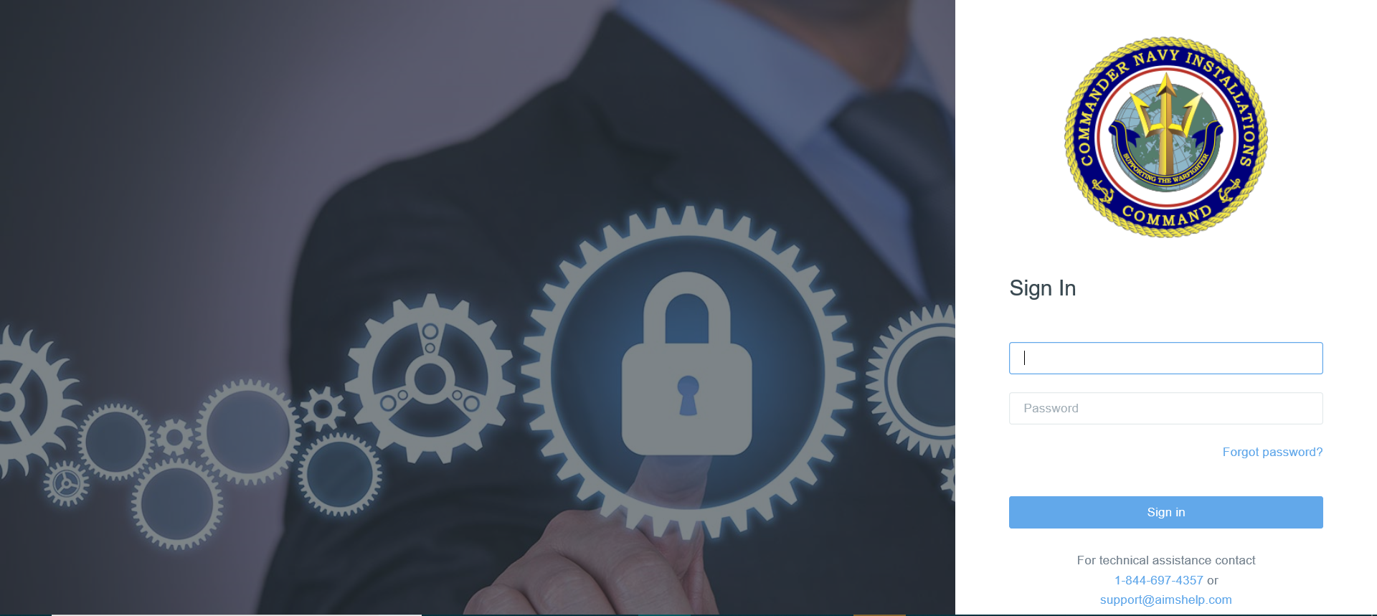
Objective 1: MTP – Accessing TMS and SSO and searching and selling tickets
Notes:
Use this slide to show login screens – you should be logging into TMS but not showing this login to the class.
This instructions assumes they will have a login from the manager

Slide 8
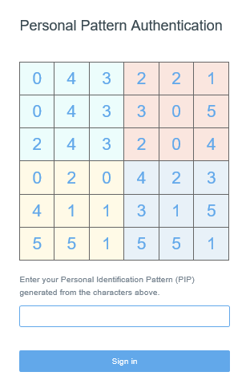
Objective 1: MTP – Accessing TMS and SSO and searching and selling tickets
Create login pattern
The numbers change every time
The pattern is always the same
Must at least 6 blocks

Slide 9
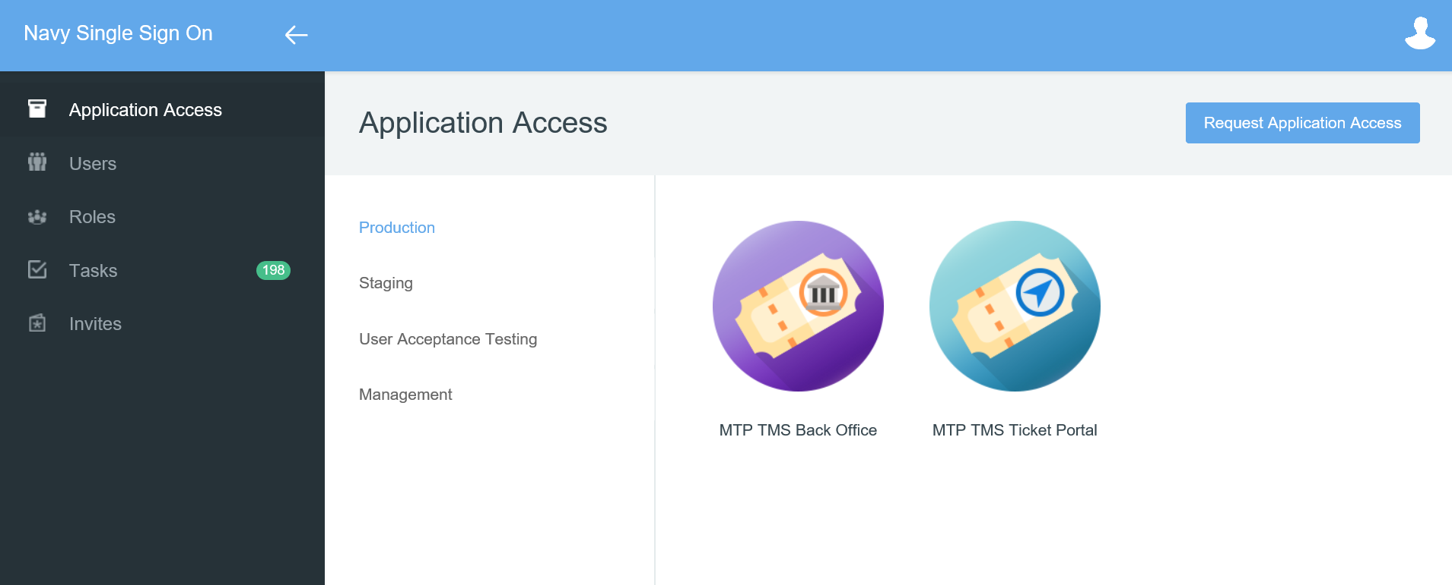
Objective 1: MTP – Accessing TMS and SSO and searching and selling tickets
Notes:
Aelect TMS Back Office to Login to the ticket sales application

Slide 10
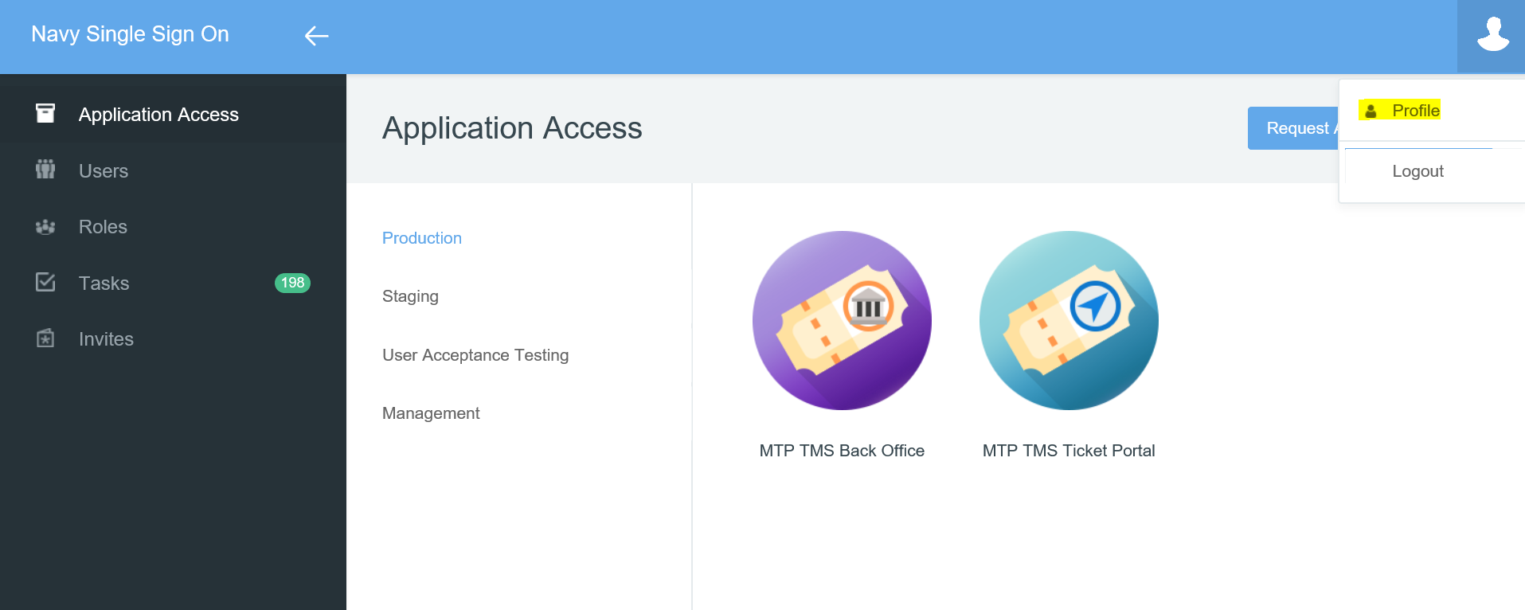
Objective 1: MTP – Accessing TMS and SSO and searching and selling tickets
Notes:
Every 90 days you will be prompted to reset your password
You can do this after you login into SSO before launching the TMS Sales Portal

Slide 11
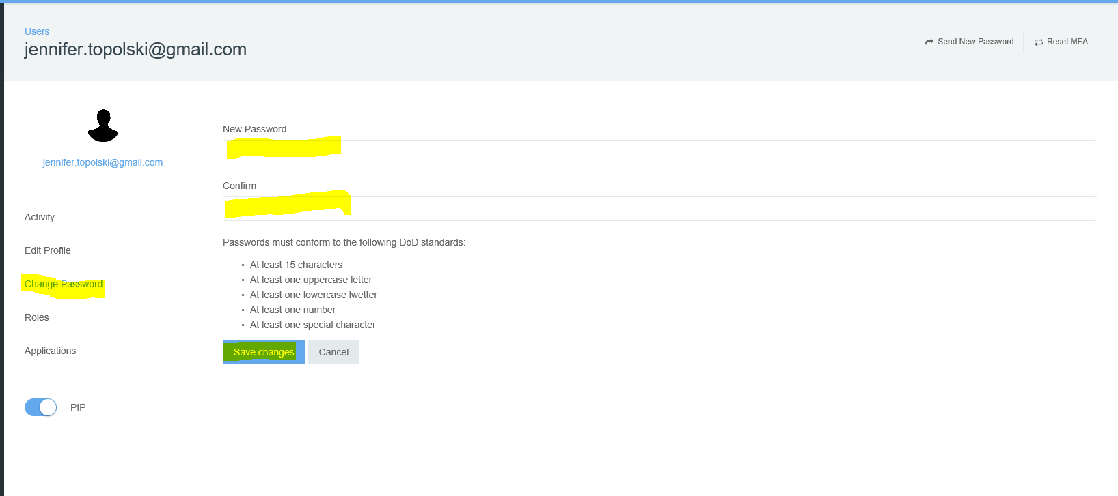
Objective 1: MTP – Accessing TMS and SSO and searching and selling tickets
Notes:
Every 90 days you will be prompted to reset your password
You can do this after you login into SSO before launching the TMS Sales Portal
Select the icon in the upper right
Select profile
Select Change Password
And you can enter a new password before your account is locked
Select application access to get back to the TMS Sales Portal Icon and launch the sales portal screen

Slide 12
Notes:
This is the TMS Dash Board

